Slide 1
Reactjs Best Practices

Slide 2
Overview
Three ways to create a React Component
With function MyComp( props ) { … }
With React.createClass( { … } )
With class MyComp extends React.Component { … }
Presentation Components
NO UI STATE OR APP STATE
Connection to Business Logic via injected properties
Pure function
Container Components
Manages UI and / or App State
LOOSE COUPLING to Presentation Components

Slide 3
What’s Important about import?
Like Spring, everything’s a singleton!!!
When you require() or import a module,
Node evaluates the contents of the module
Node caches the results
Node returns the cache value next time
If you want a singleton, export an object
module.exports = { abc: function() …. }
If you want individual instances of a class,
Export the class, not the object
export default class Abc extends Component { … }
Then you do a new on the class – like React does…

Slide 4
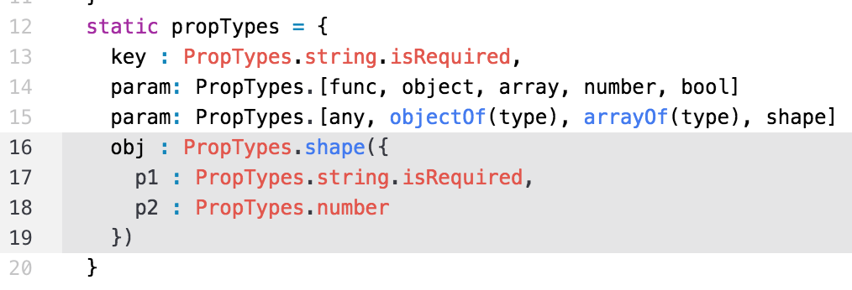
PropTypes
Defines valid types for properties on the component
ONLY validated during development, not production
Values:
Extremely useful, especially with shared components
Validation errors in Console on browser.

Slide 5
Three Ways - Considerations
Three ways to create a Component
Differences
How to define the Component
How to define valid Props (PropTypes)
static variable vs. prototype
How to define default Props
How to pass properties to it
How to get data from it
What is the this
What are they best at?

Slide 6
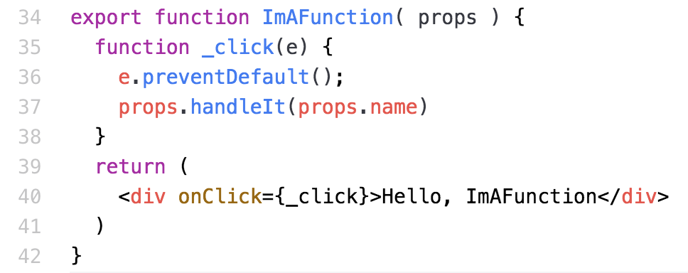
Three Ways - Function
Component is a Function with one parameter, props
Very simple
No this, no state
Calling handlers very simple
Reference props
Event Handler

Slide 7
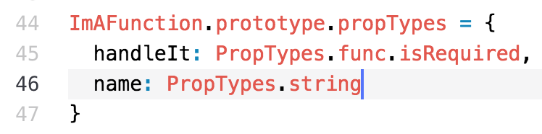
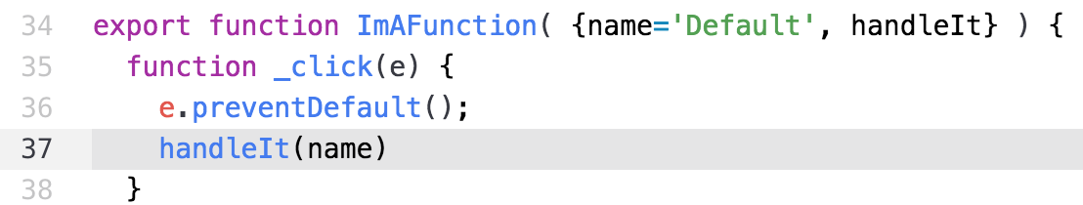
Three Ways – Function - PropTypes
Defined via Function.prototype.propTypes
Default values, normal parameter defaults
No props.handleIt, props.name

Slide 8
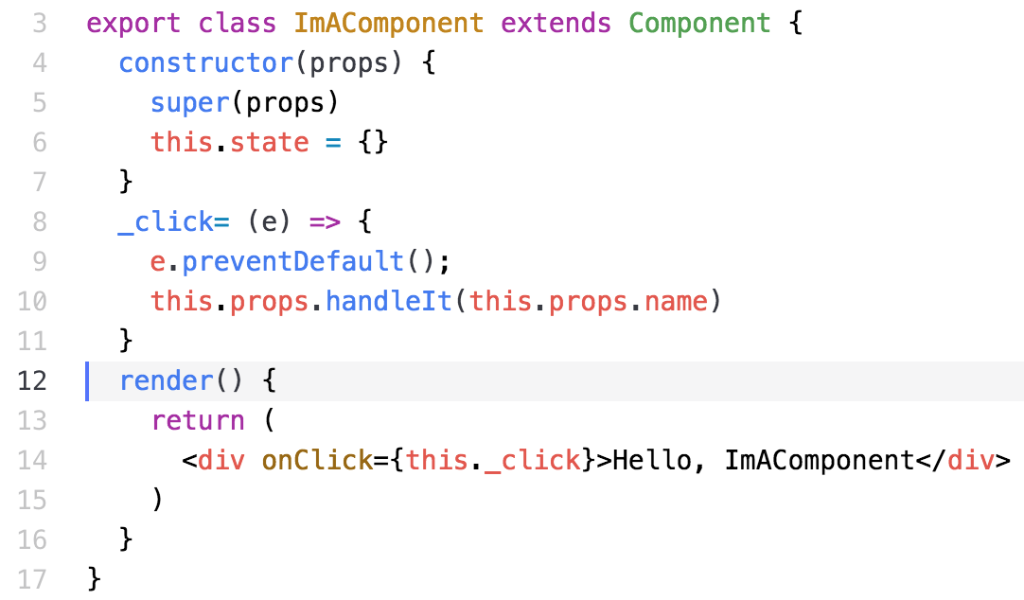
Three Ways - Component
Extend React.Component
Define state
Reference props
Event Handler

Slide 9
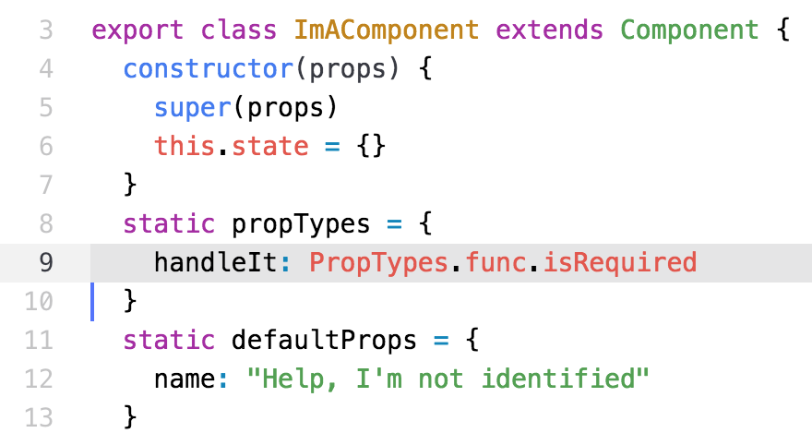
Three Ways – Component - PropTypes
Explicit static definitions of types and defaults, simple

Slide 10
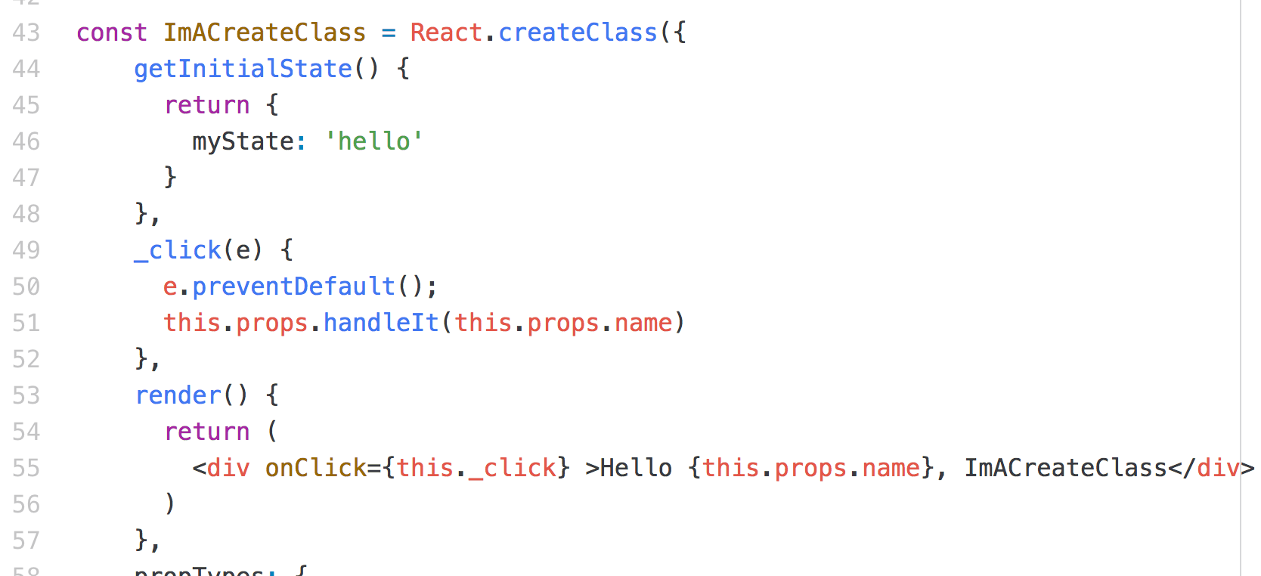
Three Ways – CreateClass - DEPRECATED
Uses React.createClass
Define state
Reference props
Event Handler

Slide 11
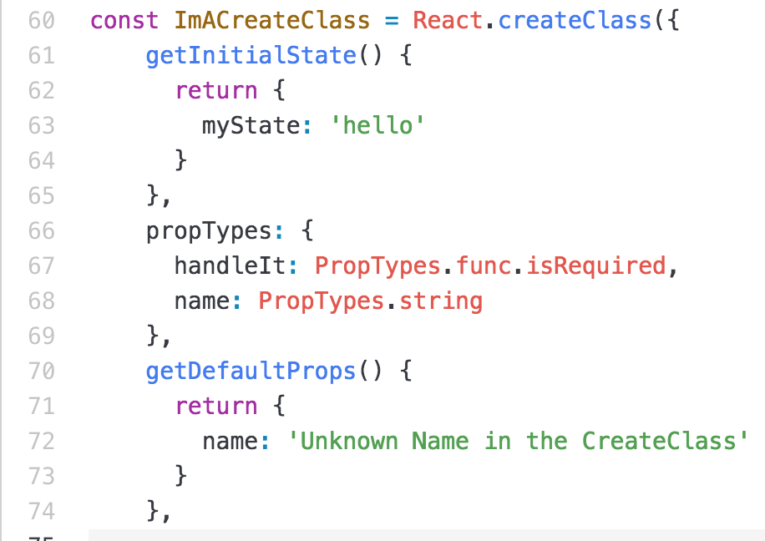
Three Ways – CreateClass - PropTypes
Notice the commas

Slide 12
Presentation Components
No State
No this
Easy to test
No internal state
Functional Programming
Input → process → output
Idempotent
All connections to Business Logic and Application State
Injected by the controller
Uses a Function(props) signature
NO THIS (this) in the function

Slide 13
Example:
File → TodoList.js
function TodoList( props ) { return ( <div id="layout"> <h1 id="page-title">Express Todo</h1> <div id="list"> <TodoInput addTodo={props.addTodo} /> {props.todos.map( function( todo, idx ) { return ( <TodoItem key={idx} todo={todo} update={props.update} remove={props.remove} /> ); })} </div> </div> )

Slide 14
Container Component
Better (Looser) Coupling
Isolates the Presentation Components
From Application Business Logic
From Application AND UI state
Interacts with Business Logic
Creates callbacks for the Presentation Components

Slide 15
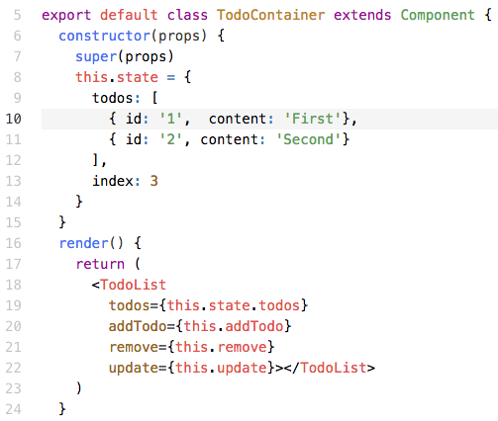
Example: TodoContainer.js
UI State
Connection to UI

Slide 16
Example: TodoContainer.js – cont.
addTodo = ( content ) => { var todo = { id: this.state.index++, content: content }; this.setState( { todos: this.state.todos.concat( todo ) } ); } remove = (id) => { var todos = this.state.todos.filter( function(todo) { return todo.id !== id }); this.setState( { todos: todos }); } update = ( todo ) => { var todos = this.state.todos.map( function( item ) { if ( item.id === todo.id ) { item.content = todo.content; } return item; }); this.setState( { todos: todos }); }
Connection
To
Business
Logic

Slide 17
Format UI Source
Which one is easier to read?
<TodoList todos={this.state.todos} addTodo={this.addTodo} remove={this.remove} update={this.update} />
OR
<TodoList todos={this.state.todos} addTodo={this.addTodo} remove={this.remove} update={this.update} />

Slide 18
Naming Conventions
Like Java
Component names should be Capitalized
File names should reflect the Components exported
Should be capitalized
Can use extension of ‘js’ OR ‘jsx’
Depends on build tools

Slide 19
Directory Structure
Emerging standards.
PayPal uses many different directory structures
Impacts build tools

Slide 20
Summary
Container vs. Presentation Components
Very important architectural pattern
Much easier to test and maintain
Naming Conventions
Much easier to maintain
UI Source Format
Much easier to read, hence maintain

Slide 21
Lab
File → /instructions/react-best-practices.docx
Modify an existing project
Change Components to Presentation components
Create a Container component
Add PropTypes

