Slide 1
React Shared State

Slide 2
Overview
Multiple components want the same data
Login vs Marketing (Hello, Clay, buy more stuff!!!)
Share the state information in two ways
Common Parent manages the data
One child gets the state (Login), send the state to the parent
Other child gets the state in the props
Requires parent knows about the children.. Direct children, usually
Easy to implement
Children share the state via singleton
How does one child know that another child modified the state???
Observer pattern (Event Listeners, etc)

Slide 3
What’s Important about import?
Like Spring, everything’s a singleton!!!
When you require() or import a module,
Node evaluates the contents of the module
Node caches the results
Node returns the cache value next time
If you want a singleton, export an object
module.exports = { abc: function() …. }
If you want individual instances of a class,
Export the class, not the object
export default class Abc extends Component { … }
Then you do a new on the class – like React does…

Slide 4
Common Parent
Parent component manages the data
One child changes the data
Parent passes data to children via attributes
Children automatically re-render when props change
Like the TodoList as a parent with TodoInput and TodoItem as children
Problems
Parent is usually a direct parent of the children
Otherwise, each descendent must pass the data to their children
Tightly coupled – children with parent

Slide 5
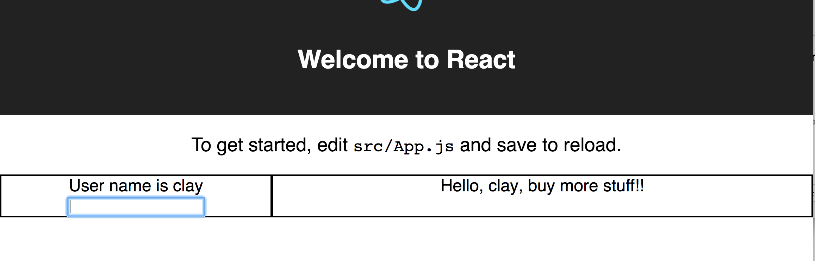
Overview
Parent is Layout.js
Left is Login.js
Right is Marketing.js
They share the login name

Slide 6
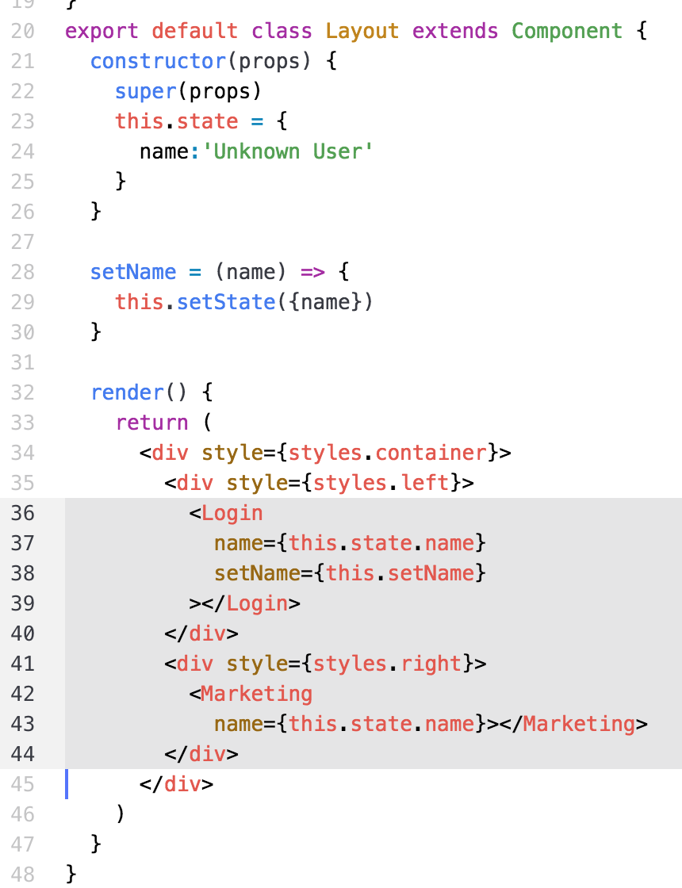
Common Parent – Layout.js
Maintains state
this.state.name
Tightly coupled
Login.js
Marketing.js
NO Intervening comps
Everything is fixed
On page

Slide 7
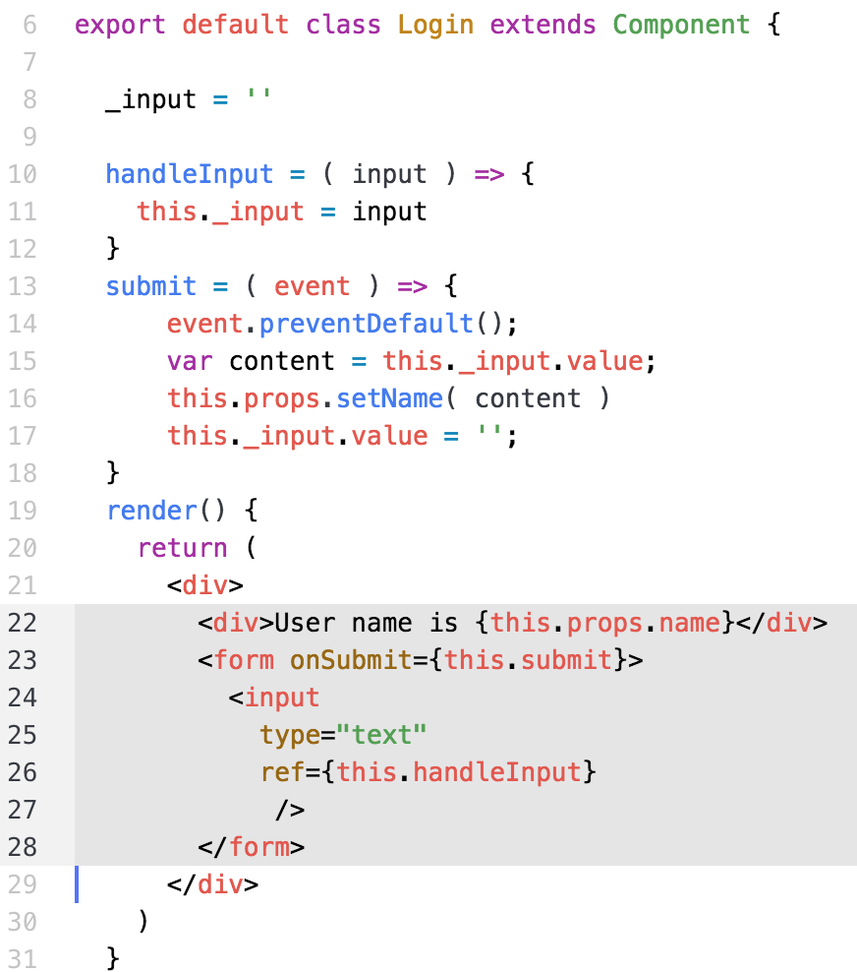
Left – Login.js
Uses ‘ref’ for input
Uses callback,
this.props.setName
Send to parent
Displays
this.props.name
Tightly coupled to parent

Slide 8
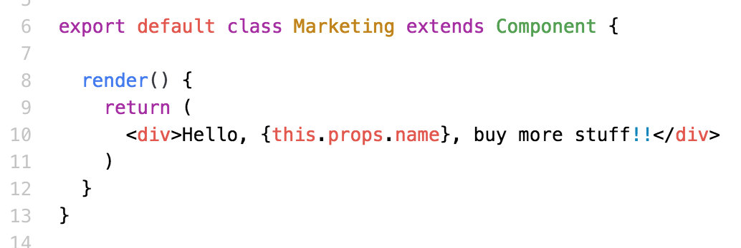
Right – Marketing.js
Uses this.props.name to display user name
Parent passes the name to the child
Tightly coupled to the immediate parent
Via this.props.name

Slide 9
Singleton Solution
Single CRUD object to manage the state
Simple JS object, export from a library
Advantages
Loose coupling
Components can be anywhere
Much easier maintenance
Disadvantages
Components are more complex
Must use Observer pattern(or Event listeners, or something)
Called when data changes
Tells the components when to re-render()

Slide 10
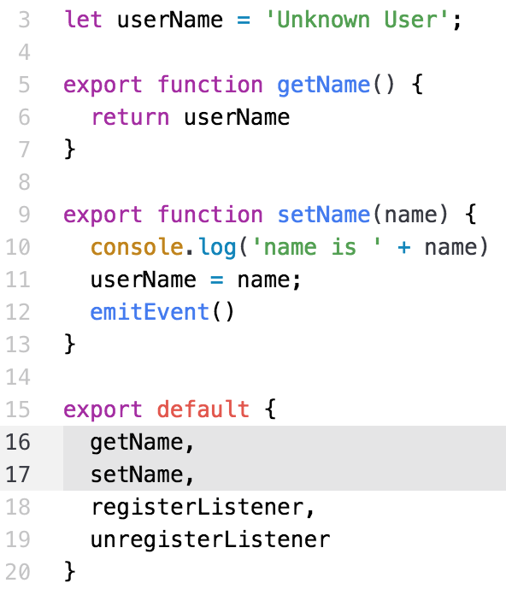
Singleton Data – UserInfo.js
Page 1
CRUD API
getName()
setName(name)
Simple, easy to test

Slide 11
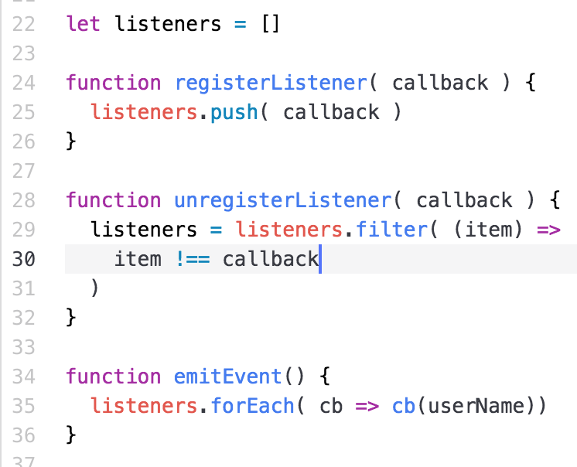
Singleton Data – UserInfo.js
Page 2
Listener Interface
Register Listener
Change data
Calls each listener
Passes the data
Simple, easy to test

Slide 12
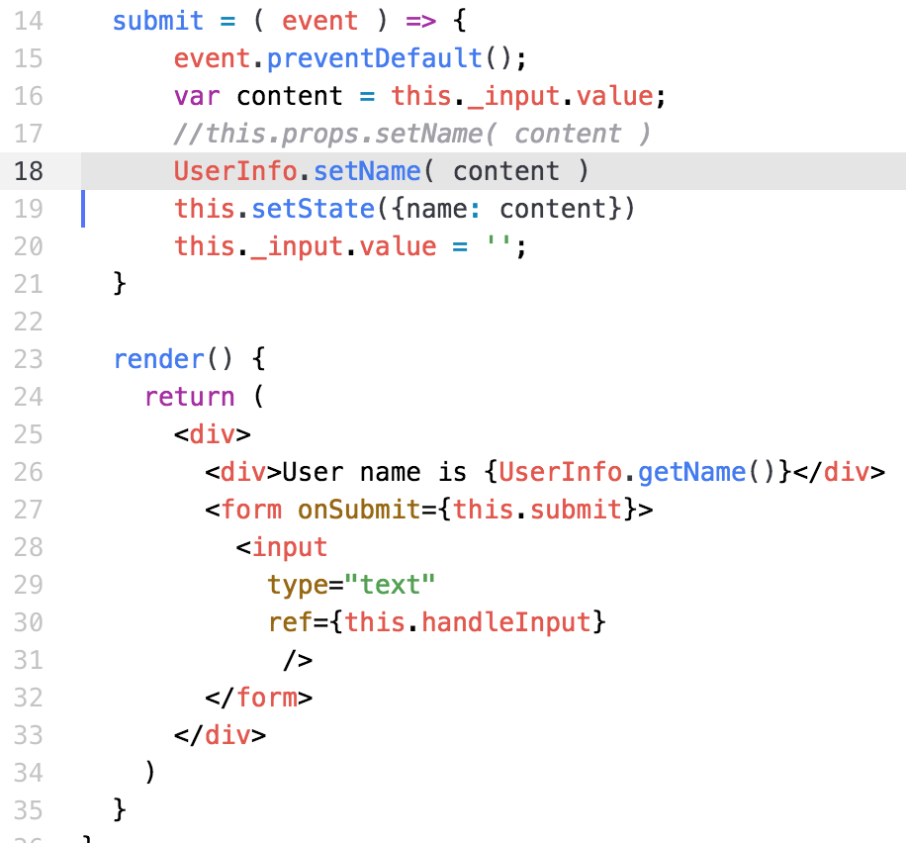
Left Side – Login.js
Sends name
To UserInfo
Changes own state
Problem
What if someone
else changes the
data???

Slide 13
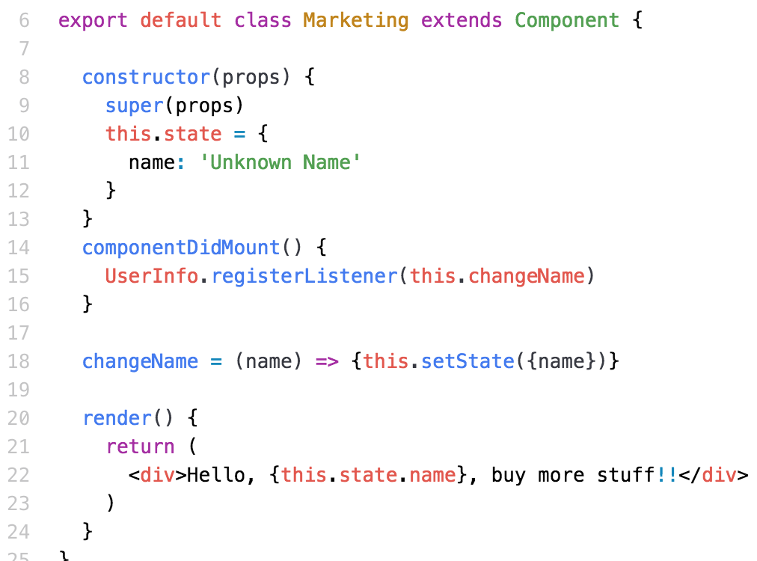
Right – Marketing.js
Must listen for changes to data
Change state
Causes render()

Slide 14
Lab Exercise
Use the instructions
Start with Parent managed state
Change to singleton managed state

