Slide 1
Communicating with the Server

Slide 2
Overview
React is a CLIENT side framework
Assume the server provides a REST interface
HTTP interface
Communicates with JSON objects
From the React app
Use XML Http Request (XHR)
Too Hard
Use jQuery (or any other JS client framework)
$.getJSON(‘/api/todos’, function( todos ) { // stuff }
$.post(‘/api/todos’, { id: ??, content: ‘hello’}, function( todos ) ..

Slide 3
More Client AJAX Solutions
PayPal uses MANY different Network Solutions
Fetch – npm install isomorphic-fetch
fetch('/v1/api/todos', {credentials: 'same-origin'}) .then( (response ) => response.json() ) .then( json => {} ) .catch( err => {} ); fetch('/v1/api/todos', { credentials: 'same-origin', method: 'post', body: 'hello' });
Lot’s of options

Slide 4
More Client AJAX Solutions
PayPal uses MANY different Network Solutions
axios– npm install axios
axios.get('/v1/api/todos/12345') .then( response => response.data ) .catch(function (error) { console.log(error); }); axios.post('/user', { firstName: 'Fred', lastName: 'Flintstone' }) .then( response => {} ) .catch( err => console.log(err));
Lot’s of options

Slide 5
Problems with Client Side Frameworks
Can’t run on the server
Require a window object
Uses globals from the window object
When server renders the page
Server runs JS to create the page
Errors encountered
Solution
Only execute the Client Side framework when on the client… duh..
Life cycle
componentDidMount() – only runs on browser, not server

Slide 6
Problems – AJAX is Asynchronous
Must use asynchronous techniques
Callbacks – update the state when it returns
Promises – update the state on the then()
Async – update the state at the end
NOTE: we must update the components state
Use setState( { key: value } );
Tells React to re-render the component

Slide 7
TodoList
var TodoList = module.exports = React.createClass({ getInitialState() { return { todos: [] } }, componentDidMount() { controller.findAll( this.done ); }, done: function( todos ) { this.setState( { todos: todos }); }, render: function render() { var self = this;
Initialize as empty array
Update only in the browser
Update view model

Slide 8
Server Side Model
File → /models/todos.js
Sent to client from server
Notice the _csrf property
'use strict'; module.exports = function TodosModel() { return { name: 'todos', todos: [ { id: '1', content: 'First'}], _csrf: '' }; };

Slide 9
Todo-controller
File → /js/todo-controller.js
var $ = require('jquery'); var _csrf = ''; module.exports = { create: function (content, callback) { $.post('/api/todos',{ content: content, _csrf: _csrf }, function( model ) { _csrf = model._csrf; callback( model.todos ); }); }, findAll: function ( callback ) { $.get( '/api/todos', function( model ) { _csrf = model._csrf; callback( model.todos ); }); },
Import the client side library
Keep track of the CSRF token
Return the array of todos

Slide 10
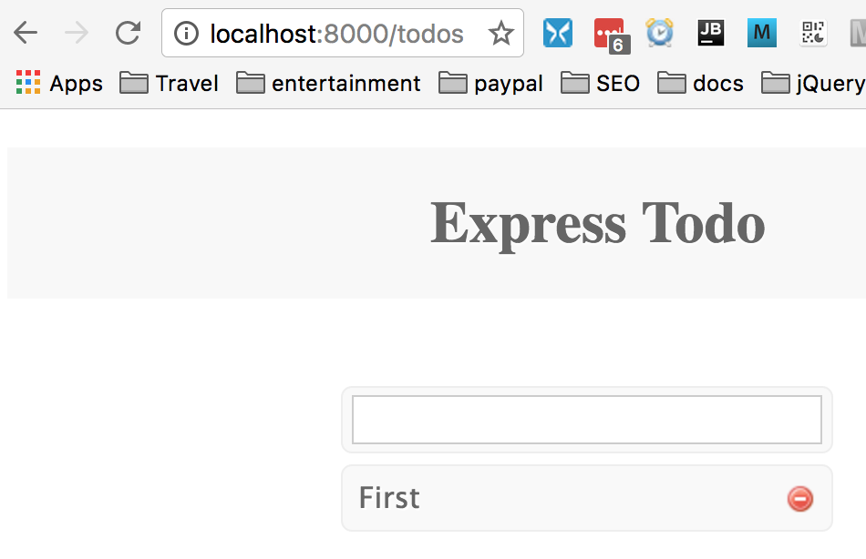
The URL is /todos
Notice the URL
Refresh the page
It works…

Slide 11
Summary
React works well with AJAX
Be careful of the client side framework when rendering on the server
Load client side framework with require() like normal
Only EXECUTE the client side framework when on the browser, not the server
Use componentDidMount() to contain client side only code.

Slide 12
Lab Exercise
Use existing Express RESTful app
Convert the /src/components/todo-controller.js to use AJAX
Instead of in-memory model
In <TodoList> initialize the array with:
componentDidMount() – runs on client only
Instead of componentWillMount() – runs on both client and server

