Slide 1
Reactjs Flux

Slide 2
Overview
React Flux allows multiple unrelated components to access the same data
It uses the Observer pattern in a general purpose fashion
It allows separation between the components when depending on the same domain model
It uses a common Dispatcher singleton to
Allow independent components to access the same data
Allow registering listeners called when model changes
It uses Actions to instruct the Dispatcher
An Action is JUST a message to a Data Store through the Dispatcher
Flux wraps the Business Logic → calls to the server

Slide 3
What Happens?
Data Store start ups
Data Store → registers Name with Dispatcher
Dispatcher does NOT know what functions the Data Store provides
Data Store waits for clients to call
Container → creates a message for the Store (an Action)
Container → sends message to Dispatcher
Dispatcher → sends message to Store
Store → Controller -- responds to message

Slide 4
What Happens?
NOTE: The Data Store provides an EventEmitter interface
Container A → registers a callback for ‘change’ event
By sending an Action through the Dispatcher
Later
Container B → changes the Data Store data
By sending an Action through the Dispatcher
Data Store → emits the ‘change’ event
Container A → receives the ‘change’ event callback with data

Slide 5
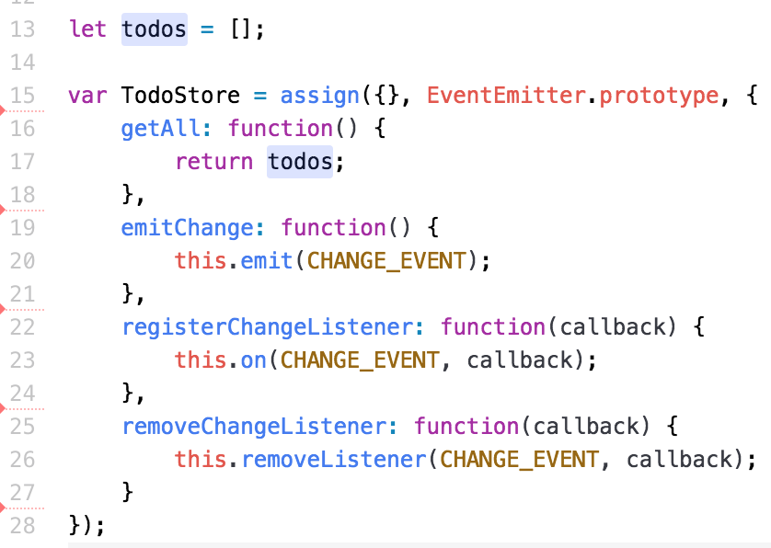
The Data Store
File ➔ src/todos/todo-store.js
The State
Extends EventEmitter
The callback
calls here
Trigger Event
Manage
Listeners

Slide 6
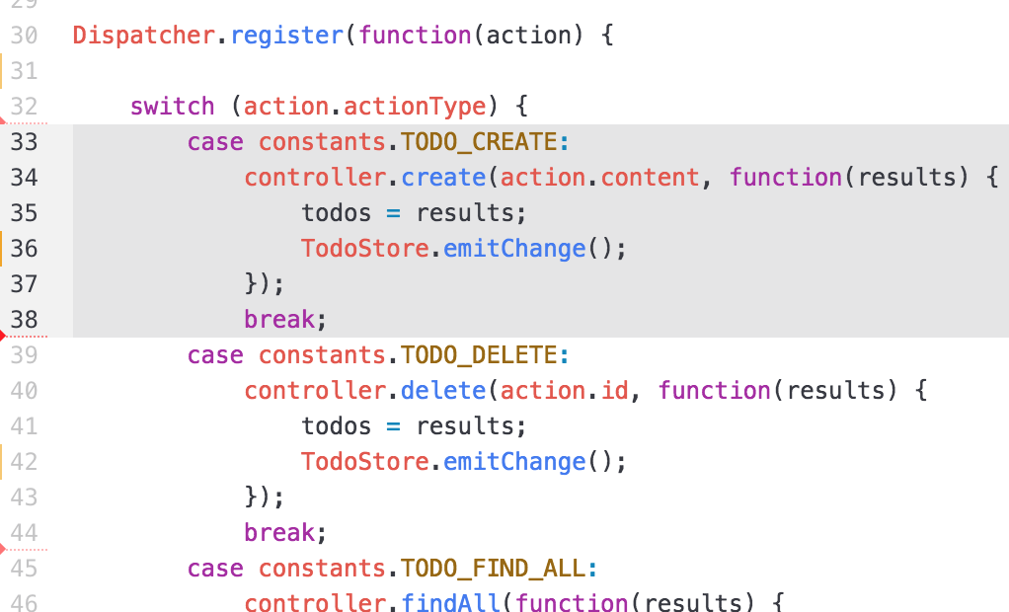
The Data Store – Register with Dispatcher
File ➔ src/todos/todo-store.js
Register
Action Type
Delegate the work
Trigger Event

Slide 7
The Listening Component
The component
Register a listener for the ‘change’ event
Registers with the Data Store
Later, when ’someone’ changes the Data Store
The DataStore calls ALL the event listeners
For the event ‘change’
This invokes the method in the COMPONENT
Later, the COMPONENT method
Calls the Data Store to find out the current status and updates the component state

Slide 8
The Listening Component, <Status>
Register the listener
getInitialState() { return { number: 1 } }, componentDidMount() { TodoStore.registerChangeListener(this._change); this._change(); }, _change() { this.setState( { number: TodoStore.getAll().length } ); },
Register the listener method
Get the current Data Store state
Update the component state

Slide 9
The Listening Component, <Status>
Render the component
getCountMessage() { switch (this.state.number) { case 0: return 'There is nothing to TODO. Enter one?'; case 1: return 'There is 1 TODO.'; default: return 'There are ' + this.state.number + ' TODOs'; } }, render: function render() { return ( <div id='status'> <h1>This is the status page</h1> <h1>{this.getCountMessage()}</h1> </div> ); }
Change the View with the State
Change the View with the State

Slide 10
The Change Component, <TodoContainer>
The user starts something
Like ‘Add TODO Item to List’
This component changes the Data Store
By sending an ACTION to the Dispatcher
Adds an item to the List
The Data Store
Calls this.emit( CHANGE_EVENT )
Invokes ALL the change listeners
The component updates its state
React updates the screen

Slide 11
The Change Component, <TodoContainer>
Initialize the component
var TodoContainer = module.exports = React.createClass({ getInitialState() { return { todos: [] } }, componentDidMount() { TodoStore.registerChangeListener(this._change); Dispatcher.dispatch({actionType: Constants.TODO_FIND_ALL}); }, _change() { this.setState( { todos: TodoStore.getAll() }); },
Register the listener method
Tell the Data Store to do work
Update the state when Data Store changes

Slide 12
The Change Component, <TodoContainer>
Render the component
Notice it isolates the <TodoList> from the business logic
render: function render() { return ( <TodoList todos={this.state.todos} addTodo={this.addTodo} remove={this.remove} update={this.update} /> ) },
The next page shows how the container delegates the CRUD work to the Store via the Dispatcher

Slide 13
The Change Component, <TodoContainer>
Change the model from the View
addTodo( content ) { Dispatcher.dispatch({actionType: Constants.TODO_CREATE, content: content}); }, remove(id) { Dispatcher.dispatch({actionType: Constants.TODO_DELETE, id: id}); }, update( todo ) { Dispatcher.dispatch({actionType: Constants.TODO_UPDATE, todo: todo}); }
Change the TODO List
Change the TODO List

Slide 14
Lab Exercise
In this lab, you will:
Modify an existing React app
It does the TODO app
It has a TodoContainer component which calls the TodoController directly
Add a Flux Dispatcher
Use the one from the ‘flux’ module
Create a TodoStore
Uses the existing TodoController to do the work
Add the TodoStore CHANGE listeners
The TodoStore must extend the Event object

