Slide 1
Reactjs Redux Async

Slide 2
Overview
Asynchronous code is more complex (of course)
The Action function handles it
Calls dispatch() multiple times
Usually the async Action should
Invoke a BEFORE action
To change the UI (like a spinner) by changing the state
Invoke the ASYNC code
Invoke the AFTER action with the data from Async
In the callback from the async call
Removes the spinner (by changing the state)

Slide 3
Async Actions
The reducer handles state change based on the action
It has the signature of ( state, action ) => state
We get the Async data and dispatch the reducer ourselves
The Async ACTION function does the following:
The function gets called by Redux via mapping
Signature is ( dispatch, p1, p2 ) => null
The function invokes the async business logic – eg RESTful call
When the async part returns, the action calls:
dispatch( action_object )

Slide 4
UI Async Issues
In the UI, you probably want to use a spinner (or something)
Display during the Async operation
Hide after the Async finishes
Handle Async error messages
The component needs another property
Indicates in the middle of Async (using the property ‘isDelayed’)
So the saveQuote() action now becomes THREE actions
The saveQuote( dispatch, name, quote )
Now dispatches the other two
The requestQuote(dispatch) which sets a property ’isDelayed’ to TRUE
This is BEFORE the async call
The receiveQuote( dispatch, name, quote ) which does the old save

Slide 5
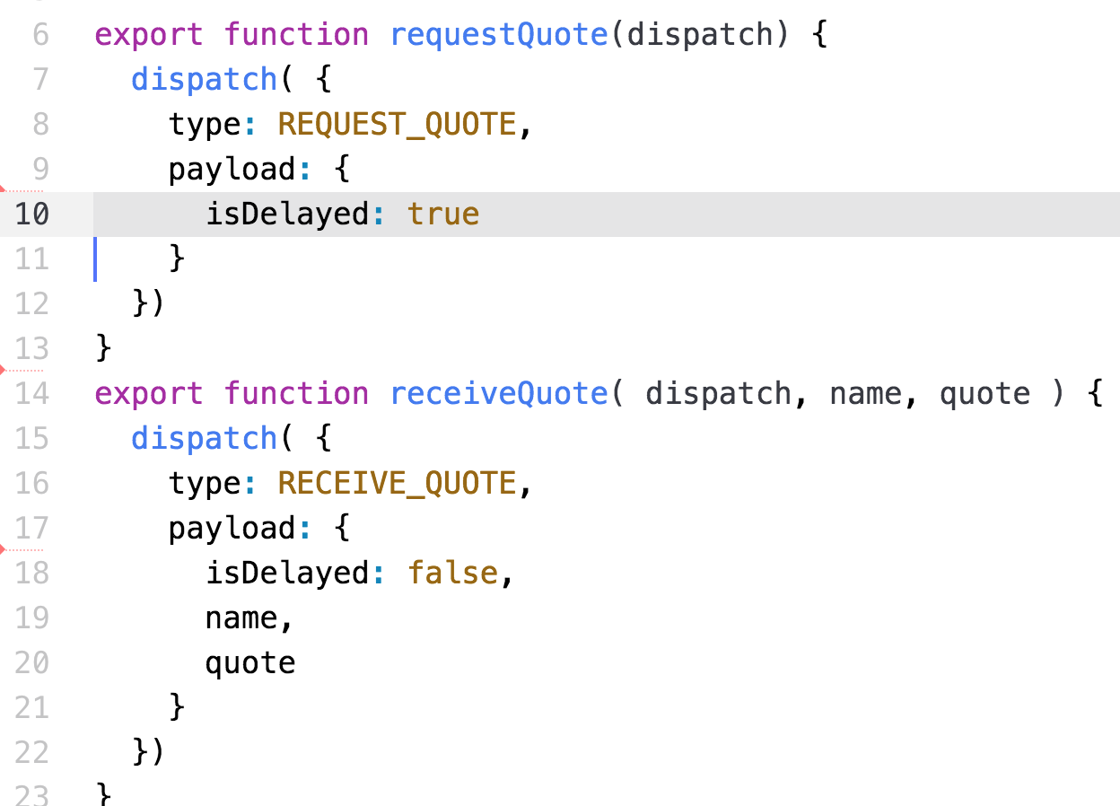
The New Actions
File → actions.js
Called BEFORE the async call
Sets the isDelayed property
Called AFTER the async call
Clears the isDelayed property

Slide 6
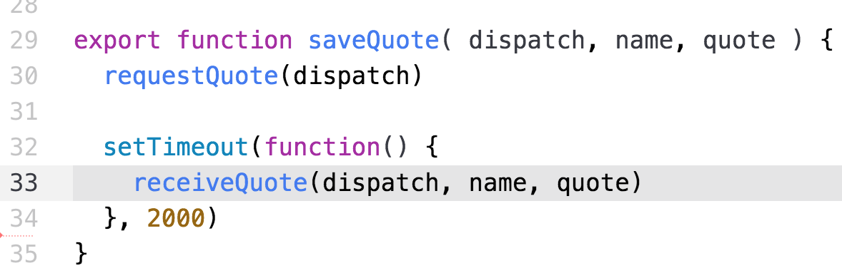
The New Actions with dispatch()
File → actions.js
Same action name
Dispatched BEFORE the async call
Dispatched AFTER the async call

Slide 7
The New Reducer
File → reducer.js
function nameReducer( state, action ) { state = state || initialState; switch (action.type) { case constants.SAVE_QUOTE: case constants.RECEIVE_QUOTE: return { ...state, name: action.payload.name, quote: action.payload.quote, isDelayed: false }; case constants.REQUEST_QUOTE: return { ...state, isDelayed: action.payload.isDelayed }; default: return state } }

Slide 8
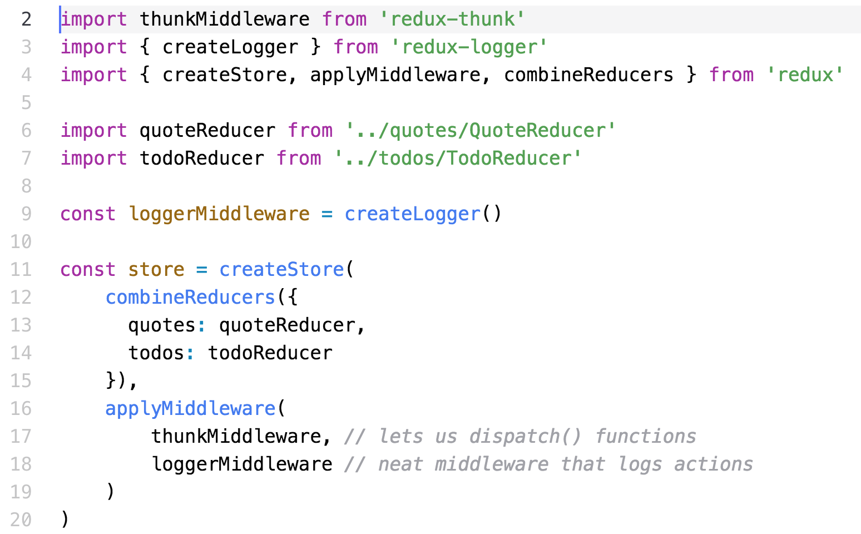
Configure the store – store.js
Configure the store to add the dispatch() function call

Slide 9
Summary
Async requires that the Action
Dispatches multiple Action Commands
The BEFORE action – spinners
The ASYNC call
The AFTER action
Save the data
Set the state for
Spinners
Errors

Slide 10
Lab Exercise
In this lab, you will:
Start with the Redux app
Modify the Actions and Reducers
To handle an async call
Configure the store
Watch it work!!!

