Slide 1
Webpack

Slide 2
Overview
React usually uses webpack as a build tool
Webpack has lots of interesting features
Bundles different types of files
CSS, SASS, LESS, JS, JSX, JSON, XML, etc.
The browser downloads the bundle in one file instead of multiples
Webpack has development tools
HMR – Hot Module Replacement
Edit a file, save it, webpack automatically sends it to the browser
Webpack development server
Serves as http server, handles HMR
Lots of configuration

Slide 3
What Webpack Does
Files ➔ JS ➔ Single File ➔ Browser ➔ Unbundle ➔ Ready
Loaders
To JS
Bundles
To single file
Browser
Unbundles
CSS
JS
HTML
Bundle.js
CSS
JS
HTML

Slide 4
Issues
Which files to load?
Convert to JS?
Which files to ignore?
Eg. node_modules
Which files to load?
Recursively from require() or import
Which output file(s)
Name of bundle.js
Location of bundle.js
How to access the file from the browser?
Via <script> tag

Slide 5
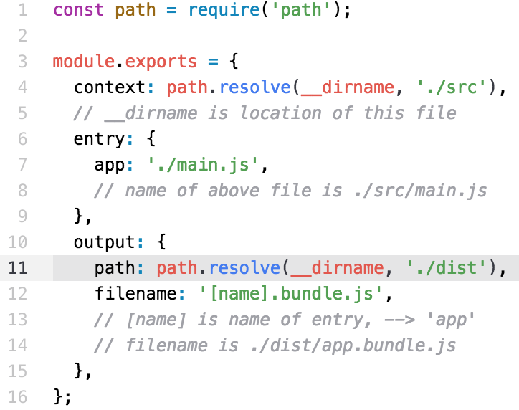
Webpack.config.js
File ➔ webpack.config.js
Bundles ./src/main.js and everything it requires()
Absolute path name
Absolute path name
Allows multiple bundles

Slide 6
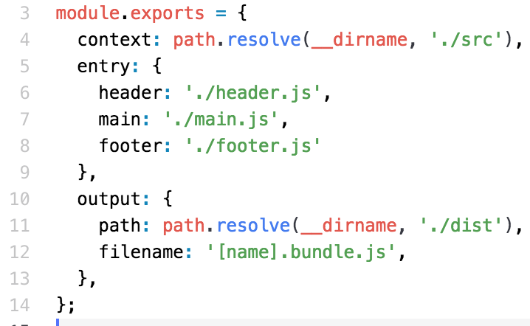
Multiple Bundles
Multiple bundles
Files ➔
./dist/header.bundle.js
./dist/main.bundle.js
./dist/footer.bundle.js
Very useful when they don’t change much
Issue: What if they all import the same file(s)???

Slide 7
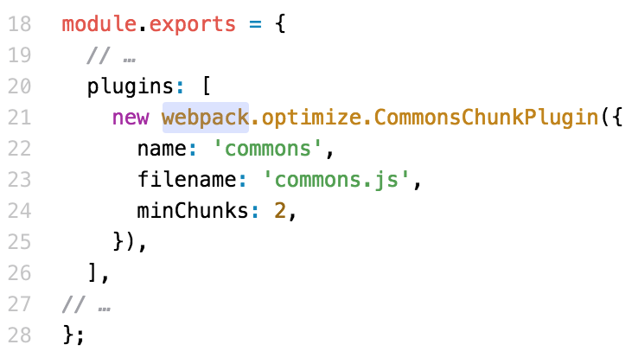
Shared Resources From require()
If the bundle files share a require() file
Create File ➔ commons.js
Contains all files referenced two or more times

Slide 8
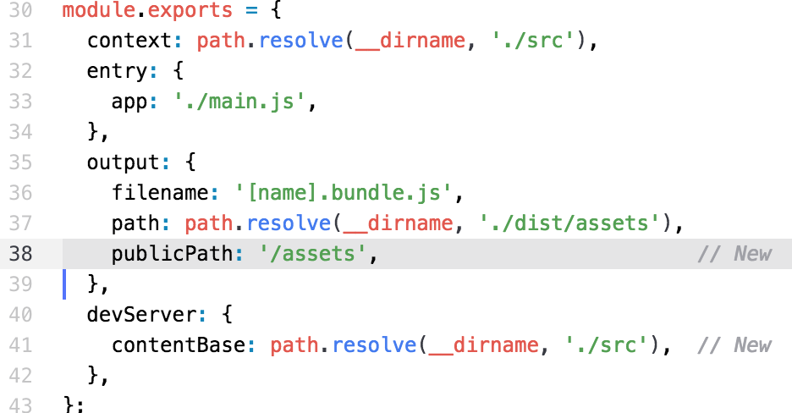
Webpack Development Server
Define public folder, ./assets/
From the browser, <script src=”/assets/app.bundle.js”></script>
Start the server (an embedded Express server) with
webpack-dev-server

Slide 9
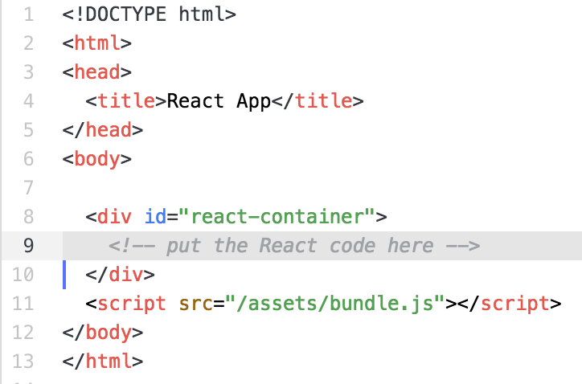
HTML
File ➔ ./src/index.html
Loads the bundle
React code here
Load the bundle

Slide 10
Loaders
Loaders are preprocessors
Convert file content to JavaScript
Babel
Convert es2015 JS to es5 JS
es6 (es2015) not supported on all browsers
Convert JSX code to es6
Convert spread operator
LESS
Convert *.less files to *.css files
SASS
Convert *.scss or *.sass files to *.css files

Slide 11
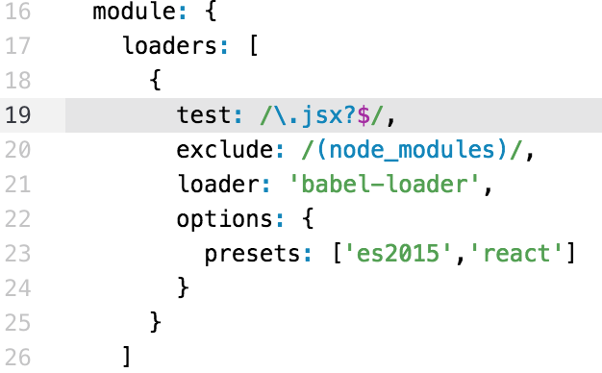
Loader Example
Loading babel
babel-loader
Presets are modules
babel-preset-es2015
babel-preset-react
Install with npm or yarn
RegExp determine file names
test: and exclude:
NOTE: this tests all *.js and *.jsx files WHY???

Slide 12

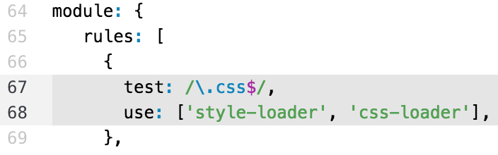
CSS Loader
Suppose you want to load the CSS data in your React app
Webpack will:
Convert the text to JavaScript
Add it to the bundle
Bundle will:
Add a <style> tag in the <head>
Must install the two loaders:
yarn add style-loader css-loader

Slide 13
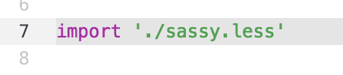
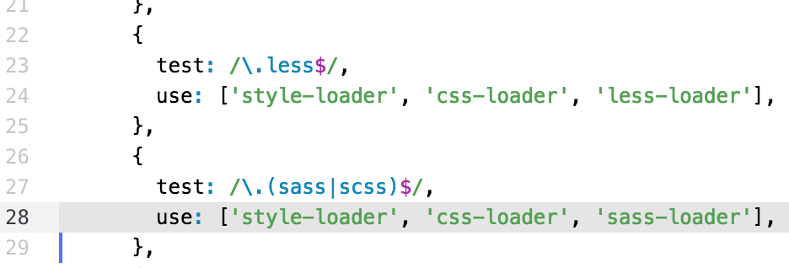
Less and Sass Loader
Executes in reverse order
CSS preprocessors
Webpack will:
Compile to CSS
Convert to JS
Bundle the result
Bundle will:
Add a <style> inside the <head>
Install with:
yarn add less-loader less
yarn add sass-loader node-sass

Slide 14
Summary
Webpack extremely powerful
Creates a single bundle of JavaScript from all our code
Suitable for browser, loads with <script> tag
Converts files
JS files to standard JS instead of es6 or es7 or JSX or …
CSS files to JS
Embed styles from CSS into <style> inside <head>
LESS or SASS
CSS preprocessors
Convert to CSS first, then process

Slide 15
Lab Exercise
Refer to /instructions/webpack.docx for the lab
Start with React app
Start with skeleton webpack.config.js
Configure support for Babel
Configure support for CSS
Configure support for LESS
Configure support for webpack development server

