Slide 1
Testing React Components

Slide 2
Overview
Unit testing React components
Each component is MVC
Output is the VIEW
Very different from other coding
Has multiple parts to verify
First, verify that the component renders the View correctly
Second, verify that the component responds to the events
Third, verify that the event responses correctly changed the View

Slide 3
Overview
React testing has two parts
Something to render the DOM (so we can test it) – emulate the device
Something to run the tests (and verify correctness)
jest
jest is a test runner – defines the test programs to run
Has assertions – to verify correctness
Has code coverage -
react-test-renderer and enzyme
Renders the DOM to a JSON object
Emulates user interaction (click events, enter text, etc)
enzyme traverses the DOM much easier (like jQuery methods)

Slide 4
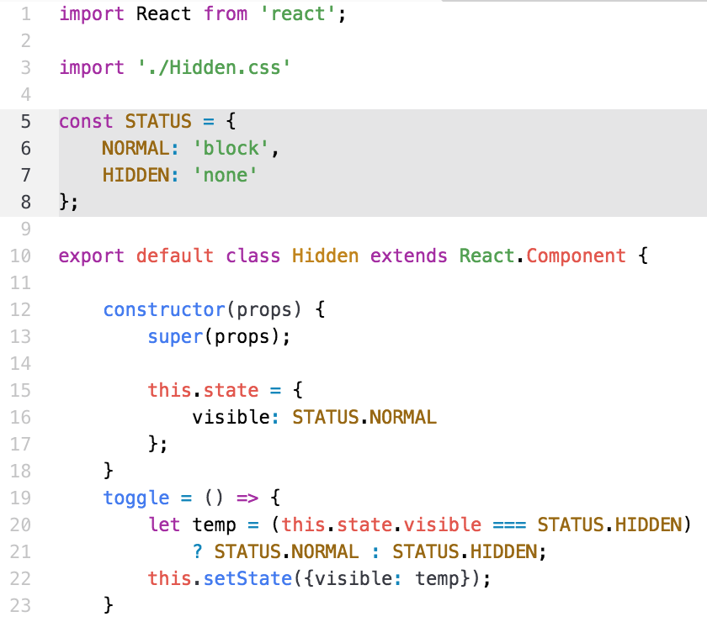
Example Component – Hidden.js
File → /src/components/Hidden.js

Slide 5
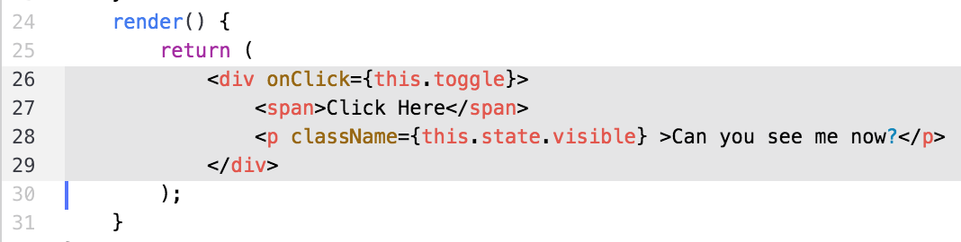
Example Component – Hidden.jsx
The className attribute should be either ‘none’ or ‘block’
The ‘click’ event should change the attribute value
How many children does the <div> have? ➔ ???

Slide 6
Unit Testing Tool - jest
Jest – invented by Facebook
Test runner (like mocha)
Creates SNAPSHOTS of the View
Saves in folder, __tests__/__snapshots__
Compares snapshots with previous runs
Understands yarn or npm
Also runs standalone
Test files have special names
*.test.js or *.spec.js
Runs all the files with these names

Slide 7
Jest API
Jest global environment
afterEach( fn )
beforeEach( fn )
afterAll( fn )
beforeAll( fn )
describe( name, fn )
start of a suite of it() tests
‘name’ string used in output text
it( name, fn )
one test
‘name’ string used in output text
test(name, fn ) – alias for it()

Slide 8
Jest Assertions
Use expect( value ) function has methods:
.toBe( value ) -- uses ’===‘ under the covers
.toEqual( value ) -- uses ‘===‘ under the covers
.toBeNull()
.toBeTruthy()
.toBeFalsey()
.toContain( item ) -- for arrays
.toThrow()
.toMatch( regexp )
.toMatchObject( object )

Slide 9
Jest Assertions – snapshots
expect( value ).toMatchSnapshot()
‘value’ is a string or JSON object
Compares the current value with the old value
Old values stored in
__tests__/__snapshots__/<filename.js>.snap
Example:
it('should exist', () => { expect(comp).not.toBeNull(); expect(comp).toMatchSnapshot(); });

Slide 10
Using react-test-renderer
‘react-test-renderer’
Renders the component (duh!!)
Creates a react component
Component has props, children, etc.
Must perform the events manually
Traversing the nodes is painful
Fixed in ‘enzyme’ later

Slide 11
Example
Use beforeEach() to create component to test
describe('Hidden -- ', () => { let component, comp; beforeEach(() => { component = renderer.create( <Hidden /> ); comp = component.toJSON(); }); it('should exist', () => { expect(comp).not.toBeNull(); expect(comp).toMatchSnapshot(); });

Slide 12
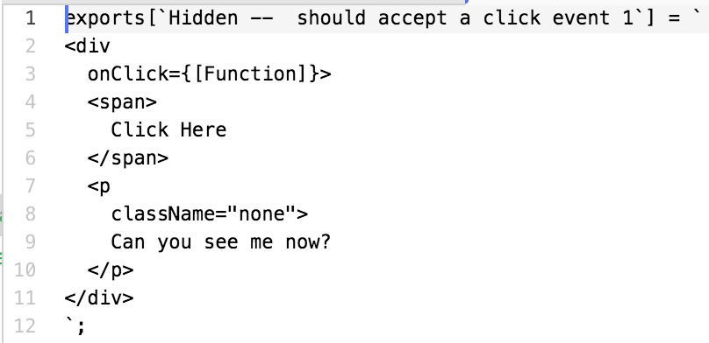
Example
Notice ‘comp’ is the <div> in the rendered component
it('should accept a click event', () => { // manually trigger the callback comp.props.onClick(); // re-rendering comp = component.toJSON(); expect(comp).toMatchSnapshot(); });
Manually call the onClick() method
Create a snapshot

Slide 13
The Advantage of Snapshots
Snapshots are great for render() tests
Snapshots have problems
They require a HUMAN being
To verify changes are as intended
To determine what broke
Snapshots test changes in the render() string
This example can be almost 100% tested using snapshots
No need to verify changes to the class of <p>
Snapshot does it for you.

Slide 14
Walking Through the React Component
The JSON representation of the rendered component is:
<div onClick={[Function]}> <span>Click Here</span> <p className="none"> Can you see me now? </p> </div>
QUESTIONS:
How many children does the <div> have?
How many attributes (props) does the <div> have?
How many attributes (props) does the <p> have?
What is the value of className of the <p> element?
How do you call the ‘onClick’ function on the <div>?

Slide 15
Walking Through the React Component
The JSON representation of the rendered component is:
<div onClick={[Function]}> <span>Click Here</span> <p className="none"> Can you see me now? </p> </div>
QUESTIONS:
How many children does the <div> have? => 2
How many attributes (props) does the <div> have?
How many attributes (props) does the <p> have?
What is the value of className of the <p> element?
How do you call the ‘onClick’ function on the <div>?

Slide 16
Walking Through the React Component
The JSON representation of the rendered component is:
<div onClick={[Function]}> <span>Click Here</span> <p className="none"> Can you see me now? </p> </div>
QUESTIONS:
How many children does the <div> have? => 2
How many attributes (props) does the <div> have? => 1
How many attributes (props) does the <p> have?
What is the value of className of the <p> element?
How do you call the ‘onClick’ function on the <div>?

Slide 17
Walking Through the React Component
The JSON representation of the rendered component is:
<div onClick={[Function]}> <span>Click Here</span> <p className="none"> Can you see me now? </p> </div>
QUESTIONS:
How many children does the <div> have? => 2
How many attributes (props) does the <div> have? => 1
How many attributes (props) does the <p> have? => 1
What is the value of className of the <p> element?
How do you call the ‘onClick’ function on the <div>?

Slide 18
Walking Through the React Component
The JSON representation of the rendered component is:
<div onClick={[Function]}> <span>Click Here</span> <p className="none"> Can you see me now? </p> </div>
QUESTIONS:
How many children does the <div> have? => 2
How many attributes (props) does the <div> have? => 1
How many attributes (props) does the <p> have? => 1
What is the value of className of the <p> element? => none
How do you call the ‘onClick’ function on the <div>?

Slide 19
Walking Through the React Component
The JSON representation of the rendered component is:
<div onClick={[Function]}> <span>Click Here</span> <p className="none"> Can you see me now? </p> </div>
QUESTIONS:
How many children does the <div> have? => 2
How many attributes (props) does the <div> have? => 1
How many attributes (props) does the <p> have? => 1
What is the value of className of the <p> element? => none
How do you call the ‘onClick’ function on the <div>? =>
comp.props.onClick()

Slide 20
Walking Through the React Component
The JSON representation of the rendered component is:
<div onClick={[Function]}> <span>Click Here</span> <p className="none"> Can you see me now? </p> </div>
QUESTIONS:
How do you access the children of <div>?
How do you access the className of <p>?
How do you VALIDATE the className of <p>?

Slide 21
Walking Through the React Component
The JSON representation of the rendered component is:
<div onClick={[Function]}> <span>Click Here</span> <p className="none"> Can you see me now? </p> </div>
QUESTIONS:
How do you access the children of <div>?
comp.children ➔ an array of elements
How do you access the className of <p>?
How do you VALIDATE the className of <p>?

Slide 22
Walking Through the React Component
The JSON representation of the rendered component is:
<div onClick={[Function]}> <span>Click Here</span> <p className="none"> Can you see me now? </p> </div>
QUESTIONS:
How do you access the children of <div>?
comp.children ➔ an array of elements
How do you access the className of <p>?
comp.children[0].props.className ➔ a String
How do you VALIDATE the className of <p>?

Slide 23
Walking Through the React Component
The JSON representation of the rendered component is:
<div onClick={[Function]}> <span>Click Here</span> <p className="none"> Can you see me now? </p> </div>
QUESTIONS:
How do you access the children of <div>?
comp.children ➔ an array of elements
How do you access the className of <p>?
comp.children[0].props.className ➔ a String
How do you VALIDATE the className of <p>?
expect( comp.children[0].props.className).toEqual( ‘none’)

Slide 24
Enzyme – a Testing Framework
Validating the JSON is very painful
Enzyme includes “jQuery-like” selections
Enzyme has three different renderers
Shallow – does NOT call render() on children
Suitable for most components
Does NOT create a whole DOM
Mount – renders the entire component
Requires a DOM (maybe jsdom on the server)
Allows testing of lifecycle methods (componentWillMount(), etc)

Slide 25
Enzyme Wrappers
Three types of renderers
import { shallow, mount } from 'enzyme'; describe('Hidden -- ', () => { let shallowWrapper = shallow(<Hidden />); let mountWrapper = mount( <Hidden /> ); let wrapper; beforeEach(() => { wrapper = shallow(<Hidden />); });
We use shallow() in these examples
Examples:

Slide 26
Enzyme Functions
50+ methods on the wrapper, ’jQuery-like’
’find()’ → with string selector, ”p.none”, returns an ARRAY
‘type()’ → type of element (a String in shallow), “div”
‘first()’ → first() child of wrapper
‘children()’ →
‘parent()’ →
‘parents()’ →
‘text()’ → text of ALL children
‘html()’ →
‘props()’ →
‘children()’ →

Slide 27
Enzyme Selectors
Enzyme selectors use ‘jQuery-like’ CSS syntax,
Element → ‘div’
Class → ‘.none’, ’.block’, ‘p.none’
ID → ‘#myComponentId’
Returns a COPY of the element, not a reference
Also selector methods
first() ➔ find(”div”).first() ➔ returns ONE <div> if it exists
last()
children()
parent(), parents()
Etc.

Slide 28
Examples
‘find()’ with a selector
What is being selected?
What data type is returned?
it('should render one <p /> components', () => { expect( wrapper.find('p') ).toHaveLength(1); });
Enzyme
Jest globals

Slide 29
Examples
it('should have one child', () => { expect( wrapper.children() ).toHaveLength(2); }); it('should have a type of <div>', () => { expect( wrapper.type() ).toEqual('div'); }); it('should have a <p> with class === "block', () => { expect( wrapper.find('p.none') ).toHaveLength(0); expect( wrapper.find('p.block') ).toHaveLength(1); }); it('should have a <p> with class === "none" after click', () => { wrapper.find('div').simulate('click'); expect( wrapper.find('p.block') ).toHaveLength(0); expect( wrapper.find('p.none') ).toHaveLength(1); });
CLICK!!

Slide 30
References
Jest API references
https://facebook.github.io/jest/docs/api.html
Enzyme
http://airbnb.io/enzyme/docs/api/shallow.html
NOTE: the examples do NOT use jest

Slide 31
Lab Exercise
Use the instructions
Use the test runner, jest
Create test program using ‘react-test-renderer’
Shown in the first part of presentation
Create a test program using Enzyme
Much easier selection
Much easier event simulation

