Slide 1
Reactjs Redux

Slide 2
Overview
Redux
Allows shared STATE between independent components
Alternative – pass parts of state down to unrelated components
Provides a single STATE for the entire app
Provides a Command Pattern interface (with Actions)
Like Do / Undo / Redo implementations
Provides a standard way to modify the STATE
dispatch() method → dispatches the commands (Actions)
Provides a standard way to CREATE CONTAINERS
props are a subset of single STATE
Callbacks are wrappers around dispatch() of Actions

Slide 3
Overview
Containers
Isolate View Components from the Business Logic
Manage the STATE
Provide the View Components with
State data via props parameter
Callbacks via props parameter
Redux CREATES Containers
Maps State data to props variables
Maps callbacks to props variables
Callbacks dispatch() to the Redux store to change state
Redux changes the state data and it goes on and on

Slide 4
What Happens…
Redux → Starts up, registers all Reducers (think Flux stores)
Redux → Creates Container wrapper around Component
Maps State data to input attributes on the Component
Maps Callbacks (dispatches to Redux) to attributes on the Component
Component → User clicks on something
Component → Invokes a callback to Container
Container → Calls Redux dispatch() with Action
Redux → Sends Action to Reducer
Reducer → Changes the State
Container → Maps the State to the Component
React → Notices the State changes and re-renders Component

Slide 5
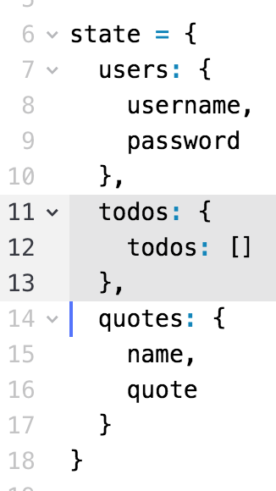
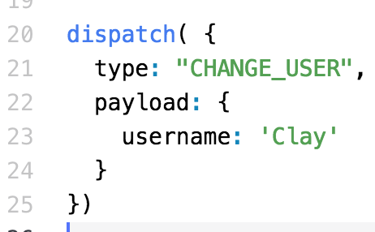
Single STATE
Redux has Single State
Managed internally
May have multiple parts
Each part for different components
Only way to change the state
Via dispatch() method on Redux
Dispatch() an Action
Change state.users.username to ‘Clay’

Slide 6
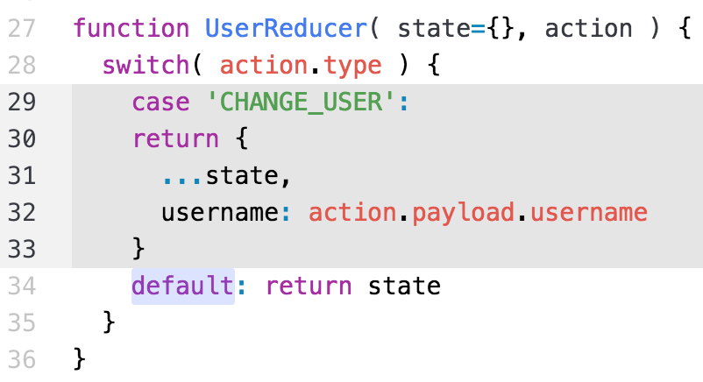
Change State Functions
Redux calls Reducers
To Change State
We write
action.type
Tells us what to do
action.payload
Data to perform work
Return input state if don’t understand action.type
Change state.users.username to ‘Clay’

Slide 7
Reducers
Reducers are PURE FUNCTIONS
No change to globals
No change to input parameters
Performs
input ➔ transform ➔ output
Two parameters
state ➔ current state
action ➔ what to do to the state
Returns new state
Signature is
( state, action ) ➔ state
Action tells reducer to
change state.username to ‘Clay’

Slide 8
Redux Flow
Maps state properties
to
Input attributes (props)
Always start with the UI
Maps actions
to
Callback attributes
(props)
Calls Business Logic
Results to Reducer

Slide 9
Glossary
React-redux
Creates Containers
Manages single STATE
Reducer
They change the store data (the STATE)
Action
Functions which interface with the Business Logic
Command objects
Sent to the Reducer to tell it WHAT to do
dispatcher()
Interface to react-redux
Sends Action → Reducer to change the state

Slide 10
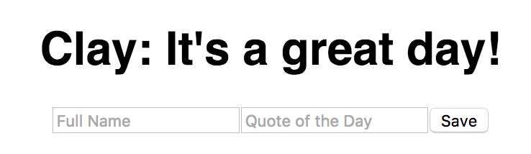
UI Example – Page 1
User enters a Name and a Quote
User presses the Save button
Save performs a submit() of the form
Called by Redux which creates a Container for <Quote>:
<Quote name={nameValue} quote={quoteValue} saveQuote={saveQuote} />
Input Values from State
Callback to dispatch()

Slide 11
UI Example – The <Quote> Component
import React from 'react' export default function Quote( props ) { // SUBMIT event handler is on the next slide return ( <div className="nameInput"> <h1>{props.name}{props.name ? ':' : ''} {props.quote}</h1> <form onSubmit={submit}> <input placeholder="Full Name" ref={data => _name = data} /> <input placeholder="Quote of the Day" ref={data => _quote = data} /> <button type="submit">Save</button> </form> </div> ) }
Input PROPS

Slide 12
UI – Page 3
Continued from previous slide
export default function Quote ( props ) { let _name, _quote function submit(e) { e.preventDefault() props.saveQuote( _name.value, _quote.value ) _name.value = '' _quote.value = '' } return ( // returns the JSX markup from the prev slide ) }
Callback to REDUX

Slide 13
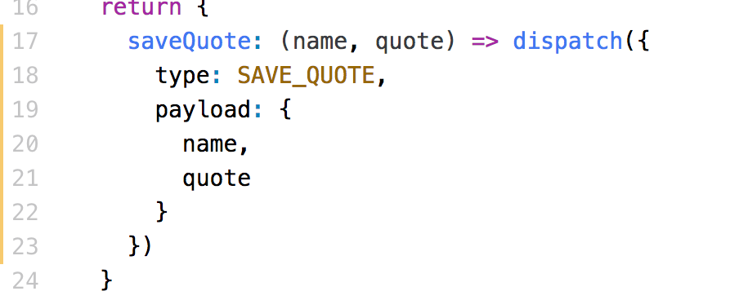
UI – Page 4
props.saveQuote( name, quote )
Callback must:
Calls the Redux DISPATCHER
Sends Dispatcher an Action – command object with properties
Dispatcher sends Action to reducer (next page)

Slide 14
Reducer Example
Notice the signature ( state, action ) => state
const initialState = { name: '', quote: '' }; export function quoteReducer( state, action ) { state = state || initialState; switch (action.type) { case “SAVE_QUOTE”: return { ...state, name: action.payload.name, quote: action.payload.quote }; default: return state } }
Create a new state
Keep all props of old state
Update these properties

Slide 15
Configure Redux
Redux CREATES Container Components
We want Redux to create a Container around <Quote>
<Quote name={nameValue} quote={quoteValue} saveQuote={saveQuote} />
We have to map the STATE properties to our name and quote attributes
We have to map the saveQuote attribute to our callback
What are the parameters to our saveQuote() function ➔ ???

Slide 16
Configure Redux
Redux CREATES Container Components
We want Redux to create a Container around <Quote>
<Quote name={nameValue} quote={quoteValue} saveQuote={saveQuote} />
We have to map the STATE properties to our name and quote attributes
We have to map the saveQuote attribute to our callback
What are the parameters to our saveQuote() function ➔ ???
saveQuote( name, quote )

Slide 17
Configure Redux
Redux needs to know
Which subset of the state attached to which attribute on the Component
<Quote> Component needs ‘name’ and ‘quote’
With mapStateToProps()
Which Actions should be dispatched to the store
CRUD to store
With mapDispatchToProps()
Dispatch Actions to the Store
Pass the dispatch() function to the action
Define CONTAINER around the Component

Slide 18
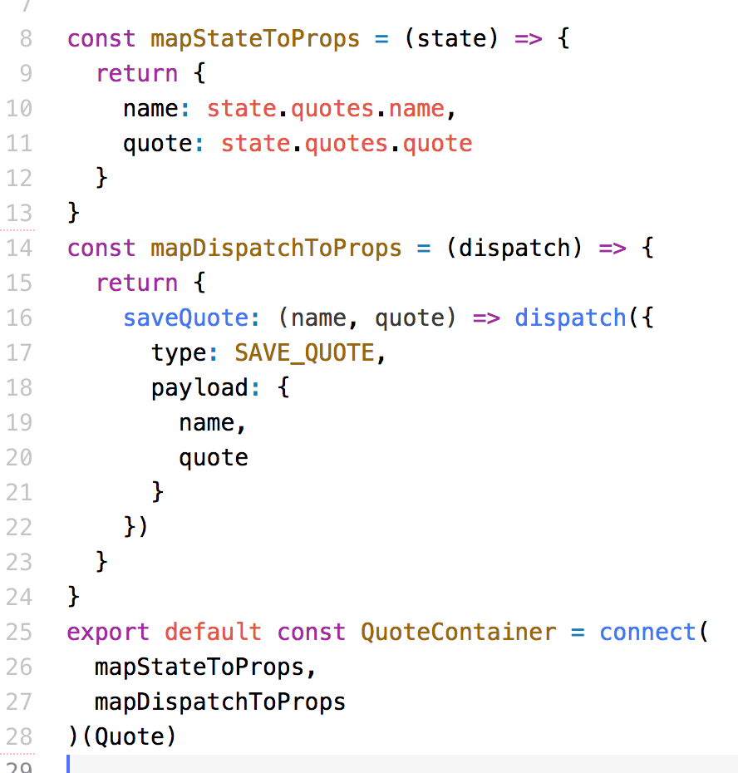
Container Example
THREE attributes
Our saveQuote() callback
Create new Container
Tells Redux what Attributes
To use when calling Quote
Wrap around the Quote Component

Slide 19
Configure Redux
Redux CREATED QuoteContainer Component
Redux creates the Container around <Quote>
<Quote name={nameValue} quote={quoteValue} saveQuote={saveQuote} />
We have to map the STATE properties to our name and quote attributes
We have to map the saveQuote attribute to our callback
Callback calls dispatch() with some Action

Slide 20
Configuring Redux – One Reducer
File → index.js
import { Provider } from 'react-redux' import { createStore } from 'redux' import quoteReducer from './quotes/quoteReducer' let store = createStore(quoteReducer) store.subscribe(() => console.log(store.getState()) ) ReactDOM.render( <Provider store={store}> <App /> </Provider>, document.getElementById('root') );
Handles store dispatches
Listen for accessing the store
Surround the App with the store Provider

Slide 21
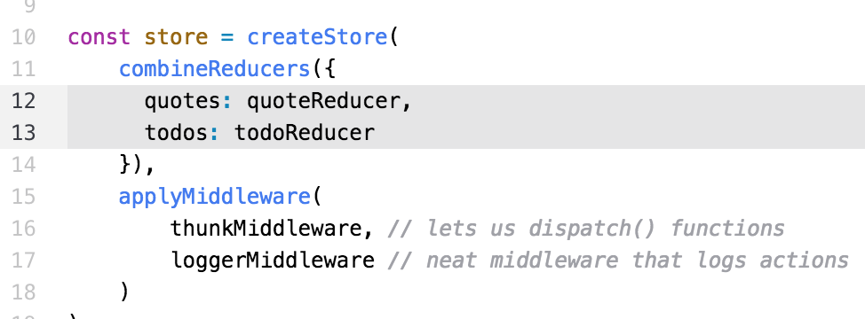
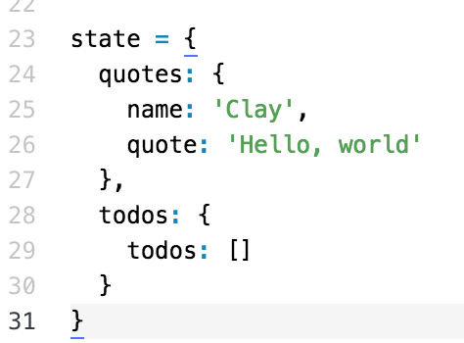
Configure Redux – Multiple Reducers
Many Reducers
Single STATE
Two namespaces
Access using
state.quotes.name
state.todos.todos
Two Reducers
For Async

Slide 22
Store
The store contains the state of the application
All it does is CALL THE REDUCERS
Reducer changes the STATE
Can register listeners
Only ONE store in a Redux application
Contains the entire application state
Change the STATE using the REDUCER pattern

Slide 23
In Summary
Test Questions
How many copies of the STATE are there?
What does a reducer do?
What are the parameters to the reducer?
What does the reducer return?
How do you call the Redux store?
What is the parameter to dispatch()?
What object is the command?

Slide 24
In Summary
Test Questions
How many copies of the STATE are there? ➔ ONE
What does a reducer do?
What are the parameters to the reducer?
What does the reducer return?
How do you call the Redux store?
What is the parameter to dispatch()?
What object is the command?

Slide 25
In Summary
Test Questions
How many copies of the STATE are there? ➔ ONE
What does a reducer do? ➔ changes the STATE
What are the parameters to the reducer?
What does the reducer return?
How do you call the Redux store?
What is the parameter to dispatch()?
What object is the command?

Slide 26
In Summary
Test Questions
How many copies of the STATE are there? ➔ ONE
What does a reducer do? ➔ changes the STATE
What are the parameters to the reducer? ➔ (state, action)
What does the reducer return?
How do you call the Redux store?
What is the parameter to dispatch()?
What object is the command?

Slide 27
In Summary
Test Questions
How many copies of the STATE are there? ➔ ONE
What does a reducer do? ➔ changes the STATE
What are the parameters to the reducer? ➔ (state, action)
What does the reducer return? ➔ the new state
How do you call the Redux store?
What is the parameter to dispatch()?
What object is the command?

Slide 28
In Summary
Test Questions
How many copies of the STATE are there? ➔ ONE
What does a reducer do? ➔ changes the STATE
What are the parameters to the reducer? ➔ (state, action)
What does the reducer return? ➔ the new state
How do you call the Redux store? ➔ dispatch( action )
What is the parameter to dispatch()?
What object is the command?

Slide 29
In Summary
Test Questions
How many copies of the STATE are there? ➔ ONE
What does a reducer do? ➔ changes the STATE
What are the parameters to the reducer? ➔ (state, action)
What does the reducer return? ➔ the new state
How do you call the Redux store? ➔ dispatch( action )
What is the parameter to dispatch()? ➔ an ACTION
What object is the command?

Slide 30
In Summary
Test Questions
How many copies of the STATE are there? ➔ ONE
What does a reducer do? ➔ changes the STATE
What are the parameters to the reducer? ➔ (state, action)
What does the reducer return? ➔ the new state
How do you call the Redux store? ➔ dispatch( action )
What is the parameter to dispatch()? ➔ an ACTION
What object is the command? ➔ the Action

Slide 31
Async Actions
But what about Async calls? – like to a RESTful service
The reducer handles state change based on the action
We get the Async data and dispatch the reducer ourselves
The next section discusses Async Actions

Slide 32
Summary
There are a lot of moving parts in Redux
Redux has a SINGLE STATE for the whole app
Reducers allow changing the state within the store
Signature ( state, action ) => state
Pure functions
Should NOT be asynchronous
Actions define WHAT you can do to the state ( CRUD )
Business Logic results → dispatch() → REDUCER
Containers MAP the state to props and actions to props
Tells Redux the input and output props to Components
STATE → input props, ACTIONS -> callback props

Slide 33
Lab Exercise
In this lab, you will:
Change the Container Components to use Redux
Create the Actions and Reducers
Configure the store
Watch it work!!!

