Slide 1
Non-linear
Presentation Controller for dual monitor setup
Created by Dr Nitin Paranjape and Raj Chaudhuri

Slide 2


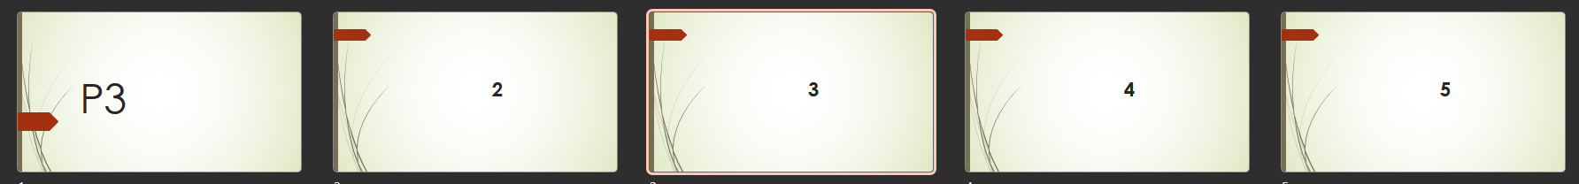
Multi-presentation scenario
Notice the currently active slides

Slide 3
Multi-presentation scenario
P2 – slide 2 is currently visible

Slide 4
Multi-presentation scenario
And now you want to show P1 – Slide 3, WITHOUT showing P1 – Slide 1

Slide 5
When is this macro useful?
If you
  have dual monitor setup
  have multiple presentations running in presentation mode
  need the ability to jump to any slide in any presentation
  without disturbing the currently displayed slide
Then you need this tool

Slide 6
Why not just use the Presenter View?
Presenter View shows only one presentation at a time
You cannot switch presentations using Presenter View
The only way to switch between running presentations is by using the taskbar-icon-hover-thumbnails
In each presentation there is one CURRENT slide
It is not possible switch to a different presentation and show a non-current slide – without showing the current slide
This macro helps you run any slide from edit view (even if the presentation is currently not running)

Slide 7
How to use this macro
Open multiple presentations on one monitor (primary monitor – PM)
Arrange them on one half of the PM (Windows – LeftArrow)
Set the Slide Shows to run on the other monitor (secondary monitor –SM)
Run the starting slide of each presentation
Enable Presenter View on PM
Arrange Presenter View window on right side (Windows – RightArrow)
Use the presenter view to navigate to any slide from the currently running presentation
When you want to switch to a different slide in a different presentation, choose the slide in edit mode and run the macro
Practice using this macro before using it in a real presentation

Slide 8
Additional macros
Close All Running Slide Shows
  Stops all slide shows
  Keeps the files open
Close all presentations
  Closes all presentations, except the macro presentation

Slide 9
Thank You
Created by Dr Nitin Paranjape and Raj Chaudhuri

