Slide 1
Arrange Pictures instantly.
Especially logos.
Ideal for arranging customer / product logos.
Created by Dr Nitin Paranjape and Raj Chaudhuri

Slide 2










Before
After
The macro hides the original images.
Here I am showing the images for illustration purpose only.

Slide 3
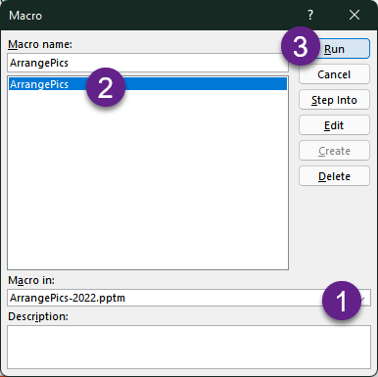
How to use this macro
Keep this file open
Go to your slide
Add pictures to the slide
Select 3 or more pictures
Choose View tab – Macros
Select macro ArrangePics
Click Run
Pictures will be arranged as SmartArt
Original pictures are hidden

Slide 4
Limitations
We have tested it with 300 pictures.
It may take time to process pictures.
Processing is slower on the Mac.
Please be patient while the processing is going on.

Slide 5
Test Cases
The following slides contain various test cases.
You can try the macro on them.

Slide 6
Running tests
Go to a test slide
Select all objects on the slide
Run the macro

Slide 7
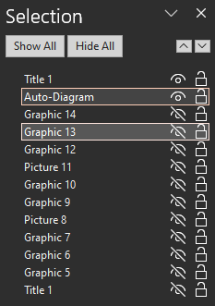
Resetting tests
Once the macro runs, original images are hidden.
The diagram created by the macro is named as “Auto-Diagram”
To reset a test slide after testing:
  Go to Home tab – Selection – Selection Pane. Choose Show All.
  Select and delete the shape named “Auto Diagram”

Slide 8
















Case 1: Multiple SVG icons

Slide 9
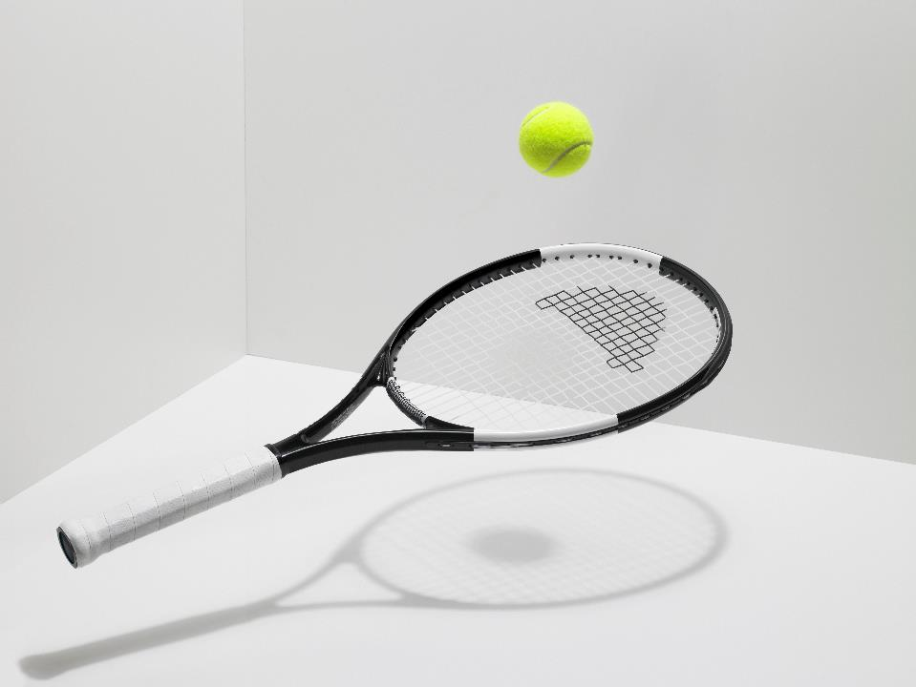





Case 2: Multiple pictures

Slide 10





Case 3: Mixed

Slide 11





Case 4: Placeholder has SVG graphic

Slide 12
Thank You
Blog YouTube LinkedIn

