Slide 1


Testing of Asphalt 9: Legends – 10 items checklist and 5 bugs.
Asphalt 9: Legends v.3.5.200.2
to install - go to Microsoft Store or Xbox app at OS Windows
Checklist
1) Skip waiting time, when car is refilling its gas by using <<TOKENS>>
2) Try to buy <<UNCOMMON CRADS>> << BLUEPRINTS >> in <<LEGEND STORE>> for <<CREDITS>>, when out off <<CREDITS>>
3) Try to upgrade <<NITRO>> up to <<STAGE 6>> of <<1 STAR>> <<NISSAN 370Z NISMO>>
4) Change language in <<GAME SETTINGS>> from English to Spanish
5) Test driving controls with <<TOUCHDRIVE ON>>
6) Test driving controls with <<TOUCHDRIVE OFF>>
7) Try to race in multiplayer’s <<SILVER LEAGUE>> being in <<BRONZE LEAGUE>>
8) Change color of <<CHEVROLET CAMARO LT>>
9) During race try to perform <<BARREL ROLL>>
10) During race try to perform <<PERFECT NITRO>>

Slide 2
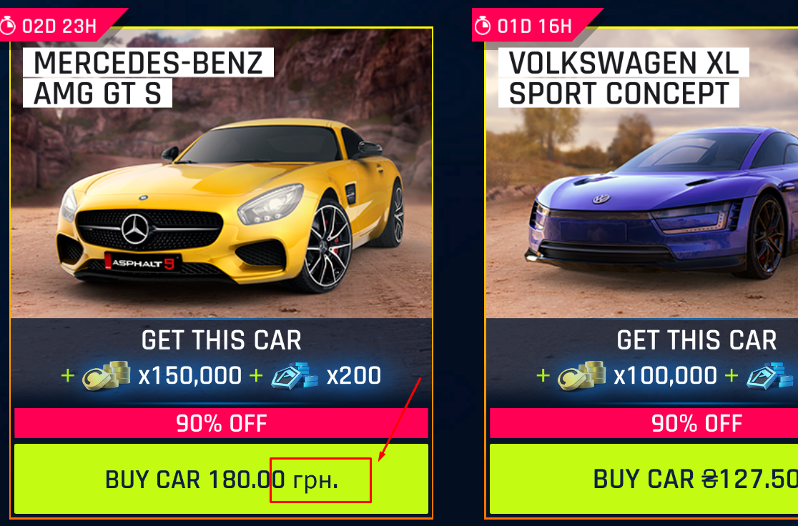
Bug reports
1) <<SHOP>>, << SPECIAL OFFERS>> – price is displayed incorrectly
STR:
1. Go to <<SHOP>>, <<SPECIAL OFFERS>>.
2. Pay attention at price of <<MERCEDES-BENZ AMG GT S>>.
AR: 180.00грн.
ER: ₴180.00
Severity: Trivial
OS: Windows 11

Slide 3
2) <<WELCOME TO SCOTLAND EVENT>> of <<GEARHEADS SEASON>> – out of bounds bug
STR:
1. Race <<WELCOME TO SCOTLAND EVENT>> of <<GEARHEADS SEASON>>.
2. Turn on <<TOUCHDRIVE OFF>> mode.
3. Hold A button while performing <<SHOCKWAVE>> close to out of bounds area (3rd second of video).
https://share.vidyard.com/watch/pU7jkF4PBLT8pL3p2xX9aT
AR: car goes out of bounds
ER: car should be going in bounds of track
Severity: Major
OS: Windows 11
3) <<HIMALAYAS DOWNHILL EVENT>> of <<LEGENDARY START 2018 SEASON>> – out of bounds bug
STR:
1. Race <<HIMALAYAS DOWNHILL>> of <<LEGENDARY START 2018 SEASON>>.
2. Turn on <<TOUCHDRIVE OFF>> mode.
3. Turn left to the ramp at around 100 km p/h to reach out of bounds area (13th second of video).
https://share.vidyard.com/watch/TXT3HCsuFMSvs6J6qTtTTy
AR: car goes out of bounds.
ER: car should be going in bounds of track
Severity: Major
OS: Windows 11

Slide 4
4) <<GARAGE>>, changed color of <<DODGE CHALLENGER SRT 8>> doesn’t display
STR:
1. Go to <<GARAGE>>.
2. Go to <<DODGE CHALLENGER SRT 8>> maintenance menu.
3. Change color to 7th in LTR order.
4. Go to <<GARAGE>>.
5. Pay attention at color of <<DODGE CHALLENGER SRT 8>>.
https://share.vidyard.com/watch/F4M2mmh7z6bPS9EmsdKZxv
AR: 1st in LTR order
ER: 7th in LTR order
Severity: Major
OS: Windows 11
5) GAME SETTINGS, LANGUAGE AND COUNTRY – unable to change language from English to Spanish
1. Go to <<GAME SETTINGS>>menu.
2. In << LANGUAGE AND COUNTRY>> menu choose Spanish.
3. Restart game.
https://share.vidyard.com/watch/5ww2WCLrdmtj9Re1wDH8qg
AR: English
ER: Spanish
Severity: Critical
OS: Windows 11

