Slide 1
Time series modelling approach to intervention Forecasting in icu
Pan Ziyuan

Slide 2
background
Patients in hospital intensive care units (ICUs) generally have life-threatening conditions, and require close monitoring and rapid therapeutic interventions. They are connected to an array of equipment and monitors, and are carefully attended by the clinical staff.
If we can predict the need of interventions (such as invasive and non-invasive ventilation) a few hours beforehand, it will help the caregivers better prepare for the interventions, and it can prevent the conditions of patients from getting worse.

Slide 3
background
Data Source: MIMIC-III Critical Care Database. It is a large, freely-available database comprising deidentified health-related data associated with over forty thousand patients who stayed in critical care units of the Beth Israel Deaconess Medical Center between 2001 and 2012. The size of the database is about 100 Gb.
Intended Analysis Methods: Deep learning sequential models (such as RNN, LSTM) and probabilistic models.

Slide 4
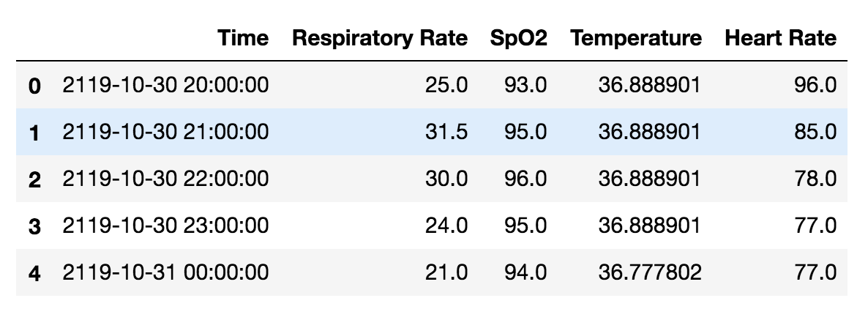
Data preprocessing
Desired data format: For each patient, we want to get the time series data (the values of selected features at each time interval).
Actual data format: SQL database tables.

Slide 5
DATA preprocessing
Database size is too large, need to extract the data we want.
Need to select certain features (such as blood pressure, heart rate…) from all different kinds of data.
Data in the database is collected from two sources (CareVue and MetaVision). The format or unit of measurement may be different.
Missing data and wrong data.

Slide 6
Data preprocessing
Feature selection: Selecting more features means reducing the number of patients for analysis. So I set the following criteria:
1. We need to have the data of the feature for most of the patients.
2. It should be an important indicator.
3. Ideally the value should be real number.
In the end, 16 time varying features and 2 static features are selected. The database contains the information of about 60000 patients in total. About 10000 patients have the all the features we need.

Slide 7
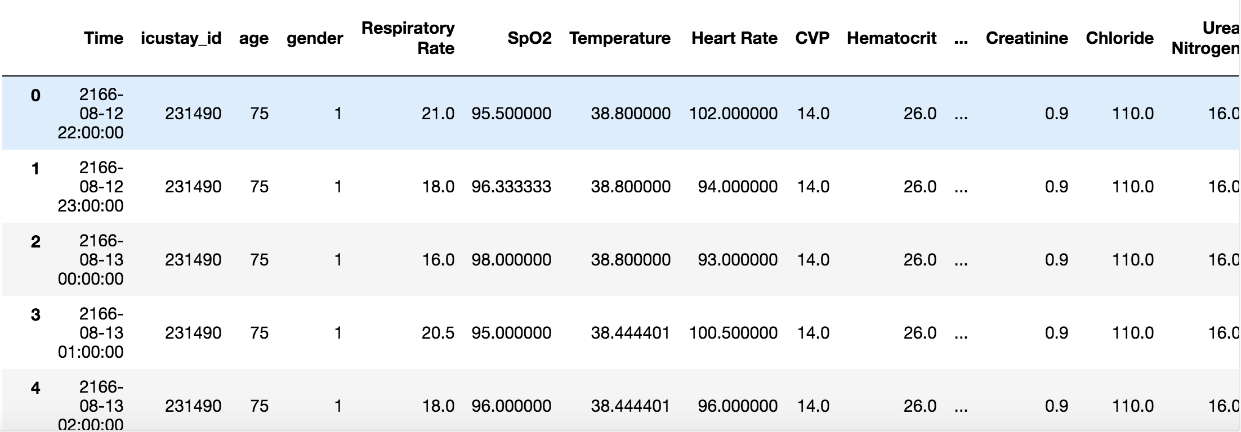
Data preprocessing
For each selected patients, extract the data from the database and generate a time series table. It takes about one second for each patient after optimizing the algorithms.
Fill the missing fields.

Slide 8
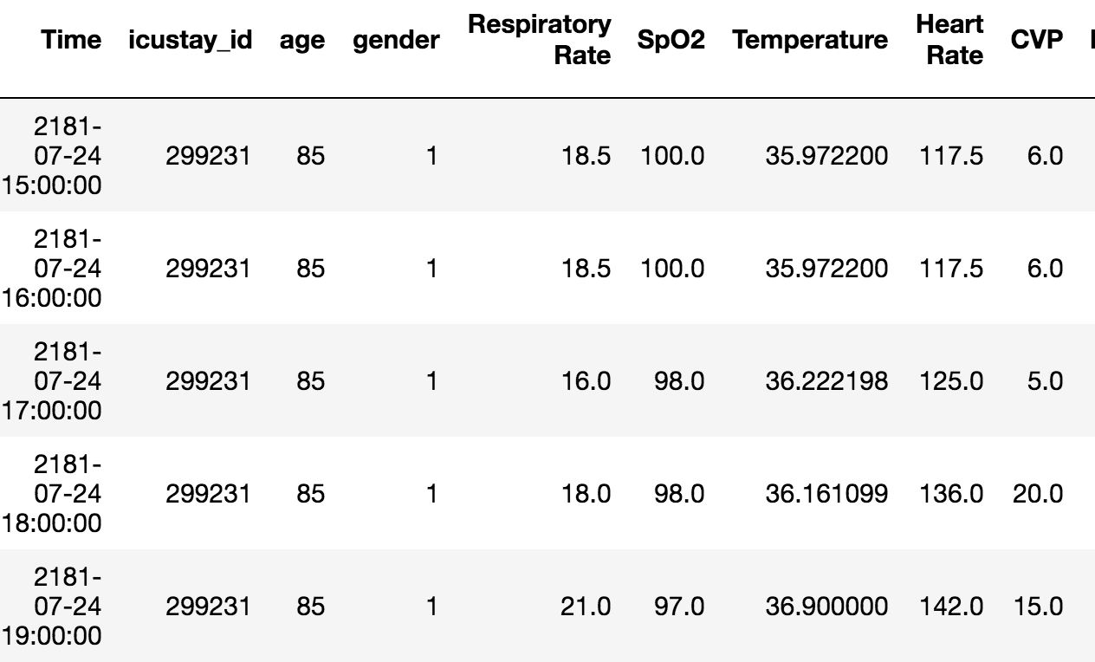
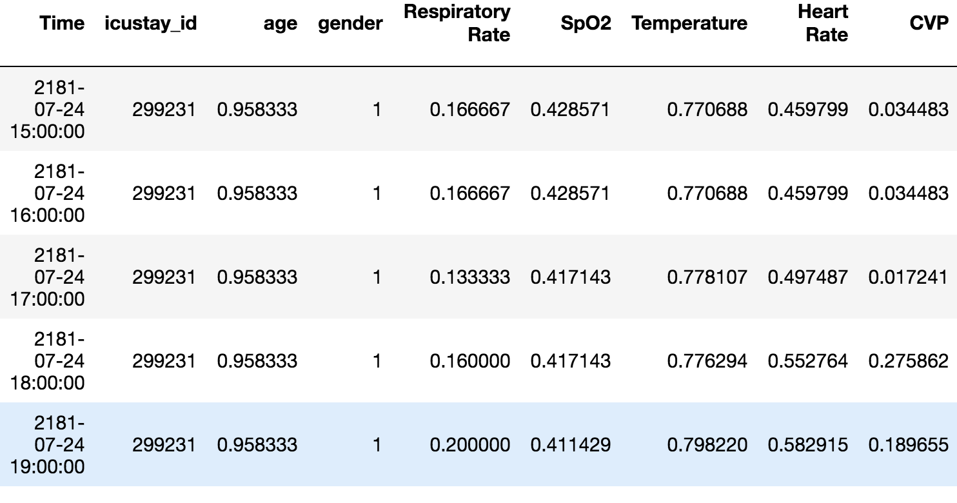
Data preprocessing
Data Normalization: Make sure values of all features are on a similar scale (0-1). It also makes it easier to plot different features against time.

Slide 9
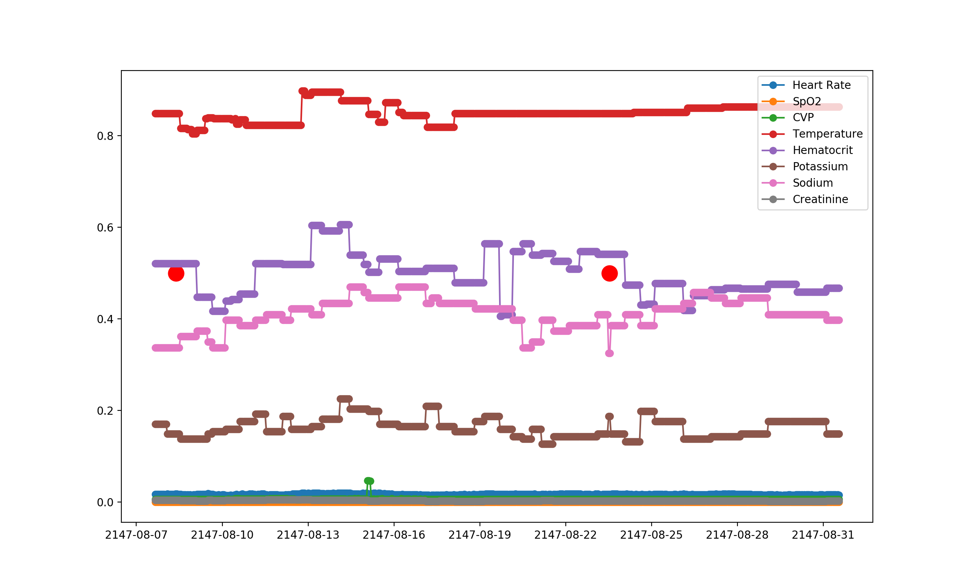
Data preprocessing
Handling the wrong values

Slide 10
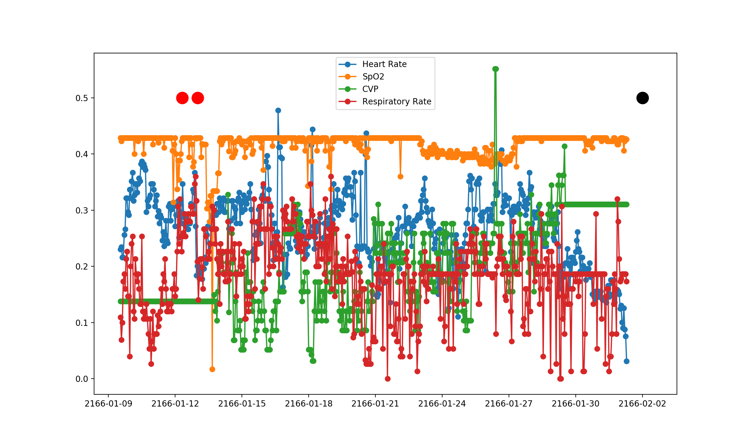
Data visualization
I built a tool using python to plot the time series data of a certain patient:

Slide 11
Data modelling
Deep Neural Network:

Slide 12
Data modelling
Deep Neural Network: Hard to increase the accuracy beyond 0.6

Slide 13
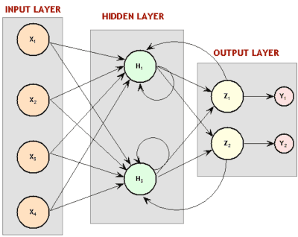
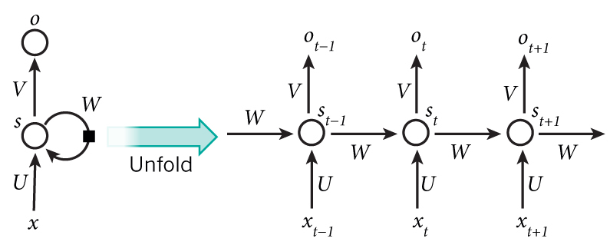
Next step: data modeling
Recurrent Neural Networks (RNN):

Slide 14
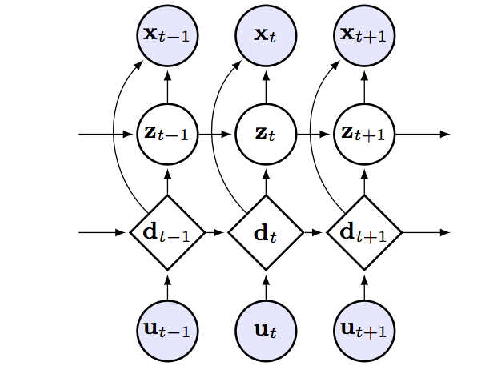
Next step: data modeling
Stochastic Recurrent Neural Networks:

