Slide 1
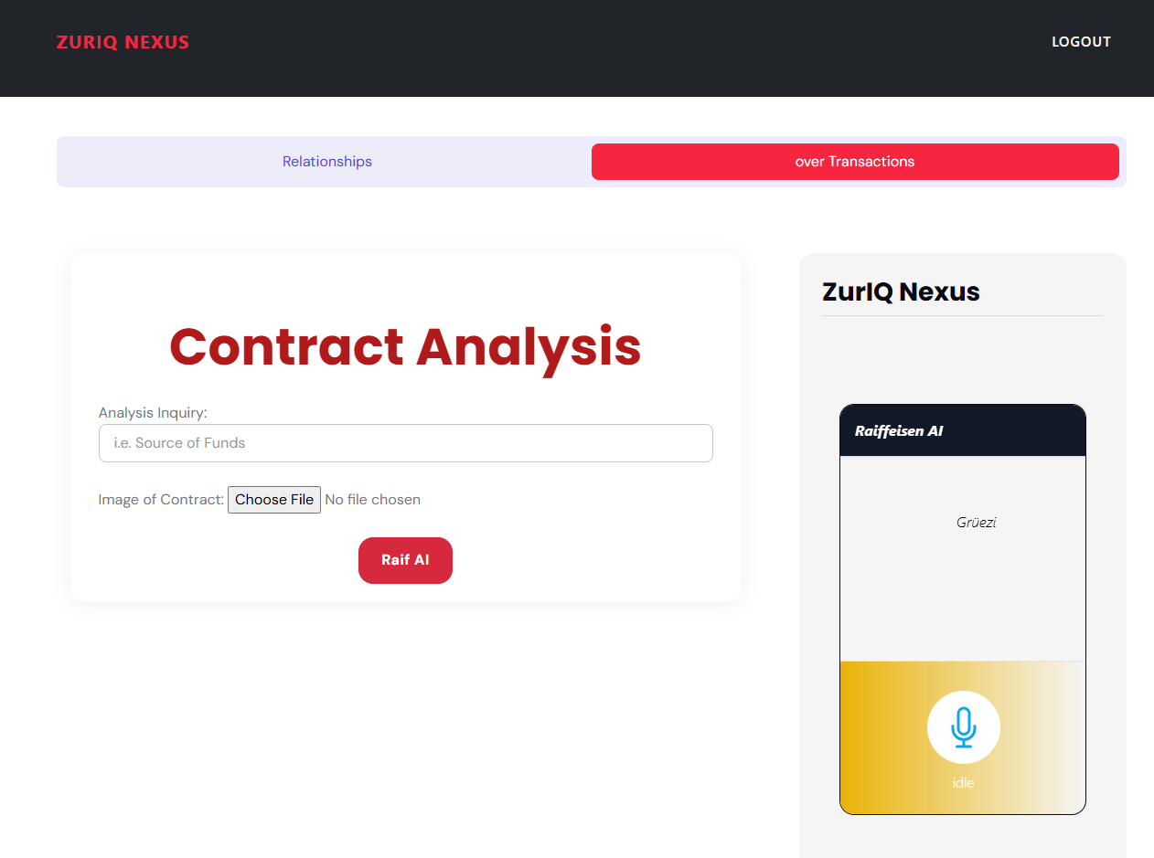

The new client gave me a 500 page trust document
our onboarding meeting is for only 1 hour!

Slide 2
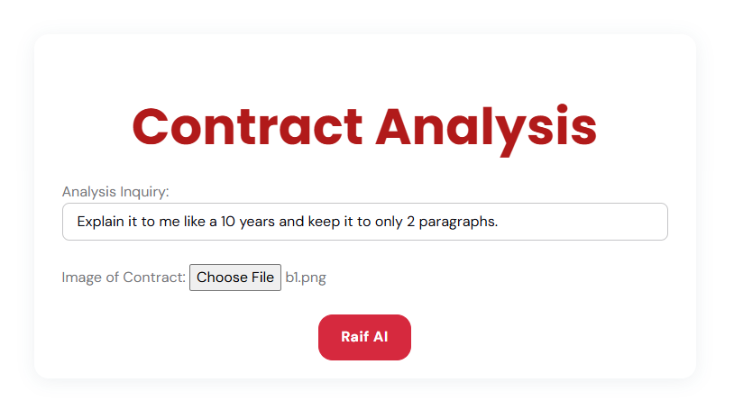
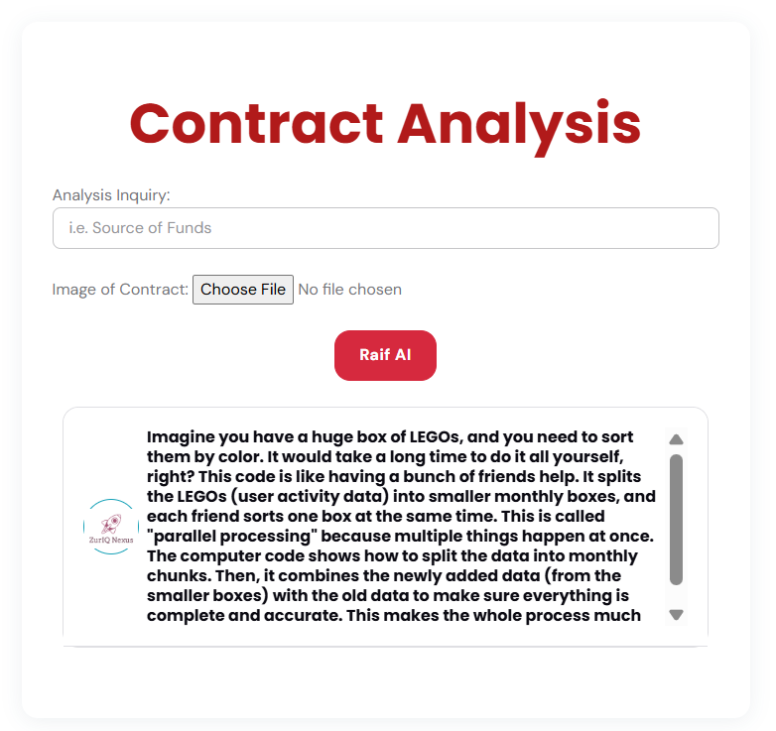
ZurIQ to the Rescue!

Slide 3
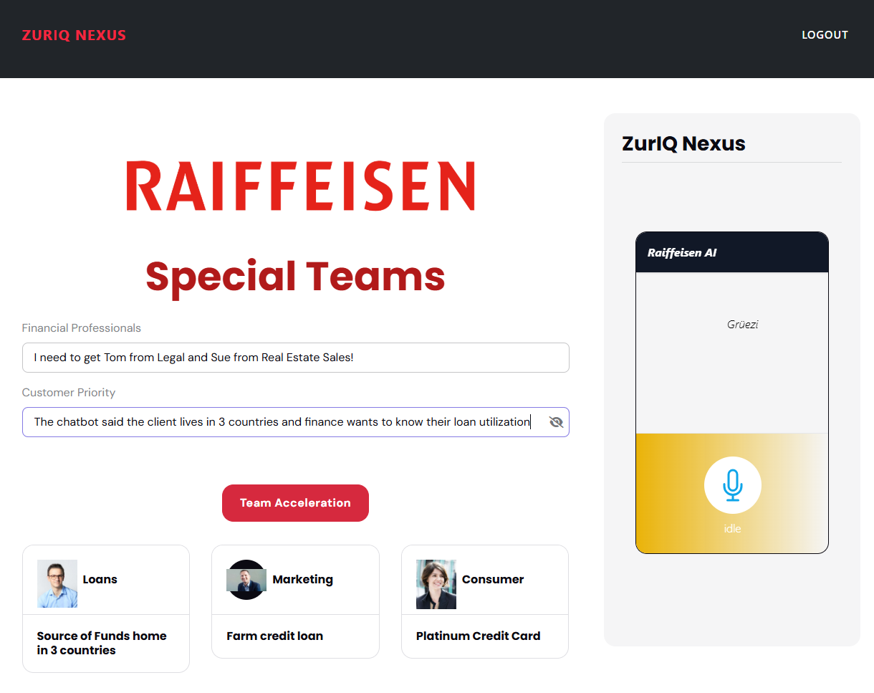
Stronger Together.

Slide 4
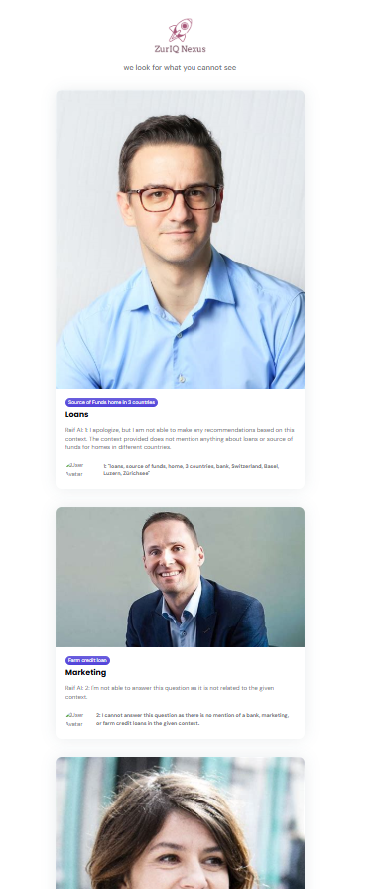
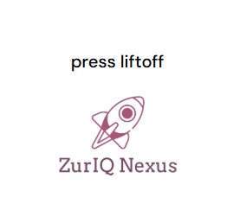
All you need is ZurIQ
Tom from Legal said to look into source of funds at Luzern and Basel branches in trust.
Marius from Marketing notice Farm in trust to A/B Test for mailer with 30% interest margins.
Sue from Real Estate Loans says look into domicile of trust for load qua

