Slide 1


Time Division Multiplexing based Direct Current Control of a Series-End-Winding Permanent Magnet Synchronous Motor
בקרת זרם ישירה למנוע סינכרוני עם מגנט קבוע בחיבור Series-End, המבוססת על אלגוריתם ריבוב חלוקת זמן - TDM
Dr. Eli Barbie
Shamoon College of Engineering
Dr. Dimitry Baimel
Shamoon College of Engineering

Slide 2
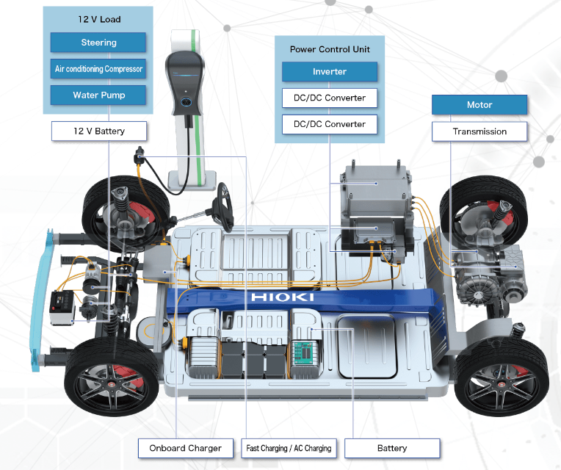
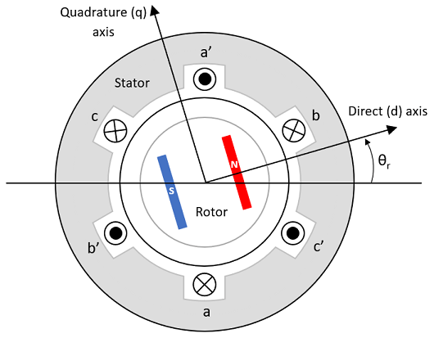
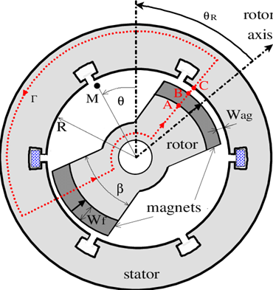
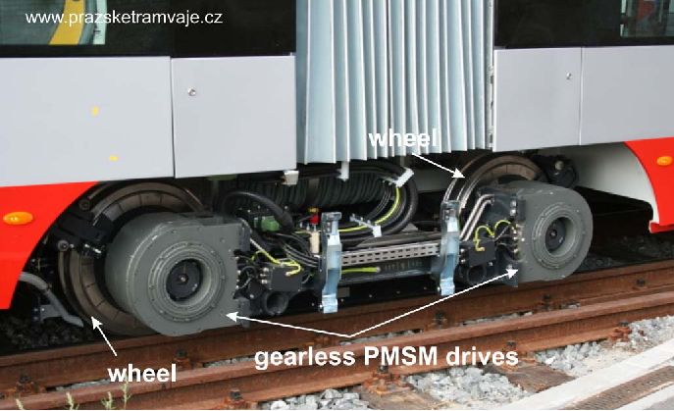


Permanent Magnet Synchronous Motor (PMSM)
Pros :
Higher Efficiency (85% +, no rotor losses).
Accurate Speed/Position control.
Reduced Size and Weight (High Power Density).
Lower noise and heat generation (no slip rings).
Low maintenance.
Can serve as a synchronous generator.

Slide 3
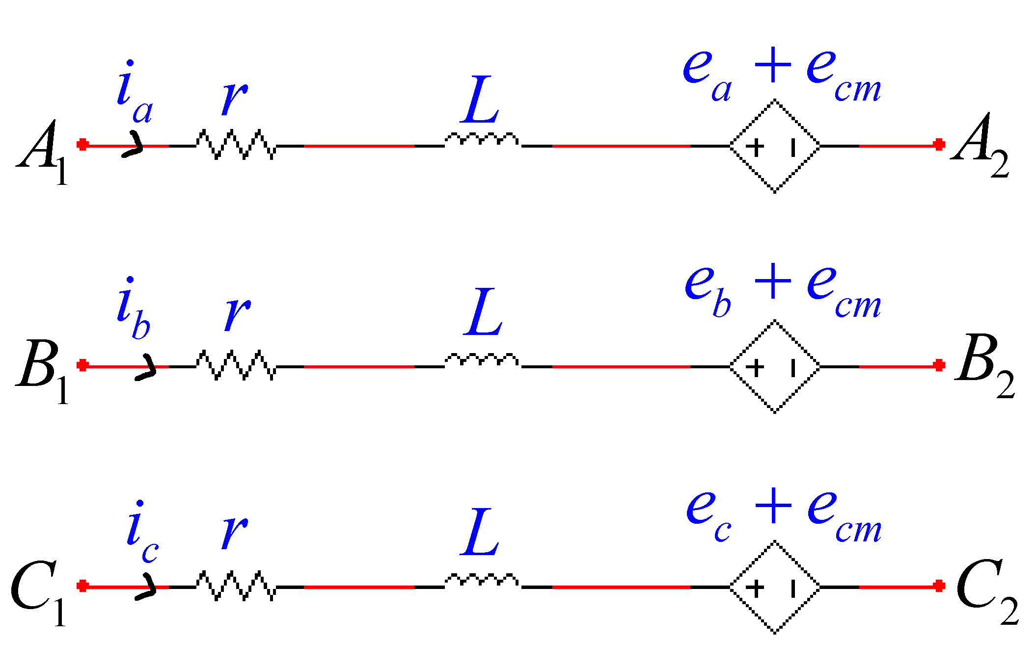
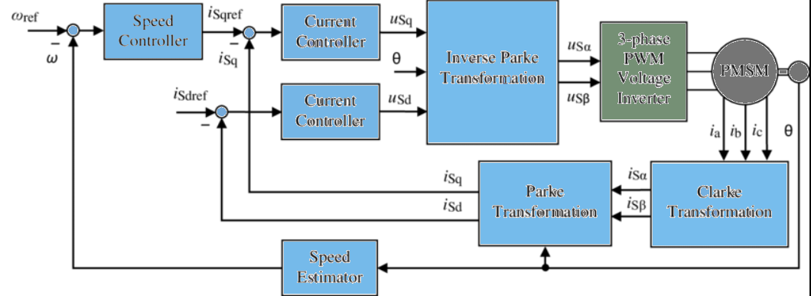
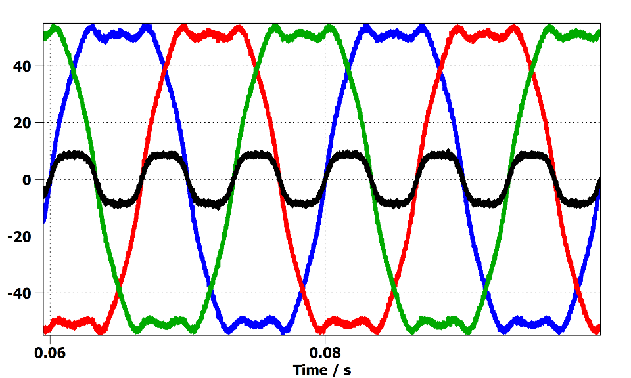
Permanent Magnet Synchronous Motor (PMSM)
Cons :
Salient Pole (surface mount magnets)
Stator equivalent model (3rd harmonic CMV)
Expensive (rare-earth magnets).
Back EMF harmonics and zero-sequence currents.
Open-Winding operation required for optimal power density.
Complex Control algorithms (DTC or FOC required).
Control Block Diagram (FOC)
Typical Back-EMF and CM Voltage

Slide 4
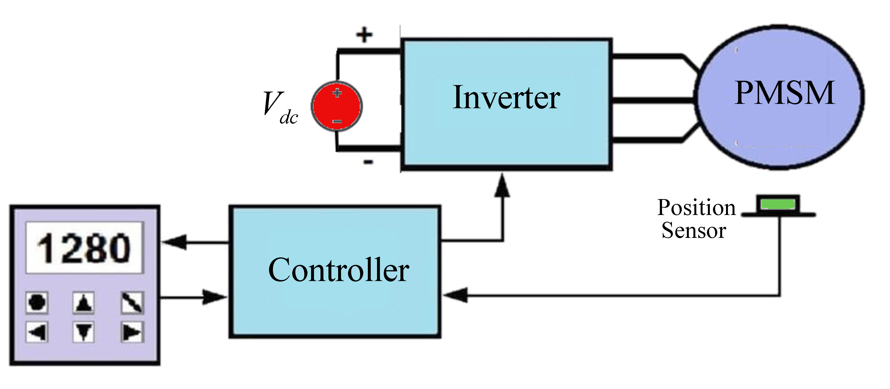
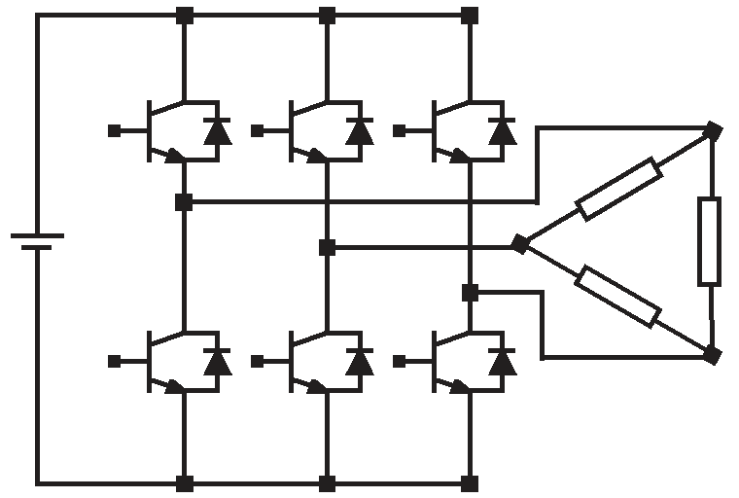
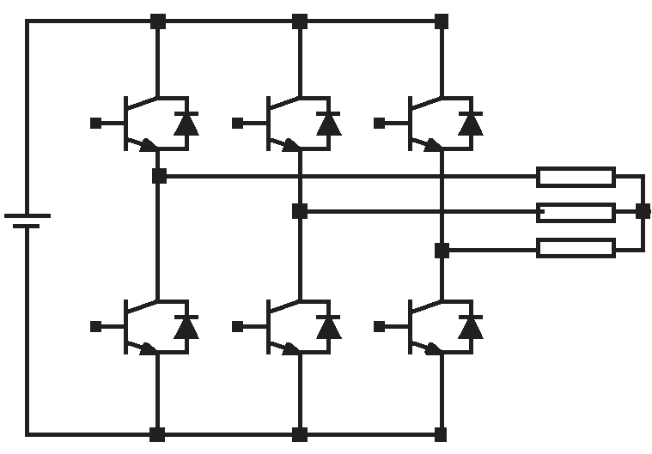
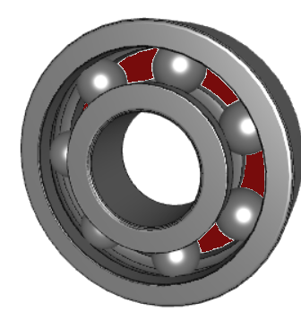



PMSM Drives
PMSM Drive System’s Objectives :
Cost Effective.
Optimal DC Source Utilization
High Efficiency.
Low Current THD.
Low Torque Ripple.
Zero Sequence Current Suppression.
3-Leg VSI + Delta-connected PMSM
3-Leg VSI + Star-connected PMSM
ZSC Mitigation NOT feasible
Full DCS Utilization NOT feasible

Slide 5
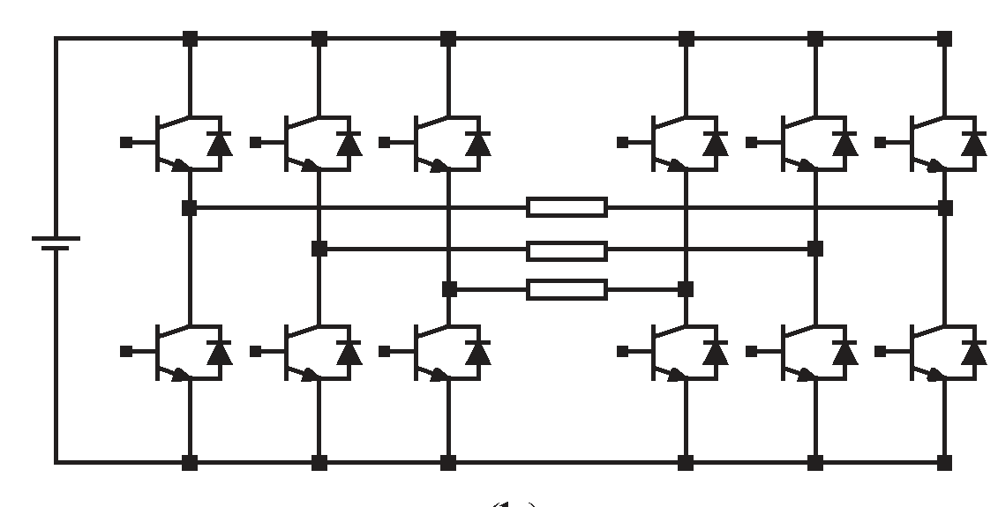
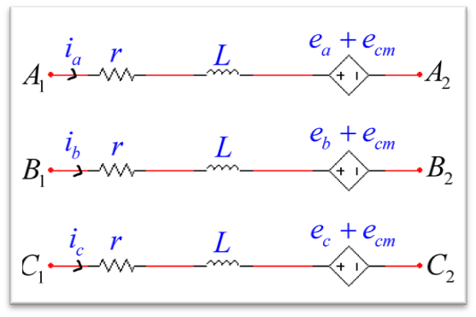
PMSM Drives: Open-Winding VSI
6-Leg VSI + Open-Winding PMSM
Optimal DC Source Utilization
Low Current THD.
Low Torque Ripple.
Expensive (6 legs vs 3)
Inadequate Zero Sequence Current Suppression.

Slide 6
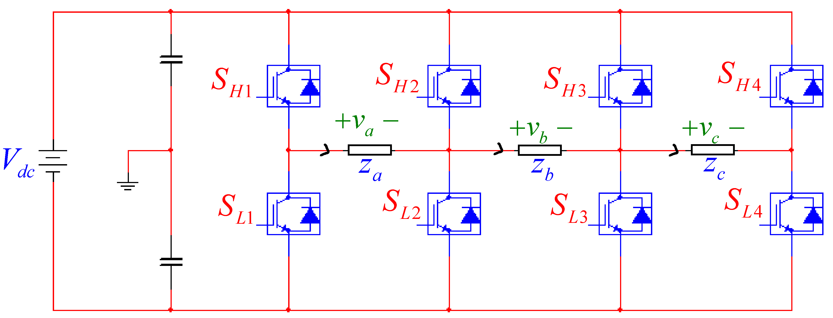
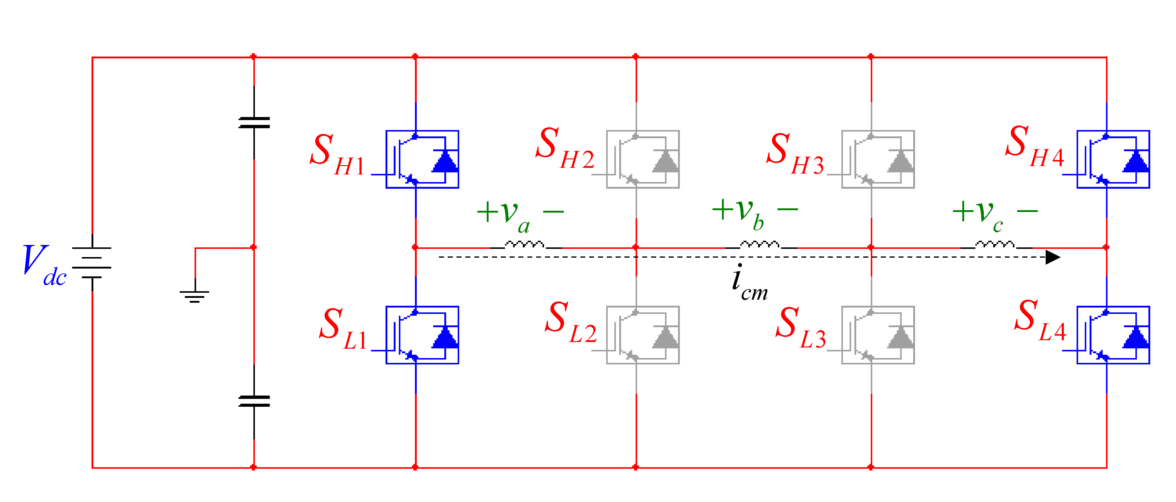
PMSM Drives: Series-End VSI
4-Leg VSI + Series-End-Winding PMSM
Series-End VSI:
Cost Effective.
Optimal DC Source Utilization
Low Current THD.
Zero Sequence Current Suppression.

Slide 7
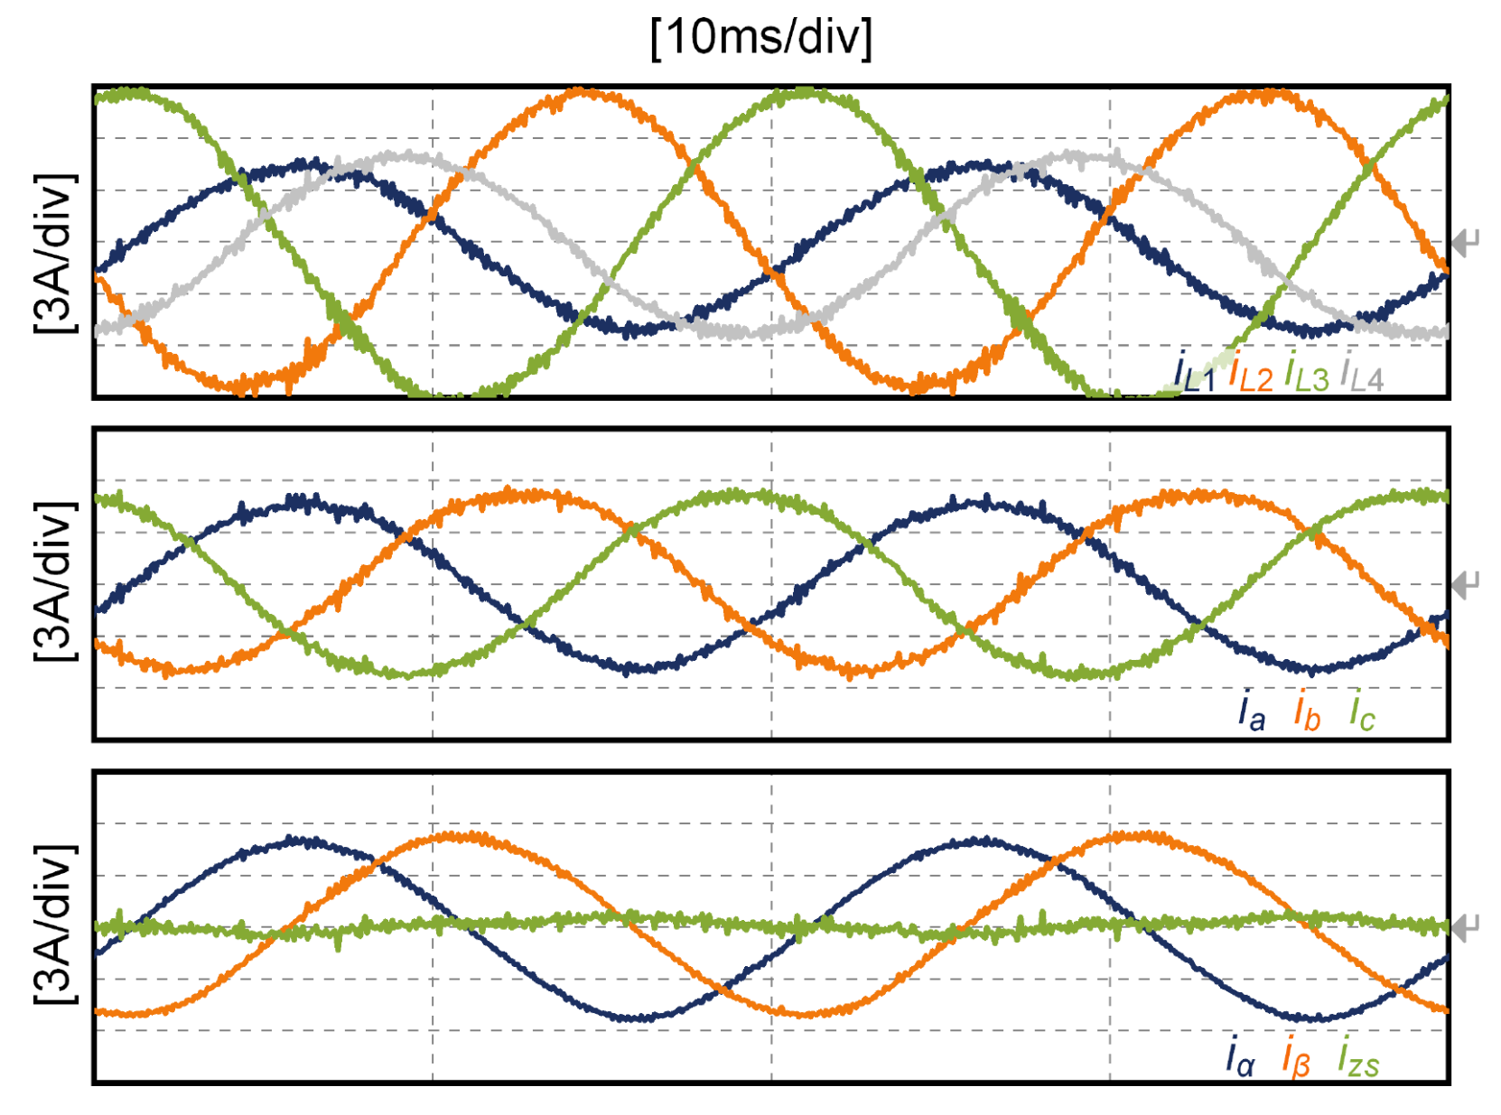
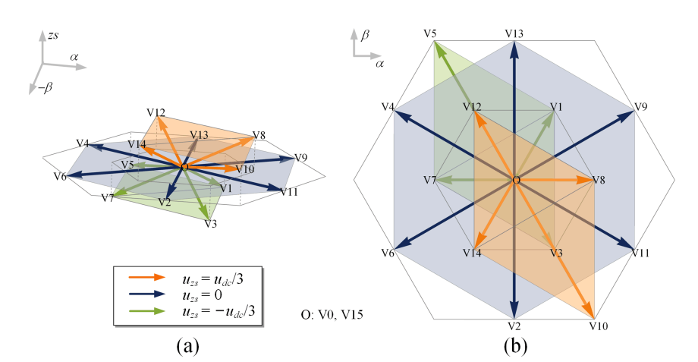
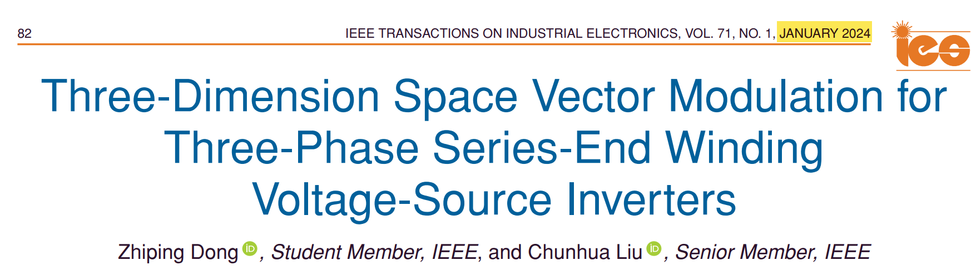
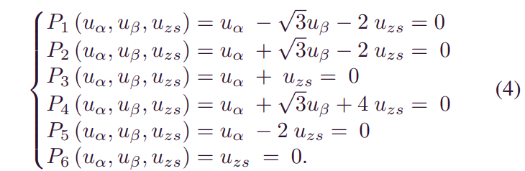
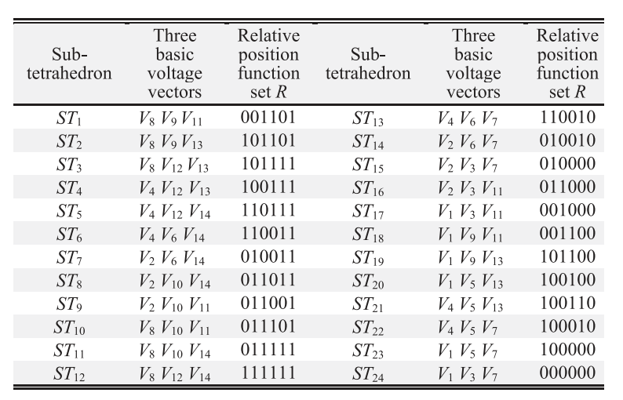
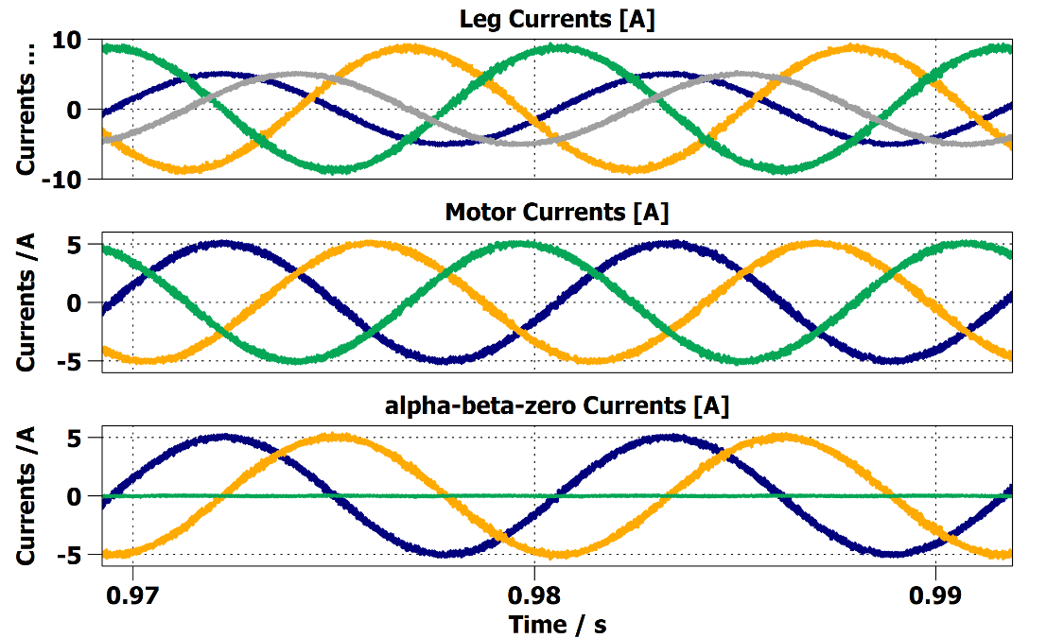
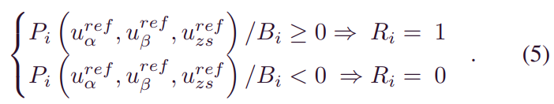
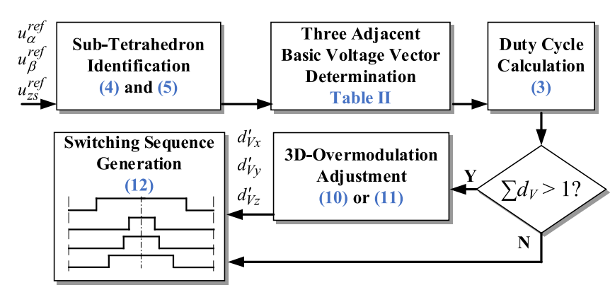
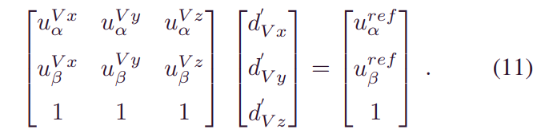
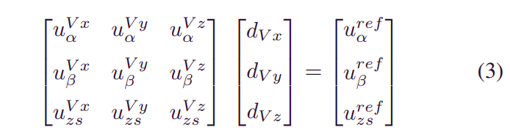
PMSM Drives: Series-End VSI
Existing Control Solutions

Slide 8
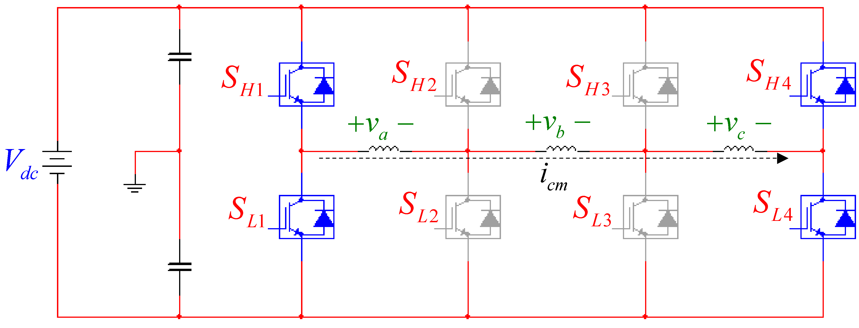
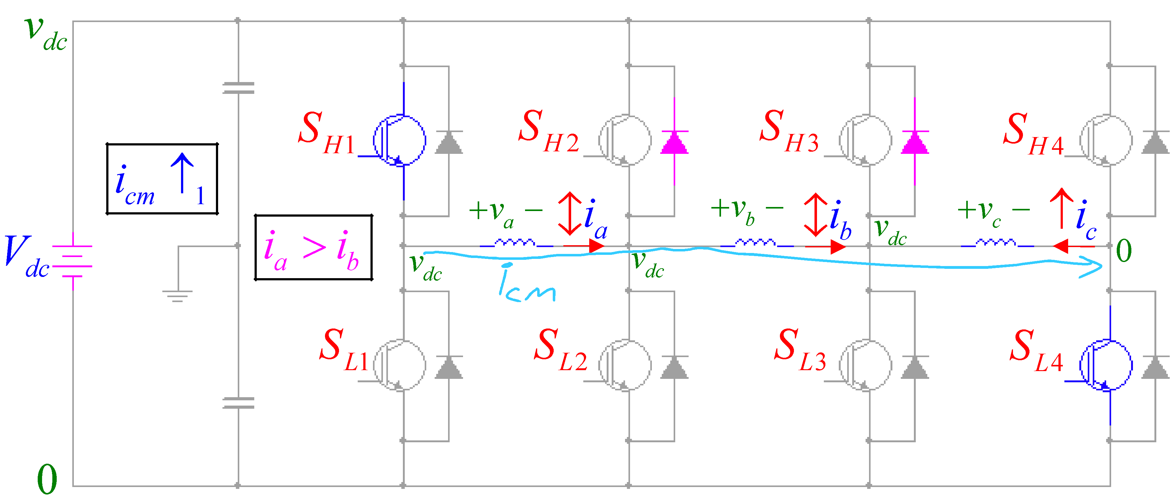
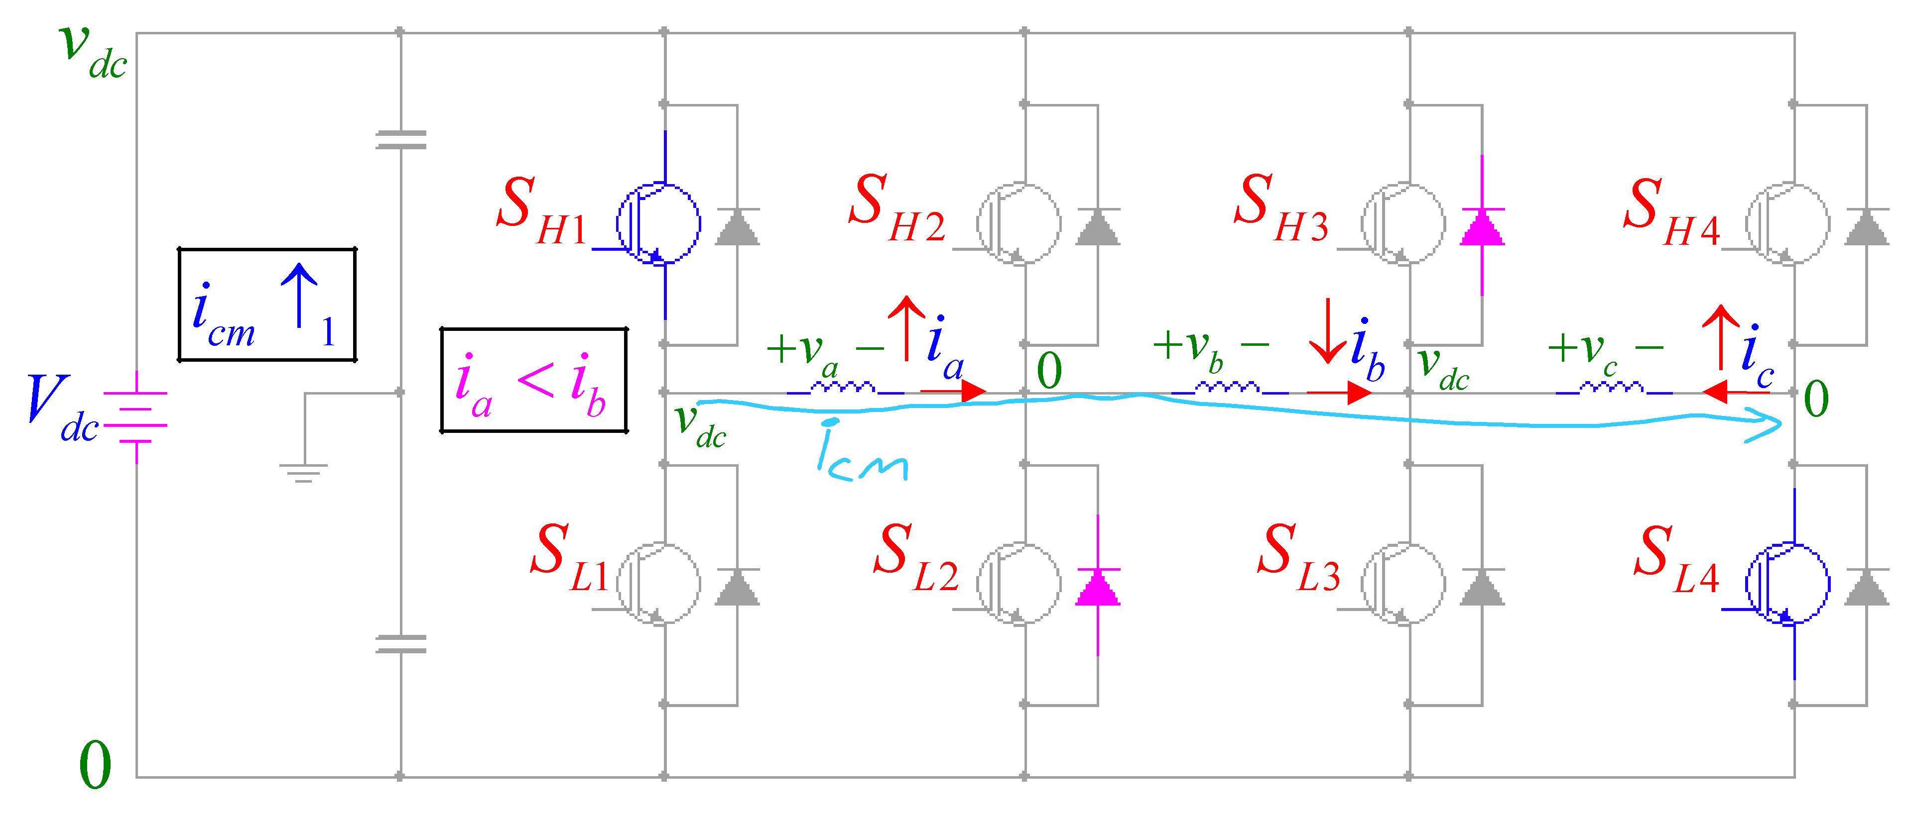
Series-End VSI Control Challenges
Stator Model:
Series-End VSI:
Only one phase can be corrected for ZSC at a time!
Adverse Impact on Phase Currents

Slide 9
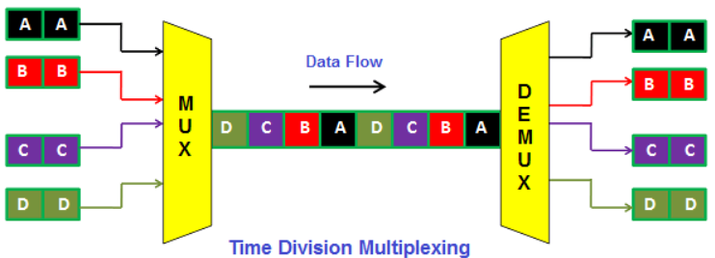
Solution: TDM-based Series-End VSI Control
Stator Model:
Series-End VSI:
Current Component Decupling

Slide 10
TDM-based Series-End VSI Control
Control Objectives:
Series-End VSI:
6 Errors in total:
Common Mode Errors:
Differential Mode Errors:

Slide 11
TDM-based Series-End VSI Control
Per-Phase Errors (6 to 3 error reduction - compare-swap)
Series-End VSI:
Error Priority determination:

Slide 12
TDM-based Series-End VSI Control
Series-End VSI:
Per-Leg Lookup Table:
What cannot be corrected is preserved (by applying zero voltage to the discarded phase)

Slide 13
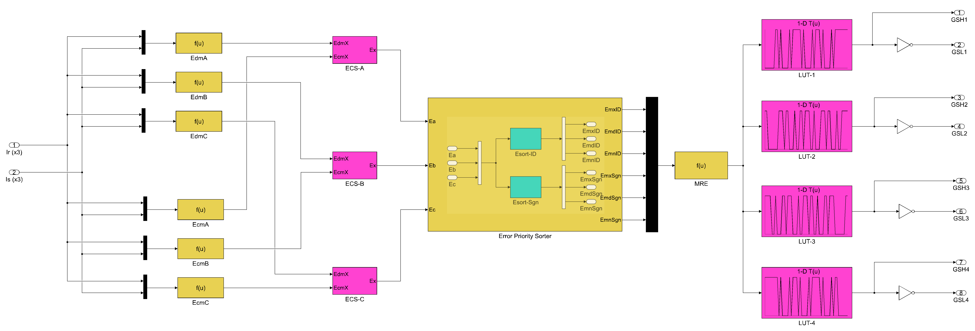
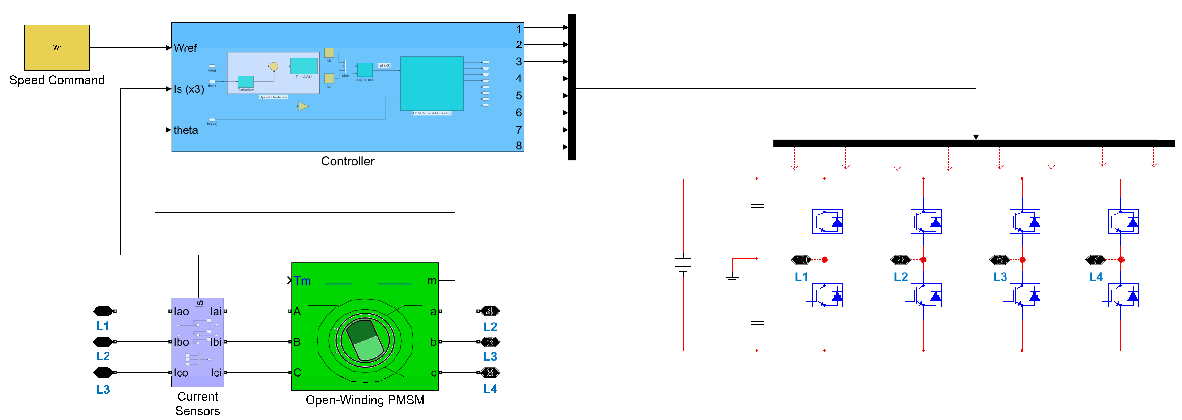
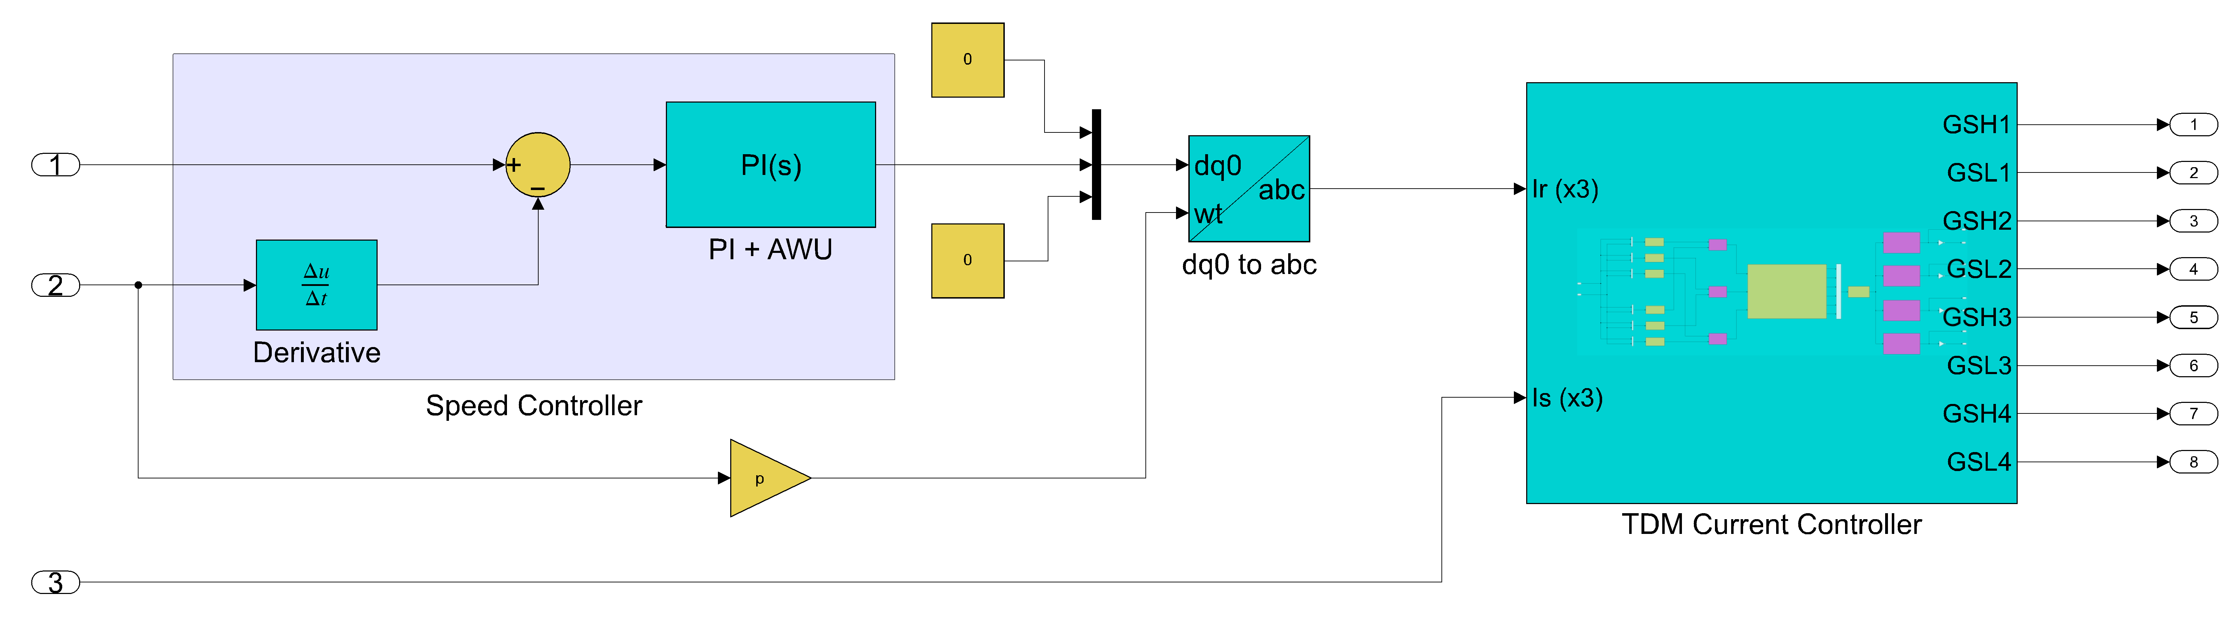
TDM-based FOC Controller
Main Block Diagram:
Current TDM Loop
Speed PI Loop

Slide 14
TDM-based FOC Controller
Main Block Diagram:

Slide 15
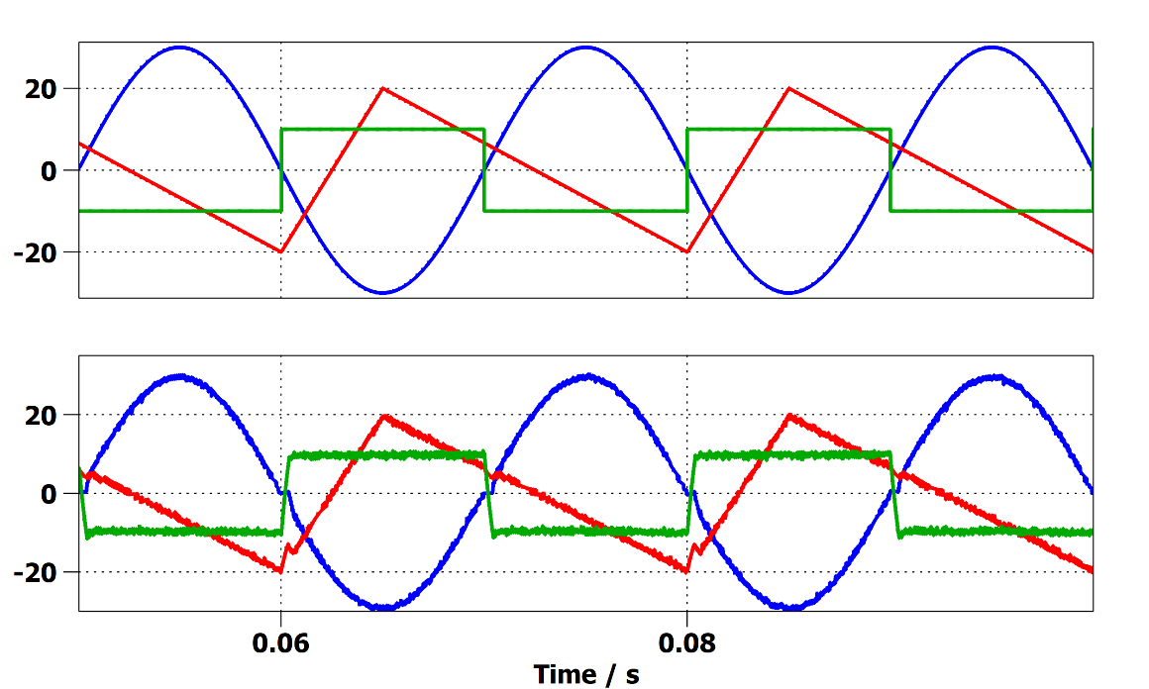
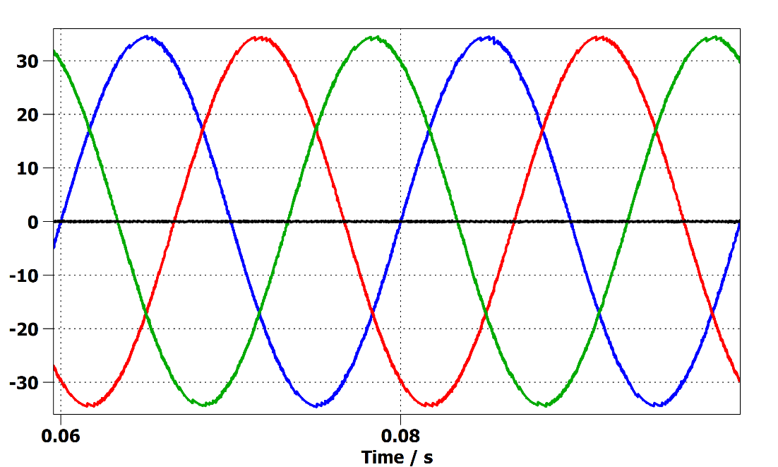
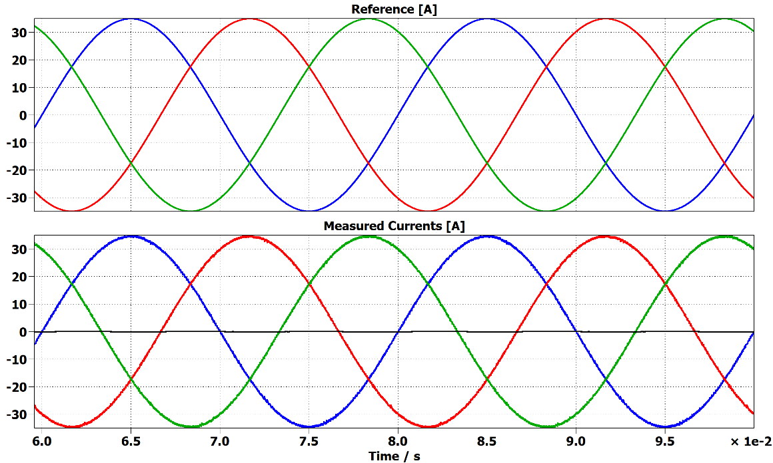
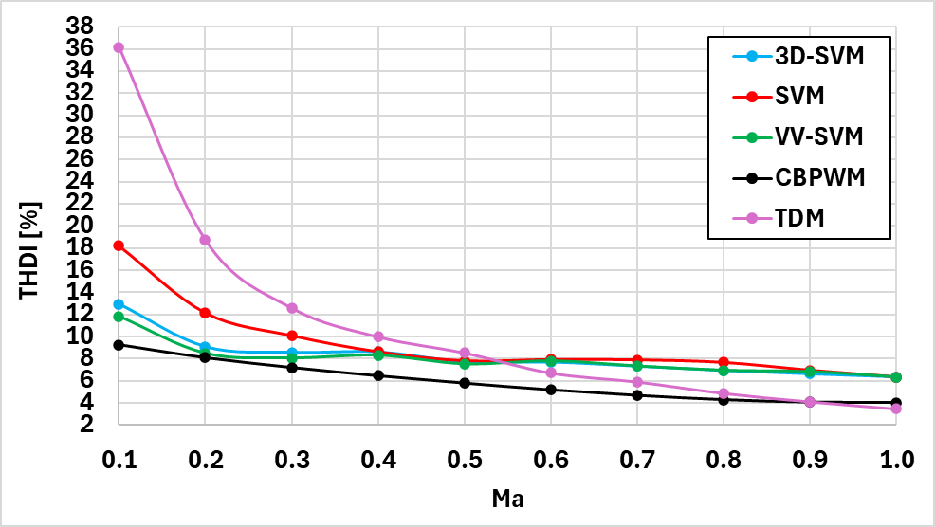
Validation and Simulation Results
Non-sinusoidal currents test (Ecm = 0):
Current THD RLE load (Ecm = 0.2Vdc)
RL Load test (Ecm = 0):
Current THD Comparison (fmax = 5kHz)

Slide 16
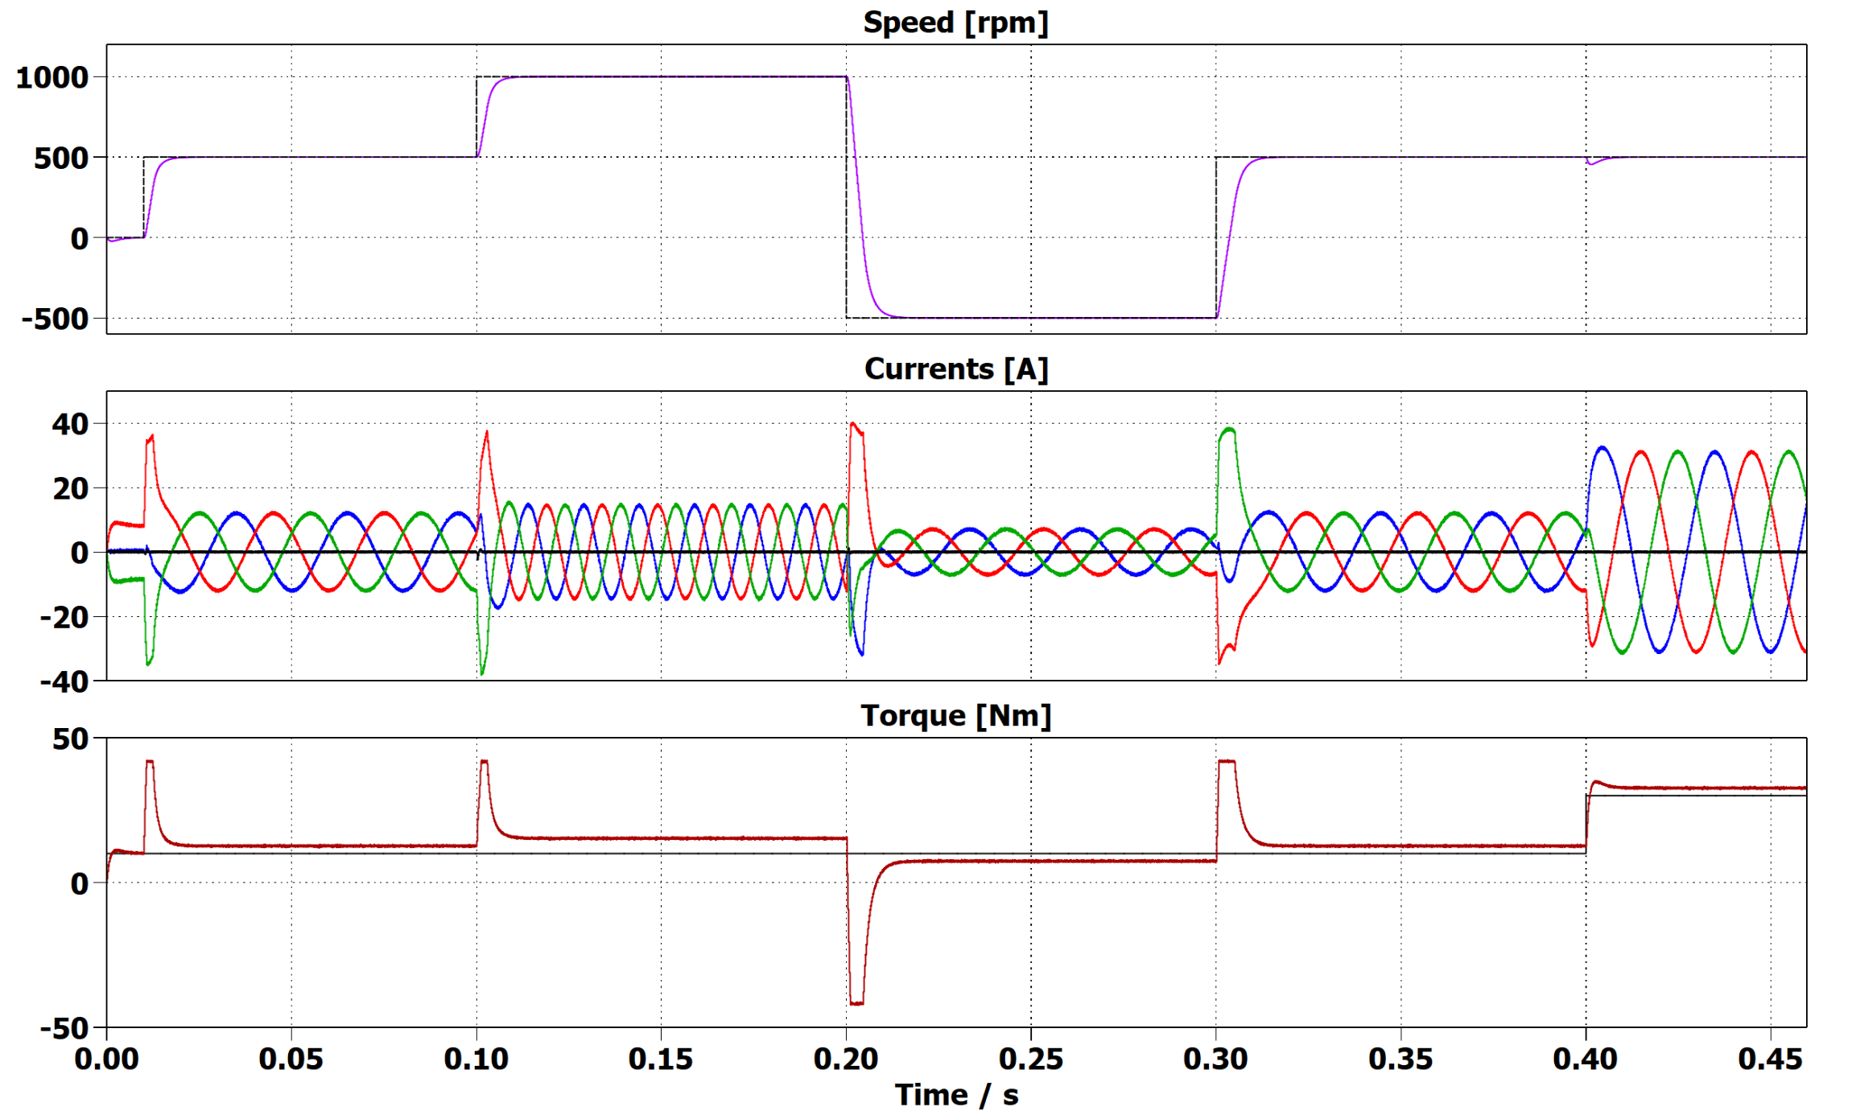
Validation and Simulation Results
PMSM Control test:
Speed Command Change
Low Torque Ripple
Load Torque Change

Slide 17
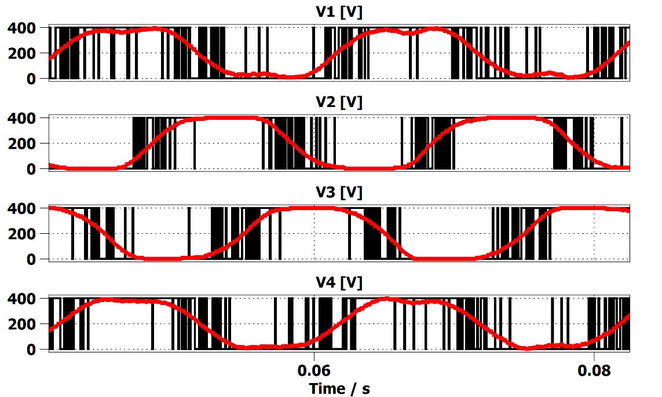
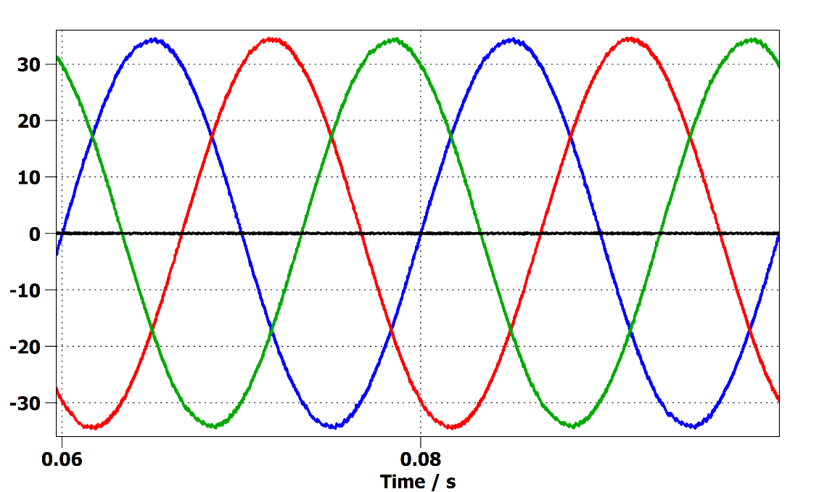
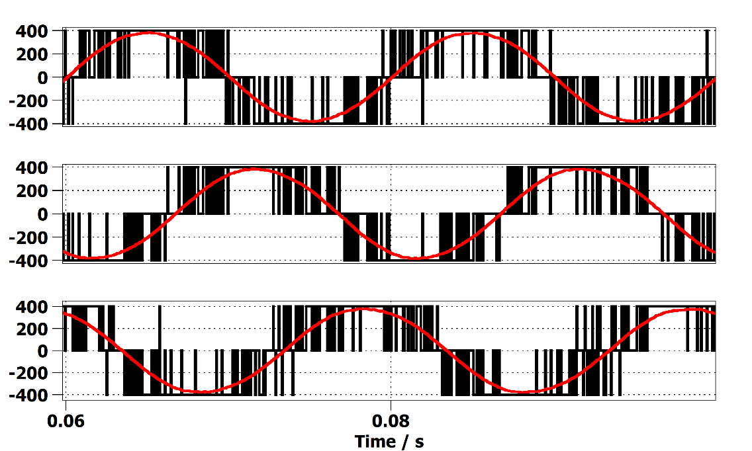
Validation and Simulation Results
Leg Voltages and Cycle averages
Phase Currents
Phase Voltages
Full DC Source Utilization (Ma = 1.0)

Slide 18
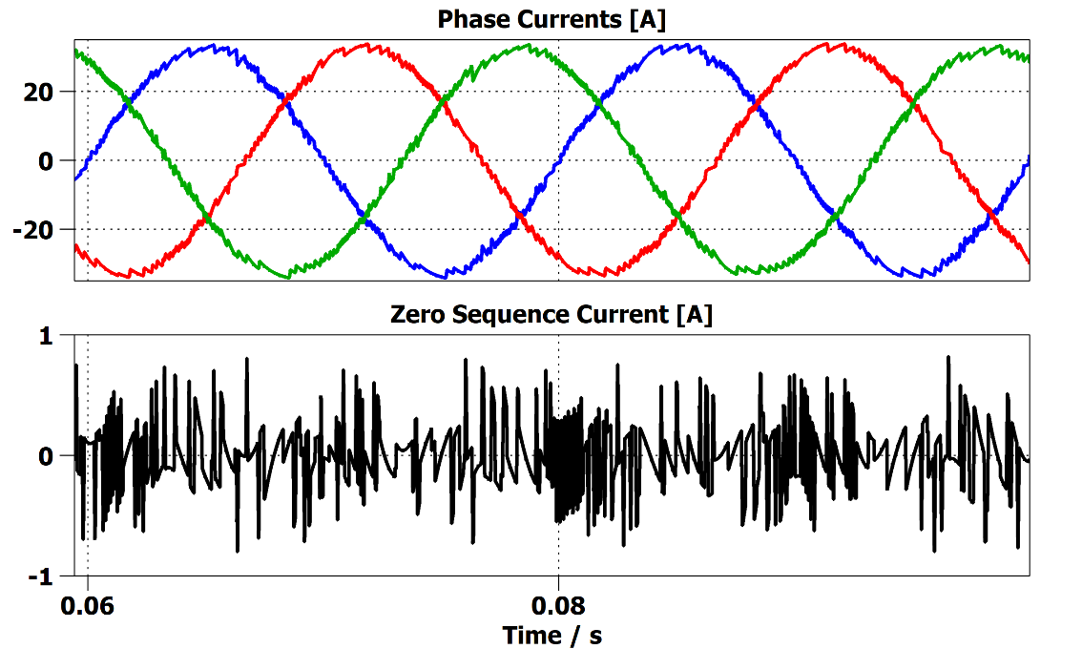
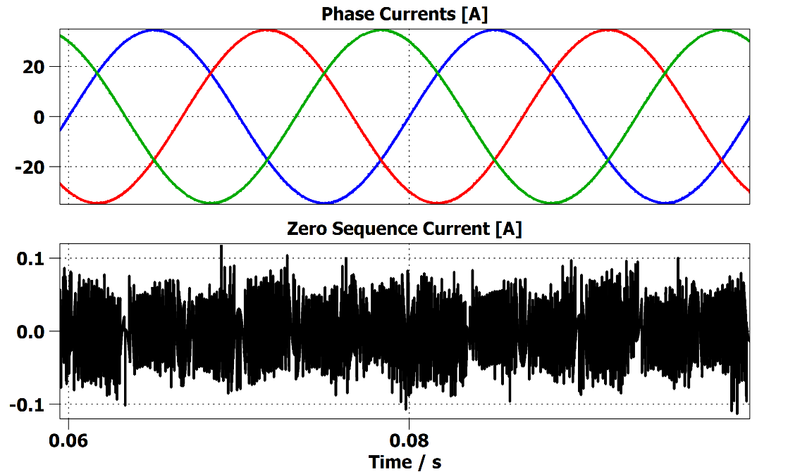
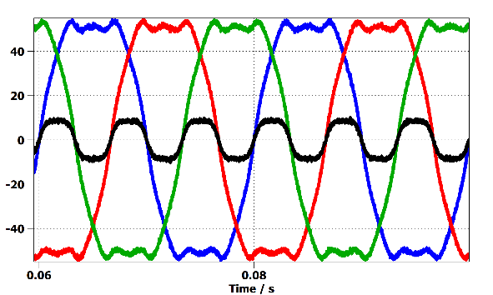
Validation and Simulation Results
Max Switching Frequency Impact
Back EMF with CMV

Slide 19
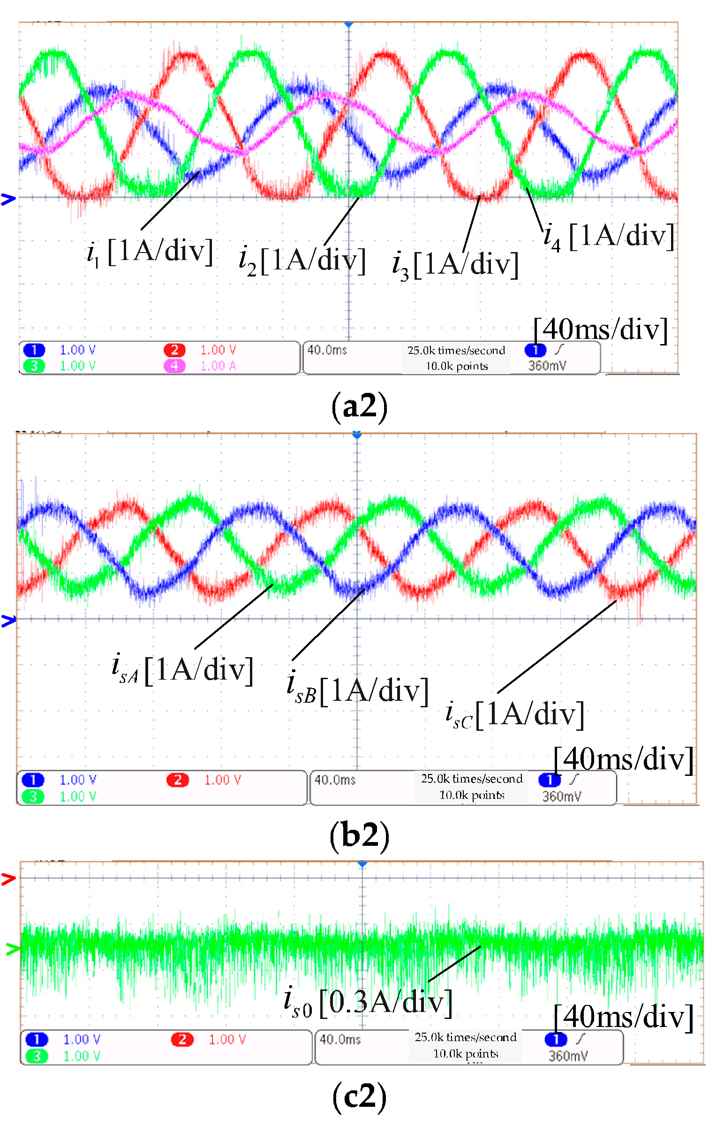
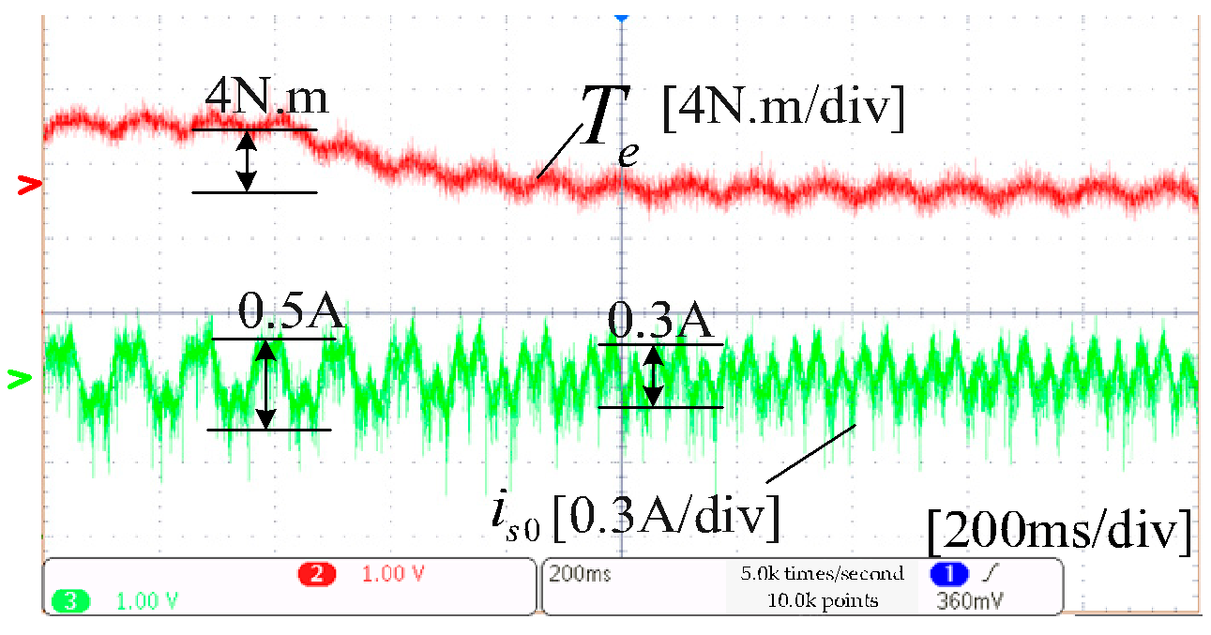
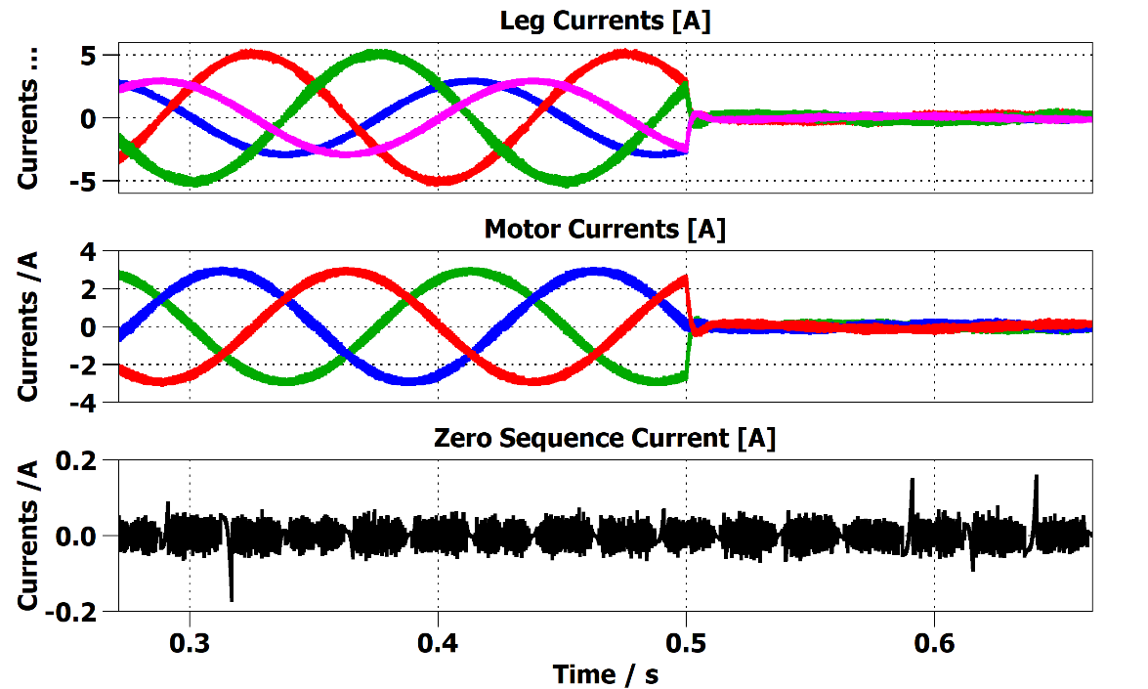

Validation and Simulation Results
3D-SVM
Virtual Vectors SVM
Leg Currents
Phase Currents
Zero Currents
TDM
TDM

Slide 20
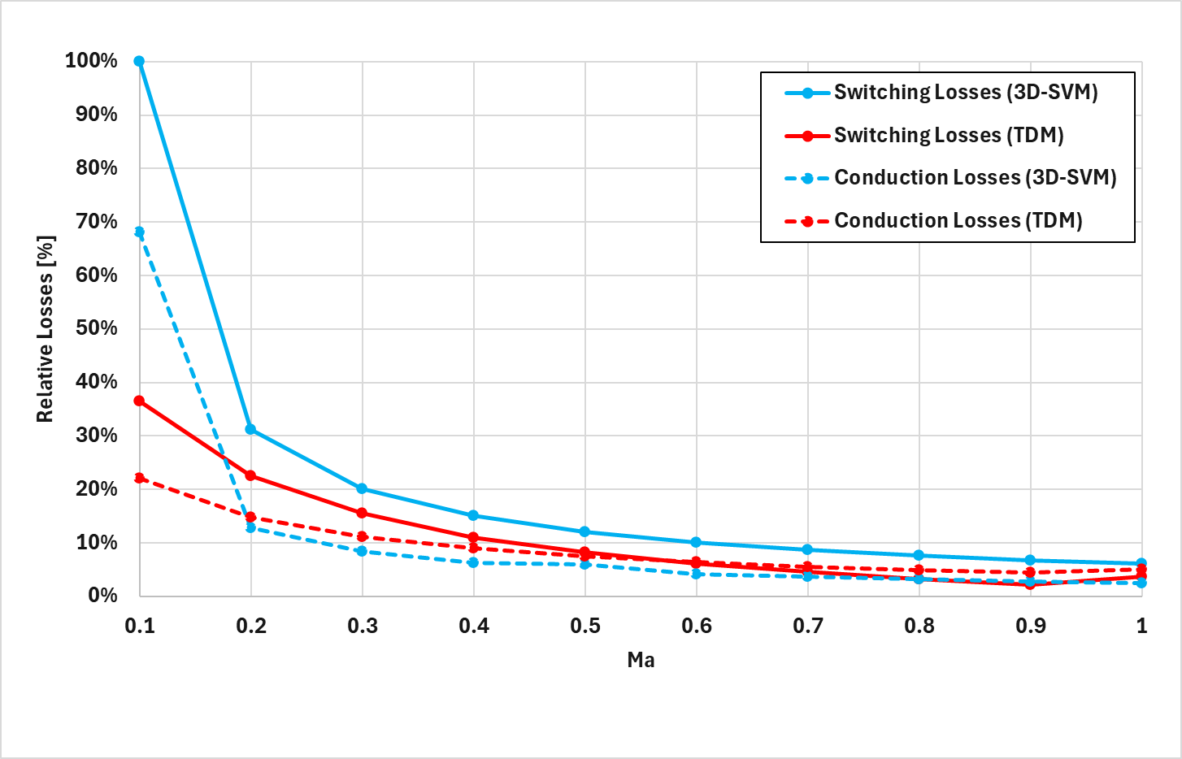
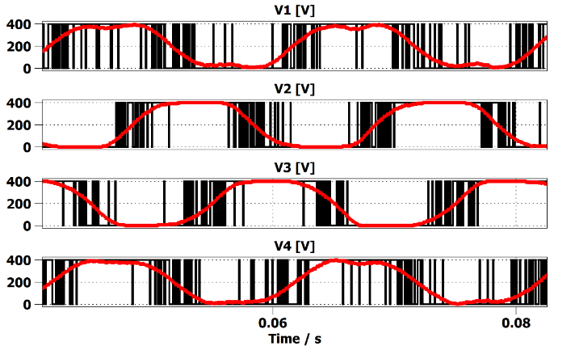
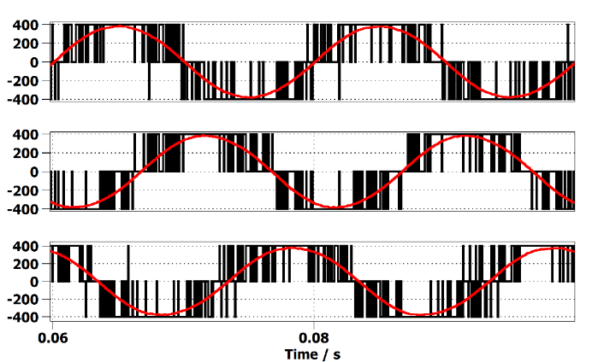
Validation and Simulation Results
Power Losses Comparisons
Switching Losses 3D-SVM
Conduction Losses 3D-SVM
Switching Losses TDM
Conduction Losses TDM

Slide 21
Summary
TDM Advantages:
Simple Look-Up Table Control Approach with minimal computational burden
Optimal DC Source Utilization Feasibility
Improved Efficiency (lower switching frequency required, minimal conduction loss impact)
Better Current THD at medium-high currents.
Excellent Sequence Current Suppression capability.
Low Torque Ripple.

Slide 22

Questions?
eliba@sce.ac.il

