Slide 1
ADVANCED MOTOR DRIVES & HARDWARE VALIDATION
Hardware-Efficient Optimal Error-Priority Control for Series-End VSI With ZSC Suppression
בקרת זרם אופטימלית מבוססת תעדוף שגיאה (OEPC) לממיר Series-End VSI עבור מנועי PMSM ודיכוי זרמי סדרה אפס
Dr. Eli Gad Barbie
✦ Project Supervisor & Senior Lecturer
✦ Dept. of Electrical & Electronics
✦ Shamoon College of Engineering
Maxim Radkin
✦ M.Sc. Candidate
✦ Dept. of Electrical & Electronics
✦ Shamoon College of Engineering
Prof. Dmitry Baimel
✦ Senior Member, IEEE
✦ Dept. of Electrical & Electronics
✦ Shamoon College of Engineering

Slide 2
METHODOLOGY EVOLUTION
Evolution: From Single-Error TDM to Multi-Objective OEPC
⏳ Classical TDM Approach (Time Division Multiplexing)
✦ Single Error Focus: TDM corrects only the single prime error at each switching cycle.
✦ Sequential Round-Robin: Cycles through phases one-by-one, discarding potential secondary corrections.
✦ Preservation Policy: Applies zero-voltage self-circulation to non-prime phases to avoid error deterioration.
בשיטת TDM מתקנים שגיאה קריטית אחת בלבד בכל מחזור מיתוג.
🚀 Proposed OEPC Strategy (Optimal Error-Priority Control)
✦ Multi-Objective Optimality: Actively attempts to correct as many phase errors and ZSC components simultaneously as feasible.
✦ Deterministic 96-Entry LUT: 7-bit error signature maps directly to optimal switching states in < 1.75 µs.
✦ Dynamic Error-Mode Predominance: Dynamically balances differential phase currents and common-mode ZSC suppression.
בשיטת OEPC מנתחים את כל 6 השגיאות ומתקנים מקסימום שגיאות בו-זמנית לפי סדר עדיפויות דטרמיניסטי.

Slide 3
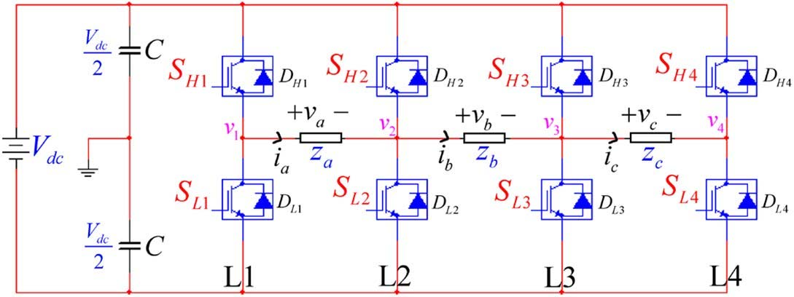
SYSTEM TOPOLOGY & MODELING
Series-End VSI Architecture & Zero-Sequence Current (ZSC)
4-Leg Series-End VSI Characteristics
✦ Optimal DC-Bus Utilization: Delivers Ma = 1.0 (identical to dual-inverter setups) with only 4 legs (8 switches vs 12).
✦ Open-Winding PMSM: Significantly enhances machine power density and dynamic torque response.
✦ Hardware Realization (Altium Design): Physically built using custom GaN switches (Power_Swech - GUN_ V2) and floating current sensors (Isolated_Current_Sensor _V2_1).
✦ ZSC Mitigation Challenge: Absence of floating neutral creates closed ZSC path via outer legs 1 and 4.
✦ Inter-Phase Coupling: Leg 4 switching impacts all 3 phase currents simultaneously.

Slide 4
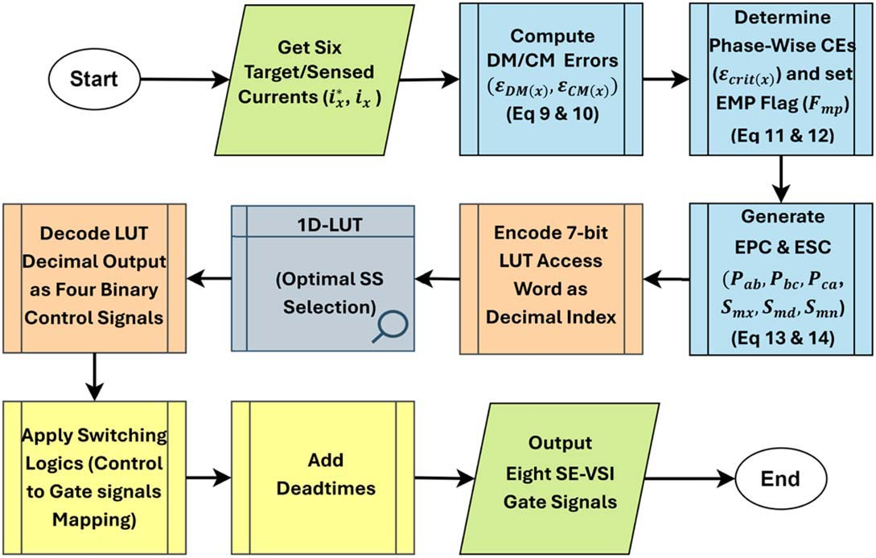
CONTROL ALGORITHM
Error-Priority Processing & 7-Bit LUT Signature
Deterministic ABC Coordinate Processing
✦ 6 Current Errors: 3 Differential-Mode (DM) + 3 Common-Mode (CM) errors calculated directly.
✦ Critical Error Selection: Pairwise comparison selects the dominant error per phase.
✦ Error Mode Predominance (EMP / Fmp): Determines whether CM (ZSC) or DM (phase currents) dominates.
✦ Error Priority Code (EPC): 3-bit magnitude hierarchy of phase errors.
✦ Error Signs Code (ESC): 3-bit polarity representation (+/-).
חישוב לוגי ישיר בקואורדינטות ABC המפיק כתובת בת 7 ביטים לטבלת LUT קומפקטית ללא התמרות צירים.

Slide 5
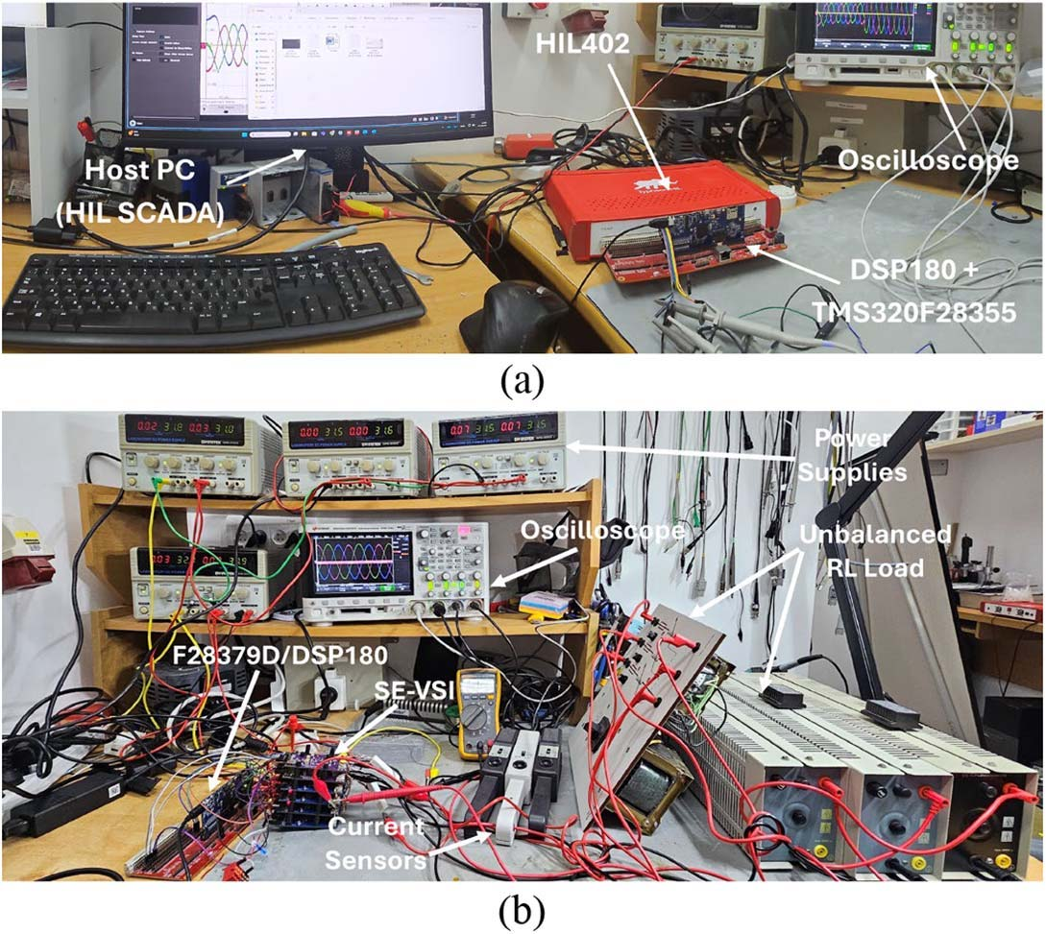
VALIDATION & REAL-TIME HIL
Typhoon Controller-Hardware-In-the-Loop (C-HIL) Setup
C-HIL Real-Time Emulation Setup
✦ Typhoon HIL402/HIL404 Emulator: Ultra-high fidelity real-time emulation of PMSM and power stages at 1 MHz sample rate.
✦ Physical DSP Controller: Texas Instruments TMS320F28335 / TMS320F28379D executing OEPC code in real time.
✦ Sub-Microsecond Execution: Current control loop executes in 1.75 µs (0.85 µs on F28379D).
✦ Hardware Integration: Interfaced the physical DSP controller, GaN converters, and Typhoon HIL platform.

Slide 6
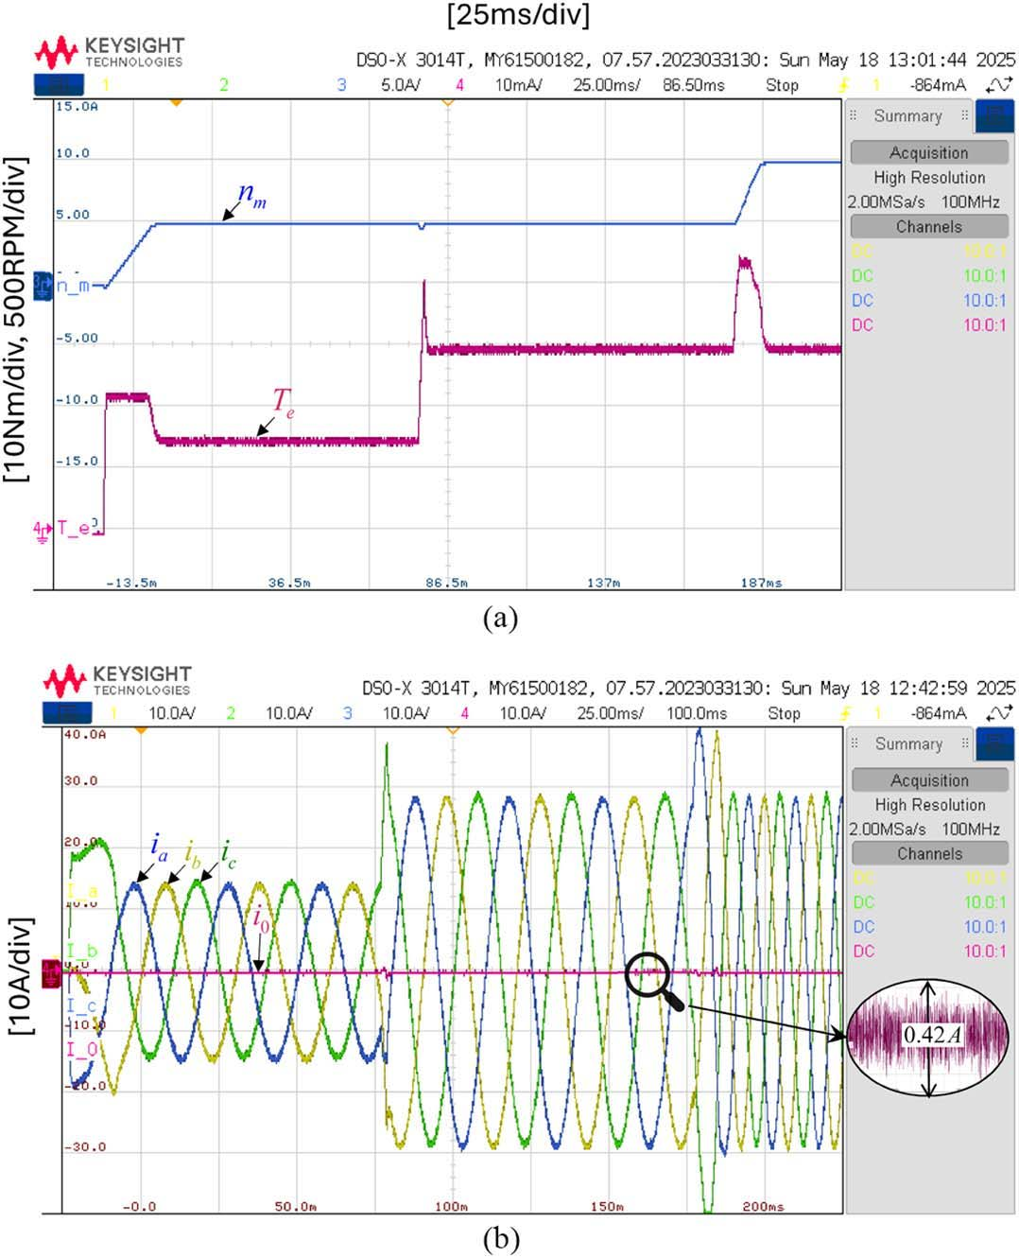
C-HIL EXPERIMENTAL RESULTS
Real-Time Motor Drive Dynamic Response under C-HIL
Dynamic Performance & ZSC Suppression
✦ Speed & Load Transients: Smooth acceleration to 1500 RPM with rapid settling time (< 50 ms).
✦ Torque Disturbance Rejection: Abrupt 5 Nm to 45 Nm load steps handled with zero current runaway.
✦ Torque Ripple Clamping: Maintained within +/- 0.5 Nm under full load.
✦ Complete ZSC Clamping: Peak-to-peak ZSC ripple held below 0.42 A during all transients.

Slide 7
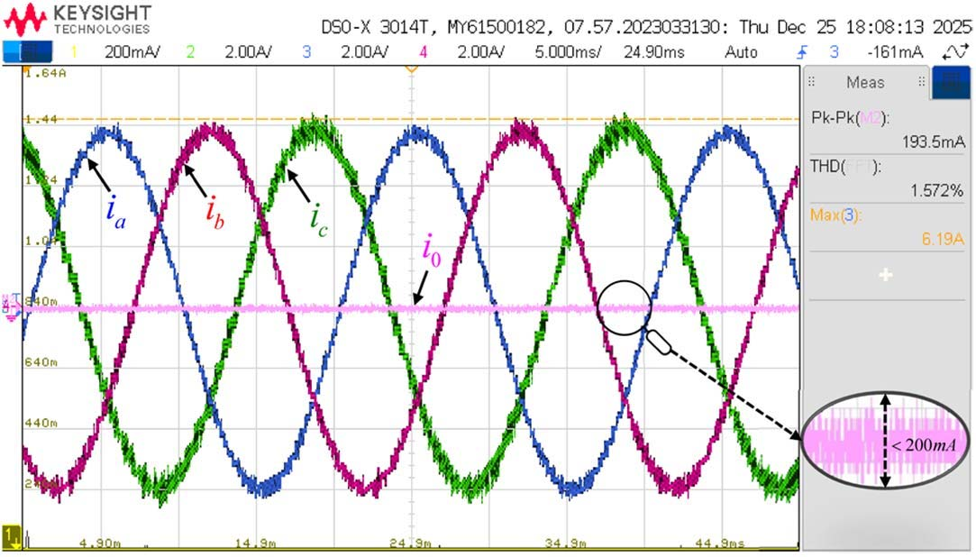
PHYSICAL HARDWARE VALIDATION
Experimental Results under Severe Load Asymmetry (+/- 25%)
Stress Test on GaN Inverter Prototype
✦ Laboratory Prototype: Built with GaN Systems GS66516B (650V / 60A) transistors.
✦ Physical Impedance Asymmetry: Inductors tuned to +/- 25% unbalance (La=7.5mH, Lb=10mH, Lc=12.5mH).
✦ Experimental Current Quality: Perfectly balanced 3-phase currents with THD = 1.57%.
✦ ZSC Ripple Clamped to 0.19 A: Validates flawless suppression under severe physical unbalance.

Slide 8
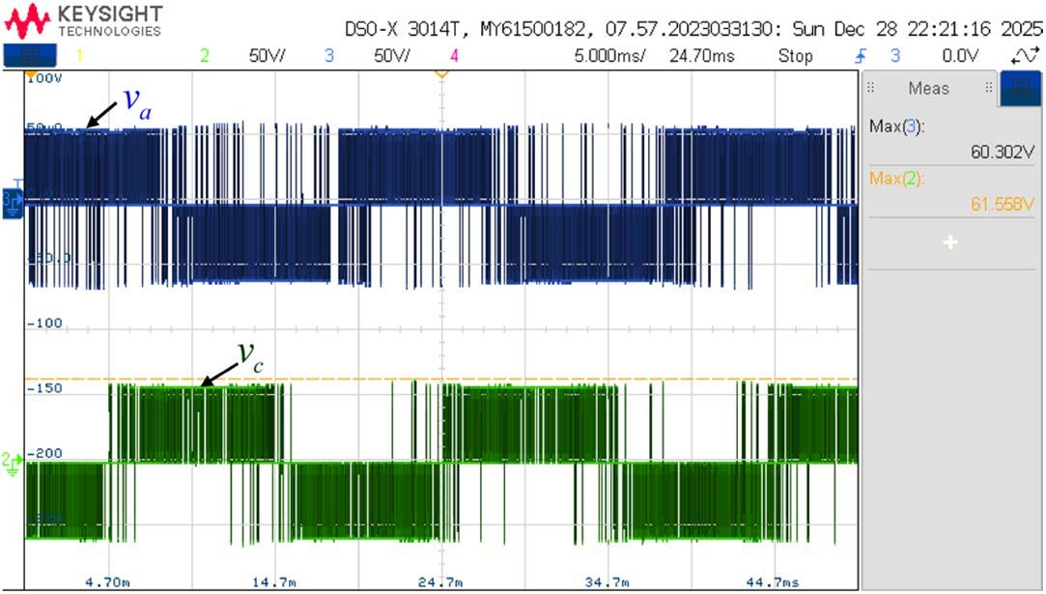
PHYSICAL HARDWARE VALIDATION
Measured Differential Voltages & Adaptive Modulation
Dynamic Duty Cycle & Power Efficiency
✦ Adaptive Phase-Wise Duty Cycles: Distinct switching patterns automatically generated per leg to balance asymmetric load.
✦ Maximal DC Utilization: Reaches Ma = 1.0 without overmodulation clipping.
✦ Variable Switching Frequency: Corrects errors only when necessary, reducing switching losses by up to ~30%.
✦ EMI Spread Spectrum: Natural harmonic dispersion eliminates sharp EMI peaks.

Slide 9
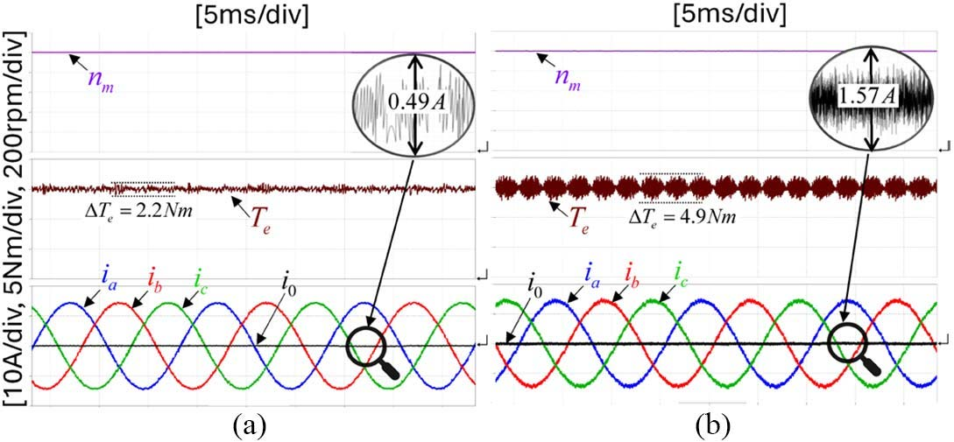
BENCHMARKING & PERFORMANCE
Comparative Analysis: OEPC vs. Conventional Schemes
Computational Complexity & Efficiency
✦ OEPC Execution Time: 1.75 µs on TMS320F28335 (150 MHz) - Baseline 100% computational load.
✦ 3D-SVM: 3.3x heavier computational burden per core with fixed switching losses.
✦ CBPWM: 16x heavier arithmetic load; exhibits current spikes during dead-time.
✦ Multi-Vector MPC: >150x heavier complexity; highly sensitive to parameter errors.

Slide 10
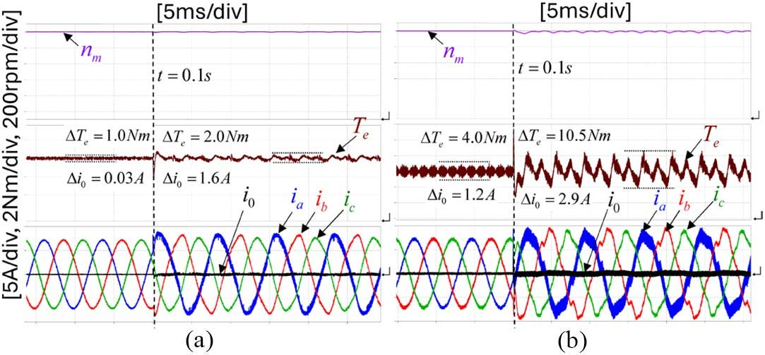
MACHINE FAULT TOLERANCE
Intrinsic Fault Robustness under Inter-Turn Short Circuits (ITSC)
Passive Fault Containment without Extra Sensors
✦ 10% ITSC Stator Fault: Evaluated under identical internal machine short-circuit conditions.
✦ CBPWM Breakdown: Carrier-based control fails to contain the fault, causing severe current runaway and destruction.
✦ OEPC Inherent Clamping: Error-priority logic naturally clamps the fault currents, maintaining stable operation and preventing runaway.
✦ Critical Limp-Home Capability: Ideal for mission-critical EV drivetrains and aerospace systems.

Slide 11
RESEARCH CONTRIBUTIONS & PUBLICATION
IEEE Transactions on Industrial Electronics (TIE) Milestone
🌟 Acceptance in Top-Tier IEEE Journal (Q1)
✦ Decisive Impact of Experiments: The comprehensive physical experimental verification and C-HIL validation were the cornerstone of acceptance in IEEE TIE.
✦ Authorship Note: While Maxim Radkin was not formally listed on the initial submission due to IEEE initial-round author freeze rules, his execution of the hardware setup and testing directly enabled this achievement.
המאמר היוקרתי ב-IEEE TIE התקבל הודות לתוצאות הניסוייות המעשיות ולסטאפ ה-HIL המעבדתי שנבנה.
🔬 Laboratory Validation & Experimental Tasks
✦ DSP-to-Typhoon C-HIL Interface: Interfacing Texas Instruments DSP with real-time Typhoon emulator.
✦ GaN Inverter Fabrication: Construction and debugging of the 4-Leg Series-End power stage.
✦ Asymmetric Inductor Test Rig: Calibration and stress-testing under +/- 25% impedance imbalance.
✦ Oscilloscope Capture & FFT Analysis: High-bandwidth current/voltage measurements and harmonic evaluation.

Slide 12
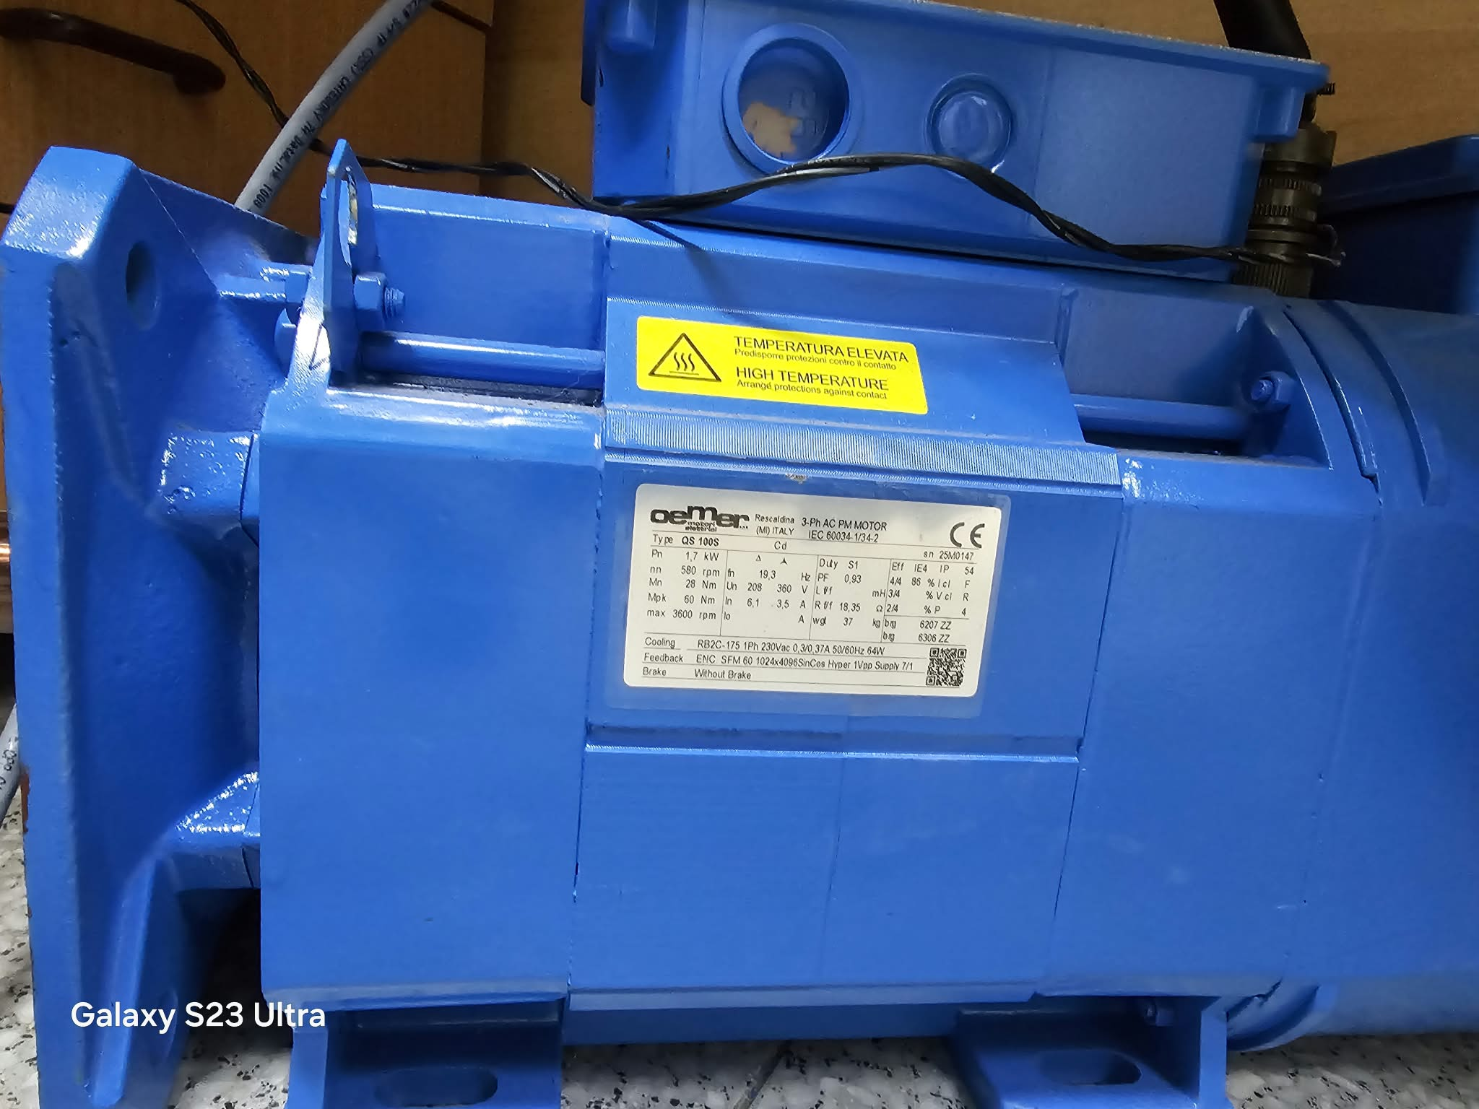
ONGOING RESEARCH & NEXT STEPS
Hardware Progression: Newly Acquired PMSM & Custom Inverters
Next-Phase Experimental Setup
✦ Newly Acquired Industrial PMSM: High-performance open-winding servomotor with integrated SICK SFM60 Hiperface optical encoder.
✦ Custom-Built Inverters: In-house fabricated 4-leg Series-End power stages for full-scale dyno testing.
✦ Experimental Continuity: Comprehensive physical dyno testing, field-weakening control, and efficiency validation.

Slide 13
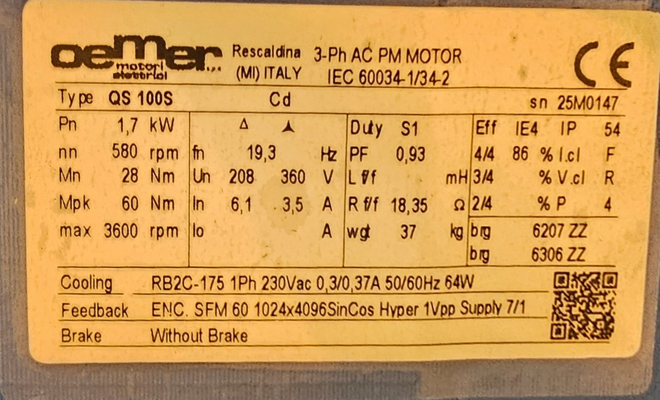
MECHANICAL & STRUCTURAL SETUP
SolidWorks CAD Mechanical Assembly & Sensor Integration
Precision Mechanical Test Bed
✦ SolidWorks 3D Modeling: Full CAD design of motor test bench (PMSM_Load_Stend.SLDASM) and machine bed adapters.
✦ T210 Torque Sensor Mount: Precision alignment flange for dynamic shaft torque and efficiency measurements.
✦ SICK SFM60 Hiperface RS485 Interface: High-speed serial protocol decoding on DSP for rotor flux angle estimation.

Slide 14
SUMMARY & CONCLUSIONS
Summary of Key Achievements & Technological Impact
💎 Technical Breakthroughs
✦ Sub-Microsecond Execution: Ultra-fast logic-based LUT (< 1.75 µs) on low-cost DSPs.
✦ Complete ZSC Suppression: Eliminates zero-sequence circulating current without bulky passive filters.
✦ Full DC-Bus Utilization: Delivers Ma = 1.0 equivalent to 6-leg dual-inverters with 33% fewer switches.
✦ Superior Power Efficiency: ~30% reduction in switching losses via adaptive switching frequency.
✦ Inherent Fault Tolerance: Resilient against +/- 25% load unbalance and internal stator ITSC short circuits.
📊 Validation & Future Horizons
✦ Triple-Layer Validation: Verified across digital simulations, Typhoon HIL real-time emulation, and physical GaN prototype.
✦ IEEE TIE Publication: High-impact publication enabled directly by the experimental results.
✦ Active Continuation: Ongoing research with newly acquired industrial PMSM and custom-built inverters.
המחקר ביסס את שיטת ה-OEPC כחלופה מעשית, יעילה ופורצת דרך עבור מנועי PMSM ורכבים חשמליים.

Slide 15
OPEN FOR DISCUSSION
Thank You for Your Attention!
תודה רבה על ההקשבה - שאלות ותשובות

