Slide 1
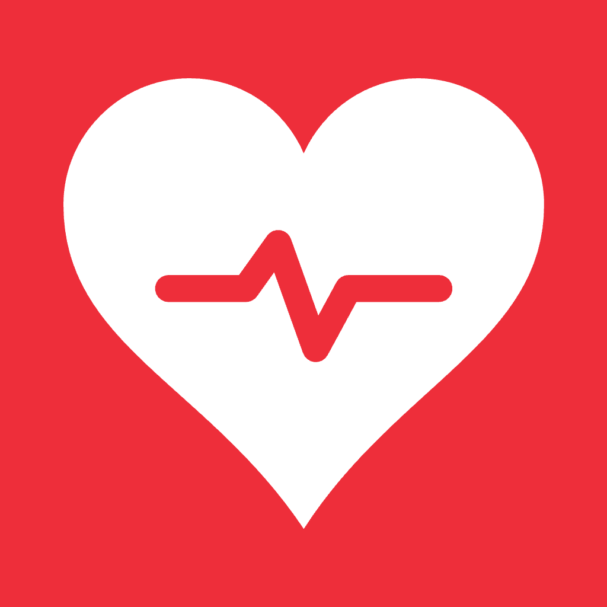
SEED INVESTMENT OVERVIEW
RedMed
Reducing Human Suffering
A passive NFC medical ID, built for the one moment a QR code can't handle.
Notes:
Open with the tagline and the one-line pitch: a passive NFC medical ID for the moment a QR code can't handle.

Slide 2
THE PROBLEM
Fails You When You Need It Most
QR codes need clean light — never there in the dark, rain, or blood
Most hide the code inside the band, under an unconscious wrist
Apple Health needs the right phone, unlocked, and a responder who knows to look
Notes:
QR and phone-based IDs fail in the exact conditions where they're needed most.

Slide 3
02 · THE SOLUTION
A Tap, Not a Scan
Any phone taps the band — profile opens instantly, no app or login
First aid and emergency contacts, with 911 as the obvious next step
No battery, no server, no breach — it just works, forever
Notes:
A tap replaces a scan: instant, no app, no battery, no server.

Slide 4
PRODUCT IN ACTION
Two Screens. One Tap. Zero Friction.
SETUP — OWNER, ONCE
TAPPED VIEW — BYSTANDER
Name
Alex Rivera
Call 911
Blood type
O negative
Trauma hospitals nearby
Allergies
Penicillin
Allergies
Penicillin
Conditions
Type 1 diabetes
Emergency contact
Jamie Rivera
Save & write to band
Illustrative sample profile — shown for demonstration only.
Notes:
Setup takes seconds once; a tap by any bystander opens the tapped view instantly.

Slide 5
03 · COMPETITIVE LANDSCAPE
Faster Than Anything Else on the Market
RedMed
QR Bracelets
Apple Health ID
Engraved Tags
Works in Low Light
Yes
No
Yes
Yes
No App or Login
Yes
Yes
No
Yes
First-Aid Guidance
Yes
No
No
No
Notes:
RedMed is the only option that clears all three bars: low light, no app, and first-aid guidance.

Slide 6
04 · REGULATORY & PRIVACY
Built Outside HIPAA's Reach — By Design
RedMed isn't a HIPAA covered entity or business associate — direct-to-consumer wearables generally fall outside HIPAA, and with no server, there's no centralized PHI store to breach in the first place
Still in scope for the FTC Health Breach Notification Rule and state health-data laws (e.g., Washington's My Health My Data Act) — RedMed's local-only architecture is built to minimize exposure under both
Tag data is intentionally unencrypted so any responder's phone can read it instantly — the same tradeoff every medical ID bracelet makes, disclosed up front
Notes:
RedMed sits outside HIPAA by design; the FTC Health Breach Notification Rule and state laws still apply.

Slide 7
05 · BUSINESS MODEL
One Product, One Payment, No Servers to Run
$30–60, One Time
Replacement, Not Repair
No subscriptions or backend — the profile lives on the band, so there's no recurring cost per customer.
No battery to fail. A damaged unit means a new band from the store — the AirTag model.
Attached Revenue
Enterprise & Fleet Contracts
IFAK affiliate links, plus a standing discount for veterans and first responders — a core, trusted audience.
Bulk procurement by EMS agencies, fire departments and military units — a repeatable B2B2C channel with reorder as bands turn over.
Notes:
One-time hardware purchase, no subscriptions, plus attached and B2B revenue lines.

Slide 8
06 · MARKET
A Fast-Growing, Underserved Market
$1.4B
$28.6B
~2.3M
Medical ID Bracelets
Medical Alert Systems
Beachhead Buyers
Global market, projected by 2033 — up from roughly $0.85B in 2025. RedMed's direct category.
The broader wearable medical-alert market by 2035, growing at roughly 11% a year — the category RedMed can expand into.
US EMS professionals and active-duty military personnel — a concentrated, trusted-channel wedge.
Sources: Precedence Research (medical alert systems, 2025), Verified Market Research (medical ID bracelets, 2024), NAEMT and DoD personnel figures.
Notes:
A concentrated beachhead of EMS and military, inside a fast-growing broader category.

Slide 9
07 · TRACTION
Where We Stand Today
TBD
TBD
TBD
Bands Sold / Activated
Tap-to-Load Success Rate
Tap-to-Info Time
Target metric — the clearest signal of real-world adoption.
Target metric — proves the core promise works every time, unlike QR.
Target metric — the whole product exists to drive this to zero.
Pre-launch — figures to be filled in as pilots and early sales land.
Notes:
Pre-launch — metrics to be filled in as pilots and early sales land.

Slide 10
08 · GO-TO-MARKET
Reach the People Who Already Carry the Risk
Direct-to-consumer — full margin, no retail markup
Veteran & first-responder communities — built-in trust and word of mouth
Outdoor & hunting retailers — the shelf this design was built for
Notes:
DTC first, leaning on veteran and first-responder trust networks, plus outdoor retail.

Slide 11
09 · TEAM
Who's Building This
Maximilian Aguilar-Aasted
Jonathon Augusto
Heaven Jager
CEO
CSO
CMO
Placeholder — drop in real names, photos and bios.
Notes:
Founding team — photos and bios to be finalized.

Slide 12
10 · THE ASK
Help Us Get Bands Into the World
TBD
SAFE
18 mo
Raise Amount
Instrument
Runway to Next Raise
Terms placeholder — fill in raise amount and valuation cap once finalized.
Manufacturing & Tooling
Inventory
NTAG216 hardware, silicone molding, first production run.
Stock to cover launch demand.
Web & Setup Tooling
Go-to-Market
Setup form, tag-writing flow, training videos.
Launch marketing and channel partnerships.
Notes:
Raise amount TBD, SAFE instrument, 18-month runway; use of funds across manufacturing, inventory, tooling and go-to-market.

Slide 13
GET IN TOUCH
Reducing Human Suffering
One band. One tap. No app, no login, no light needed.
hello@redmed.com
SEED ROUND NOW OPEN
© 2026 RedMed
Confidential — not for distribution
Notes:
Close with contact info and the open seed round.

