Slide 1

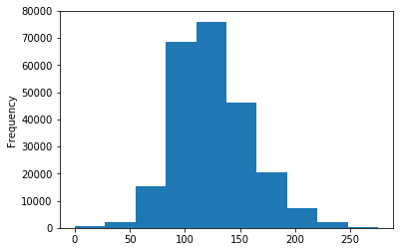
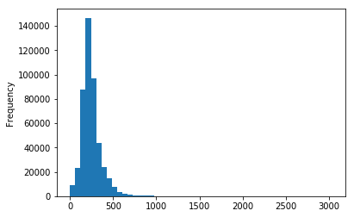
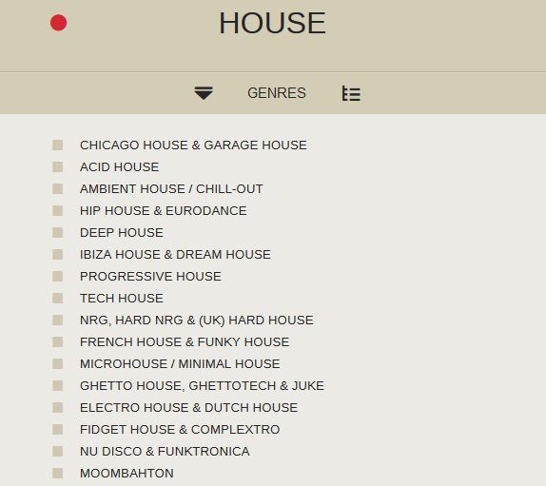
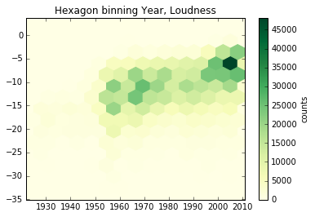
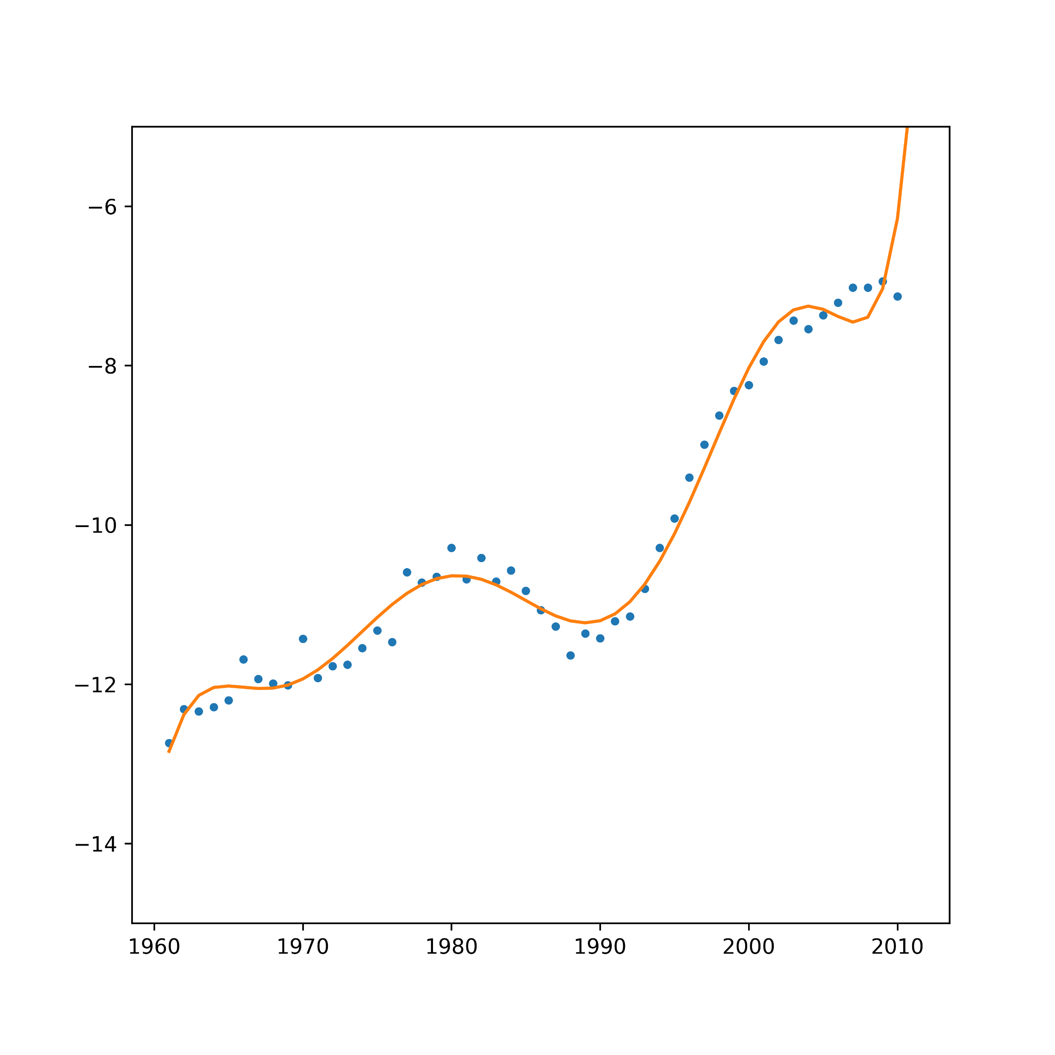
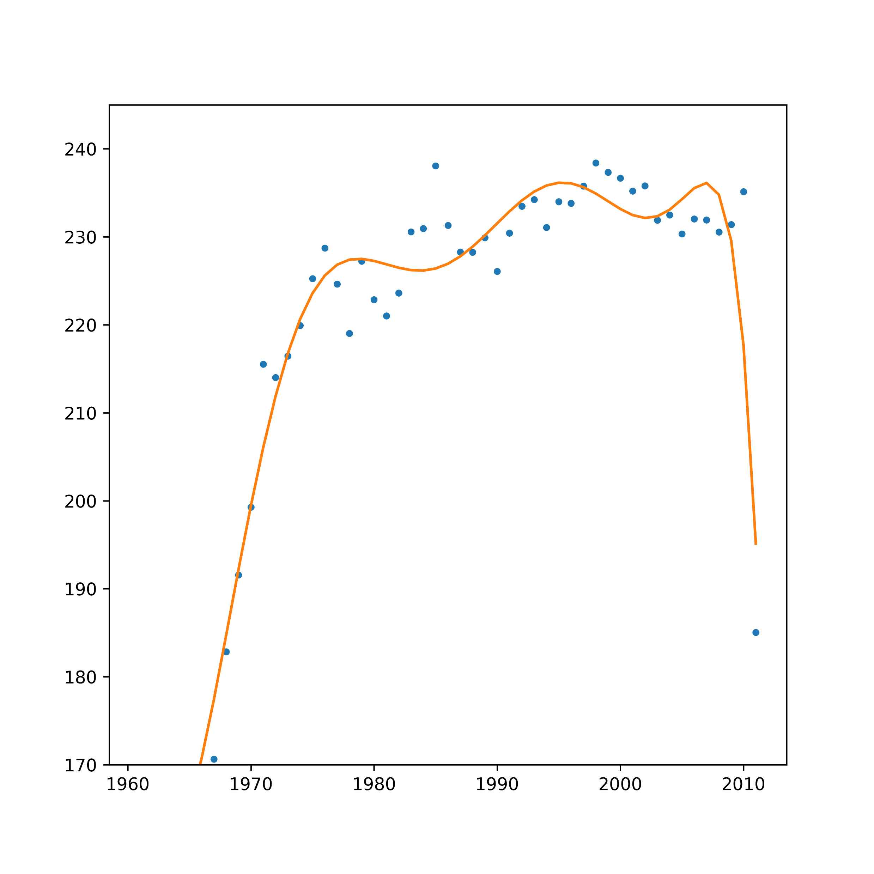
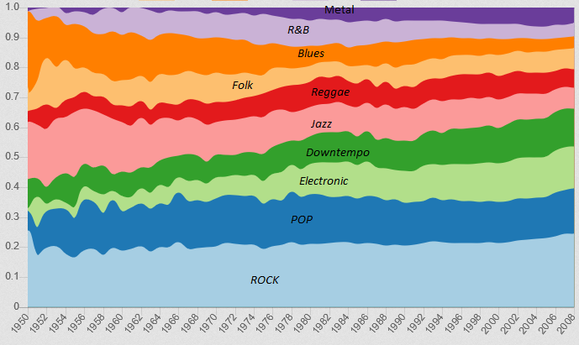
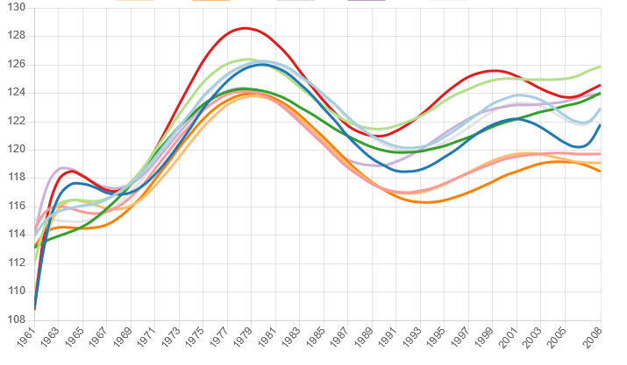
Evolution of music throughout the years – Applied Data Analysis
Max Premi and Maximilian Rünz
In the past music was a form of art and expression. Nowadays music is part of everyone's daily life. One does hear music during work, shopping and watching movies. As music has grown to such a big part of our life, we were interested how music evolved in the recent years.
Dataset
The analysis is based on the MillionSong DB. This dataset contains one million songs, of which we have used 600 thousand songs. The data is formatted in h5 files per song. Per song we have analyzed the following features:
Artist, Year, Danceability, Duration, Tempo, Time Signature, Energy, Key, Genre and Loudness.
The songs were released between 1926 and 2010.
Genre Mapping
Due to the high number of unique song genres we decided to reduce those to a few main genres. This was realized using the genre map of musicmap.info:
A genre tree was built based on the genres from the music map. In the next step the genres of the MillionSong DB were matched to the music map genres. After the mapping the genres could be reduced to fourteen unique genres.
Data Cleaning
Out of the analyzed songs, only 250 thousand contained information about their release date. The other songs were discarded. Additionally the songs released earlier than 1960 were removed, as they were not enough to draw meaningful conclusions for those years. Furthermore, some features contained no information and were removed. Last but not least, other songs were removed since their calculated features were not confident enough.
Analysis
For the analysis we have aggregated the song statistics per year. In the resulting timeseries per feature we searched for minima and maxima in order to identify major changes. Last but not least, the evolution was measured using the difference between the 95% confident intervals.
Unfortunately, features like Key and Time Signature did not show significant changes.
Results
Evolution of Loudness (dB) through the years
Evolution of Duration (seconds) through the years
Genre distribution through the years
Tempo evolution (BPM) through the years by genre

