Slide 1

Analysis of Differences in Texts between Real and Fake News
By Cristian Lopez, Karina Sindermann, Quan Nguyen, Sebastian Vazquez-Gasty, Jackson Maschman,

Slide 2
Overview
Introduction
Preprocessing
Apriori Algorithm
Ensemble Method
Qualitative Data Analysis
Future Works
Q&A

Slide 3
Introduction
News and media is a necessary feature in an interconnected, global society.
Information may be subject to bias and agenda, potentially leading to misinformation or falsities.
False news is often exacerbated by political or business/corporation interests.
Fake news refers to deliberately fabricated or manipulated information that is spread with the intention of misleading people or creating a false narrative.

Slide 4
Introduction
Research and development has been implemented to counteract fake news.
Reviewers and analysts
Shown to be inefficient with mass influx of information.
Our goal is to identify distinctive characteristics of false news
Our approach:
Use Apriori to identify common text patterns in real and false news
Look at state-of-the-art techniques using Ensemble method
Qualitative data analysis: Identify differences in linguistic features of true and false news.

Slide 5
Problem Definition
Text mining is the process of finding meaningful patterns and new insights from unstructured texts. Text mining techniques can be used to analyze language patterns in news articles and social media posts to identify potential instances of fake news.
This project aims to apply various techniques to analyze the features that distinguish real news from fake news.
The inputs for this scope are primarily social media sentences, among other attributes and the output will be how likely new sentences are to be fake.
It is important to mention that we only work with texts in English.

Slide 6
Core Objectives
Tokenize texts in our inputs for our data processing
Utilize association mining on the word choices on stories classified as fake news.
Research existing models for predicting whether news is fake.
Evaluate the overall efficiency of association mining
Examine alternative methods to identify fake news using linguistic features.

Slide 7
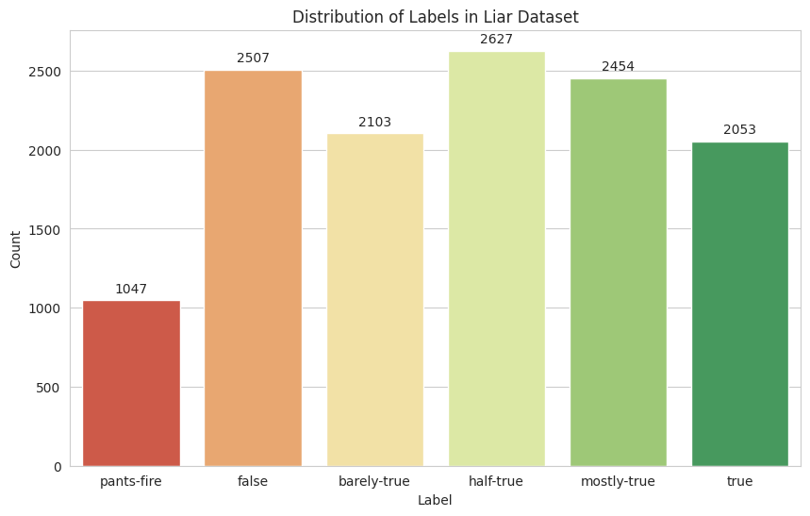
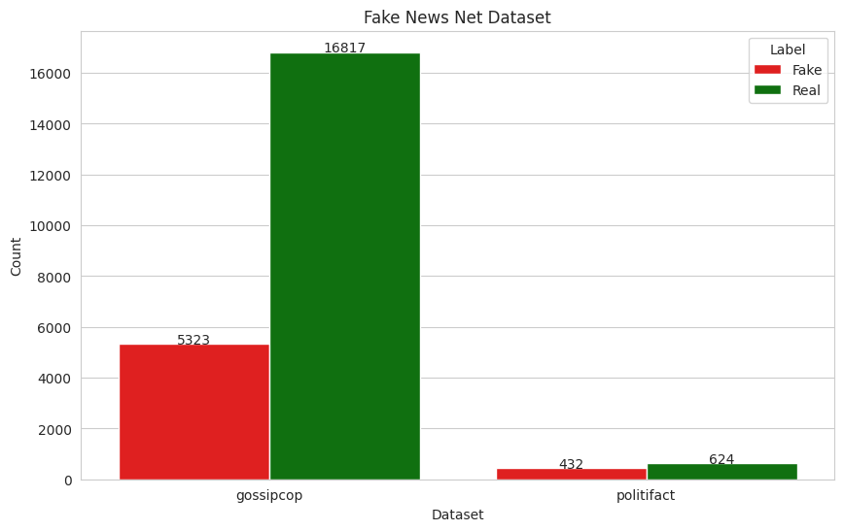
Dataset
Liar:
collection of fact-checked statements from PolitiFact
labels: pants-fire, false, barely-true, half-true, mostly-true, and true
Fake-News-Net
consists of news articles from the domains gossip and politics
Labels: true and false

Slide 8
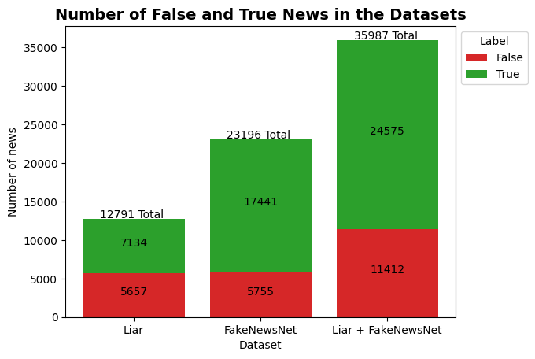
Dataset

Slide 9
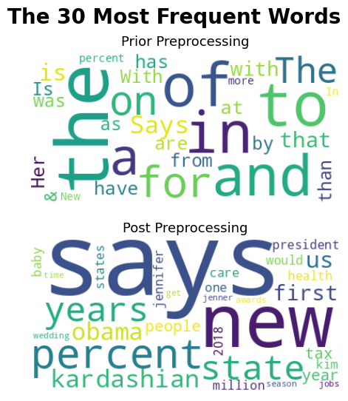
Preprocessing: the basics
Load and combine two datasets: Liar dataset and FakeNewsNet dataset
Remove rows with missing values
Convert labels to numerical values
Preprocess text data using the following steps:
Remove punctuation
Convert all text to lowercase
Remove stop words using NLTK library
Notes:
({'pants-fire': 0, 'false': 0, 'barely-true': 0, 'half-true': 1, 'mostly-true': 1, 'true': 1})

Slide 10
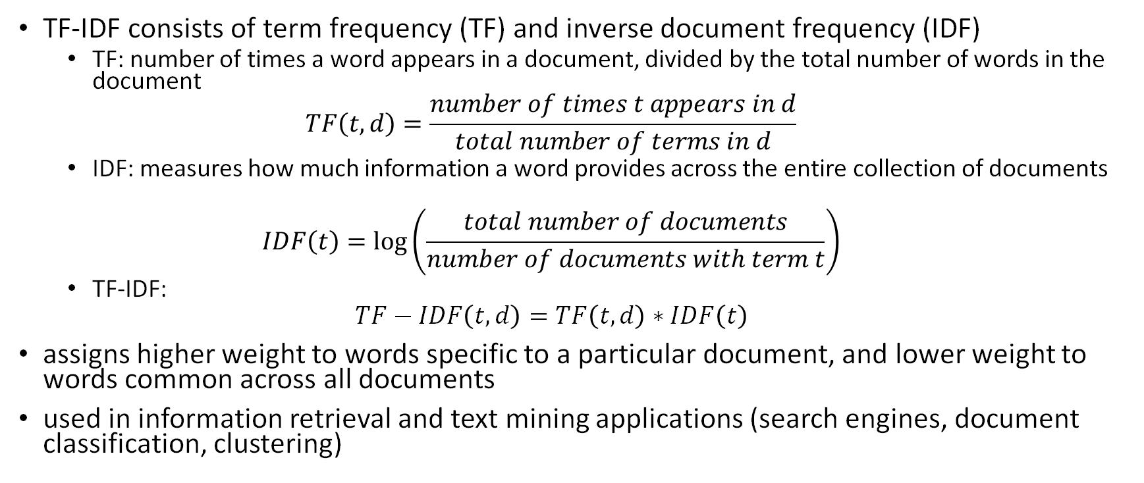
Preprocessing: TF-IDF
TF-IDF consists of term frequency (TF) and inverse document frequency (IDF)
TF: number of times a word appears in a document, divided by the total number of words in the document
$$TF\left(t,d\right)=\frac{number of times t appears in d}{total number of terms in d}$$
IDF: measures how much information a word provides across the entire collection of documents
$$IDF\left(t\right)=\log\left(\frac{total number of documents}{number of documents with term t}\right)$$
TF-IDF:
$$TF−IDF\left(t,d\right)=TF\left(t,d\right)∗IDF\left(t\right)$$
assigns higher weight to words specific to a particular document, and lower weight to words common across all documents
used in information retrieval and text mining applications (search engines, document classification, clustering)
Notes:
(term frequency-inverse document frequency)
reflects importance of a word to a document in a collection or corpus
Convert preprocessed text data to numerical features using TfidfVectorizer
The final preprocessed combined dataset contains the following columns:
id
label (0 for false, 1 for true)
statement (preprocessed text data converted to numerical features)

Slide 11
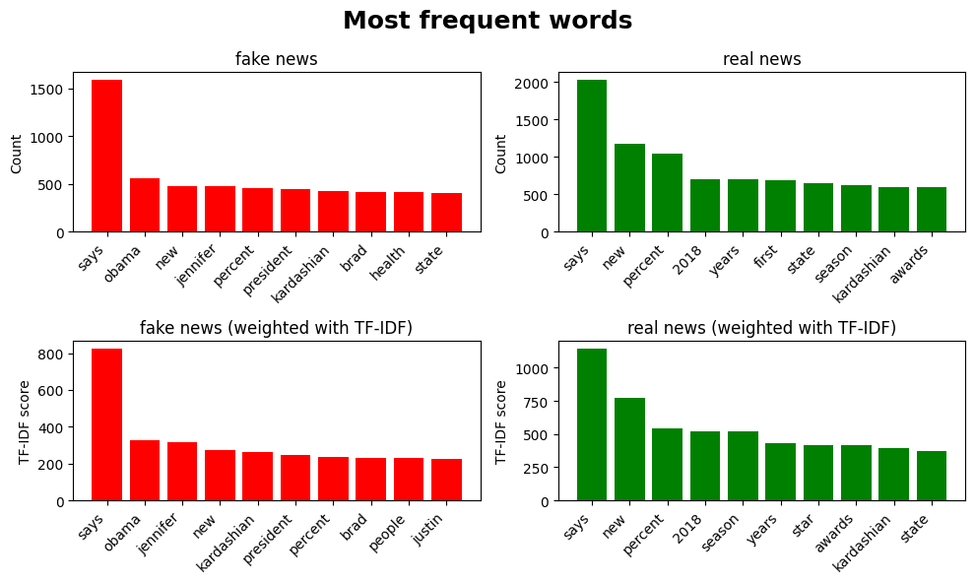
Preprocessing: TF-IDF

Slide 12
Step 1. Load sentences
Apriori
All sentences, then, split in real and fake news
Step 2. Convert sentences to transactions
In each sentence, we split it into individual items
Step 3. Create transaction dataset
The data is converted to a convenient type for further analysis
Step 4. Apply Apriori algorithm
By using support, identify the frequent itemsets.
We extract association rules from the frequent itemsets, by using confidence

Slide 13
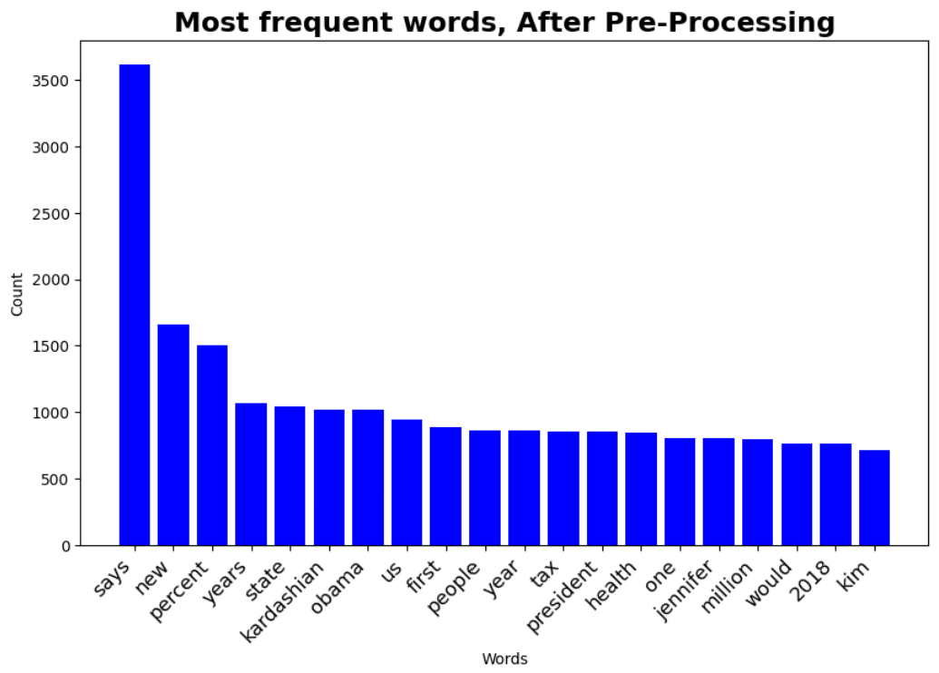


Post Preprocessing
“Kardashian” and “Kim” are among the most frequent words. Their support is:

Slide 14
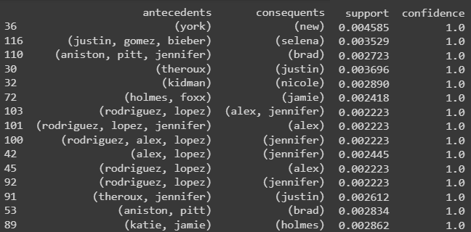
Data set: 35987 news
Apriori
Support: 0.2% (71 words)
Frequent items: 1225
Confidence: 90%
Rules: 137
Names are mostly be celebrities, politicians, or other public figures.

Slide 15
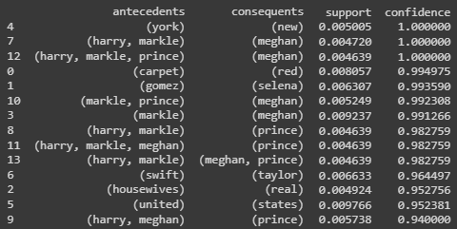
Data set: 35987 news
Apriori
Real news: 24575
Fake news: 11412
Real news
Support: 0.4% (98 words)
Frequent items: 421
Confidence: 90%
Rules: 13

Slide 16
Data set: 35987 news
Apriori
Real news: 24575
Fake news: 11412
Real news
Detected pattern:
Support: 0.2% (49 words)
Frequent items: 1117
wedding =>harry => meghan=>markle
Confidence: 90%
Rules: 63

Slide 17
Data set: 35987 news
Apriori
Real news: 24575
Fake news: 11412
Real news
Detected patterns:
Support: 0.2% (49 words)
Frequent items: 1117
wedding =>harry => meghan=>markle
wedding =>harry => meghan
red=>carpet=>award
people=>choice=>award
Confidence: 50%
Rules: 218

Slide 18
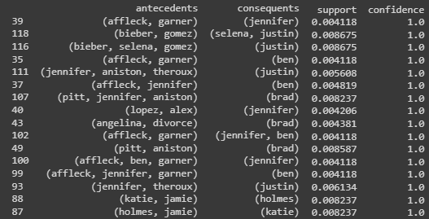
Apriori
Fake news
Support: 0.4% (45 words)
Frequent items: 610
Confidence: 90%
Rules: 138
angelina => divorce => brad
law => health => care
Names are mostly celebrities, politicians, public figures; law.

Slide 19
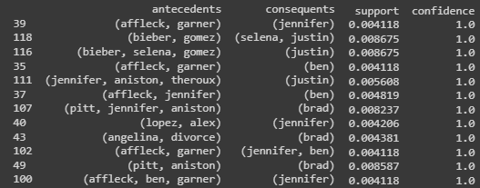
Apriori
Fake news
Support: 0.2% (22 words)
Frequent items: 1576
Confidence: 90%
Rules: 484
Compared to previous, no interesting rules

Slide 20
Apriori
By using support and confidence as 0.4% and 50%, respectively.
In both cases we found three categories:
1) Celebrities’ names (harry, selena, kardashian, meghan, kylie, etc.),
2) Entertainment, music, and awards (choice, housewives, carpet, wedding, red, health, awards, etc.)
3) Political figures (donald, hillary, clinton, trump, obama, barack).
Interestingly, for fake news dataset, we found other words related to:
1) Legal issues (illegal, supreme, report, court, administration, insurance, divorce),
2) Immigration (immigrants, social)
3) Government (gov, administration).

Slide 21
Apriori's result summary
Apriori was able to pick up related words in the same topics such as
Harry Prince and Weddings.
Many obtained rules are rather obvious
Kim => Kardashian.
Harry => Prince
Celebrities, entertainment, music, and political figures are popular because they are often newsworthy.
Fake news seem contains legal, immigration, and government, all of which are controversial issues.

Slide 22
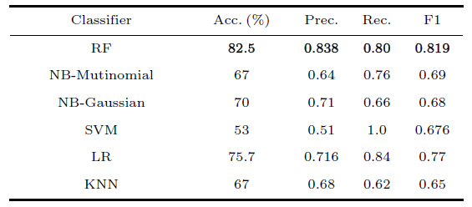
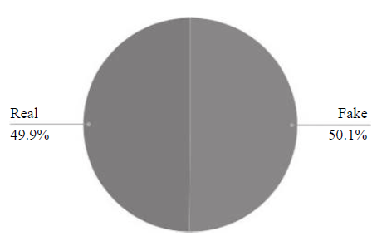
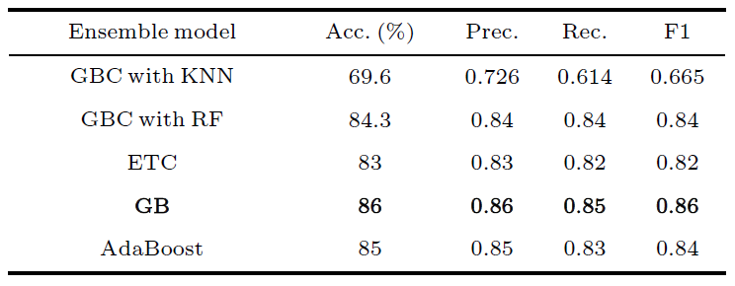
Using Classifiers
A state of art view
Text-mining-based Fake News Detection Using Ensemble Methods
Reddy et al. 2020
Using TF-IDF
Best Results: Using Random Forest (RF) and Gradient Boosting (GB)
Dataset combined from FakenewsNet and McIntire

Slide 23
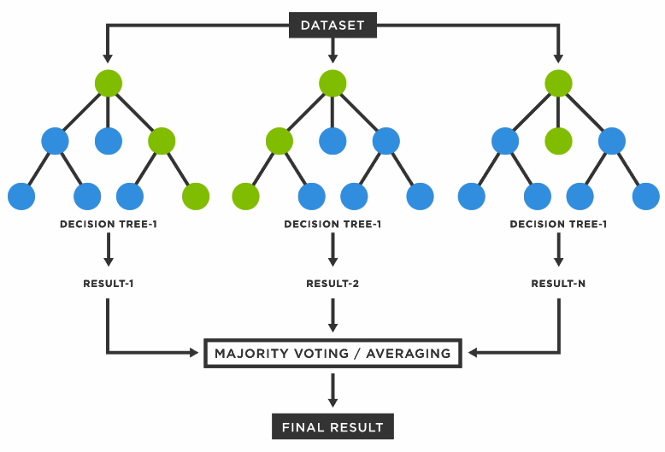
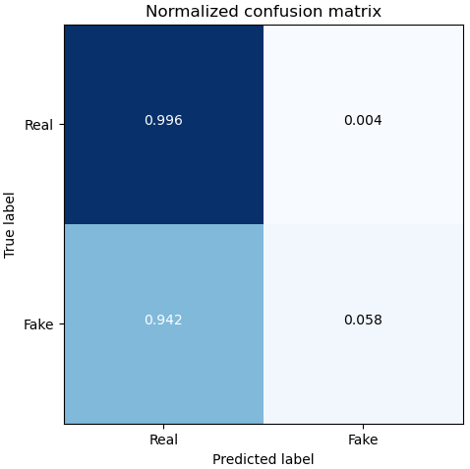
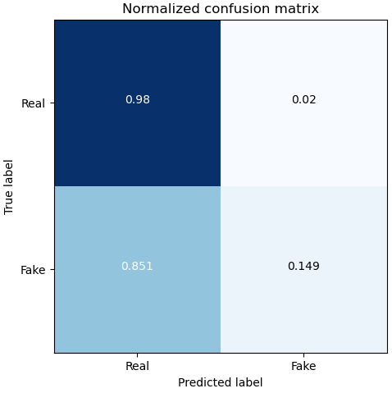
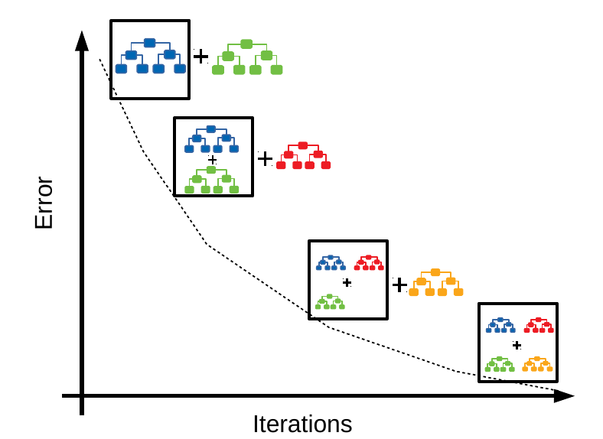
→We use default parameters first (sklearn).
→ Split data in train/test (70/30)
Random Forest
Gradient Boosting
Random Forest
Gradient Boosting
Accuracy | 0.69
Precision | 0.78
Recall | 0.53
F1-Score | 0.46
Accuracy | 0.71
Precision | 0.74
Recall | 0.56
F1-Score | 0.54
Notes:
RF: Ensemble Bagging method (independent predictors/models/learners and combine them using some model averaging techniques).
GB: Ensemble Boosting method (predictors are not made independently, but sequentially)

Slide 24
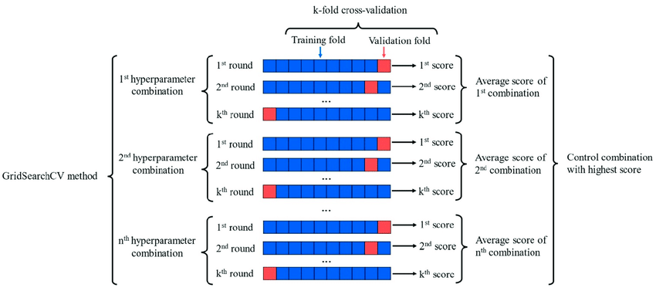
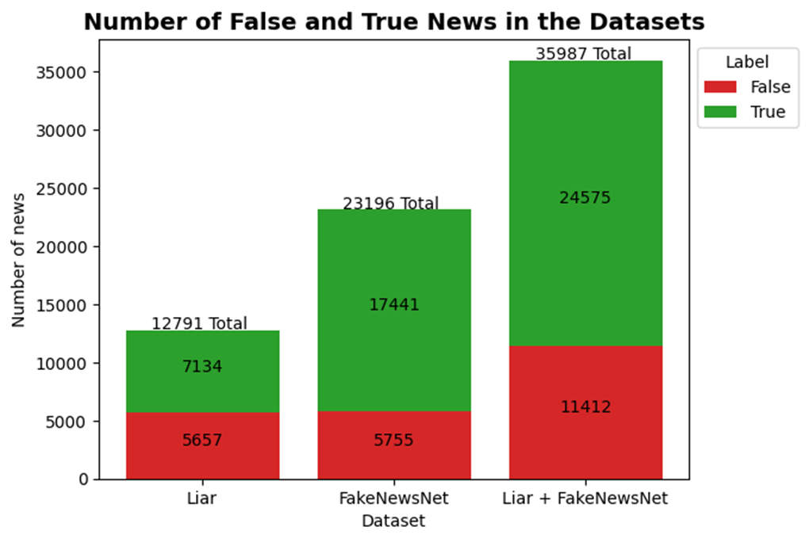
Using Classifiers
Data was imbalanced → Cross validation → StratifiedKFold (sklearn)
Testing with different combinations of hyperparameters
GridSearchCV tool (sklearn)
Notes:
StratifiedKFold → This cross-validation object is a variation of KFold that returns stratified folds. The folds are made by preserving the percentage of samples for each class.

Slide 25
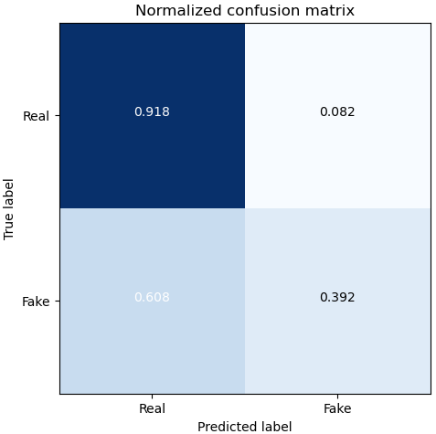
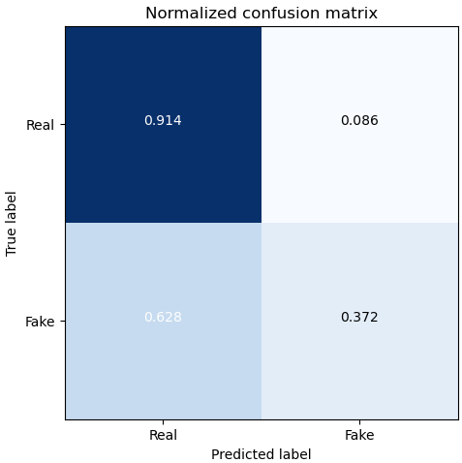
Using Classifiers
Random Forest
Gradient Boosting
Random Forest
1000 trees, Entropy.
Gradient Boosting
→0.075 learning rate, maximum depth of trees 15, 300 estimators.
Comments
→Both classifiers were being improve.
→False positive rate decrease (~20%).
→True negatives increased (~30%).
→F1 score increased.
Accuracy | 0.75 | 0.06
Precision | 0.73 | -0.05
Recall | 0.66 | 0.13
F1-Score | 0.67 | 0.21
Accuracy | 0.74 | 0.03
Precision | 0.71 | -0.03
Recall | 0.64 | 0.08
F1-Score | 0.65 | 0.09

Slide 26
Other techniques
Since Apriori Algorithm and Ensemble Method did not deliver promising results, we turned to qualitative data analysis (QDA) as another alternative. We used Quirkos, an online commercial tool for QDA, to analyze linguistic features in our dataset.
We looked at different criteria that people often use to discern between true and false news.
Excessive use of superlatives, sensational language
Extensive use of pronoun
Overall sentiment

Slide 27
Results
Categories | Fake News | Real News
Superlatives | 43.65% | 56.35%
Comparatives | 52.47% | 47.53%
Sensational words | 49.36% | 50.64%
Pronoun | 50.20% | 49.80%
first- and second-person pronoun | 49.80% | 50.20%
Positive sentiment | 40.27% | 59.73%
Negative Sentiment | 53.17% | 46.83%
Each category had a support level of around 1-2%.
The analysis of 4 metrics did not show a statistically significant difference between real news and fake news, indicating that these features were not useful for detecting fake news in this dataset.
However, the presence of superlatives was found to be relatively more common in real news, which is not in line with previous research that has shown how superlatives are often used to exaggerate and sensationalize news stories.

Slide 28
Results
Categories | Fake News | Real News
Positive sentiment | 40.27% | 59.73%
Negative Sentiment | 53.17% | 46.83%
In contrast, the results of the sentiment analysis revealed that almost 60% of the positive news articles were truthful.
Interestingly, we observed a significant difference in the percentage of positive news articles between real and fake news, suggesting that fake news writers are less likely to focus on uplifting and joyful stories, and instead may have been more focused on negative and sensational news.
This also led us to identify one intriguing feature about our dataset
 | Positive sentiment | Negative sentiment
Fake News | 9.2% | 11.6%
Real News | 13.7% | 10.3%

Slide 29
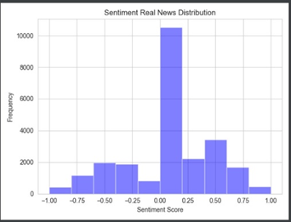
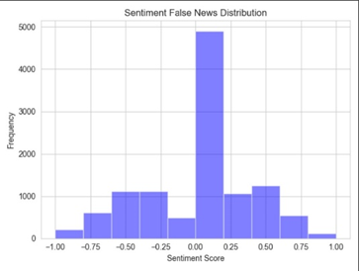
Sentiment distribution
Sentiment Real News Distribution
Sentiment False News Distribution
Notes:
One noticeable trait was the bimodal nature of both distributions. A bimodal distribution in a histogram of sentiment scores might infer that the dataset consists of two distinct groups or clusters of data points with different sentiment scores. For example, in the context of sentiment analysis of product reviews, a bimodal distribution may suggest that there are two types of customers: one group that is highly satisfied with the product and another group that is highly dissatisfied. In our cases, this implied that there was a dataset that contained mostly negative sentiment.
In general, a bimodal distribution indicates that the dataset was not homogeneous and that there were underlying factors that created two or more groups of data points with different characteristics. This could be useful information for further analysis and requires additional data exploration.

Slide 30
Future works
Improve Apriori Algorithm by using more state-of-the-art approaches such as using statistical analysis to filter for rules instead of a fixed support and confidence threshold level.
Expand qualitative data analysis to include more complex linguistic features such as context, homonyms
Investigate the cause of the bimodal distribution and determine whether there is any correlation between text sentiments and topics.

