Slide 1

Apriori for News

Slide 2
Step 1. Load sentences
Apriori - Steps
Split in real and fake news
Step 2. Convert sentences to transactions
In each sentence, we split it into individual items
Step 3. Create transaction dataset
The data is converted to a convenient type for further analysis
Step 4. Apply Apriori algorithm
From the transaction dataset, a list of frequent itemsets is generated
By using support, identify the frequent itemsets
We extract association rules from the frequent itemsets, by using confidence

Slide 3
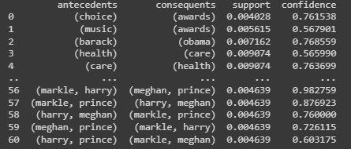
Data set: 35987 news
Apriori – GossipCop dataset
Real news: 24575
Fake news: 11412
Real news
Support: ~100
Frequent items: 421
Confidence: 0.5
Rules: 61
Detected words:
harry, selena, kardashian, choice, housewives, carpet, wedding, meghan, donald, kylie, care, red, taylor, kourtney, health, awards, royal, york, hillary, swift, met, clinton, obama, khloe, prince, trump, united, music, gala, markle, kim, states, real, new, barack, gomez, jenner, net, worth

Slide 4
Apriori – GossipCop dataset
The real news include words related to:
1) Celebrities: harry, selena, kardashian, meghan, kylie, taylor, kourtney, khloe, prince, markle, kim, gomez, jenner
2) Entertainment, music, and awards: choice, housewives, carpet, wedding, red, health, awards, royal, met, music, gala, real, net worth
3) Political figures: donald, hillary, clinton, trump, obama, barack
This suggests that the dataset may include news or articles related to entertainment and politics.

Slide 5
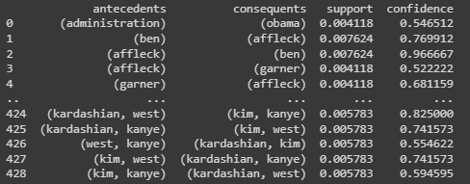
Apriori – GossipCop dataset
Fake news
Support: ~50
Frequent items: 610
Confidence: 0.5
Rules: 429
Detected words:
illegal, caitlyn, travis, says, walker, angelina, supreme, miley, swift, jolie, foxx, khloe, theroux, trump, celebrities, alex, report, pitt, blake, insurance, bieber, shelton, jenner, cyrus, harry, selena, perry, kristen, katy, jennifer, middleton, care, kylie, taylor, health, react, west, clinton, social, cruise, president, kris, states, security, gomez, katie, net, kanye, nicole, pattinson, kardashian, rodriguez, meghan, garner, kourtney, brad, royal, tom, house, stefani, obama, gwen, court, scott, justin, kidman, obamas, gov, barack, immigrants, ben, worth, divorce, despite, robert, donald, affleck, kate, kendall, lopez, thompson, hillary, administration, disick, jamie, prince, united, kim, markle, stewart, aniston, holmes, white, tristan

Slide 6
Apriori – GossipCop dataset
The fake news include words related to:
1) Legal issues: illegal, supreme, report, court, administration, insurance, divorce
2) Immigration: immigrants, social
3) Government: president, states, gov, administration
4) Celebrities: caitlyn, travis, walker, angelina, miley, swift, jolie, foxx, khloe, theroux, alex, pitt, blake, bieber, shelton, jenner, cyrus, harry, selena, perry, kristen, katy, jennifer, middleton, kylie, taylor, react, west, cruise, kris, security, gomez, katie, net, kanye, nicole, pattinson, kardashian, rodriguez, meghan, garner, kourtney, brad, tom, stefani, gwen, scott, justin, kidman, ben, robert, affleck, kate, kendall, lopez, thompson, disick, jamie, prince, kim, markle, stewart, aniston, holmes, Tristan
5) Political figures : trump, clinton, obama, donald, hillary, barack, obamas
This suggests that the dataset may also include news or articles related to legal, entertainment, and political issues

