Slide 1
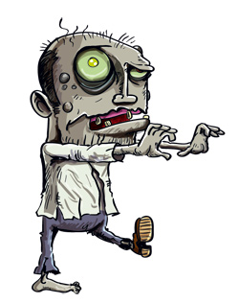
Patient Zero
Brains are delish.
Max Sazhaev 300830601
Manpreet Matharu 300838888
Kyle Puno 300629575
Igor Brovchenko 300829961

Slide 2
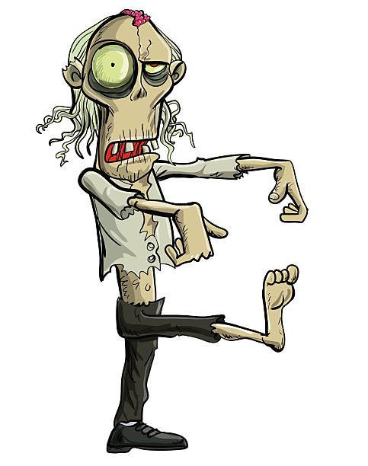
High Level Concept:
Start off as 1 zombie, the Patient 0
Hit the humans trying to save themselves from you to turn them into zombie allies
Control the zombies you and your friend create and make them attack other humans
Player zombie has special abilities such as jumping and fast movement, can also command other zombies
Win by being the only species standing
Patient 0.1 - Have a friend by your side to help you conquer the world

Slide 3
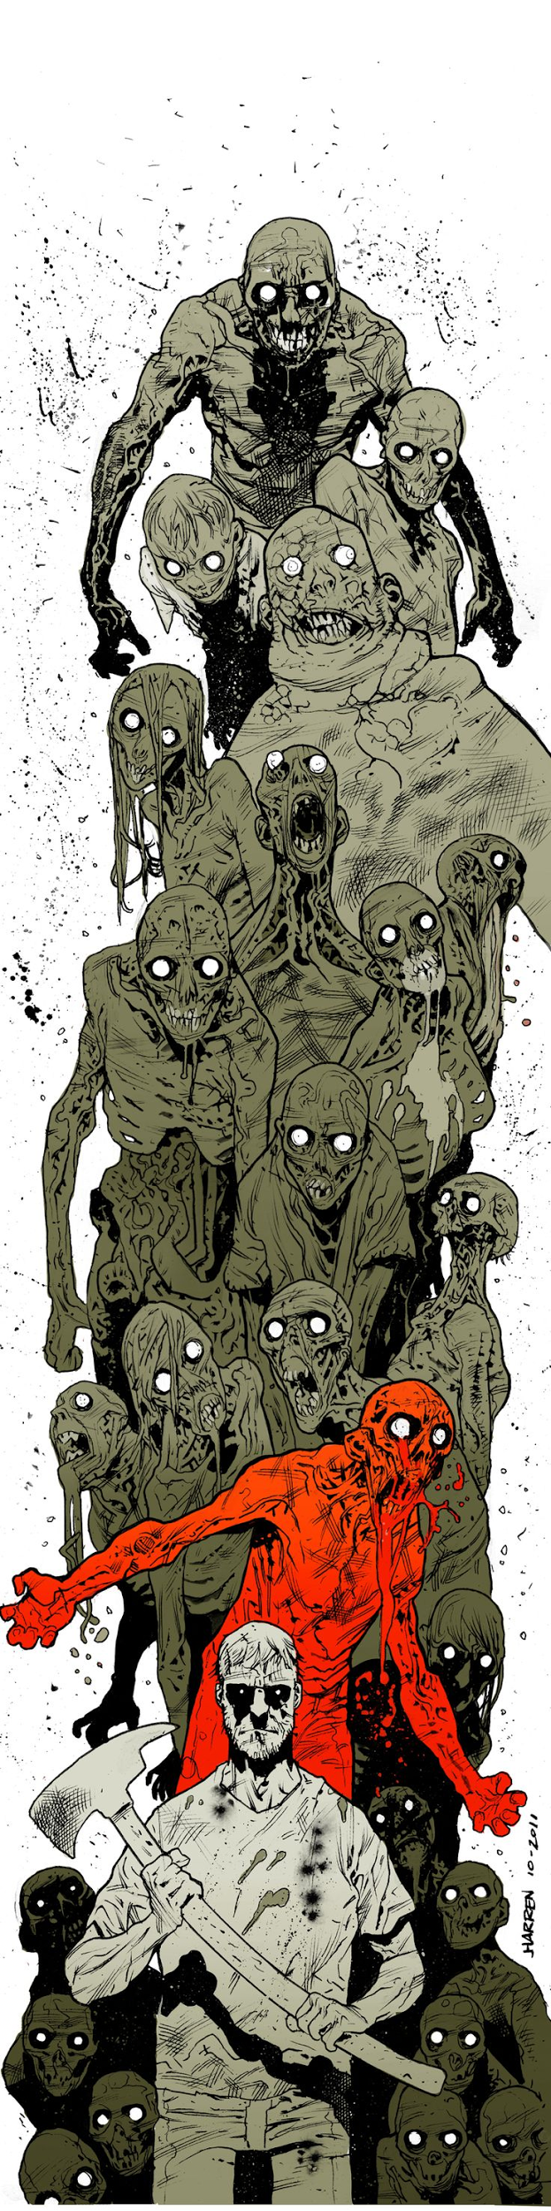
Game World
It was just a few weeks since the break out of zombie virus. Humans are running in panic without even trying to fight. Recently dominant species is hiding away from big cities, such as small towns and insane asylums. In game you will visit different sights to witness and speed up the end of human race. Game levels:
Insane Asylum: This is inside an insane asylum. The hallways looks very gloomy and the structure is maze-like. Perfect for hunting humans. You have to jump over a pit which could kill the zombie
Town: Just a small town outside the city, it contains some rocks, houses, and a well, and some cars.
Bridge: Some areas in the city have been destroyed, ground has collapsed and the humans needed a bridge to cross it, but so do you.

Slide 4
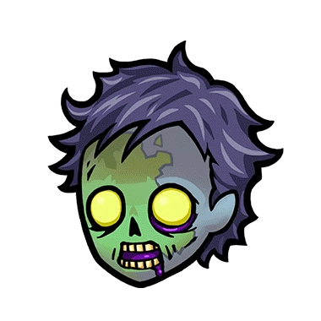
Features
First person point of view
Control with mouse and keyboard
LAN COOP Multiplayer for 2 players
Human NPCs are trying to run away from player
Player is slowly dying
Humans get converted to zombies after touching player or zombie
Player gains health and score after conversion
Goal level is to convert all the humans into zombies
Player can control zombies by selecting one with left mouse click and giving order to a selected zombie with right click

Slide 5
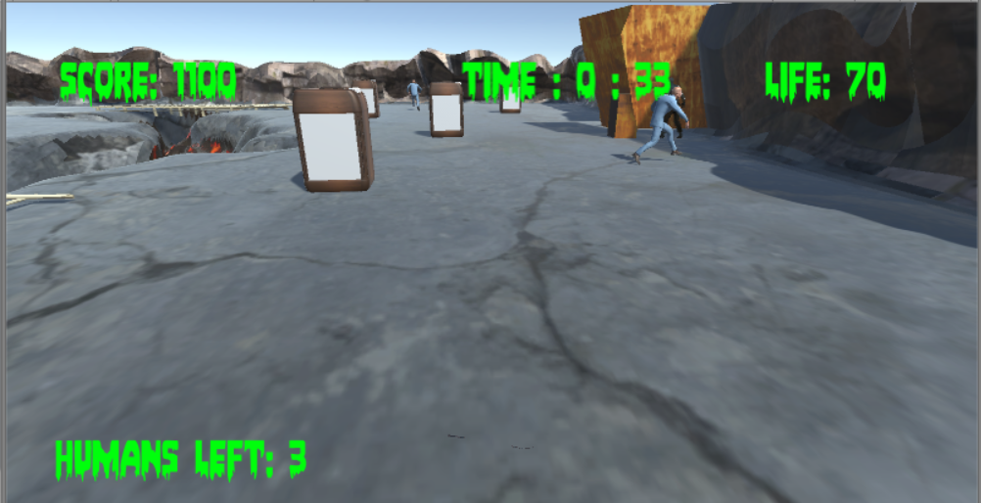
Interface
Player’s Score in the top left corner
Play Time in the top middle of the screen
Player’s Life in upper right corner
Counter of the humans remaining on the level in lover left corner

Slide 6

Version history:
Engine:
Version 1 – December 2nd 2017
Version 2 – December 18th 2017
Version 3 - January 9th 2018

Slide 7

Thank you!

