Slide 1


2
ECONOMIC MODELS: TRADE-OFFS AND TRADE
Revised by Solina Lindahl

Slide 2
WHAT YOU WILL LEARN IN THIS CHAPTER
What are economic models and why are they so important to economists?
How do three simple models—the production possibility frontier, comparative advantage, and the circular-flow diagram—help us understand how modern economies work?
Why is an understanding of the difference between positive economics and normative economics important for the real-world application of economic principles?
Why do economists sometimes disagree?

Slide 3
MODELS IN ECONOMICS
Model: a simplified representation of a real situation that is used to better understand real-life situations.

Slide 4
“OTHER THINGS EQUAL”
Other things equal assumption: all other relevant factors remain unchanged.
We try to treat economics as close to a laboratory science as possible—with only one variable allowed to change at a time.

Slide 5
THE PRODUCTION POSSIBILITIES FRONTIER
The PPF is a diagram that shows the
combinations of two goods that are possible for a society to produce at full employment.

Slide 6
TRADE-OFFS: THE PPF (1 of 2)
We can use the PPF model to answer questions like:
How much can we produce?
What will it cost us to change our mix of production?
Does it make sense to import the good from somewhere else?

Slide 7
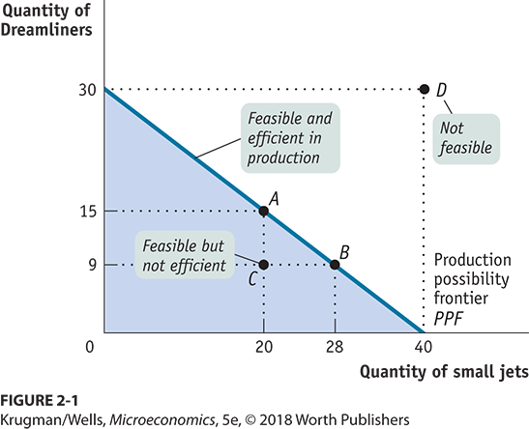
TRADE-OFFS: THE PPF (2 of 2)

Slide 8
OPPORTUNITY COST
Opportunity Cost: what must be given up in order to get a good.
If Boeing decides to change its production from point A to point B, it will produce 8 more small jets but 6 fewer Dreamliners: each small jet has an opportunity cost of 6 / 8 = 3 / 4 of a Dreamliner.

Slide 9
LEARN BY DOING: PRACTICE QUESTION 1
Suppose you are stranded on an island. Luckily, this island is rich in clams and mangos. If you devote all of your time to harvesting clams, you can get 100 clams in a week. If you us all of your time to collect mangos, you can find 200 mangos in a week.
Assume it is possible to collect fractional amounts of both goods and draw a sketch of your production possibility frontier for a week. (Place mangos on the x-axis and clams on the y-axis.)
Calculate the opportunity cost of each good.

Slide 10
LEARN BY DOING: PRACTICE QUESTION 2
With a partner, create your production possibilities curve for the following two activities: (a) drawing happy faces and (b) drawing elephants:
Take turns timing each other for 30 seconds and recording the following:
The maximum number of happy faces drawn
The maximum number of elephants drawn
Now construct your PPF with elephants on the vertical axis and faces on the horizontal axis.
Calculate your opportunity cost for each good.

Slide 11
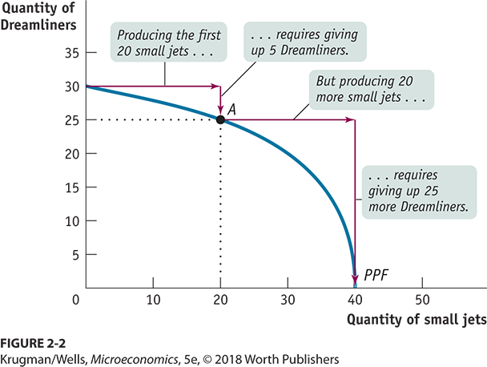
INCREASING OPPORTUNITY COST

Slide 12
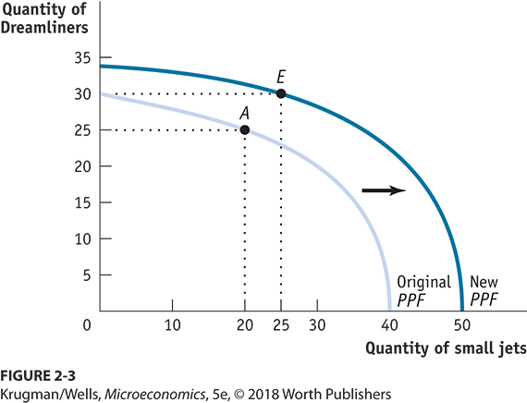
ECONOMIC GROWTH

Slide 13
WHAT CAUSES ECONOMIC GROWTH?
Two possibilities:
An increase in factors of production: resources used to produce goods and services.
Better technology: the technical means for producing goods and services.

Slide 14
FACTORS OF PRODUCTION
Land includes natural resources, such as mineral deposits, oil, natural gas, water, and actual land acreage.

Slide 15
FACTORS OF PRODUCTION PART 2
Labor is the mental and physical abilities of the workforce.

Slide 16
FACTORS OF PRODUCTION PART 3
Physical capital is manufactured items used to produce other goods and services.

Slide 17
FACTORS OF PRODUCTION PART
Human capital is the educational achievements and skills of the labor force (which increase labor productivity).

Slide 18
COMPARATIVE ADVANTAGE AND GAINS FROM TRADE (1 of 2)
Theory of Comparative Advantage:
It makes sense to produce the things you’re especially good at producing… and buy everything else from others.

Slide 19
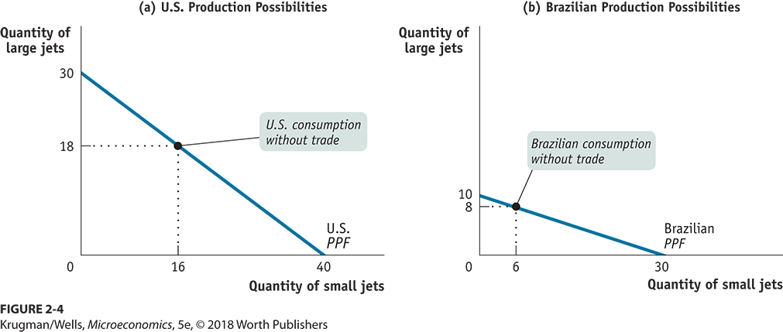
HOW COMPARATIVE ADVANTAGE CREATES GAINS FROM TRADE (1 of 2)

Slide 20
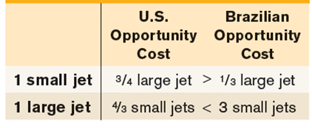
HOW COMPARATIVE ADVANTAGE CREATES GAINS FROM TRADE (2 of 2)
Since each country has a different opportunity cost, it makes sense to specialize and trade…

Slide 21
INDIVIDUAL AND COUNTRY COMPARATIVE ADVANTAGE
A country has a comparative advantage in producing a good or service if its opportunity cost of producing the good or service is lower than other countries’.
An individual has a comparative advantage in producing a good or service if his or her opportunity cost of producing the good or service is lower than for other people.

Slide 22
HOW BOTH SIDES CAN GAIN FROM TRADE
Table 2-2 How the United States and Brazil Gain from Trade
 |  | Without Trade: Production | Without Trade: Consumption | With Trade: Production | With Trade: Consumption | Gains from Trade
United States | Large Jets | 18 | 18 | 30 | 20 | 2
United States | Small Jets | 16 | 16 | 0 | 20 | 4
Brazil | Large Jets | 8 | 8 | 0 | 10 | 2
Brazil | Small Jets | 6 | 6 | 30 | 10 | 4
Through specialization and trade, both countries produce more and consume more than if they were self-sufficient.

Slide 23
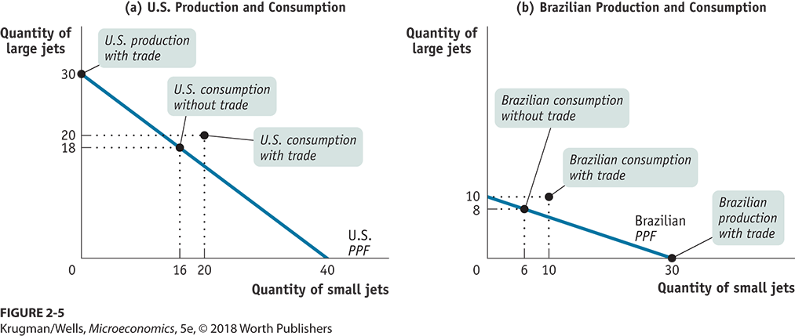
COMPARATIVE ADVANTAGE AND GAINS FROM TRADE (2 of 2)

Slide 24
ABSOLUTE VS. COMPARATIVE ADVANTAGE
Don’t confuse absolute with comparative advantage.
Just because the United States can produce more of both goods doesn’t mean we’re better off without trade.
Pay attention to opportunity costs:
If it’s cheaper for Brazil to produce small jets than it is for the United States, the United States will want to import small jets from Brazil.

Slide 25
LEARN BY DOING: PRACTICE QUESTION 3
If Texia specializes in food, it can produce 1,000 units of food and 0 units of clothing this year. If it specializes in clothing, it can produce 500 units of clothing and 0 units of food. This year Urbania can produce either 500 units of food and 0 units of clothing or 200 units of clothing and 0 units of food. (assume linear production possibility frontiers)
_______has the absolute advantage in the production of clothing and ________has the absolute advantage in the production of food.
Texia; Texia
Texia; Urbania
Urbania; Texia
Urbania; Urbania
Notes:
Answer is A

Slide 26
LEARN BY DOING: PRACTICE QUESTION 4
If Texia specializes in food, it can produce 1,000 units of food and 0 units of clothing this year. If it specializes in clothing, it can produce 500 units of clothing and 0 units of food. This year Urbania can produce either 500 units of food and 0 units of clothing or 200 units of clothing and 0 units of food. (assume linear production possibility frontiers)
_______has the comparative advantage in the production of clothing and ________has the comparative advantage in the production of food.
Texia; Texia
Texia; Urbania
Urbania; Texia
Urbania; Urbania
Notes:
Answer is B

Slide 27
LEARN BY DOING: PRACTICE QUESTION 5
If a country specializes according to its own comparative advantage and then trades with other nations:
it will operate at a point inside its production possibilities frontier.
it can consume at a higher level than the domestic production possibilities frontier.
its production possibilities frontier will shift or rotate inward.
it can consume at the same level as the domestic production possibilities frontier.
Notes:
Answer is B

Slide 28
LEARN BY DOING: PRACTICE QUESTION 6
Write down, then discuss with a partner:
What do you think? Would the U.S. economy be better off if we did not import so much clothing from China?
List the groups who you think would gain and the groups who would lose if Chinese clothing imports were restricted.

Slide 29
LEARN BY DOING: PRACTICE QUESTION 7
Suppose that in Australia, it takes 2 hours to harvest 10 bushels of apples and 4 hours to harvest 10 bushels of tomatoes. Suppose a worker in Brazil can harvest 10 bushels of apples in 4 hours or 10 bushels of tomatoes in 5 hours. Which of these statements is TRUE?
Brazil has a comparative advantage in producing tomatoes.
Brazil has a comparative advantage in producing apples.
Brazil has an absolute advantage in producing both goods.
In trade between these two countries, Australia would gain and Brazil would lose.
Notes:
Answer is A

Slide 30
TRANSACTIONS: THE CIRCULAR-FLOW DIAGRAM PART 1
Trade takes the form of barter when people directly exchange goods or services that they have for goods or services that they want.
The circular-flow diagram represents the transactions in an economy by flows around a circle.
A household is a person or a group of people that share their income.
A firm is an organization that produces goods and services for sale.

Slide 31
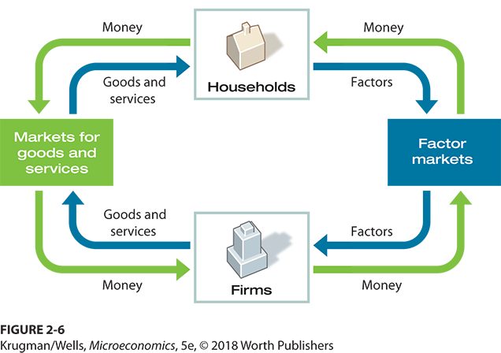
THE CIRCULAR-FLOW DIAGRAM

Slide 32
TRANSACTIONS: THE CIRCULAR-FLOW DIAGRAM PART 2
Firms sell goods and services that they produce to households in markets for goods and services.
Firms buy the resources they need to produce goods and services in factor markets.
An economy’s income distribution is the way in which total income is divided among the owners of the various factors of production.

Slide 33
LEARN BY DOING: PRACTICE QUESTION 8
With a partner, trace the following events through the circular flow:
the introduction of a new technology that boosts productivity
the decision of consumers to save more money
an increase in government spending

Slide 34
USING MODELS: POSITIVE VERSUS NORMATIVE ECONOMICS
Positive economics is the branch of economic analysis that describes the way the economy actually works.
Normative economics makes prescriptions about the way the economy should work.
Positive economics is about description; normative economics is about prescription.
A forecast is a simple prediction of the future.

Slide 35
LEARN BY DOING: PRACTICE QUESTION 9
Label each of the following statements as normative (a) or positive (b):
More than 60% of women are in the labor market.
Rent control laws should be implemented because they help to achieve equity or fairness in housing.
Society should take measures to end gun violence.
People who smoke pass on increased medical costs to the whole society.
Single mothers are more than twice as likely as married mothers to be in poverty.
Notes:
Positive: #1, 4, 5
Normative: # 2, 3

Slide 36
USING MODELS: WHEN AND WHY ECONOMISTS DISAGREE
Media coverage tends to exaggerate the real differences in views among economists.
Economics is often tied up in politics.
Powerful interest groups find and promote economists who profess supportive opinions.
Diverse people have diverse values.
Reasonable people can come to different conclusions because of their values.
Economic modeling requires simplifying assumptions.
Two economists can legitimately disagree about which simplifications are appropriate.

