Slide 1

HRR Genes Databases

Slide 2

Project Background
HRR process (homologus recombinational repair) is a major DNA repair pathway that provides a mechanism for the error-free removal of damage present in DNA.
The impairment of HRR process is called homlogous recombinaion repair deficiency (HRD) and genes involved in this pathway. such as BRCA1/2 or PALB2 needed for repair can be either mutated within the tumor or germline.
The impaired genes sensitize the tumor to PARP inhibitors and platinum-based chemotherapy, which target the destruction of cancer cells by working in tandem with HRD through synthetic lethality.
PARP inhibitors have shown great promise in BRCA deficent cells in clinical studies, and several have been approved for treatment of ovarian, breast, prostate and pancreatic cancers in different clinical settings. This has led to HRD positivity as a new biomarker for patient stratification.
By doing this project we aim to create a database that will assist in

Slide 3
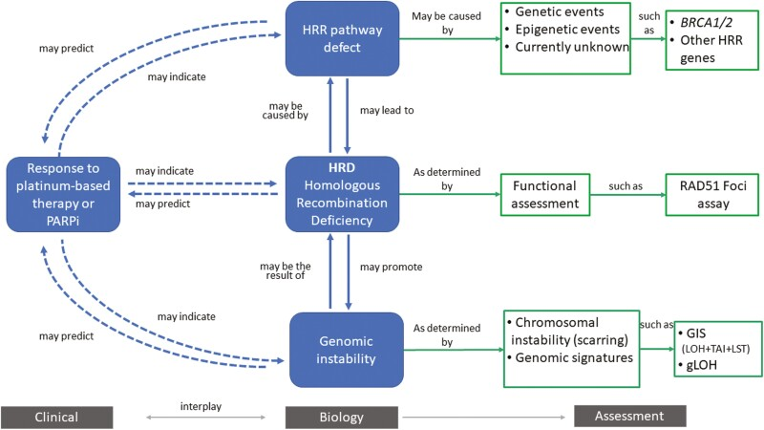
Project Background
By doing this project we aim to create a database that will assist in HRR gene exploration from under represented Indian Cancer Cohort.

Slide 4
Project Objectives
To make a database of HRR genes associated details observed from under-represented Indian Cancer Cohort.
To make exploration of HRR genes easier

Slide 5
Project’s Cohort
Parameter | Count
Total Number of Samples | 1434
Total Number of Annotated Samples | 607
Total Number of Samples with VCF | 457
Total Number of Samples with NO VCF | 370
For this project we will use 607 annotated Samples

Slide 6
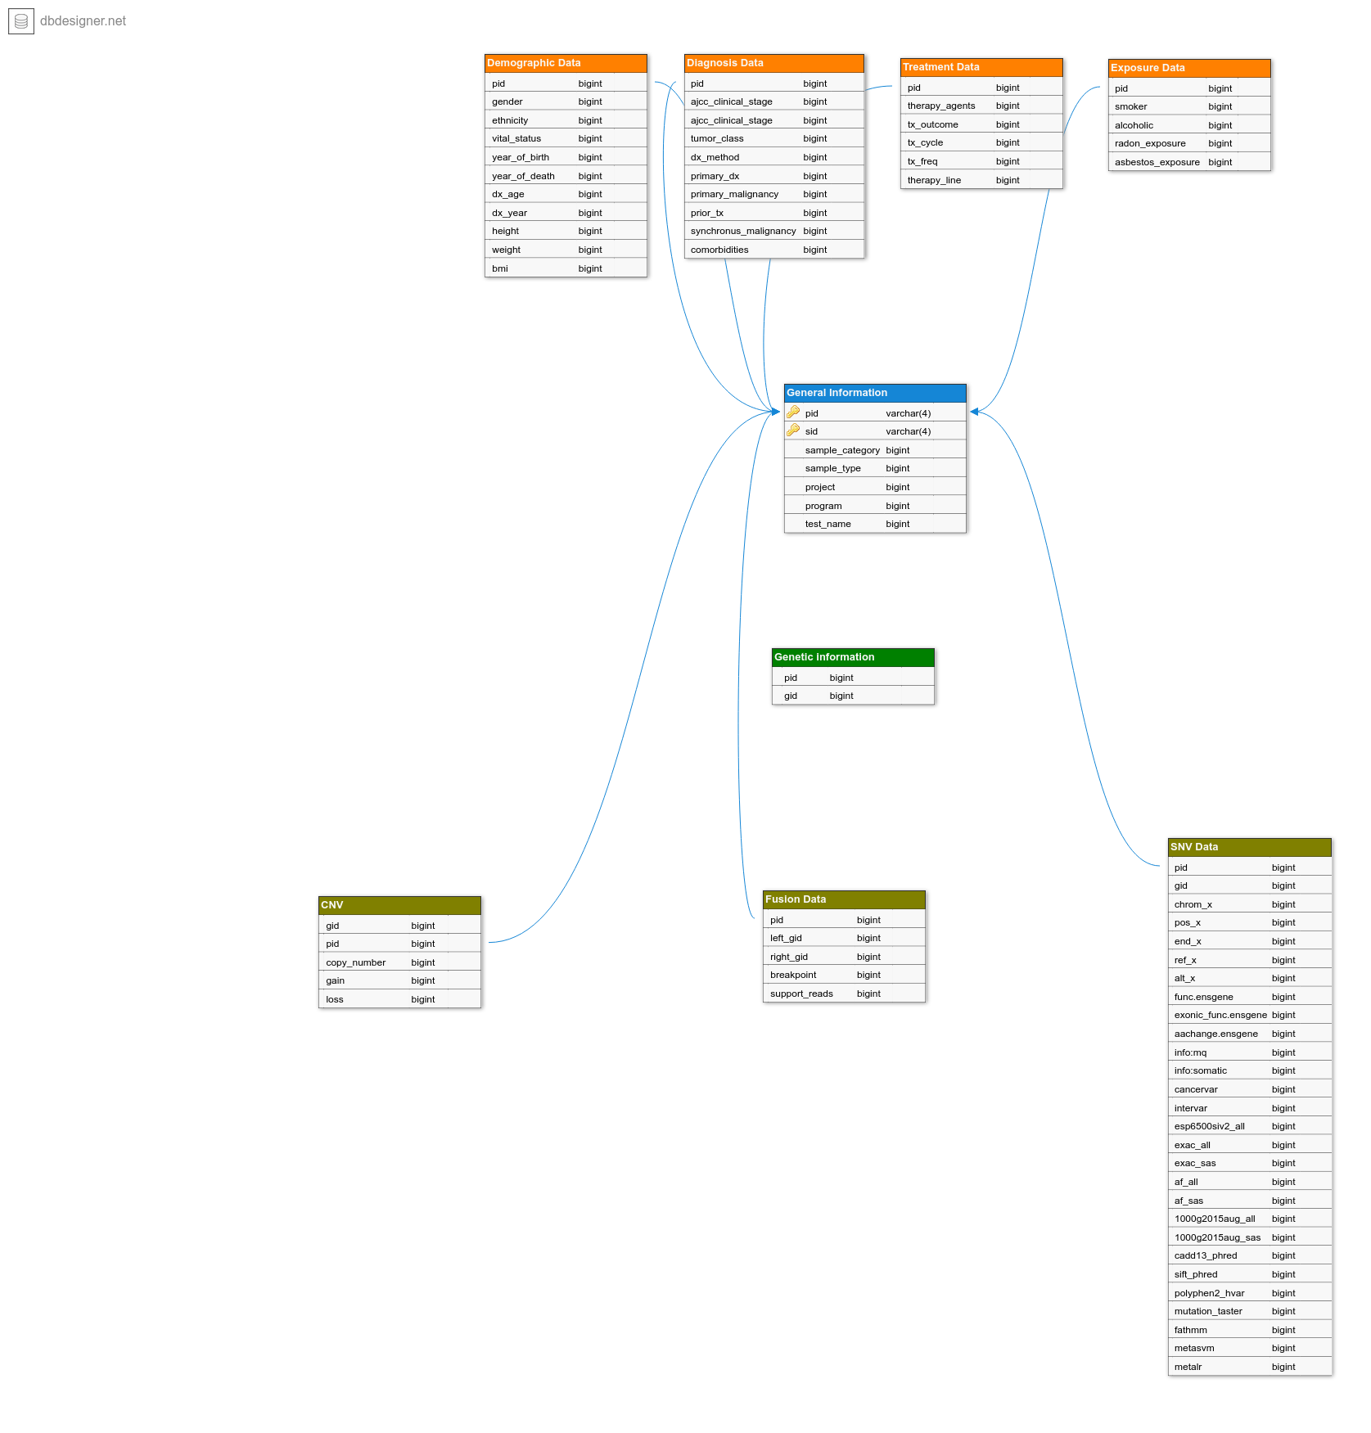
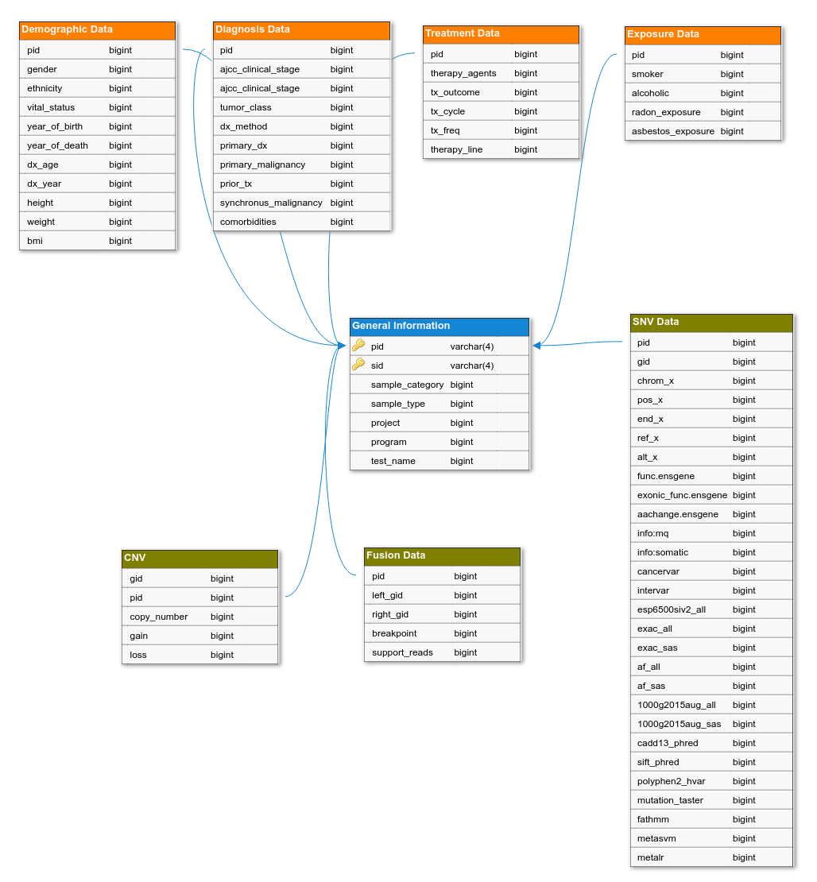
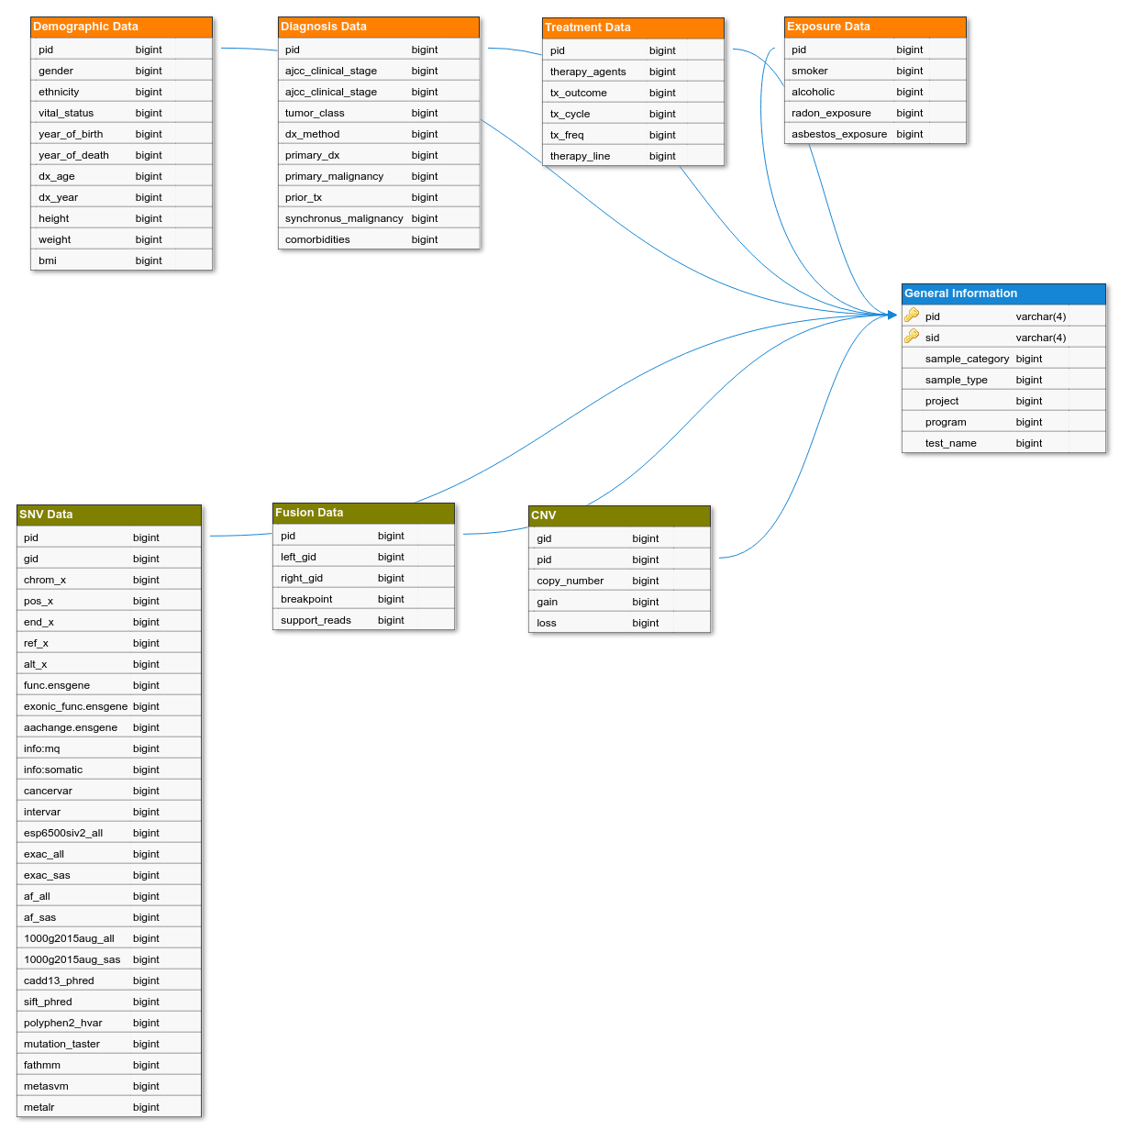
Work Done So Far
Input Files are sorted out
Necessary Information Fields have been decided
Rough Database Schema has been made
Preprocessing python script has been made
Rough Relational Database Schema

Slide 7
Support Needed

