Slide 1
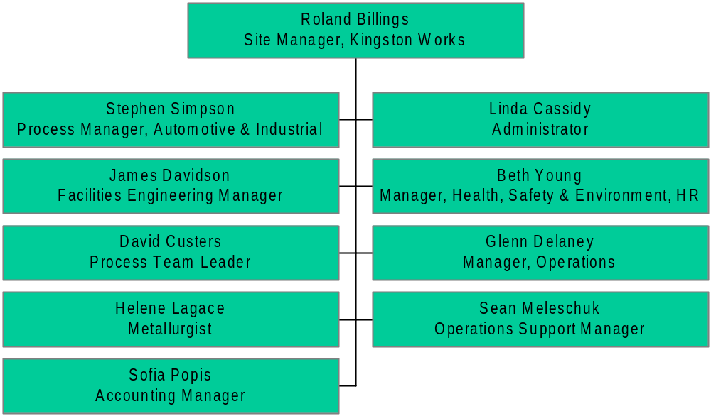
Rolled Products Americas and Asia

Slide 2
[Intro]
Hey
Hey
Hey
Hey
[Verse 1]
It takes a certain kinda man with a certain reputation_x000b_To alleviate the cash from a whole entire nation
Take my loose change and build my own space station
Just because you can, man
Ain't no refutin' or disputin' I'm a modern Rasputin
So contract disputes to some brutes in Louboutin
Act highfalutin while my boys put the boots in
Yeah you can, can
(Spasiba)
[Chorus]
Party like a Russian
End of discussion
Dance like you got concussion oh
Put a doll inside a doll
Party like a Russian
Disco seduction
Party like a Russian oh
Have it like an oligarch
[Post-Chorus]
Oh oh oh oh (hey)
Oh oh oh oh oh oh

Slide 3
[Verse 2]
I've got Stoli and Bolly and molly, so I'm jolly
And I'm always off my trolley, so I never say sorry
There's a doll inside a doll inside a doll inside a dolly
Hello, Dolly
I put a bank inside a car inside a plane inside a boat
It takes half the Western world just to keep my ship afloat
And I never ever smile unless I've something to promote
I just won't emote
(Spasiba)
[Chorus]
Party like a Russian
End of discussion
Dance like you got concussion oh
We've got soul and we've got gold
Party like a Russian
Disco seduction
Party like a Russian oh
Have it like an oligarch
[Bridge]
Raz, dva, tri, chetyre
Cause the Russian boys, we're everywhere
There's revolution in the air
Oh oh oh, oh oh oh
[Chorus]
Party like a Russian
End of discussion
Dance like you got concussion oh
Put a doll inside a doll
Party like a Russian
Disco seduction
Party like a Russian oh
Have it like an oligarch

Slide 4
A Project Gutenberg of Australia eBook Title: GONE WITH THE WIND Author: Margaret Mitchell (1900-1949) eBook No.: 0200161.txt Edition: 1 Language: English Character set encoding: ASCII--7 bit Date first posted: February 2002 Date most recently updated: February 2002 This eBook was produced by: Don Lainson dlainson@sympatico.ca Production notes: Nil Project Gutenberg of Australia eBooks are created from printed editions which are in the public domain in Australia, unless a copyright notice is included. We do NOT keep any eBooks in compliance with a particular paper edition. Copyright laws are changing all over the world. Be sure to check the copyright laws for your country before downloading or redistributing this file. This eBook is made available at no cost and with almost no restrictions whatsoever. You may copy it, give it away or re-use it under the terms of the Project Gutenberg of Australia License which may be viewed online at http://gutenberg.net.au/licence.html To contact Project Gutenberg of Australia go to http://gutenberg.net.au Title: GONE WITH THE WIND Author: Margaret Mitchell (1900-1949) GONE WITH THE WIND by Margaret Mitchell PART ONE CHAPTER I Scarlett O’Hara was not beautiful, but men seldom realized it when caught by her charm as the Tarleton twins were. In her face were too sharply blended the delicate features of her mother, a Coast aristocrat of French descent, and the heavy ones of her florid Irish father. But it was an arresting face, pointed of chin, square of jaw. Her eyes were pale green without a touch of hazel, starred with bristly black lashes and slightly tilted at the ends. Above them, her thick black brows slanted upward, cutting a startling oblique line in her magnolia-white skin--that skin so prized by Southern women and so carefully guarded with bonnets, veils and mittens against hot Georgia suns. Seated with Stuart and Brent Tarleton in the cool shade of the porch of Tara, her father’s plantation, that bright April afternoon of 1861, she made a pretty picture. Her new green flowered-muslin dress spread its twelve yards of billowing material over her hoops and exactly matched the flat-heeled green morocco slippers her father had recently brought her from Atlanta. The dress set off to perfection the seventeen-inch waist, the smallest in three counties, and the tightly fitting basque showed breasts well matured for her sixteen years. But for all the modesty of her spreading skirts, the demureness of hair netted smoothly into a chignon and the quietness of small white hands folded in her lap, her true self was poorly concealed. The green eyes in the carefully sweet face were turbulent, willful, lusty with life, distinctly at variance with her decorous demeanor. Her manners had been imposed upon her by her mother’s gentle admonitions and the sterner discipline of her mammy; her eyes were her own. On either side of her, the twins lounged easily in their chairs, squinting at the sunlight through tall mint-garnished glasses as they laughed and talked, their long legs, booted to the knee and thick with saddle muscles, crossed negligently. Nineteen years old, six feet two inches tall, long of bone and hard of muscle, with sunburned faces and deep auburn hair, their eyes merry and arrogant, their bodies clothed in identical blue coats and mustardcolored breeches, they were as much alike as two bolls of cotton. Outside, the late afternoon sun slanted down in the yard, throwing into gleaming brightness the dogwood trees that were solid masses of white blossoms against the background of new green. The twins’ horses were hitched in the driveway, big animals, red as their masters’ hair; and around the horses’ legs quarreled the pack of lean, nervous possum hounds that accompanied Stuart and Brent wherever they went. A little aloof, as became an aristocrat, lay a black-spotted carriage dog, muzzle on paws, patiently waiting for the boys to go home to supper. Between the hounds and the horses and the twins there was a kinship deeper than that of their constant companionship. They were all healthy, thoughtless young animals, sleek, graceful, high-spirited, the boys as mettlesome as the horses they rode, mettlesome and dangerous but, withal, sweet-tempered to those who knew how to handle them. Although born to the ease of plantation life, waited on hand and foot since infancy, the faces of the three on the porch were neither slack nor soft. They had the vigor and alertness of country people who have spent all their lives in the open and troubled their heads very little with dull things in books. Life in the north Georgia county of Clayton was still new and, according to the standards of Augusta, Savannah and Charleston, a little crude. The more sedate and older sections of the South looked down their noses at the up-country Georgians, but here in north

