Slide 1


MaxDock
A Max Solutions product
Dock scheduling, load combining and receiving — built in-house for the way our plants actually ship.
Freight arrives
when we say
it will.
An introduction for the leadership team
August 2026
MaxDock
1
MAX SOLUTIONS
Notes:
MaxDock. A Max Solutions product. Freight arrives when we say it will. Dock scheduling, load combining and receiving, built in-house for the way our plants actually ship. An introduction for the leadership team, August 2026.

Slide 2
HOW THIS STARTED
One Tuesday morning, and none of it was unusual.
This is where MaxDock came from — not a plan for software, a morning at one plant written down as it happened.
06:40
A truck at the gate nobody expected
Nothing in writing said it was coming, so nothing had been planned for it.
WHAT THAT MORNING COST
Three trucks, two people
07:15
Two more, inside the same fifteen minutes
The crew was set a week earlier, against a day nobody could see yet.
Four doors free and two people on shift. The doors were never the constraint.
An hour and forty of waiting
09:20
The lot backs up, and the clock is running
The first truck arrived before anyone knew it existed. Detention is billed by the hour.
The 06:40 truck is still waiting, and waiting gets charged back to us.
Two half-empty trailers
11:00
Guelph asks where their skids are
Same lane, same week, two separate trucks, two freight charges paid in full.
Half a trailer went Tuesday. The other half is booked to go Thursday.
A morning of phone calls
15:30
The day gets written up from memory
Spent rebuilding a schedule that already existed in three places.
Whoever answered the phone is the only record of what was agreed.
Written down over a few months, the same six things kept coming back. They are the next slide.
MaxDock
2
MAX SOLUTIONS

Slide 3
WHY WE STARTED THIS
Every one of these is a real day. None of them was rare.
MaxDock began as a list of things that kept going wrong at the dock, written down as they happened.
01
Everyone at once
02
Sent when it suited the sender
03
Doors open, nobody to unload
Several trucks in the same hour, and no list anywhere of who was coming when.
Our own sites dispatched on their own availability, not on the receiving plant's.
Two trucks receivable on paper. One crew in practice. Both of them waited.
04
The lot backs up
05
Nothing to plan against
06
Freight paid twice
Trucks queue in the yard, and waiting turns into detention charged back to us.
No forward view, so labour could not be set against tomorrow's arrivals.
Two part-loads to the same plant inside two days, on two separate trucks.
Underneath all six: a day of phone calls and emails spent reassembling a schedule that nobody could see.
39.3%
of truck stops end in detention. ATRI names the causes: the customer's scheduling, staffing and dock space.
MaxDock
3
MAX SOLUTIONS
Notes:
Why this exists. Six problems, all real: trucks arriving at once with no appointment list; our own sites shipping when it suited them; doors open with no crew to unload; the yard backing up into detention; no forward view to plan labour against; and freight paid twice for the same lane. Underneath all of it, a day of phone calls and emails. Industry benchmark: ATRI's 2024 research found drivers detained at 39.3 per cent of stops, with customer scheduling, staffing and dock space among the named causes.

Slide 4
WHAT WAS MISSING
No discipline, and nothing anybody could measure.
Five things a dock schedule has to do. Four were not being done at all — and the fifth is not done by anyone on the market.
1
Discipline
Any truck could arrive at any door at any hour, and nothing in the process said no.
Every dock product does this
2
Visibility
Nobody outside the shipping office could see where a load was, so they phoned to ask.
Every dock product does this
3
Traceability
A wrong load at a wrong site was found at the door, and left no record afterwards.
Every dock product does this
4
Measurement
No carrier reliability, no dock labour hours, no door utilisation. Nothing to improve against.
Every dock product does this
5
Efficiency
Two half-empty trailers on the same lane on the same day, with nothing looking for them.
Nobody on the market does this
Opendock, C3 Solutions and Transporeon were built for the first four.
The fifth is ours: half of what we move is plant to plant.
MaxDock
4
MAX SOLUTIONS
Notes:
What was missing: discipline, visibility, traceability, measurement — and efficiency. The market's dock scheduling products all address the first four. The fifth, combining loads onto one truck, is not something they do, and it matters here because half of what we move is plant to plant.

Slide 5
WHY THE MARKET DID NOT SOLVE IT
We were not the first to notice.
Opendock, C3 Solutions and Transporeon each began with a problem we recognise. Not one of them began with ours.
Opendock
C3 Solutions
Transporeon
MaxDock
THE PROBLEM IT WAS BUILT FOR
THE PROBLEM IT WAS BUILT FOR
THE PROBLEM IT WAS BUILT FOR
THE PROBLEM WE BUILT FOR
Dock coordination run on phone calls, emails and spreadsheets — impossible to scale, and invisible to everyone who needs it.
Trailers sitting, yards congesting, and detention charged for the time a truck spent waiting to be dealt with.
Arrivals bunching into peaks, so trucks queue at one hour of the day while doors stand idle at another.
All three of those — and two of our own trailers going the same way, half empty, two days apart, with nobody looking.
The figure they cite: 39.3% of truck stops end in detention (ATRI).
Their own claim: up to 90% less paid in detention.
Their own claim: up to 40% less waiting at the door.
Our own run: two bookings, one truck, 88% full.
WHAT IT MEASURES
Appointments kept.
Detention avoided.
WHAT IT MEASURES
Dwell time.
Yard and door productivity.
WHAT IT MEASURES
Waiting time.
How flat the day runs.
WHAT IT MEASURES
Trucks removed.
Skids per trailer, and crew hours.
All three schedule the arrival.
Only one of them also decides what goes on the truck — because at Max Solutions, both ends of the move are the same company.
MaxDock
5
MAX SOLUTIONS

Slide 6
WHERE WE ARE NOW
The schedule lives in three places, and none agree.
Nothing here is anybody's fault. It is what happens when a dock is booked by whoever picks up the phone.
THE PHONE
THE SPREADSHEET
THE WHITEBOARD
A booking is a conversation
One file, one site, one owner
True only in that room
A carrier calls, somebody says yes, and the only record is in one person's head until they write it down. When they are off, the plant guesses.
It cannot check whether the door is free, whether the trailer fits, or whether floor space is left. It accepts anything typed into it.
The shipping office knows what is happening. The customer, the carrier and the next plant find out by calling and asking.
The cost: a schedule that exists in one person's memory.
The cost: an appointment nobody checked before accepting it.
The cost: everyone outside the room has to phone and ask.
The cost is not one big number.
It is a hundred small ones: trucks waiting, doors idle, part-full trailers leaving, and a day nobody can reconstruct afterwards.
MaxDock
6
MAX SOLUTIONS
Notes:
The phone: a booking is a conversation. The spreadsheet: one file, one site, one owner. The whiteboard: true only in that room. The cost is a hundred small ones — trucks waiting, doors idle, part-full trailers leaving, and a day nobody can reconstruct afterwards.

Slide 7
DOCK SCHEDULING AND RECEIVING · MAX SOLUTIONS
Every door, every truck, on one screen.
MaxDock replaces phone calls, spreadsheets and whiteboards with one live online portal.
WHAT IT REPLACES
How a load moves through it
Phone calls
A booking nobody else can see
1
Supplier books the slot
Spreadsheets
One file, one site, one owner
Against that plant's real rules, with no phone call
2
Rules stop bad appointments
Whiteboards
Wiped at the end of the day
A time that would be refused on arrival is never offered
3
Coordinator moves the schedule
Email chains
Answered twice, filed nowhere
Drag a load to another door; the rules travel with it
Suppliers and carriers book their own slot against the rules each plant actually runs. Everything in this deck is working portal functionality you can open today, not a concept.
4
Reports come from dock taps
No form to fill in, so no figure anybody can massage
4
time zones,
one clock
9
reports
3
taps to receive
a truck
2
part loads
on one truck
0
licences
to buy
MaxDock
7
MAX SOLUTIONS
Notes:
MaxDock replaces the phone calls, spreadsheets and whiteboards that currently decide which truck goes to which door. Four time zones, one clock. Nine reports. Three taps to receive a truck. Two part loads on one truck. Zero licences to buy.

Slide 8
WHAT YOU WILL SEE
Eight things, in the order a load meets them.
Every one of them is working portal functionality, not a plan.
01
The board
05
What it measures
Every door, hour by hour, on one screen
Who keeps their appointment, and how much we saw
02
Combining freight
06
Compared
Two half-empty trailers become one truck
Where MaxDock differs from what is on the market
03
Booking
07
Where it stands
The supplier books it; nobody answers the phone
Built, not built, and deliberately not building
04
At the dock
08
What we need
A phone, three buttons, and every tap a timestamp
Five decisions, none of them technical
Four screens in this deck are photographs of the running product, marked THE REAL SCREEN.
MaxDock
8
MAX SOLUTIONS
Notes:
What you will see: the board, combining freight, booking, at the dock, what it measures, compared, where it stands, what we need.

Slide 9
THE SCREEN EVERYTHING ELSE HANGS OFF
One board. Every door, hour by hour.
Dock board · Mississauga · live, today
It refreshes on its own, so a wall display in the shipping office is always current. A coordinator can drag a load to another door, and the rules travel with it.
07
08
09
10
11
12
13
14
15
16
Door 1
Cascades
Received
Door 2
Guelph
Titanium
EVERY COLOUR IS A FACT
Door 3
Inbound
Received
En route to Guelph
Outbound
Door 4
Kruger
Pickering
Received
En route
Door 5
Domtar
Outbound
Inbound, outbound, received, and on the road between two of our own plants.
Now
MaxDock
9
MAX SOLUTIONS
Notes:
One board, every door, hour by hour. It refreshes on its own, a coordinator can drag a load to another door, and the rules travel with it. Every colour is a fact.

Slide 10
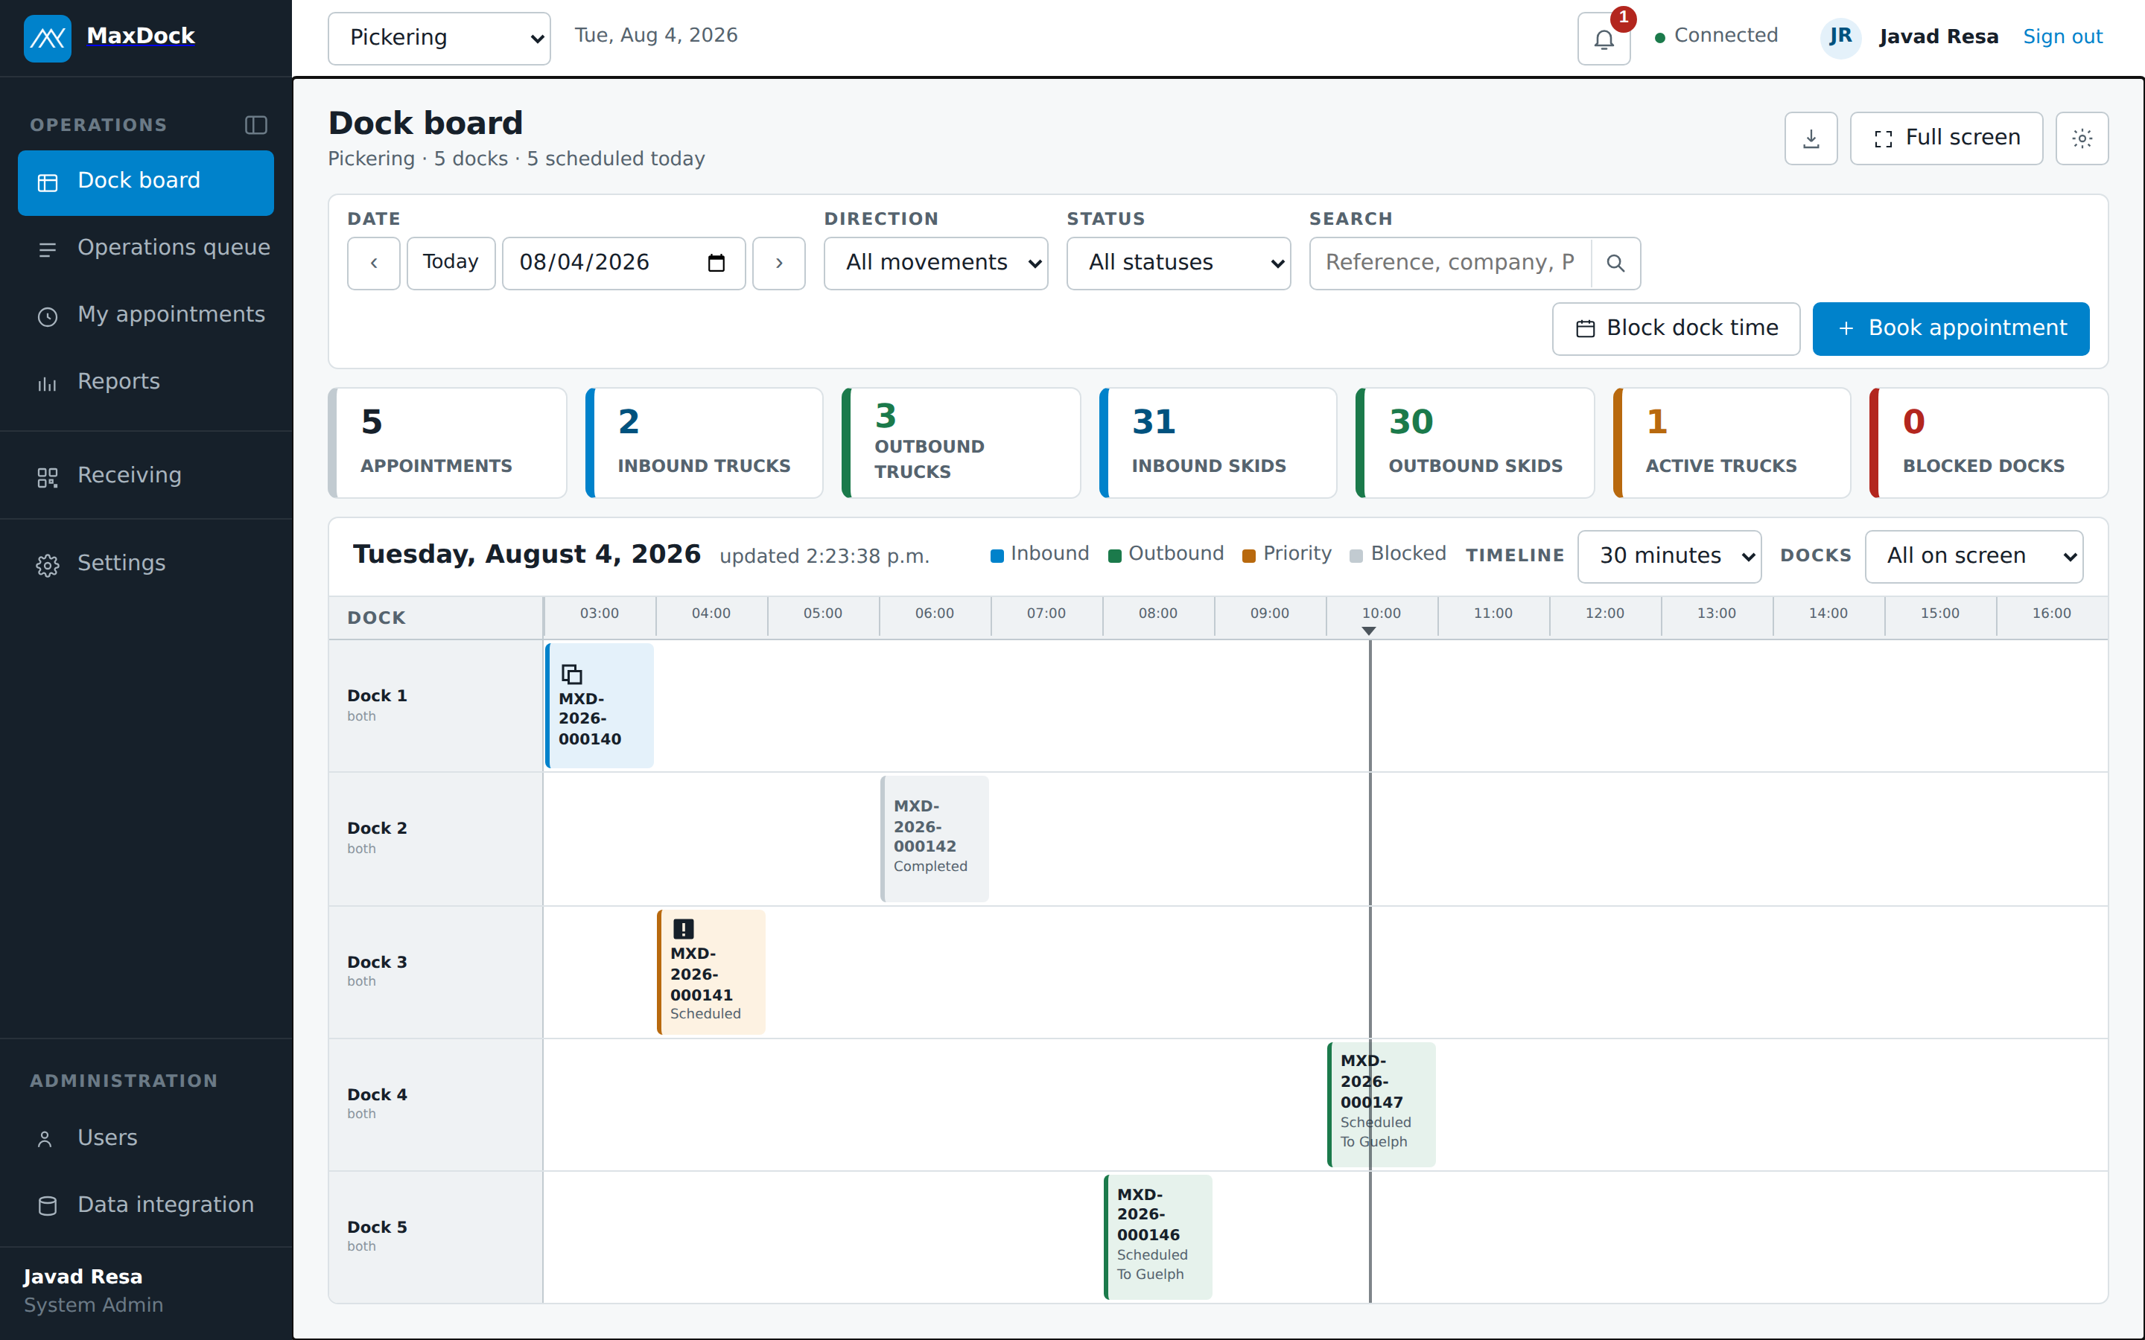
THE REAL SCREEN
This is the dock board today.
Not a mock-up. This is MaxDock running, captured from the build described in this deck.
Site and date
One picker moves the whole board between plants and days.
The seven counts
Trucks and skids in and out, active trucks, blocked doors.
The now line
The vertical rule is the current time at that plant, in its own time zone.
Each block
Reference, status and destination. Click it for the full load.
Book appointment
The same wizard an outside company sees.
MaxDock
10
MAX SOLUTIONS
Notes:
Real screen: the dock board today. Site and date picker, seven counts, now line, each block, and book appointment.

Slide 11
THE ONE WITH MONEY ATTACHED
Two half-empty trailers are one truck.
MaxDock watches for loads going the same way on the same day and offers to put them on one truck.
Outbound · Mississauga to Guelph · Thursday
BEFORE
AFTER
MXD-2026-000071
MXD-2026-000074
One trailer at 88%
53 ft · 26 skids
53 ft · 26 skids
47%
41%
Same two loads. Same day. One full freight charge removed.
Why it matters here
The customer still sees their booking
A folding-carton plant ships partial trailers constantly. Every avoided truck is a freight charge that never gets paid, and a door-hour given back.
Both numbers are kept. The merged appointment records what each original load contributed, so nothing disappears from anybody's view.
No other dock-scheduling product does this. They schedule doors; they do not look inside the trailer.
MaxDock
11
MAX SOLUTIONS
Notes:
Two half-empty trailers are one truck. MaxDock watches for loads going the same way on the same day and offers to put them on one truck. No other dock-scheduling product does this.

Slide 12
THE DETAIL THAT MAKES IT USABLE
It offers a bigger trailer, not a later day.
This is the difference between a suggestion a coordinator accepts and one they learn to dismiss.
Two loads, one lane, Thursday
Booked separately
Combined onto the 48 ft
MaxDock offers the 53 ft
14 skids + 12 skids
26 of 24 — over by 2
26 of 26 — fits
48 ft holds 24
48 ft holds 24
53 ft holds 26
The naive feature says: “try Friday.” That answer is useless, and a coordinator stops reading it.
MaxDock checks every other trailer type the plant runs before it gives up on the day.
Capacity here is skids — the unit the dock actually thinks in. Every bar is on one scale; full width is 26 skids.
MaxDock
12
MAX SOLUTIONS
Notes:
When it will not fit, it offers a bigger trailer, not a later day. 14 skids plus 12 skids overfills a 48 ft but fits a 53 ft.

Slide 13
MAX TO MAX
One booking. A door at both ends.
Half of what moves is ours going to ourselves. Today that is two phone calls and two diary entries that drift apart.
Mississauga to Guelph · MXD-2026-000074
Outbound
Inbound
Guelph knew before anybody phoned
Mississauga
Guelph
Shipping · Door 2
one booking
Receiving · Door 4
ONE TAP, TWO BOARDS
Mississauga · Shipped
Guelph · En route
a second later
The shipping site taps Shipped. That tap is the departure, so Guelph's board reads En route. Each end sees the words that are true from where it is standing.
MaxDock
13
MAX SOLUTIONS
Notes:
Max to Max: one booking, a door at both ends. The shipping site taps Shipped; Guelph's board reads En route. Each end sees the words that are true from where it is standing.

Slide 14
WHERE THIS IS GOING
The appointment books itself.
However a booking is created, it meets the same rules. The bridge to TMS and CABL is in build and heading for test.
WHERE A BOOKING COMES FROM
WHAT CHECKS IT
WHERE IT LANDS
Customer or carrier
Live today
MaxDock
One dock board
Coordinator
CHECKS THE RULES, HOLDS THE DOOR
Typed by a supplier, typed by a coordinator, or created by the bridge — it lands the same way.
Live today
The plant's own duration rules, not a fixed hour
TMS
In build
A door that is free, fits the trailer, and has floor space
The same rules applied
The same board and the same queue
CABL
One booking reference and one QR code, whatever created it
In build
The same audit history behind it
MaxDock does not wait for the bridge. The bridge removes the typing between a plant's systems and the dock. It does not switch the product on — that already happened.
MaxDock
14
MAX SOLUTIONS
Notes:
The bridge to TMS and CABL is in build and heading for test. However the booking arrived, it lands under the same rules with the same QR code. MaxDock does not wait for the bridge.

Slide 15
SELF-SERVICE BOOKING
The supplier books it. Nobody answers the phone.
A customer, vendor or carrier signs in and books against that plant's real rules. Three steps, and it used to be five.
1
Load & truck
2
Time
3
Confirm
What is on it, how many skids, which trailer, which handling. MaxDock works out how long the door will be occupied from the plant's own duration rules.
Only times that genuinely work are offered. Nothing that would be refused on arrival ever appears on the screen.
A booking reference and a QR check-in code, shareable to a driver who has no MaxDock account. If another load could share the truck, MaxDock says so here.
08:30
09:00
10:30
13:00
MXD-2026-000074
22 skids · 53 ft · 90 minutes at the door
Only what survives every rule is offered
Scanned at the door
Nothing typed that the plant cannot honour
A slot on the screen is a slot you will get
The driver needs no account and no app
Each outside company sees only its own bookings. That isolation is enforced in the database, not by hiding buttons.
Nobody is locked out. A coordinator can still book on somebody's behalf, and every booking lands on the same board.
Three steps, and it used to be five. Every step removed is a booking that gets finished.
MaxDock
15
MAX SOLUTIONS
Notes:
Self-service booking: load and truck, time, confirm. Outside companies see only their own bookings. A coordinator can still book on somebody's behalf.

Slide 16
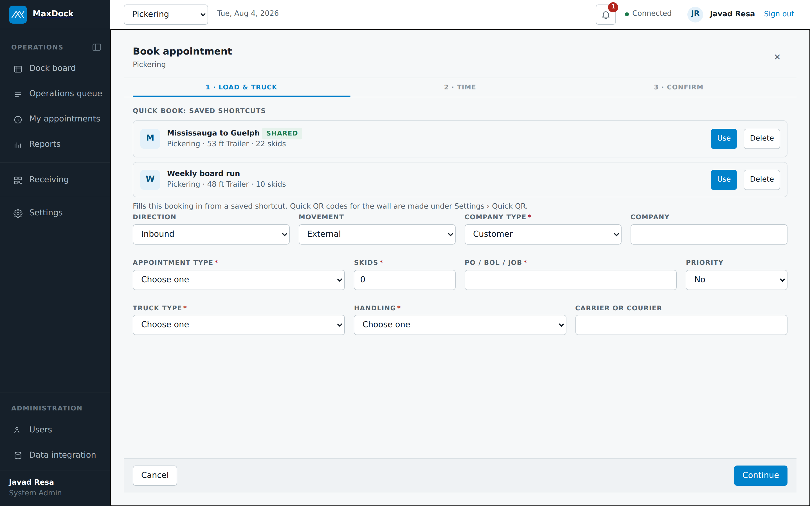
THE REAL SCREEN
What the supplier actually fills in.
Step one of three. The booker chooses the site and the load; MaxDock works out the door time from that plant's own rules.
No free-text times
The booker never types a time. They pick from what is genuinely available on that day, at that plant.
Skids, not guesses
Trailer and skid count drive how long the door is held, so the board reflects real occupancy.
One screen, three steps
It used to be five. Every step removed is a booking that gets finished instead of abandoned.
MaxDock
16
MAX SOLUTIONS
Notes:
Real screen: the supplier fills in step one of three. No free-text times. Skids, not guesses. One screen, three steps.

Slide 17
STEP TWO, IN DETAIL
A time is only offered if it survives every rule.
Thursday at Mississauga starts with twenty half-hour slots. Six of them are real.
Every half-hour slot, 07:00 to 17:00
20 times
Inside this plant's operating hours
18 times
Past the notice period this site requires
15 times
A door that is actually free
11 times
A door this trailer fits
9 times
Floor space still left for the skids
6 times
Every filter is configuration a site controls: operating hours, notice period, trailer fit, floor capacity, duration rules.
The quiet benefit: a slot that was never offered cannot be argued about on arrival.
MaxDock
17
MAX SOLUTIONS
Notes:
A time is only offered if it survives every rule: twenty slots become six. Twelve sites in four time zones each run their own rules, and every time is shown in local time.

Slide 18
MAXDOCK RECEIVING
At the door, it is a phone and three buttons.
Installable on any phone or tablet. Scan the QR on the paperwork, see the load, tap where it has got to.
Big targets, because it is used one-handed beside a running truck, in gloves, in February.
Receiving · Mississauga
MXD-2026-000071
Cascades · Outbound · 22 skids
Door 2 · 09:00 · 53 ft
The words follow the direction
Outbound: At the dock · Loading · Shipped
Inbound: At the dock · Unloading · Received
At the dock
Three taps, and that is the whole job
Loading
No forms, no notes to write up afterwards. The load is found by scanning it.
Shipped
Every tap is a timestamp
Shipped turns Guelph's board to En route.
Arrival, start, finish. That is where every report in this deck comes from.
The same app, on any phone the crew already carries. Nothing to buy and nothing to mount on a wall.
MaxDock
18
MAX SOLUTIONS
Notes:
MaxDock receiving: a phone and three buttons. Outbound: At the dock, Loading, Shipped. Inbound: At the dock, Unloading, Received. Every tap is a timestamp.

Slide 19
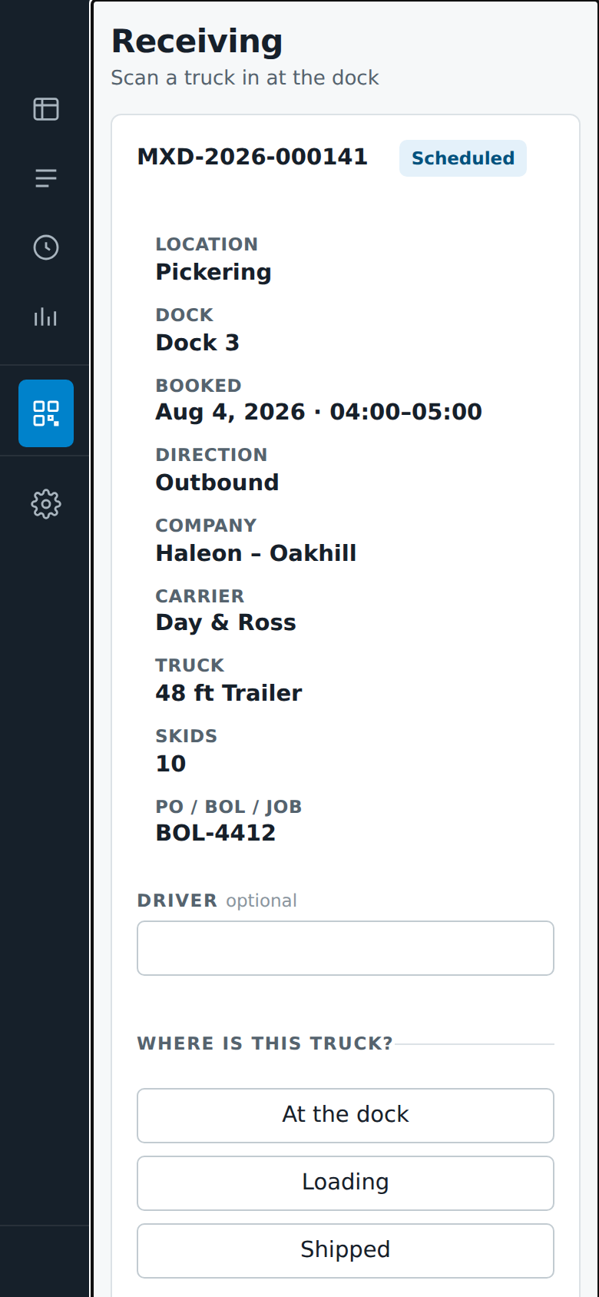
THE REAL SCREEN
The load, on the dock crew's phone.
Scanned in at the door. Everything the crew needs is above the fold, and the only thing to do is say where the truck has got to.
Reference and status
Everything about the load
MXD-2026-000141, Scheduled. The QR on the paperwork brought this up.
Site, door, booked window, direction, company, carrier, trailer, skids, and BOL.
Driver name, optional
Where is this truck?
Captured if it is useful, never a blocker to receiving the truck.
At the dock, Loading, Shipped. Three taps, and each one is a timestamp.
MaxDock
19
MAX SOLUTIONS
Notes:
Real screen: the load on the dock crew's phone. Reference and status, load details, optional driver name, and three taps for truck status.

Slide 20
A SMALL THING THAT SAVES A PHONE CALL
It knows where you are standing.
The pattern behind it: wherever MaxDock knows something the person does not, it says the specific thing.
Not “code not recognised.”
Receiving · Mississauga
This load belongs to Guelph
Scan a load booked into Guelph while standing at Mississauga and the phone says so by name. The old answer sends somebody to the office, and the truck waits while they walk.
MXD-2026-000074 is booked into Guelph, Door 4, today at 13:30. You are scanning at Mississauga.
Site
Guelph
Dock
Door 4
Booked
13:30
Truck
53 ft
It warns, it does not block.
A truck at the wrong site is a real situation with a real answer — and that answer belongs to the person standing there, not to the software.
Receive here anyway
The same pattern, everywhere in the product
A refusal names the rule that refused it. A wrong site names the site. A full floor says how many positions are left. Nothing in MaxDock says “invalid” and leaves somebody to work out why.
MaxDock
20
MAX SOLUTIONS
Notes:
MaxDock knows where you are standing. It warns, it does not block. It names the site the load belongs to instead of saying invalid or error.

Slide 21
WHAT COMPETITORS COUNT, AND WHAT WE COUNT
Capacity in skids, not in appointments.
Every other product caps trucks per hour. Two trucks per hour is meaningless when one carries 4 skids and the next carries 30.
Mississauga · floor position, Thursday
96 committed
26 this booking
18 left
140 floor positions at this plant
It runs the sum forward
So Thursday is not offered
And it stays out of the way
Every booked inbound adds skids to the floor. Every outbound takes them away. MaxDock runs that sum through the day, so it knows whether there is room before it offers a time.
The next load is 26 skids and only 18 positions remain. Thursday never appears on that booker's screen, so nobody has to refuse it at the door.
If a site has not set a floor number, the check simply does not run. Nothing is ever blocked by a number nobody entered.
Skids are the unit the dock thinks in, so they are the unit the schedule is built on.
MaxDock
21
MAX SOLUTIONS
Notes:
Capacity in skids, not appointments. 96 committed, 26 this booking, 18 left. The next load is 26 skids and only 18 positions remain, so Thursday is not offered at all.

Slide 22
WHAT IT MEASURES
Who keeps their appointment, and who does not.
Nine reports across any set of plants. The one that matters most is the simplest.
Carrier on-time · past 30 days
Cascades Containerboard
88 trucks
96.4%
Kruger Packaging
54 trucks
91.0%
Domtar
41 trucks
84.7%
Titanium Transport
36 trucks
73.2%
Day & Ross
19 trucks
61.8%
The same shape works by site, by customer and by vendor — the site scorecard is what a plant manager is measured on.
Built from timestamps the crew already created by tapping. Nobody keys in a figure, so nobody can quietly improve one.
MaxDock
22
MAX SOLUTIONS
Notes:
Who keeps their appointment and who does not. Carrier on-time, past 30 days: Cascades 96.4, Kruger 91.0, Domtar 84.7, Titanium 73.2, Day and Ross 61.8. The carrier scorecard is what gets quoted at a rate negotiation.

Slide 23
THE LINE THAT KEEPS THE REPORTS TRUSTWORTHY
It also tells you how much it measured.
On-time is counted only over loads that were actually scanned in.
Cascades Containerboard · on-time coverage
96.4%
COVERAGE
on time
61 of 88 scanned in
27 never scanned
It doubles as adoption. A site at 69% coverage is telling you something about its own habits, not just about its carriers.
Of the loads that were scanned in, 96.4% arrived inside their booked window.
The trucks nobody scans are more likely to be the late ones.
When a day gets chaotic, scanning is the first thing that gets skipped — which is exactly when a figure quoted without its coverage would flatter us.
Every report in MaxDock shows the count it was built from, so nobody has to ask how much of the picture they are looking at.
MaxDock
23
MAX SOLUTIONS
Notes:
Coverage: 96.4 per cent on time, 61 of 88 scanned in, 27 loads never scanned. It doubles as an adoption measure.

Slide 24
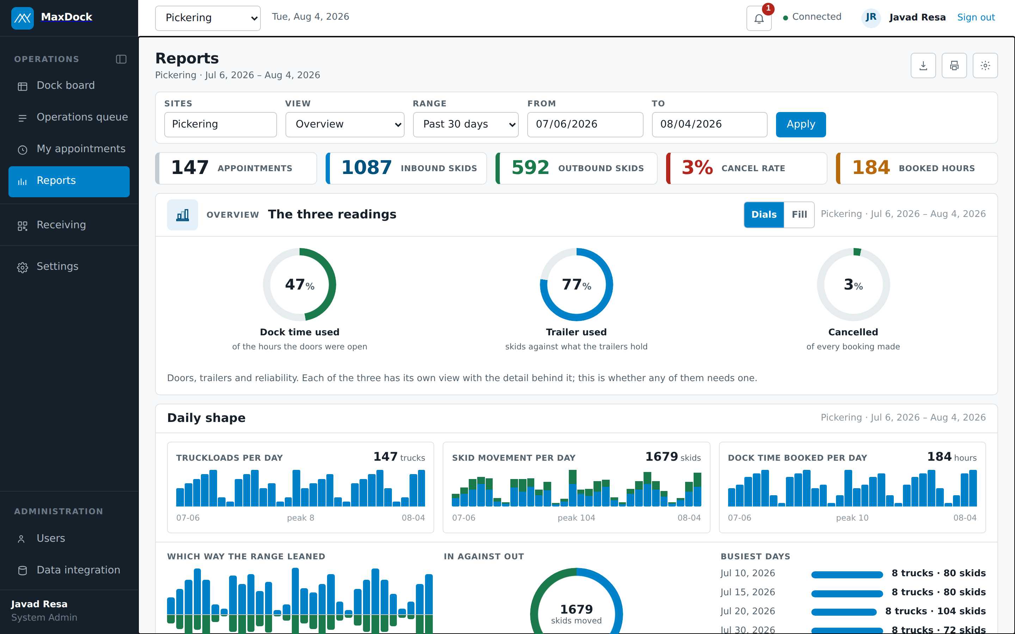
THE REAL SCREEN
Reports, built from taps nobody had to think about.
Any set of sites, any date range, nine views. Every figure here came from a booking made and a truck scanned.
The three readings
Doors, trailers and reliability — whether any of them needs a closer look.
Daily shape
Trucks, skids and booked hours per day, so a bad week is visible as a shape.
In against out
What the site took in versus what it sent out, and what that left on the floor.
Export and print
Export on every screen with data. Print lives here, where a printed page is the point.
MaxDock
24
MAX SOLUTIONS
Notes:
Real reports screen: the three readings; daily shape; in against out; export and print.

Slide 25
TWO MORE THAT COME FREE
Labour and door use, without a form to fill in.
A report may only use facts the software already collected while people did their jobs.
Dock labour, without a timesheet
Door use, hour by hour
MaxDock already knows how long each load occupies a door, because it calculated that to make the booking. Multiply by the crew each truck needs and you have dock labour hours per day, set against the shift roster.
The useful output is not the total. It is the shape: which hours are overloaded and which doors sit idle beside them.
Door 1
Mon
29 h
Door 2
Tue
40 h
Wed
21 h
Door 3
Thu
46 h
Fri
33 h
Door 4
07:00
17:00
Before spending money widening a dock, this picture says whether the doors are the constraint — or whether the scheduling was.
MaxDock
25
MAX SOLUTIONS
Notes:
Two more reports: dock labour without a timesheet, and door use hour by hour. The principle is that a report may only use facts the software already collected while people did their jobs.

Slide 26
PLANNING THE WEEK, NOT THE DAY
What next Thursday looks like, before next Thursday.
Bookings exist days ahead, so the crew can be set against them instead of after them.
DOCK HOURS BOOKED AGAINST CREW HOURS · MISSISSAUGA · NEXT WEEK
SO THE DAY GETS PROTECTED
MON
TUE
WED
THU
FRI
A standing limit
8 trucks
11 trucks
6 trucks
10 trucks
7 trucks
How many trucks a site will take at once, whatever the door count says.
A cap for one date
Tighten Thursday alone — at once, or for the whole day — and leave the rest of the week as it is.
29 of 38.4 h
34 of 38.4 h
21 of 38.4 h
33 of 30.4 h
26 of 38.4 h
Statutory holidays
76%
89%
55%
109%
68%
Chosen once per site, then computed and closed across every door, years ahead.
Thursday is over before it is booked. One person is off, so the crew has 30.4 hours and the schedule already holds 33.
A Thursday the floor cannot staff is a Thursday the booking screen never offers. The forward view is what turns a time-off request into arithmetic instead of a conversation.
MaxDock
26
MAX SOLUTIONS

Slide 27
EVERYTHING ELSE THAT IS ALREADY BUILT
And the rest of it.
Four more screens, all working, none of which needed a slide of their own.
Operations queue
My appointments
Today's work as a list: what is due, what is late, and what is at a door right now.
What an outside company sees — their own bookings, a QR code, and Share.
Settings
Users and roles
Eight sections: hours, notice, durations, docks, trailers, crew and capacity.
Who can do what, per site, with customer isolation enforced underneath.
All four are role-aware. What a coordinator sees is not what a customer sees, and not what a carrier sees. That is enforced in the database, not by hiding buttons.
MaxDock
27
MAX SOLUTIONS
Notes:
Everything else already built: operations queue, my appointments, settings, users and roles. All four are role-aware and enforced in the database.

Slide 28
THE PLAIN BEFORE AND AFTER
Six things that simply are not done today.
Not done badly — not done at all, because there has never been a system to do them in.
TODAY
WITH MAXDOCK
A week of appointments loaded at once
Retyped one at a time, or not booked at all
Bulk import from a spreadsheet, validated before it lands
Working now
Orders becoming dock appointments
Read off an email and keyed in again
The TMS and CABL bridge, in build now
In build
The booker told when something changes
A phone call, if somebody remembers
Confirmation, change and cancellation email
Next up
Three more overleaf. Four of the six are working today; the bridge and the email are in build and next up.
MaxDock
28
MAX SOLUTIONS
Notes:
Before and after: a week of appointments loaded at once through bulk import; orders becoming dock appointments through the TMS and CABL bridge; and the booker told when something changes, by confirmation, change and cancellation email.

Slide 29
THE PLAIN BEFORE AND AFTER
Three more that change the daily conversation.
These are the basics that turn a dock schedule from “who remembers?” into “open it and check.”
TODAY
WITH MAXDOCK
A number you can take away and check
Copy and paste into a spreadsheet
Export on every screen that holds data
Working now
Reconstructing what happened on Tuesday
Memory, and the whiteboard was wiped
Full audit history behind every load
Working now
Knowing a truck is at the wrong plant
Found out at the door, then a phone call
The phone names the site it belongs to
Working now
None of these needed inventing. They needed a system for the answer to live in.
MaxDock
29
MAX SOLUTIONS
Notes:
Before and after: export on every screen that holds data, full audit history behind every load, and the phone naming the site a wrong-plant truck belongs to.

Slide 30
COMPARED WITH WHAT IS ON THE MARKET
Where MaxDock is different.
The gap: established products treat every site as an island and never look inside the trailer.
MAXDOCK
THE MARKET
Load combining onto one truck
Yes
No
Bigger trailer offered when it will not fit
Yes
No
Plant-to-plant load booked at both ends
Yes
No
Floor capacity tracked in skids
Yes
Partial at best
Dock labour hours from the schedule
Yes
Partial / no
Licence cost per plant, per year
None
Subscription
Yard management is a deliberate omission, not a shortfall. There is no gate and no yard to manage in the operating model we are solving for.
MaxDock
30
MAX SOLUTIONS
Notes:
Where MaxDock is different: load combining, the bigger-trailer offer, plant-to-plant booking at both ends, floor capacity in skids, dock labour hours from the schedule, and no licence cost.

Slide 31
COMPARED WITH WHAT IS ON THE MARKET
MaxDock also covers the expected basics.
Competitor rows reflect publicly documented capability and are a guide for discussion, not a procurement assessment.
Carrier self-scheduling
Yes
Live dock board
Yes
Carrier scorecards
Yes
Phone app for the dock crew
Yes
Email confirmations and reminders
Building
Connects to the order / TMS system
In build
Yard management / trailer pool
By choice, no
OpenDock, C3 Solutions, Transporeon and Descartes all schedule doors. MaxDock's advantage is that it schedules the load, the trailer, the floor and the plant-to-plant movement as one system.
MaxDock
31
MAX SOLUTIONS
Notes:
The market comparison: carrier self-scheduling, live dock board, carrier scorecards and the phone app are yes. Email is building. The order and TMS connection is in build. Yard management is by choice, no.

Slide 32
WHERE IT STANDS TODAY
Working now, against the live database.
Not prototypes. Every item below can be opened and used this afternoon.
Booking
Operations
Self-service for customers, vendors and carriers
Live dock board and operations queue
Three steps, against each plant's real rules
Load combining, with the bigger-trailer offer
QR check-in code, shareable to any driver
Plant-to-plant movements booked at both ends
On the floor
Back office
Installable phone and tablet app
Nine reports, exportable, across any sites
Scan, then three taps to receive a truck
Roles, permissions, strict customer isolation
Wrong-site warning that names the plant
Bulk import, documents, full audit history
Built in-house. No licence, no per-plant subscription, and no vendor to renegotiate with. The trade is that the capability lives with us, which is a real thing to weigh.
MaxDock
32
MAX SOLUTIONS
Notes:
Working now: booking, operations, on the floor, back office. Built in-house, with no licence and no per-plant subscription. The trade is that the capability lives with us.

Slide 33
HONEST ABOUT THE REST
Named, not yet built.
These are gaps with a name and a path, not unknowns.
The TMS and CABL bridge
In build
Email confirmations and reminders
Blocked on a decision
In build now and heading for test. This is the piece that makes an appointment create itself.
The biggest gap in daily use. It needs a mail provider chosen — a decision, then a short job.
Copying the people CC'd on a booking
Blocked on a decision
Single sign-on with Microsoft 365
Configuration
When a booking changes, the people copied on it should hear. Same mail-provider dependency.
Configuration rather than development, once somebody in IT owns it.
Driver check-in by text
Next up
One end-to-end trial on a real load
Ready to run
For the driver with no app and no account, arriving at a plant for the first time.
Book it, scan it, complete it, and read the report it produced. Nothing to build first.
Two of the six wait on one decision: which mail provider we send from.
MaxDock
33
MAX SOLUTIONS
Notes:
Named, not yet built: the TMS and CABL bridge, email confirmations and reminders, copying the people CC'd on a booking, single sign-on with Microsoft 365, driver check-in by text, and one end-to-end trial on a real load.

Slide 34
HONEST ABOUT THE REST
Deliberately out of scope.
A gap you chose is not the same as a gap you have not noticed.
—
—
Yard and trailer-pool management
Gate check-in
There is no gate and no yard to manage. The truck arrives at the door, so the door is where MaxDock starts.
Same reason. A gate we do not have cannot produce a clock start we can trust.
—
—
Turnaround time as a headline measure
No-shows and rejected loads scoring against a site
With no gate there is no honest clock start, and GTA traffic makes the number argue with itself.
Recorded, and released by hand. A penalty nobody trusts is a penalty nobody uses.
The second list matters as much as the first. It is what keeps the system pointed at the problem we actually have.
MaxDock
34
MAX SOLUTIONS
Notes:
Deliberately out of scope: yard and trailer-pool management, gate check-in, turnaround time as a headline measure, and no-shows scoring against a site.

Slide 35
TO PUT IT IN FRONT OF REAL TRUCKS
Five decisions, and none of them are technical.
Everything in this deck already works. What is left is not building — it is deciding.
1
A mail provider
Unlocks confirmations, changes, cancellations and the people CC'd on a booking.
IT
2
The address MaxDock will live at
The phone app installs against a fixed address. Moving it later orphans the icon on every phone.
IT
3
A production database, separate from the one we build on
Today there is one, so there is nowhere to rehearse a change. The largest operational risk.
IT
4
The real account list, site by site
Coordinators, managers, and the outside companies who will book. Six accounts exist today.
Site admin
5
One plant to go first
A single site running it properly for a month teaches more than twelve running it half-heartedly.
Supply chain
Three of the five are one conversation with IT. The last one is the only decision that needs a name against it.
MaxDock
35
MAX SOLUTIONS
Notes:
Five decisions: a mail provider, the address MaxDock will live at, a production database separate from the one we build on, the real account list site by site, and one plant to go first.

Slide 36
MaxDock
Built, not proposed.
Freight arrives
when we say
it will.
The remaining work is deciding where it lives, who uses it first, and how we send the emails.
WHAT HAPPENS NEXT
1
Pick one plant to run it properly for a month
2
Choose a mail provider, and the emails switch on
3
Fix the address it lives at, before the app is installed
MaxDock
36
MAX SOLUTIONS
Notes:
Closing: MaxDock is built, not proposed. The remaining work is deciding where it lives, who uses it first, and how we send the emails.

