Slide 1
Group 35 Student Society Event Planner
ECM1414 – Data Structures and Algorithms
Max Thrift-Brothers
Cameron Russel
Utku Ozturk

Slide 2
The Problem:
A university society has a restricted amount of time and money to host an event weekend.
It would like to host the most memorable experience it can offer to its members whilst sticking to its time and/or budget.
This project analyses a list of potential activities using two algorithms.
It aims to find the subset of activities that maximises the enjoyment of its members whilst adhering to their available budget.

Slide 3
Event Planner
Purpose:
- Communicate with and link all three helper modules.
- Receives the optimal solution and outputs in a human-readable format.
- Also, it times the execution of each algorithm for analysis.
The three helper modules:
file_input – parses the input file, ready for the two algorithms to analyse
brute_force
dynamic_method

Slide 4
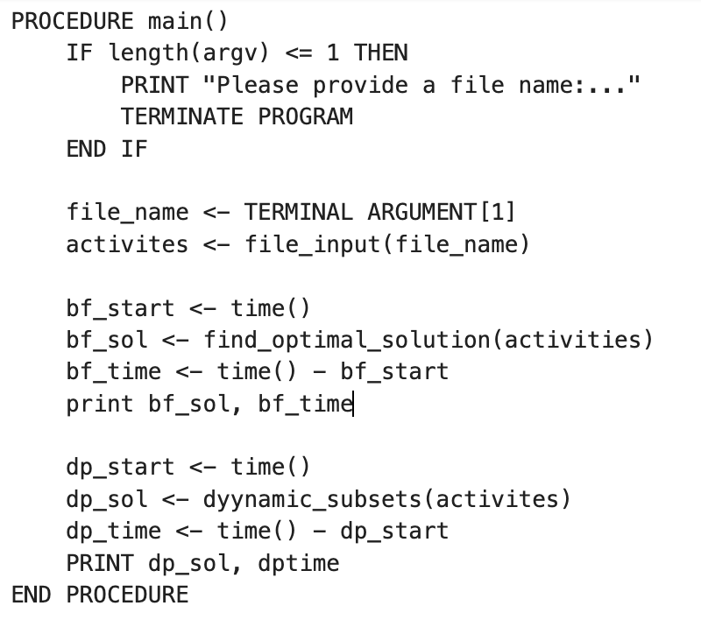
Event Planner
How it links them:
Reads file_name from the input in the terminal
Calls activites = file_input
Then it passes the same activities to both algorithms:
find_optimal_solution(activites)
Dynamic_subsets(activites)
Times each call using time() and prints both results

Slide 5
Brute Force Approach
...
FOR INTEGER size_of_subset FROM 1 TO number_of_activities DO
ARRAY[ARRAY[INTEGER]] subsets <- generate_subset(activity_indices, size_of_subset)
FOR ARRAY[INTEGER] subset IN subsets DO
INTEGER sum_of_budget <- 0
INTEGER sum_of_time <- 0
INTEGER sum_of_enjoyment_values <- 0
FOR INTEGER activity_index IN subset DO
sum_of_time += activity_list[activity_index][1]
sum_of_budget += activity_list[activity_index][2]
sum_of_enjoyment_values += activity_list[activity_index][3]
END FOR
IF (sum_of_enjoyment_values > optimal_subset['total_enjoyment_value'] AND sum_of_budget <= available_budget) THEN
optimal_subset[“subset_indices”] <- subset
optimal_subset[“time_used”] <- sum_of_time
optimal_subset[“budget_used”] <- sum_of_budget
optimal_subset[“total_enjoyment_value”] <- sum_of_enjoyment_values
END IF
END FOR
END FOR
RETURN optimal_subset
INTEGER available_budget <- activity_list[0][2]
INTEGER number_of_activities <- activity_list[0][0]
optimal_subset <- DICTIONARY {
“subset_indices”: ARRAY[INTEGER],
“time_used”: 0,
“budget_used”: 0,
“total_enjoyment_value”: 0
}
ARRAY[INTEGER] activity_indices OF SIZE number_of_activities
FOR INTEGER i FROM 1 TO number_of_activities DO
activity_indices[i-1] <- I
END FOR
...
Algorithm Logic
Notes:
Shows the audience all the pseudocode in one go.

Slide 6
Brute Force Approach
INTEGER available_budget <- activity_list[0][2]
INTEGER number_of_activities <- activity_list[0][0]
optimal_subset <- DICTIONARY {
“subset_indices”: ARRAY[INTEGER],
“time_used”: 0,
“budget_used”: 0,
“total_enjoyment_value”: 0
}
Storing these values makes the code easier to read further down.
Initialise a dictionary to contain the optimal solution.
ARRAY[INTEGER] activity_indices OF SIZE number_of_activities
FOR INTEGER i FROM 1 TO number_of_activities DO
activity_indices[i-1] <- i
END FOR
Use a list of indices to generate subsets from.
Notes:
Dictionary used because:
- Nice, easy-to-use container
- Keeps data neat and organised
- Easy lookups
Subsets from indices:
- If used activity data, it would be duplicated many times
- By using indices, they reduce the amount of duplicated data

Slide 7
Brute Force Approach
Enables the algorithm to analyse subsets of different sizes.
FOR INTEGER size_of_subset FROM 1 TO number_of_activities DO
... (a)
END FOR
... (a)
ARRAY[ARRAY[INTEGER]] subsets <- generate_subset(activity_indices, size_of_subset)
...
Call the function to generate all subsets of a given size.
Notes:
Analyse subsets of different sizes, why?
- Large inputs = computer doesn’t have enough memory to store all subsets = memory error
- So, must systematically analyse each subset size, one at a time

Slide 8
Brute Force Approach
... (a)
FOR ARRAY[INTEGER] subset IN subsets DO
INTEGER sum_of_budget <- 0
INTEGER sum_of_time <- 0
INTEGER sum_of_enjoyment_values <- 0
... (b)
Iterate through each subset.
Initialise three tracker variables.
... (b)
FOR INTEGER activity_index IN subset DO
sum_of_time += activity_list[activity_index][1]
sum_of_budget += activity_list[activity_index][2]
sum_of_enjoyment_values += activity_list[activity_index][3]
END FOR
... (b)
Update the tracker variables with the values in each activity.
Notes:
- Loop through each subset to analyse each.
- Tracker variables used to hold the properties of the current subset.
- For each activity in the subset, update the tracker variables with the values of that activity

Slide 9
Brute Force Approach
... (b)
IF (sum_of_enjoyment_values > optimal_subset['total_enjoyment_value'] AND sum_of_budget <= available_budget) THEN
optimal_subset[“subset_indices”] <- subset
optimal_subset[“time_used”] <- sum_of_time
optimal_subset[“budget_used”] <- sum_of_budget
optimal_subset[“total_enjoyment_value”] <- sum_of_enjoyment_values
END IF
END FOR
END FOR
RETURN optimal_subset
If the current subset improves the enjoyment value whilst staying within the budget, it becomes the new optimal solution.
Return the optimal solution once finished.
Notes:
- Only update the optimal solution if this subset improves the enjoyment value and stays within the available budget.

Slide 10
Brute Force Approach
...
FOR INTEGER size_of_subset FROM 1 TO number_of_activities DO
ARRAY[ARRAY[INTEGER]] subsets <- generate_subset(activity_indices, size_of_subset)
FOR ARRAY[INTEGER] subset IN subsets DO
INTEGER sum_of_budget <- 0
INTEGER sum_of_time <- 0
INTEGER sum_of_enjoyment_values <- 0
FOR INTEGER activity_index IN subset DO
sum_of_time += activity_list[activity_index][1]
sum_of_budget += activity_list[activity_index][2]
sum_of_enjoyment_values += activity_list[activity_index][3]
END FOR
IF (sum_of_enjoyment_values > optimal_subset['total_enjoyment_value'] AND sum_of_budget <= available_budget) THEN
optimal_subset[“subset_indices”] <- subset
optimal_subset[“time_used”] <- sum_of_time
optimal_subset[“budget_used”] <- sum_of_budget
optimal_subset[“total_enjoyment_value”] <- sum_of_enjoyment_values
END IF
END FOR
END FOR
RETURN optimal_subset
INTEGER available_budget <- activity_list[0][2]
INTEGER number_of_activities <- activity_list[0][0]
optimal_subset <- DICTIONARY {
“subset_indices”: ARRAY[INTEGER],
“time_used”: 0,
“budget_used”: 0,
“total_enjoyment_value”: 0
}
ARRAY[INTEGER] activity_indices OF SIZE number_of_activities
FOR INTEGER i FROM 1 TO number_of_activities DO
activity_indices[i-1] <- I
END FOR
...
Recap of Algorithm Logic
Notes:
Shows the audience all the pseudocode in one go, again.
Talk about time complexity
- Outer loop executes n-1 times
- First nested loop executes n choose “size of subset” times
- Double nested loop executes “size of subset” times

Slide 11
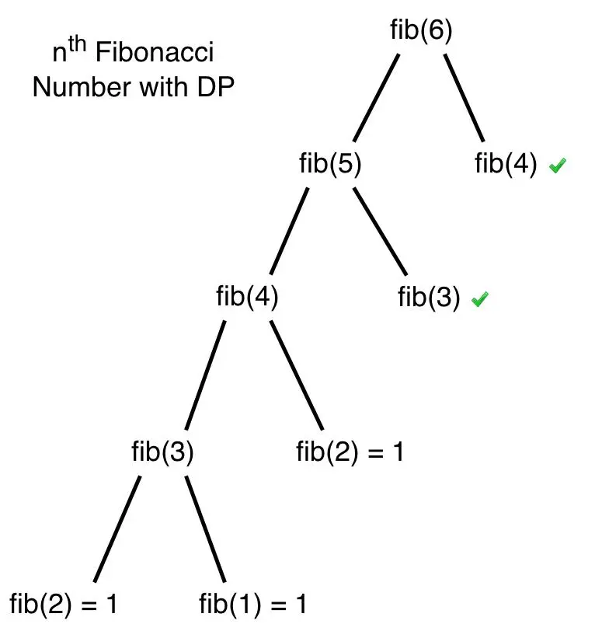
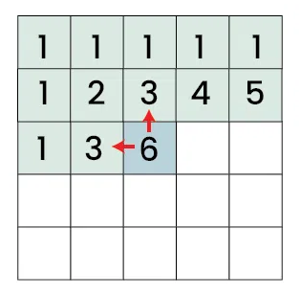
Dynamic Programming Approach:
FOR i FROM 0 TO num_activities DO
CREATE a row with length of av_budget, each with 0
ADD a row to table
END FOR
FOR i FROM 0 TO num_activities DO
act_cost <= cost of activity i
act_enjoy <= enjoyment of activity i
FOR t FROM 0 TO av_budget DO
IF act_cost <= t THEN
dp_table ADD MAX(dp_table[t-1][i],
dp_table[t-1][i -act_cost] + act_enjoy to [t][i])
ELSE
dp_table ADD dp_table[t-1][i] to [t][i]
END IF
END FOR
END FOR
This method uses a 2D array to store each computed value and uses them to compute the next values.
It is a variation to the 0/1 knapsack problem
It stores each value as db[i][b] => the maximum enjoyment from first i values with a budget b
Before each input, a choice is made:
Include the new activity
Exclude the new activity
Depending on the cost and budget left
Time Complexity: O(nB)
Notes:
Explain the importance of the images, knapsack problem etc
By keeping a store of previous results, when a new item is added the previous items are not recalculated.
Overall reducing the time and space in computing such a problem:
Leading to a space and time complexity of O(nB) – n = number of activities, B = budget
However, using such an implementation can be complex to create, it can use a lot of memory storing each value,
The size of the table is ‘nB’ therefore in most cases it will grow polynomially this impacts its use with large real-world datasets, as it might not be feasible.

Slide 12
Dynamic Programming Approach:
CREATE LIST subsets
SET remaining_budget <= av_budget
SET total_time <= 0
SET used_budget <=0
SET total_enjoyment <= 0
FOR i FROM num_activities TO 0 DO
act_cost <= cost of activity i
act_enjoy <= enjoyment value of activity i
act_time <= time for activity i
IF budget >= act_cost and dp_table[i][budget] != dp_table[i-1][budget] DO
ADD activity i to subsets
budget <= budget – act_cost
total_time <= total_time – act_time
total_enjoy <= total_enjoy + act_enjoy
required_budget <= required_budget + act_cost
END IF
END FOR
OUPUT subsets, total_time, required_budget and total_enjoy
This section them moves through each activity checking, that there is budget to include it and its not equal to the previous entry in the DP table
Updates the time, cost and enjoyment values
Outputs the optimal activities, time and budget required and enjoyment.

Slide 13
Demonstration:
file:///Applications/PyCharm.app/
https://fantastic-fiesta-wrq7jrj7jv9qfgxp9.github.dev/

Slide 14
Conclusion:
Results
Overall, both method perform similarly for small datasets of sizes up to 12 activities where both execution times are minimal.
As the number of activities increase from 12 the gap in performance and computation speed rapidly increases.
Due to the time complexity of the Brute Force algorithm, it is unable to solve sample of around 100 or more, due to the program crashing.
However, a sample size of 1000 activities can still be solved by the Dynamically Programmed and it can compute the solution in around 0.3 seconds
Challenges
Learning to collaborate on GitHub
Keeping to correct python formalities, variable names, comments etc
Increased workload due to being a smaller group

Slide 15
References:
Slide 5 - https://www.geeksforgeeks.org/competitive-programming/dp-on-grids/
Slide 5 - https://theoryofcoding.com/index.php/2015/03/02/dynamic-programming-introduction-and-fibonacci-numbers/

