Slide 1
UTILIZATION OF SEISMIC AND INFRASOUND SIGNALS FOR CHARACTERIZING MINING EXPLOSIONS
Pawlenko M.

Slide 2
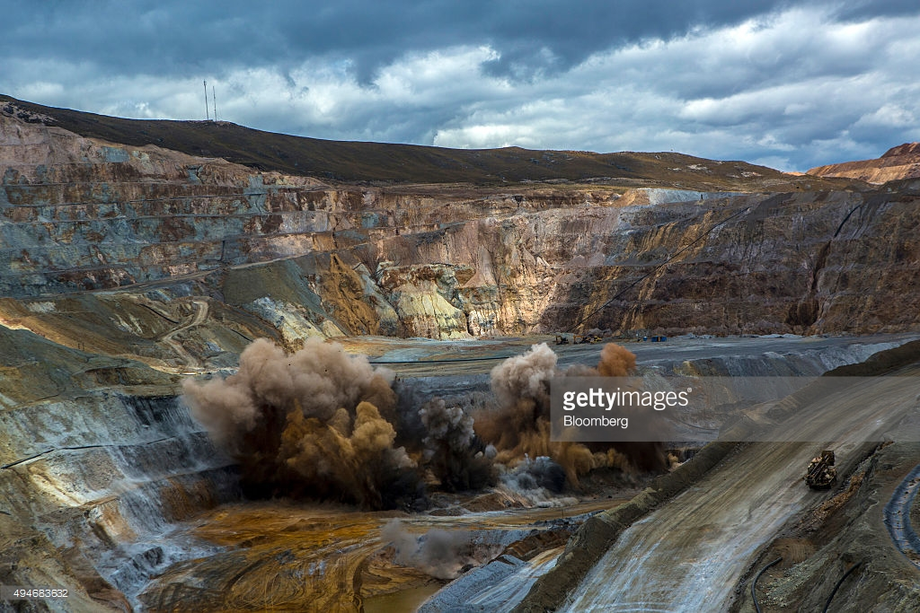

Slide 3
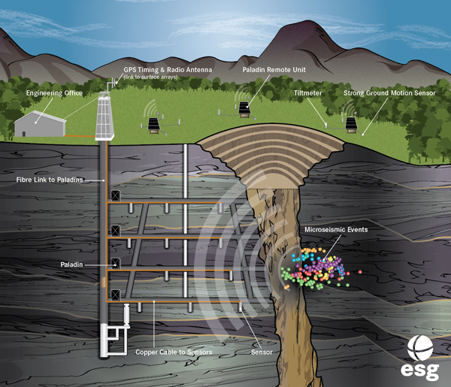
Microseismic System
Sensors: Uniaxial and triaxial accelerometers and/or geophones.
Junction Box - (JB): A NEMA-4 enclosure that houses essential acquisition and communications equipment including the Paladin® digital seismic recorder which serves as the backbone of ESG’s microseismic data acquisition system.
Ethernet communication: Fiber (underground) or radio (surface) for reliable, full waveform data transfer.
Acquisition PC: Acquisition Server, watchdog, optional large external storage drive and uninterruptable power supply (UPS).
Processing PC: Fast multi-core Processor and powerful dedicated video card.

Slide 4
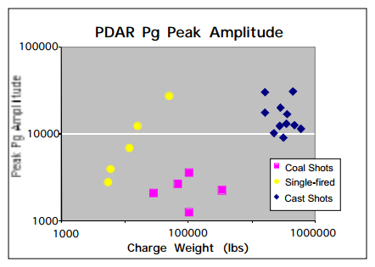
Figure 1: Peak Pg amplitudes observed at array element 03 of PDAR (360 km range) from contained singlefired explosions, delay-fired cast blasts and delay-fired coal shots

Slide 5
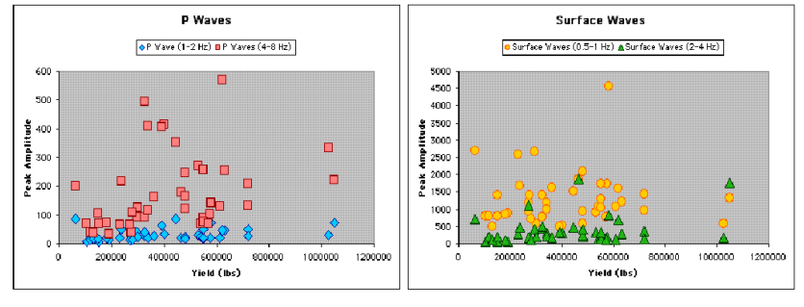
Figure 2: Peak P and Rg amplitudes observed at EYMN (Ely, Minnesota) from taconite fragmentation explosions approximately 110 km to the southwest of the station.

Slide 6
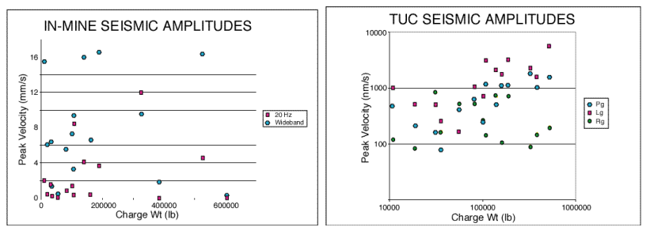
Figure 3: Peak amplitudes of in-mine recordings at Morenci are compared to total amount of explosives used in copper fragmentation blasts (left). Peak Pg, Lg and Rg amplitudes observed at the regional station TUC plotted against total amount of explosives used in the Morenci copper fragmentation explosions (right).

Slide 7
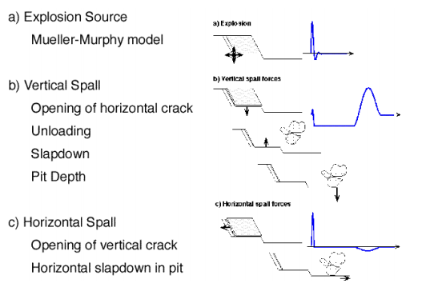
Figure 4: The three components of the equivalent mining explosion source model are represented pictorially. They consist of (a) the directly coupled energy from the contained explosion modeled as a Mueller-Murphy source function, (b) vertical spall due to the tensile failure of near-surface materials and (c) horizontal spall accompanying cast blasting when overburden is cast horizontally into a pit.

Slide 8
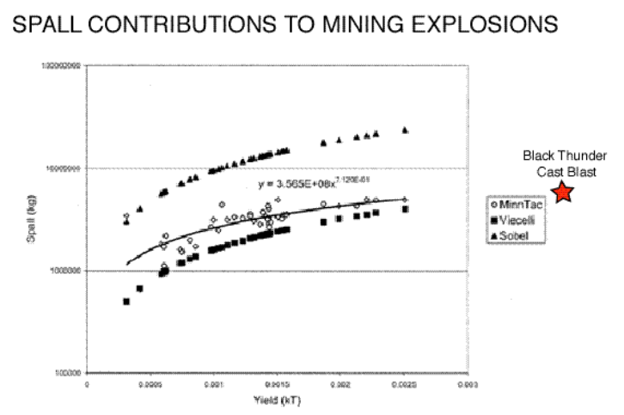
Figure 5: Spall mass (per hole) for the taconite hard rock explosions (open diamonds) and a single coal cast blast (star) was estimated from blasting logs. These empirical estimates from mining explosions are compared to the Viecelli and Sobel spall mass scaling relations developed for underground nuclear explosions.

Slide 9
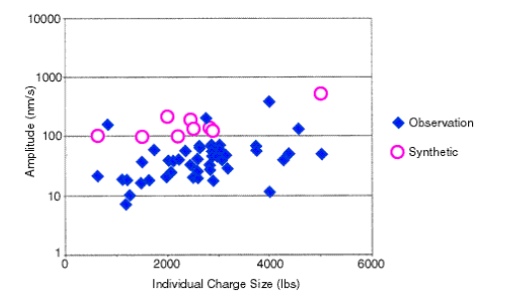
Figure 6: The mining explosion source model was used to produce synthetics for a distance and crustal velocity model appropriate for EYMN. Synthetics were produced for a number of mining explosions of different average charge weight per borehole. Peak amplitudes of the synthetics are compared to the observations from the same explosions.

Slide 10
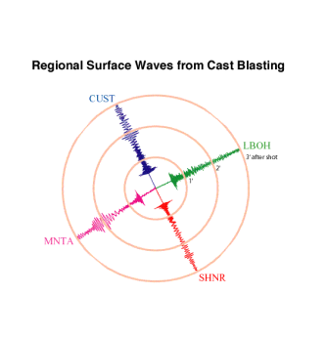
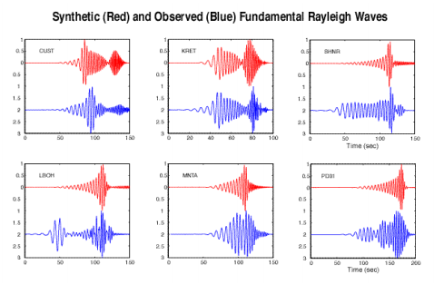
Figure 7: The mining explosion source model was also used to compute synthetics for the large-scale cast blasts. The focus in this modeling exercise is on the long period surface waves.

Slide 11
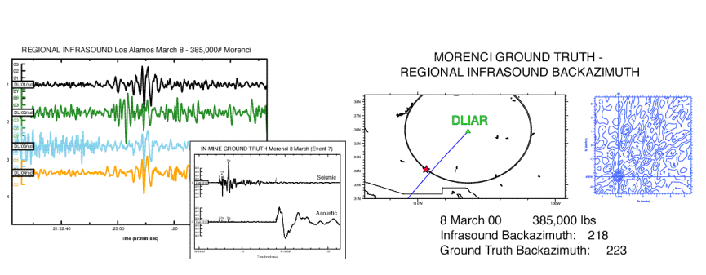
Figure 8: Mining explosions from the hard rock copper mines in southeastern Arizona generate infrasound signals as exemplified by the records from DLIAR in Los Alamos (left). Ground truth for this event was provided by close-in seismic and acoustic records of the blast (left, inset). Frequency wave number estimates were used to make the back azimuth estimate shown to the right.

Slide 12
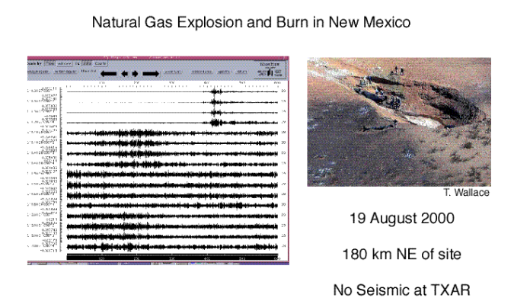
Figure 9: Infrasound (channels 1,2, 3) and seismic data (channel 4) from a seismo-acoustic station installed outside El Paso, Texas (Ft. Hancock). Each horizontal section represents 10 minutes of data. This seismo-acoustic signal that extends for over 30 minutes represents the explosion and burning of a natural gas line in New Mexico

Slide 13
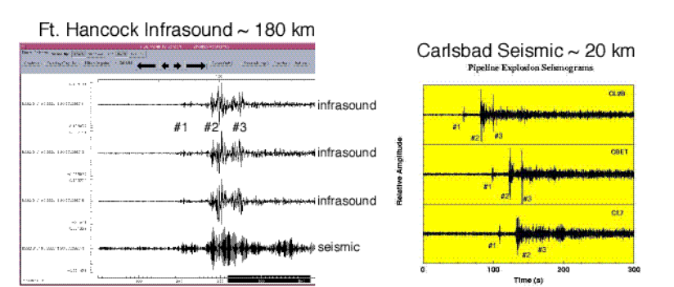
Figure 10: The details of the infrasound (channels 1-3) and seismic (channel 4) signals from the gas explosion are shown to the left. These signals are compared to close-in seismic signals of the blast shown to the right (courtesy of T. Wallace). Both the close-in seismic and the infrasound signals suggest a complex source function for the initial explosion. The seismo-acoustic station at Ft. Hancock has porous and slow velocity alluvium at the surface that may be responsible for the strong coupling between the infrasound and seismic channels.

Slide 14
CONCLUSIONS AND RECOMMENDATIONS Seismic 1. Peak seismic amplitudes from delay-fired mining explosions show little relation to explosive yield. 2. Single-fired, contained explosions generate regional seismic waves with an amplitude scaled by explosive weight, W0.84. 3. Source models for mining explosions replicate the insensitivity of peak amplitude of regional phases to total explosive weight although there is some indication that the peak regional amplitudes may be related to the weight of the simultaneously detonated explosives, possibly a single borehole. 4. Mid-period (2-12 s) surface waves are observed from large scale cast blasts and reflect the large source duration of such explosions. 5. Blasting practice varies greatly between mines and within mines and in-mine instrumentation may be required to provide ground truth for regional seismogram interpretation. Infrasound 1. A small percentage of mining explosions are observed to have infrasound signals. 2. The presence or absence of regional infrasound signals is related to event size and propagation path effects. 3. Shallow explosions may produce infrasound signals but no regional seismic signals. 4. Infrasound signals may document source duration.

