Slide 1
Consistency in Database Systems Illustrated with NRW Notation

Slide 2
NRW NOTATION
NRW (Node, Read, Write) notation describes, at a high level, how a distributed database will trade consistency, read and write performance.
N = No. of copies of each data item that the database will maintain
R = No. of copies that application will assess when reading the data item
W = No. of copies of data item that must be written before the write can complete
Most NoSQL Databases use N>W>1 more than one write must complete, but not all nodes need to be updated immediately.

Slide 3
When W = 3, R = 2 and N = 4 our outcome is: 3 + 2 = 5 and 5 > 4 so it is a STRONG CONSISTENCY. The latency of read or write is dictated by the slowest of the R or W replicas. This is why R and W are usually configured to be less than N, to provide better latency (ctd. in “Dynamo: Amazon”). Typical Values of (NRW) for Amazon Apps are (3, 2, 2)
NRW NOTATION
NRW Configuration | Outcome
( W = N ) & ( R = 1 ) | Read optimized strong consistency
( W = 1 ) & ( R = N ) | Write optimized strong consistency
( W + R ) <= N | Weak eventual consistency
( W + R ) > N | Strong consistency though quorum

Slide 4
DynamoDB: Amazon’s Highly Available Key-value Store
One problem DynamoDB, a NoSQL database service, has is partitioning. Their solution was to do “Consistent Hashing,” which resulted in incremental scalability.
There are many good tools out there that can simulate the NRW patterns, i.e. Simizer, CloudSim, SimGRID, and OptorSim.

Slide 5
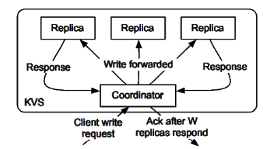
This here is a diagram of control flow for client write to Dynamo-style quorum. Where N = 3 and W = 2. A coordinator node handles the client write and sends it to all N replicas. The Write call returns after the coordinator receives W acknowledgements.

Slide 6
Some other configurations
Rika: N = 3, R = W = 2
User sometimes suggest using “low value” R = W = 1 & N = 2 and strict quorum variants for “web,” “mission critical,” and “financial” data.
Voldemort’s authors at LinkedIn often choose: N = c, R = W = [c/2] for odd c
Often great for “very low latency and high availability.
LinkedIn deployments of Voldemort with N = 2, R = W = 1 provide “some consistency,” when three way replication is not required (ctd. in Berkeley).

Slide 7
Example of databases that do not use NRW notation:
OrientDB
Redis
MongoDB
Bigtable
For the next upcoming slides we will focus more on Bigtable as an example.

Slide 8
What is Bigtable??
Bigtable is a distributed storage system for managing structured data that is designed to scale to a very large size: petabytes of data across thousands of commodity servers.
Developed by Google
Column Oriented
NoSQL database
Consistency & Partial Tolerance (of CAP Theorem)

Slide 9
What Bigtable uses instead
A lock system called a Chubby.
GFS (Google File System), a large scale file system
SSTable, what Bigtable uses to store all their data.

Slide 10

-Developed and maintained by Apache Software Foundation
-In use by CERN, eBay, GitHub, Hulu, Instagram, Netflix, Reddit and over 1500 more companies
The Apache Cassandra database prioritizes:
-Performance; Consistently outperforms popular NoSQL options in both benchmarks and real applications.
-Scalability; Linear Scalability allows large scale operations. Apple uses a network of over 75,000 nodes storing over 10 petabytes of data.
-Fault Tolerance; Data is automatically replicated to multiple nodes for fault tolerance, including across multiple data centers.
-Elasticity; Read and write throughput increase linearly as new machines are added, with no downtime or interruption of application services.

Slide 11
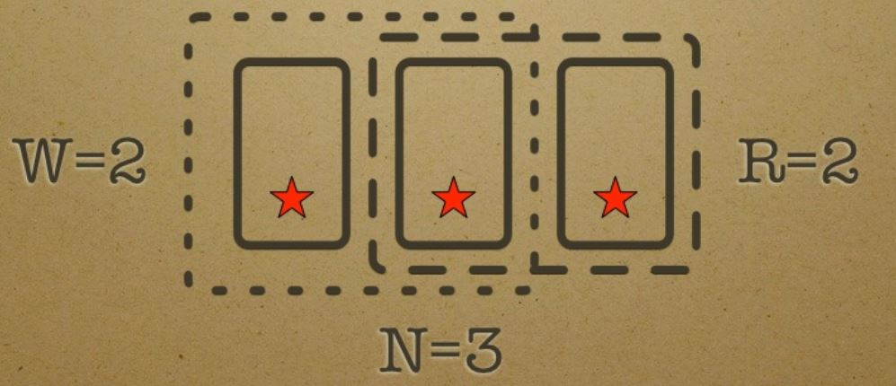
CAP THEOREM
-Cassandra is an A-P (availability & partition tolerant) database. It aims to achieve C through eventual consistency.
ACID vs. BASE
-Cassandra follows the BASE paradigm to achieve eventual consistency.
NRW Notation
-By default Cassandra is a N = 3, R = 1, W = 1 database which is weak consistency. I will be discussing an N = 3, R = 2, W = 2 implementation which uses strong consistency through quoroms (R + W > N).
An R + W > N architecture guarantees overlap of the read and write quoroms.

Slide 12
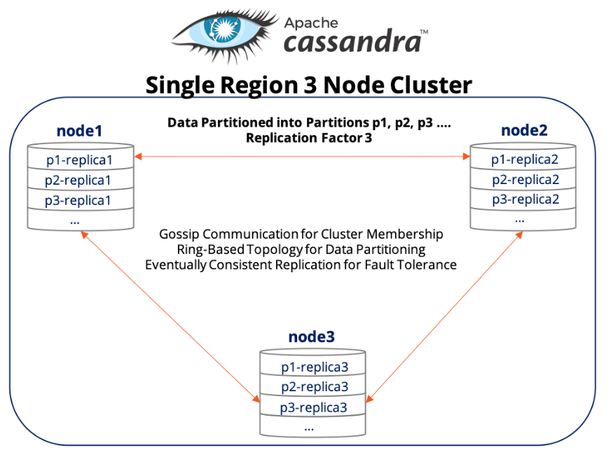
This picture represents a Single Region 3 node cluster network.
Each piece of data is stored in 3 places (N = 3) as can be seen by P1, P2 and P3 replicas.
With this structure if a single failure occurs the network is still fine as 2 replicas remain satisfying the R(ead) = 2 and W(rite) = 2 scenarios.
However, if 2 nodes / connections were to fail, this network would fail.

Slide 13
Works Cited
"Dynamo: Amazon’S Highly Available Key-Value Store” Slideplayer.Com, 2019, https://slideplayer.com/slide/7720997/.
Harrison, Guy. “Eventual Consistency.” Database Trends and Applications, 7 Jan. 2011, www.dbta.com/Columns/Applications-Insight/Eventual-Consistency-73004.aspx.
---. "Consistency Models." Next Generation Databases. Apress, Berkeley, CA, 2015.
Springer, Wilfred. “Eventually Consistent.” LinkedIn SlideShare, 21 July 2010, www.slideshare.net/springerw/eventually- consistent.
Thant, Phyo Thandar, and Thinn Thu Naing. "Improving the availability of NoSQL databases for Cloud Storage." Yangon: University of Computer Studies.
Vanroose, Peter, and GSE DB Belgium. "ACID or BASE?-the case of NoSQL.“
Berkeley, Www2.Eecs.Berkeley.Edu, 2019, https://www2.eecs.berkeley.edu/Pubs/TechRpts/2012/EECS-2012-4.pdf.
Weintraub, Grisha. Database and Data Mining, 2013, https://www.slideshare.net/GrishaWeintraub/cap-28353551
The Apache Software Foundation, http://cassandra.apache.org/
Benjamin Black, Cassandra Replication & Consistency, 2014, https://www.slideshare.net/benjaminblack/introduction-to-cassandra-replication-and-consistency
Sid Choudhury, Apache Cassandra: The Truth Behind Turntable Consistency, Lightweight Transactions & Secondary Indexes, https://blog.yugabyte.com/apache-cassandra-lightweight-transactions-secondary-indexes-tunable-consistency/

