Slide 1
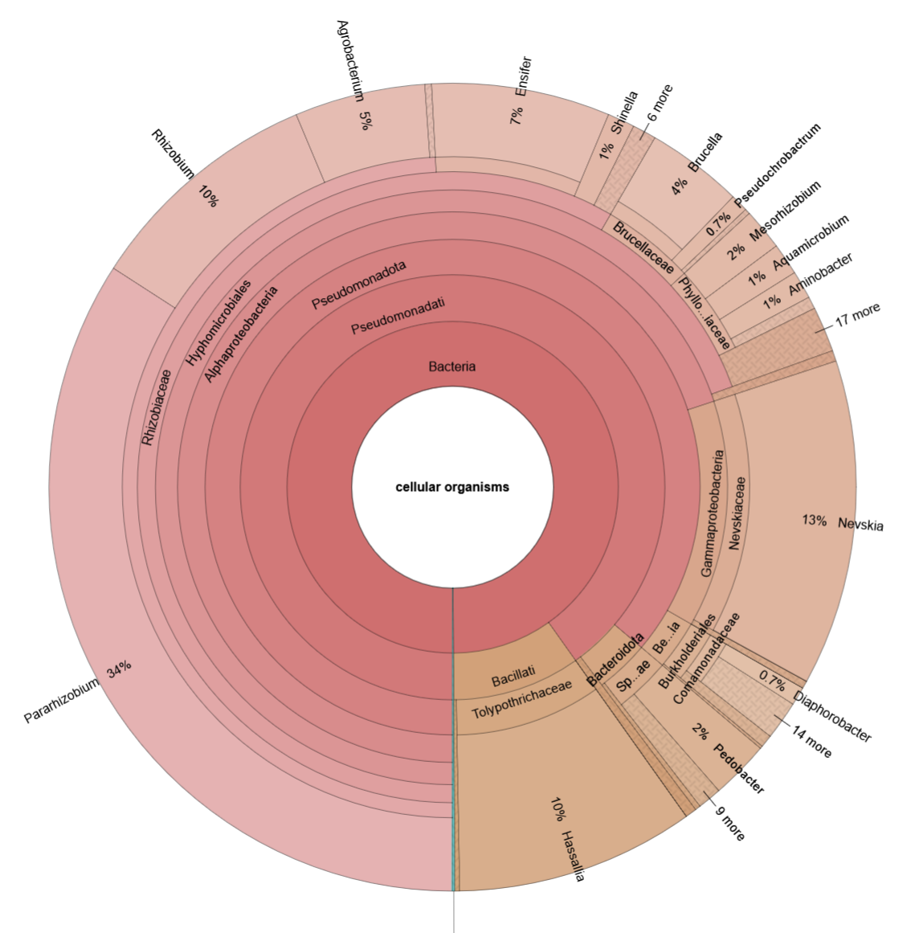
Visualizing the microbiome of mines based on 16S rRNA Seq

Slide 2
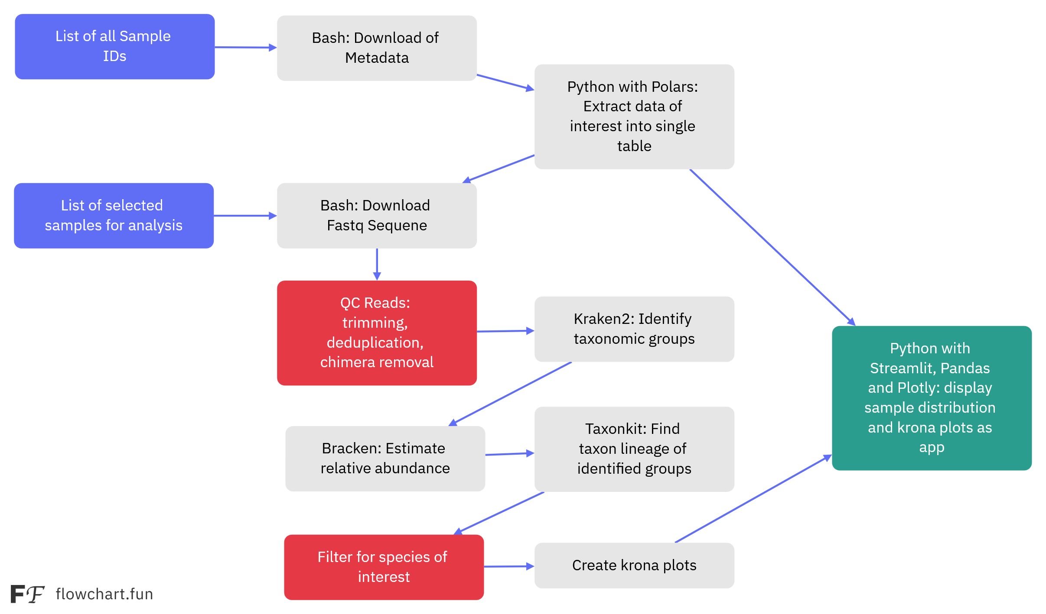
Snakemake Workflow

Slide 3
