Slide 1


The Trading BOT
Reinforcement Learning For Automated Trading
Reid Falconer, Sam MacIntyre, Hector Cano, Maximilian Zebhauser

Slide 2
Motivation and Executive Summary
Trading stocks is reward maximizing, sequential process of decision making with a high level of uncertainty, the idea would be to automatize this process
To tackle this problem we extended the dynamic programming approach and used reinforcement learning (RL), which is the third machine learning paradigm next to supervised and unsupervised learning
We trained the trading agent to decide whether to sell, hold or buy a certain stock on given data and evaluate its performance by comparing it to a random or a holding trading strategy
This problem can be extended to a portfolio managing robot/ agent, which goes far beyond the scope of this project

Slide 3
Teaching the Agent to Trade Underlying Theory and Methodology
Reinforcement learning aims to maximize a given reward signal by undertaking certain actions (in a restricted space).
Each reinforcement learning problem contains four sub-elements:
Policy
Reward signal
Value function
Model of environment (optional)

Slide 4
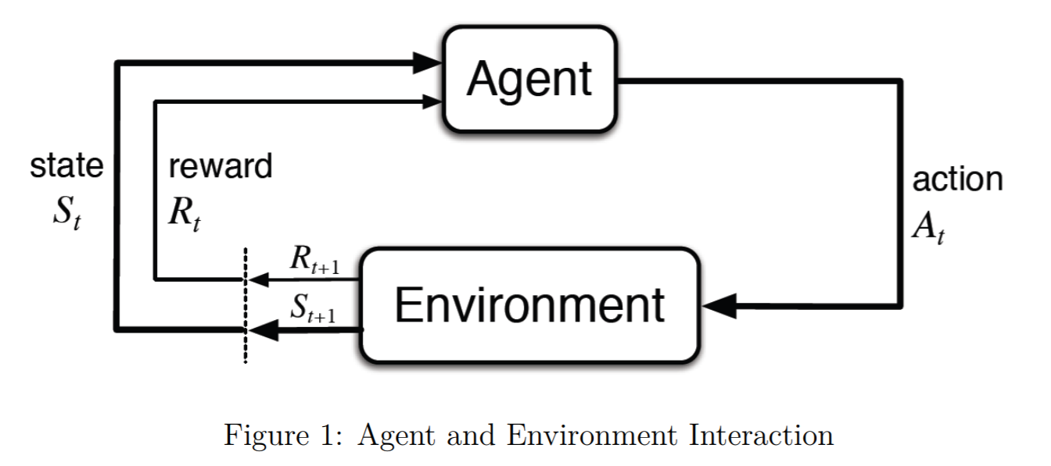

Methodology: Overview
RL are modeled as Markov Decision Process (MDP)
At a sequence of discrete time steps t = 0, 1, 2, 3..., the agent interacts with the environment. At each step t, the agent receives state information $S_{t}∈S$ and performs an action $A_{t}∈𝒜(s)$. As a consequence of the action, the agent receives a reward $R_{t+1}∈𝓡⊂ℝ$ and transitions to a new state $S_{t+1}$.

Slide 5
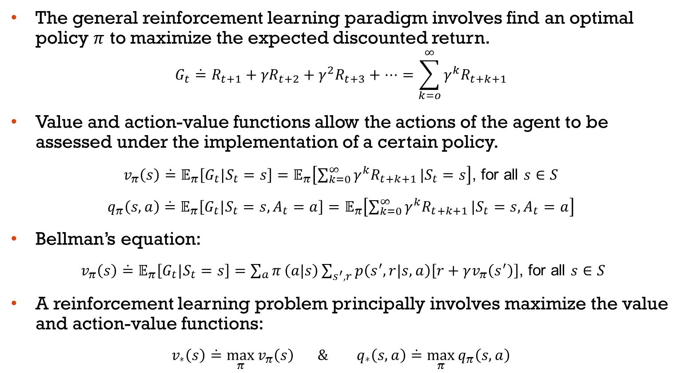
The general reinforcement learning paradigm involves find an optimal policy $π$ to maximize the expected discounted return.
$$G_{t}\dot{=}R_{t+1}+{γR}_{t+2}+{γ^{2}R}_{t+3}+⋯=\sum_{k=o}^{∞}{{γ^{k}R}_{t+k+1}}$$
Value and action-value functions allow the actions of the agent to be assessed under the implementation of a certain policy.
$v_{π}\left(s\right)\dot{=}𝔼_{π}\left[G_{t}|S_{t}=s\right]=𝔼_{π}\left[\sum_{k=0}^{∞}{{γ^{k}R}_{t+k+1}}|S_{t}=s\right]$, for all $s∈S$
$q_{π}\left(s,a\right)\dot{=}𝔼_{π}\left[G_{t}|S_{t}=s, A_{t}=a\right]=𝔼_{π}\left[\sum_{k=0}^{∞}{{γ^{k}R}_{t+k+1}}|S_{t}=s, A_{t}=a\right]$
Bellman’s equation:
$v_{π}\left(s\right)\dot{=}𝔼_{π}\left[G_{t}|S_{t}=s\right]=\sum_{a}{π}\left(a|s\right)\sum_{s^{′},r}{p\left(s^{′},r|s, a\right)\left[r+γv_{π}\left(s^{′}\right)\right]}$, for all $s∈S$
A reinforcement learning problem principally involves maximize the value and action-value functions:
$v_{∗}\left(s\right)\dot{=}\max_{π}{v_{π}\left(s\right)} \&{ q}_{∗}\left(s,a\right)\dot{=}$ $\max_{π}{q_{π}\left(s,a\right)}$

Slide 6
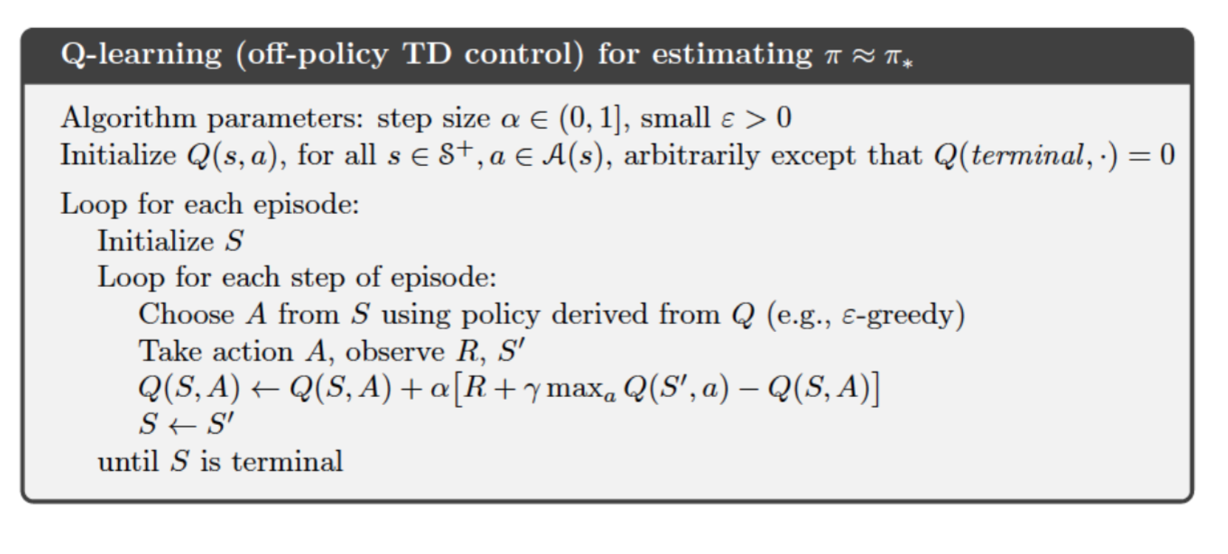
Methodology: Q-learning
Q-learning attempts to estimate $q_{∗}$ (optimal action-value function) without any regard for the policy followed.

Slide 7
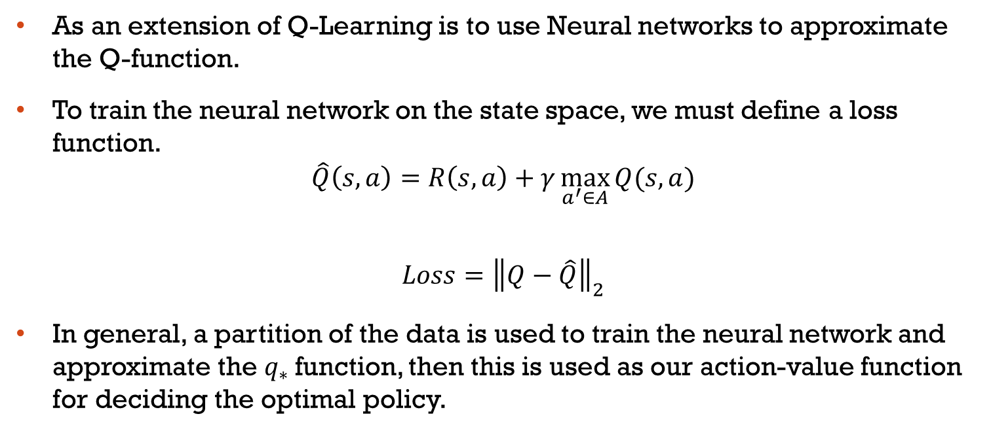
Methodology: Deep Q Learning
As an extension of Q-Learning is to use Neural networks to approximate the Q-function.
To train the neural network on the state space, we must define a loss function.
$$\hat{Q}\left(s,a\right)=R\left(s,a\right)+γ\max_{a^{′}∈A}{Q(s,a)}$$
$$Loss={\left\|Q−\hat{Q}\right\|}_{2}$$
In general, a partition of the data is used to train the neural network and approximate the $q_{∗}$function, then this is used as our action-value function for deciding the optimal policy.

Slide 8
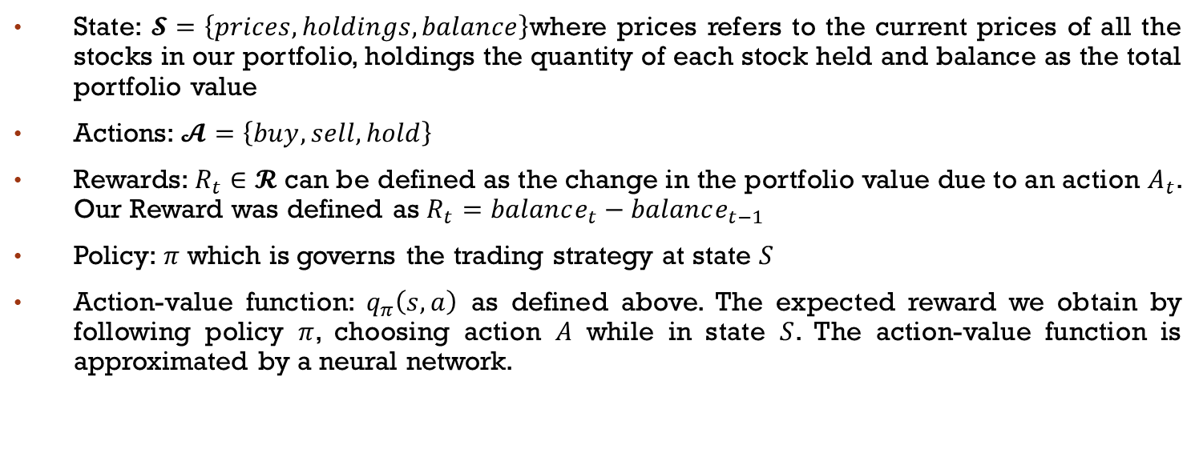
Problem formulation – Algorithm Training
State: $𝓢=\left\{prices, holdings, balance\right\}$where prices refers to the current prices of all the stocks in our portfolio, holdings the quantity of each stock held and balance as the total portfolio value
Actions: $𝓐=\left\{buy, sell, hold\right\}$
Rewards: $R_{t}∈𝓡$ can be defined as the change in the portfolio value due to an action $A_{t}$. Our Reward was defined as $R_{t}=balance_{t}−balance_{t−1}$
Policy: $π$ which is governs the trading strategy at state $S$
Action-value function: $q_{π}\left(s,a\right)$ as defined above. The expected reward we obtain by following policy $π$, choosing action $A$ while in state $S$. The action-value function is approximated by a neural network.

Slide 9
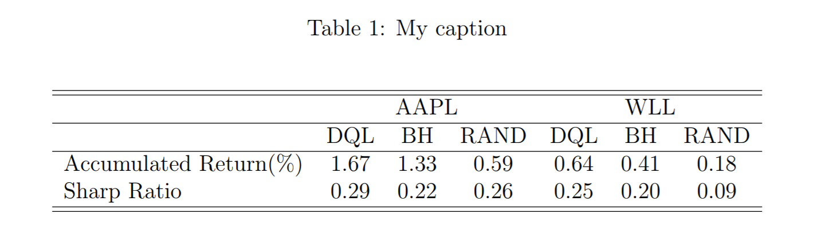
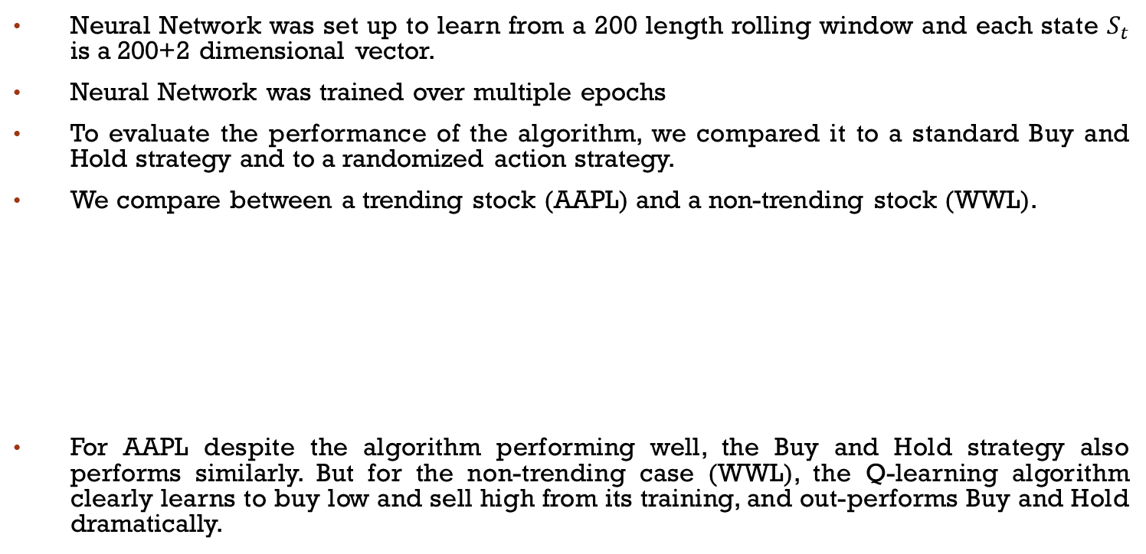
Results
Neural Network was set up to learn from a 200 length rolling window and each state $S_{t}$ is a 200+2 dimensional vector.
Neural Network was trained over multiple epochs
To evaluate the performance of the algorithm, we compared it to a standard Buy and Hold strategy and to a randomized action strategy.
We compare between a trending stock (AAPL) and a non-trending stock (WWL).
For AAPL despite the algorithm performing well, the Buy and Hold strategy also performs similarly. But for the non-trending case (WWL), the Q-learning algorithm clearly learns to buy low and sell high from its training, and out-performs Buy and Hold dramatically.

Slide 10
Conclusion and Future Extensions
Through our experiments with AAPL and WWL stocks, we have managed to show that with minimal training and hyperparameter tuning, our agent can outperform random actions and a Buy and Hold strategy.
The margin of improvement is variable depending on the presence of an upward trend in the stock price.
We have also demonstrated the agent’s ability to manage volatility of the portfolio effectively.
The initial budget appeared to be a strong determinant of the behavior of our agent.
A more thorough investigation into this and its implications for algorithmic trading would be an interesting extension.
There are many possible future developments that could be explored such as using multiple stocks, modifying the reward function, performing online-learning and doing further hyper-parameter tuning.

Slide 11
Bibliography
Sutton, R. S., & Barto, A. G. (2018). Reinforcement learning: An introduction.

