Slide 1
Project Name
Team: Reid, Sam, Max and Hector

Slide 2
Motivation
Reinforcement learning (RL) is a third machine learning paradigm.
RL problems involve learning what is necessary to do in order to maximize a numerical reward signal.
The stock market problem can be approached as a RL problem given its nature of a goal-directed agent that interacts in an uncertain environment.

Slide 3
Data

Slide 4
Methodology: Overview
Reinforcement learning aims to maximise a given reward signal by undertaking certain actions (in a restricted space).
Each reinforcement learning problem contains four sub-elements:
Policy
Reward signal
Value function
Model of environment (optional)

Slide 5
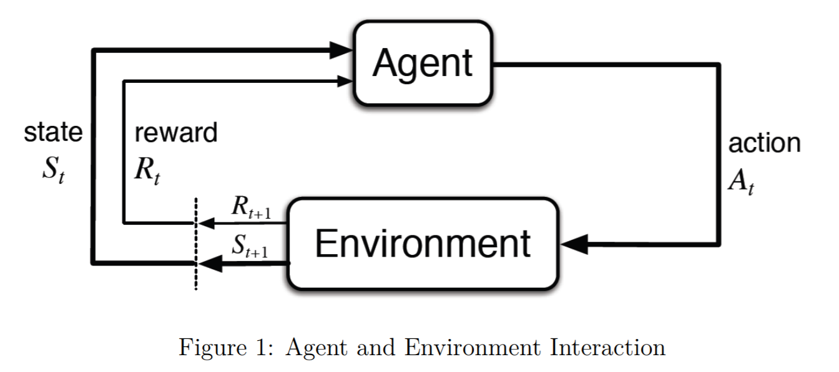

Methodology: Overview
RL are modeled as Markov Decision Process (MDP)
At a sequence of discrete time steps t = 0, 1, 2, 3..., the agent interacts with the environment. At each step t, the agent receives state information $S_{t}∈S$ and performs an action $A_{t}∈𝒜(s)$. As a consequence of the action, the agent receives a reward $R_{t+1}∈𝓡⊂ℝ$ and transitions to a new state $S_{t+1}$.
* Figure 1 source: from book

Slide 6
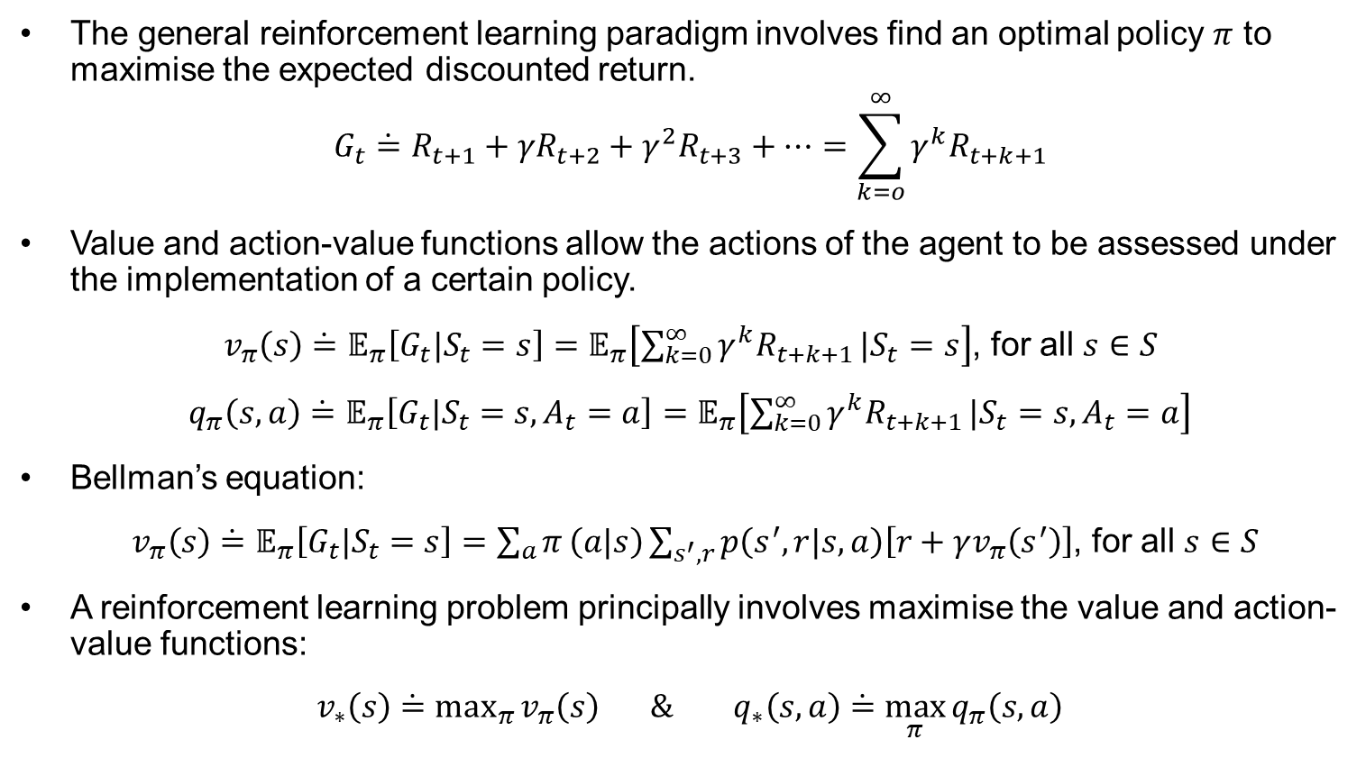
The general reinforcement learning paradigm involves find an optimal policy $π$ to maximise the expected discounted return.
$$G_{t}\dot{=}R_{t+1}+{γR}_{t+2}+{γ^{2}R}_{t+3}+⋯=\sum_{k=o}^{∞}{{γ^{k}R}_{t+k+1}}$$
Value and action-value functions allow the actions of the agent to be assessed under the implementation of a certain policy.
$v_{π}\left(s\right)\dot{=}𝔼_{π}\left[G_{t}|S_{t}=s\right]=𝔼_{π}\left[\sum_{k=0}^{∞}{{γ^{k}R}_{t+k+1}}|S_{t}=s\right]$, for all $s∈S$
$q_{π}\left(s,a\right)\dot{=}𝔼_{π}\left[G_{t}|S_{t}=s, A_{t}=a\right]=𝔼_{π}\left[\sum_{k=0}^{∞}{{γ^{k}R}_{t+k+1}}|S_{t}=s, A_{t}=a\right]$
Bellman’s equation:
$v_{π}\left(s\right)\dot{=}𝔼_{π}\left[G_{t}|S_{t}=s\right]=\sum_{a}{π}\left(a|s\right)\sum_{s^{′},r}{p\left(s^{′},r|s, a\right)\left[r+γv_{π}\left(s^{′}\right)\right]}$, for all $s∈S$
A reinforcement learning problem principally involves maximise the value and action-value functions:
$v_{∗}\left(s\right)\dot{=}\max_{π}{v_{π}\left(s\right)} \&{ q}_{∗}\left(s,a\right)\dot{=}$ $\max_{π}{q_{π}\left(s,a\right)}$

Slide 7
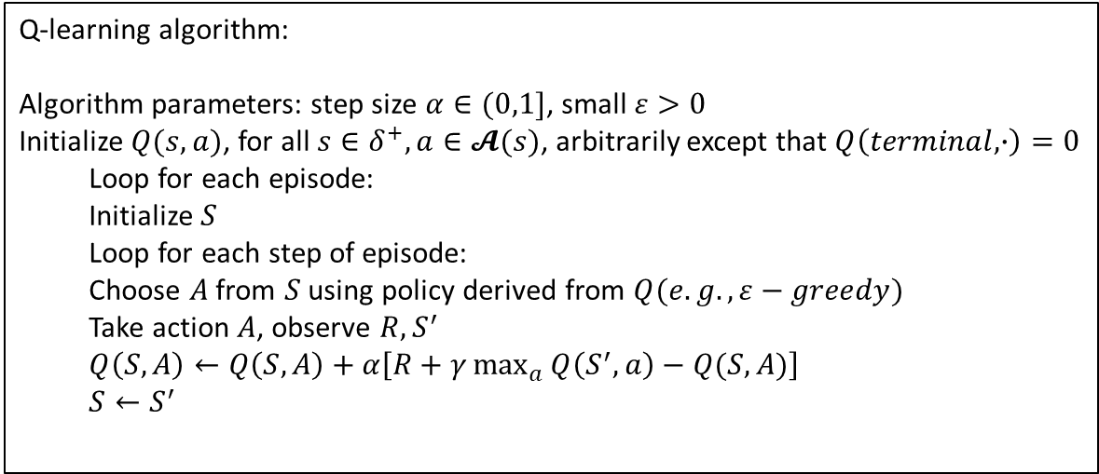
Methodology: Q-learning
Q-learning attempts to estimate $q_{∗}$ (optimal action-value function) without any regard for the policy followed.
Q-learning algorithm:
Algorithm parameters: step size $α∈(0,1]$, small $ε>0$
Initialize $Q(s,a)$, for all $s∈δ^{+},a∈𝓐(s)$, arbitrarily except that $Q\left(terminal,∙\right)=0$
Loop for each episode:
Initialize $S$
Loop for each step of episode:
Choose $A$ from $S$ using policy derived from $Q(e.g.,ε−greedy)$
Take action $A$, observe $R,S^{′}$
$Q\left(S,A\right)←Q\left(S,A\right)+α\left[R+γ\max_{a}{Q\left(S^{′},a\right)−Q(S,A)}\right]$
$$S←S^{′}$$

Slide 8
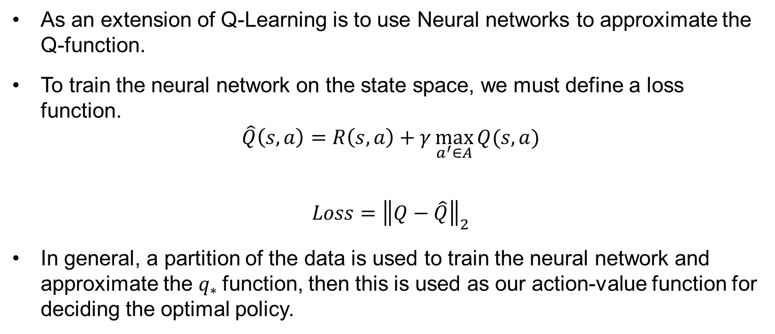
Methodology: Deep Q Learning
As an extension of Q-Learning is to use Neural networks to approximate the Q-function.
To train the neural network on the state space, we must define a loss function.
$$\hat{Q}\left(s,a\right)=R\left(s,a\right)+γ\max_{a^{′}∈A}{Q(s,a)}$$
$$Loss={\left\|Q−\hat{Q}\right\|}_{2}$$
In general, a partition of the data is used to train the neural network and approximate the $q_{∗}$function, then this is used as our action-value function for deciding the optimal policy.

Slide 9
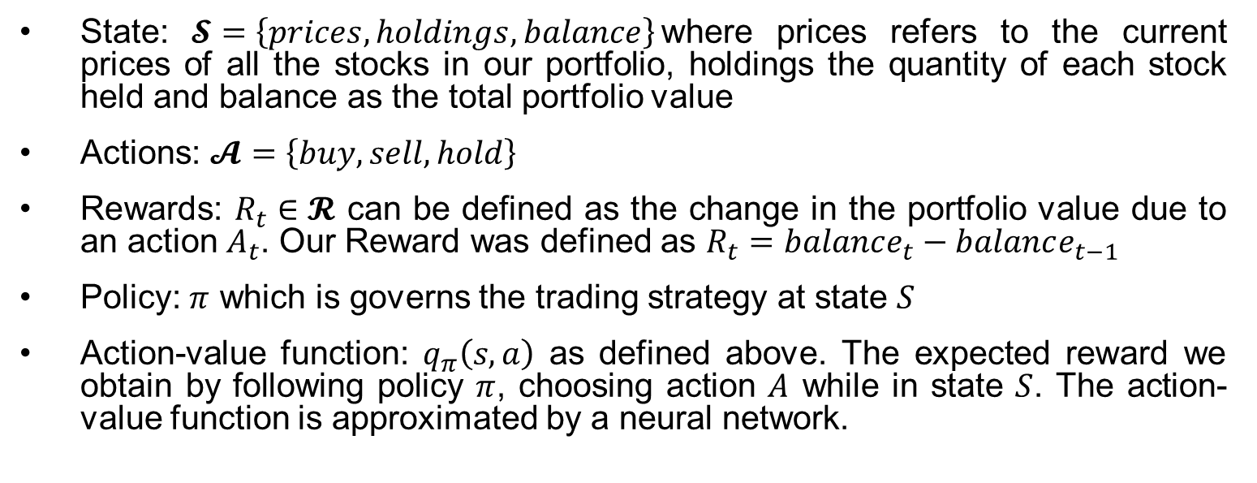
Methodology: Problem formulation
State: $𝓢=\left\{prices, holdings, balance\right\}$where prices refers to the current prices of all the stocks in our portfolio, holdings the quantity of each stock held and balance as the total portfolio value
Actions: $𝓐=\left\{buy, sell, hold\right\}$
Rewards: $R_{t}∈𝓡$ can be defined as the change in the portfolio value due to an action $A_{t}$. Our Reward was defined as $R_{t}=balance_{t}−balance_{t−1}$
Policy: $π$ which is governs the trading strategy at state $S$
Action-value function: $q_{π}\left(s,a\right)$ as defined above. The expected reward we obtain by following policy $π$, choosing action $A$ while in state $S$. The action-value function is approximated by a neural network.

Slide 10
Results

Slide 11
Conclusion

Slide 12
Bibliography

