Slide 1
Tutorial on TensorFlow & IITD HPC
-Aravind J

Slide 2
Agenda
Introduction to TensorFlow
Building a Neural Network in TensorFlow
Brief introduction to the IITD HPC
Running a Deep Learning model on the HPC

Slide 3
How To Represent a Neural Network in a computer??
Neural Networks are composite function learners.
They consist of layers of computations chained together.
The computations occur only in the forward direction.
So a directed graph is the best way to represent a neural network.
These are called “Computational Graphs”.

Slide 4
What is TensorFlow
TensorFlow is a framework for creating and executing computational graphs.
Advantages over other numeric computation frameworks(eg: numpy):-
  TF lets you build a computational graph to keep track of your computations (numpy doesn’t do this).
  This allows us to do auto-differentiation on the computations(TF calculates the gradients automatically and efficiently!!).
  Parallelism (running models on GPUs).

Slide 5
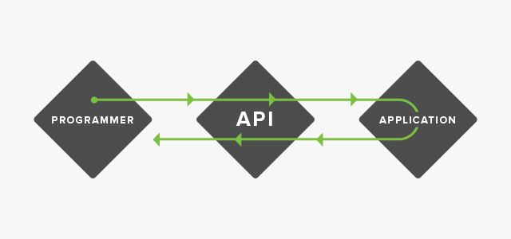
TensorFlow & Python
TensorFlow is mainly coded in C++, but it provides APIs to communicate using Python.
Consider TF as a blackbox that you can manipulate using function calls from python.
The TensorFlow will have it’s own environment that is detached from python.

Slide 6
The two step process
TF programs work in a two step process:-
  Phase 1:- Assembling a computational Graph
    TensorFlow uses static computational graphs.
    You have to fully define a computational graph before you run it. (Eager Execution avoids this, but we are not covering that in this tutorial)
  Phase 2:- Running a graph using a session
    Once a computational graph has been created, we have to run it using a SESSION.
    Sessions in TF allocate the resources necessary to store and execute the computational graph.

Slide 7
TF Graphs
A graph is a set of nodes and vertices.
The same is true for TensorFlow graphs.
The nodes of the graphs are “Operations” and the edges are “Tensors”(Multi-Dimentional arrays).
Whenever you start TensorFlow, it creates a default graph(like a blank canvas).
You create your model by adding components to it.

Slide 8
Components of a TF Graph
Constants
  Constant values ex:- weight decay parameter for L2.
Variables
  Variable values that are part of N/W ex: weights and biases.
Operations
  All operations on tensors ex: matrix multiplication hadamard product etc.
Placeholders
  Values that will be fed in during run time ex:- data and labels.
All these will be nodes in the graph that take in tensors and outputs tensors.
The edges are defined by how you connect these components.
Operations produce Tensors.

Slide 9
Building a small computational graph
Lets build a graph for:
          y = v*x + c
            Where,
              x – is a input
              c – is a constant
              v – is a variable
              y – is the output

Slide 10
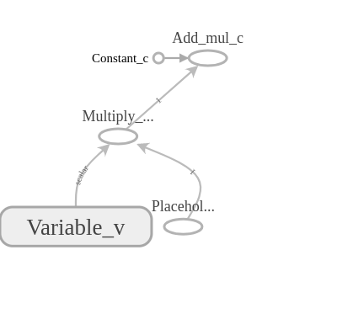
The Graph We Created

Slide 11
Running the graph using as session
Let’s run the graph created using a session.
Sessions are the phase 2 of your TF program.
Session objects place your graph onto execution devices and executes the parts that are necessary to produce your output.
Before running your graph, in each session the variables have to be initialized.
  tf.global_variables_initializer()
Opening sessions are similar to opening files.

Slide 12
Session.run()
Session object has many methods
  run
  reset
  close etc…
We call sess.run on the particular tensor which we want to run.
But placeholders must be fed with values.
  Run() takes two arguments 1) tensor to run(fetches) 2) a dictionary of values to placeholders(“feed_dict”).

Slide 13
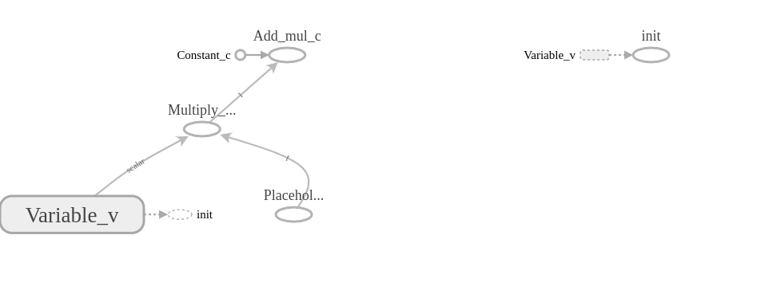
The entire graph

Slide 14
Let’s Create a NN for MNIST
What are the missing pieces now?
  Where is the gradient calculation???
  TensorFlow does it automatically for you!!
TensorFlow provides you with an array of optimizers that internally calculate the gradients and update your weights.
The optimizer can be considered as another operation or node that does:-
  W_{new} = W_{old} – learning_rate*gradients_of_W_wrt_loss

Slide 15
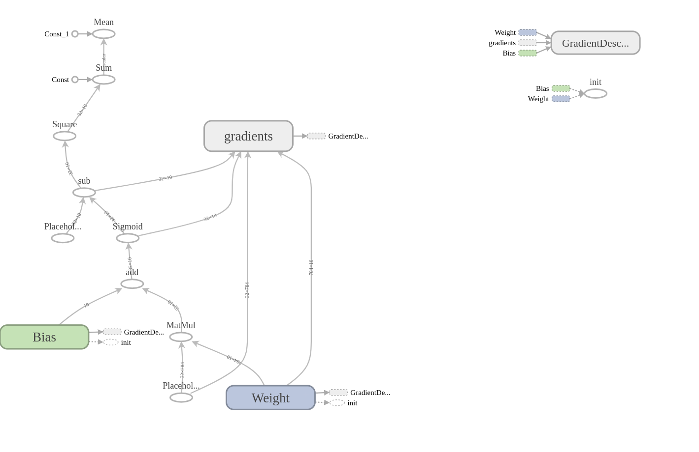
The graph

Slide 16
Variable Scope In Tensorflow
Tensorflow has a flat namespace.
Namespace in TF can be considered as a directory structure in linux.
At first each each variable will be placed in root (ie /)
If we want to organize them, use tf.variable_scope
In a level, variables should have unique names.

Slide 17
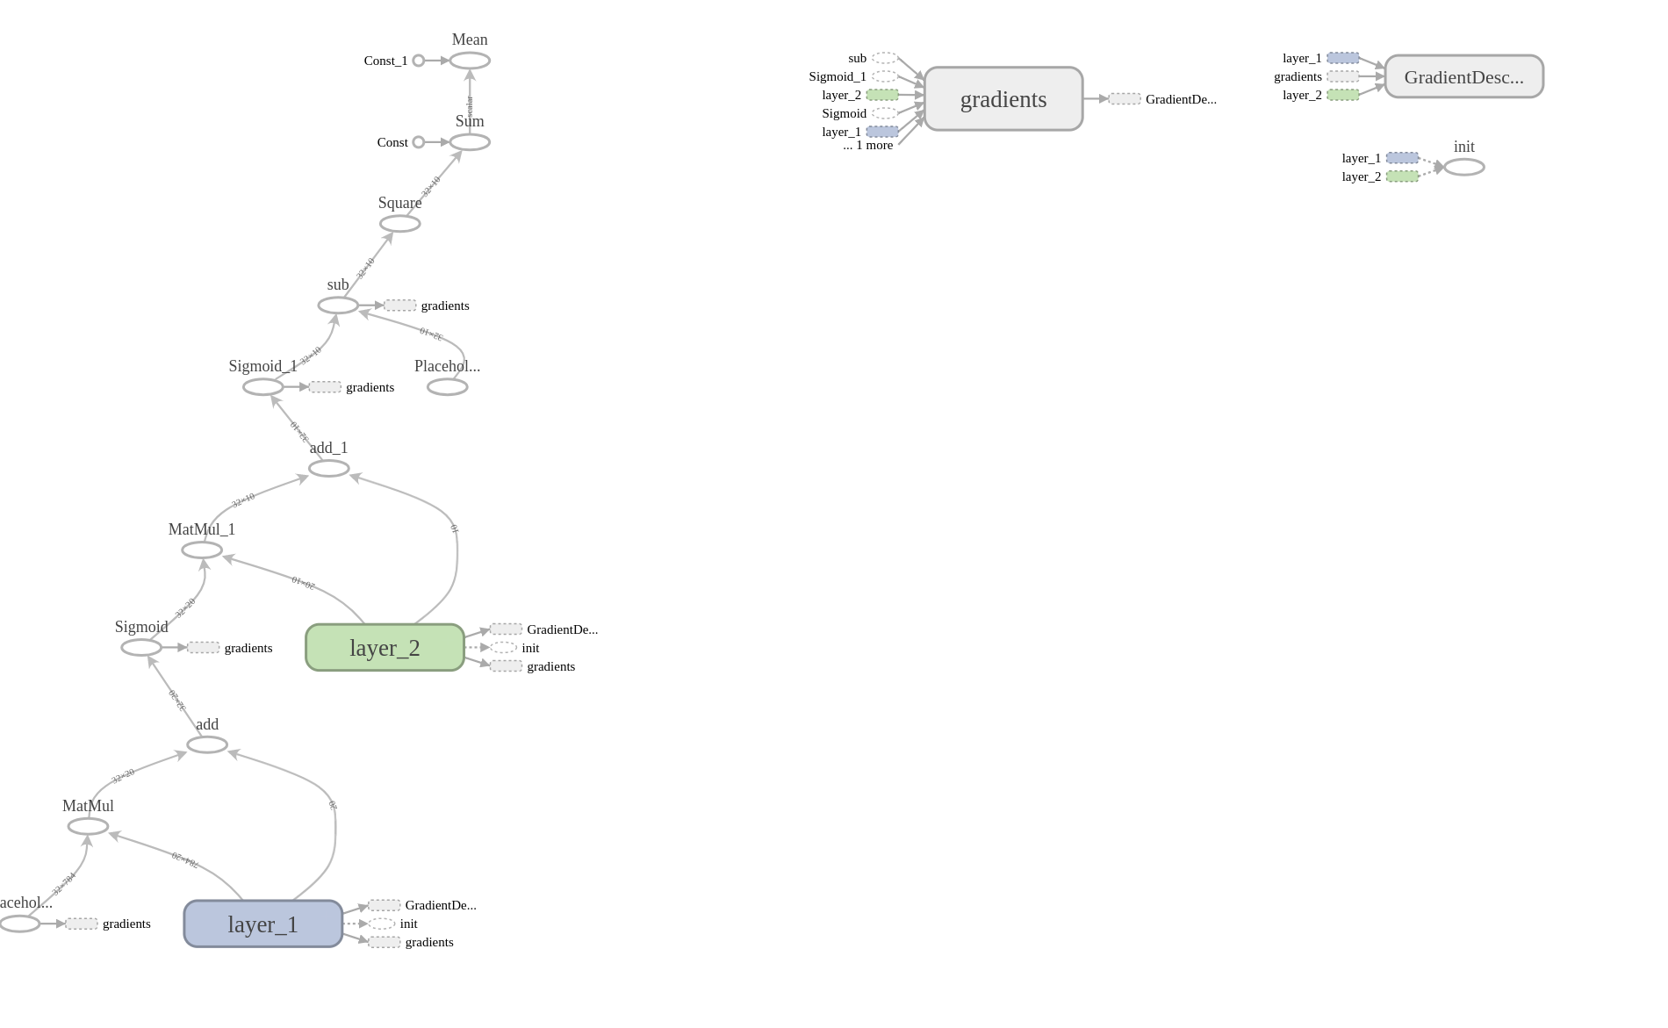
The NN with 1 Hidden Layer

Slide 18
HPC Introduction
The IITD HPC is a collection of computers called Nodes.
Each node has a specific compute capability.
Users can interact with it using Login Nodes
Access the HPC using SSH
We submit jobs to the HPC as shell scripts.
When hpc finds the needed resource it executes the job.

Slide 19
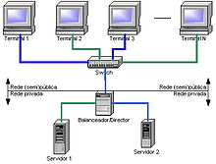
How the hpc looks( :-( )

