Slide 1
用例简介

Slide 2
用例为什么重要
  需求分析人员经常面临的一个问题
  如何将大量的、松散定义的需求提炼为一种供设计人员使用的格式，并且不会遗漏其中的重要细节？
  与系统的stakeholders合作，产生一组完整的需求以及用例（ use cases）
the use case is an excellent tool for stimulating potential users to talk about a system from their own viewpoints.

Slide 3
Use Cases 用例
A collection of use cases depicts a system in terms of what users intend to do with it.
a use case as a collection of scenarios about system use.
Each scenario describes a sequence of events.

Slide 4
Use Cases 用例
  UML规范中用例的定义
    A use case is the specification of a set of actions performed by a system, which yields an observable result that is, typically, of value for one or more actors or other stakeholders of the system.
  Use cases do not model all the tasks, instead they are used to specify user views of essential system behavior

Slide 5
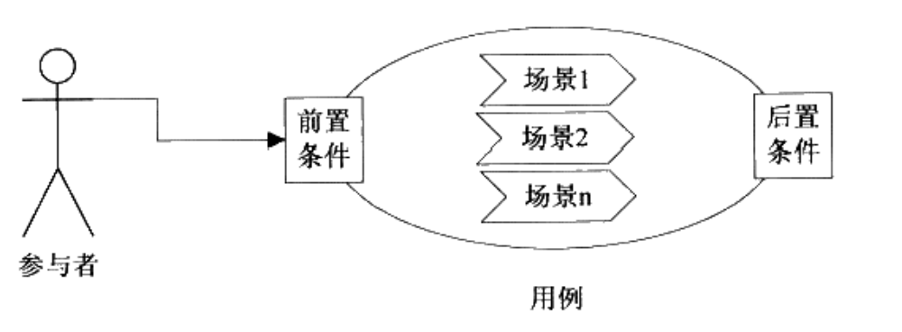
用例构成

Slide 6
用例特征
独立性
结果可观察，有意义
参与者发起，反映了参与者的愿望
动宾短语
用例：需求分析、设计、开发、测试的单元

Slide 7
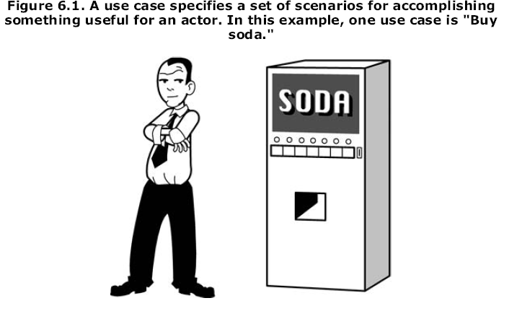
An Example: The Soda Machine

Slide 8
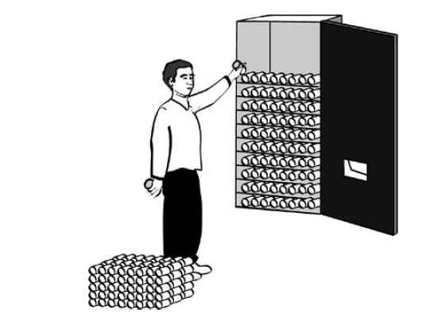
Additional Use Cases
Figure 6.2. Restocking a soda machine is an important use case.

Slide 9
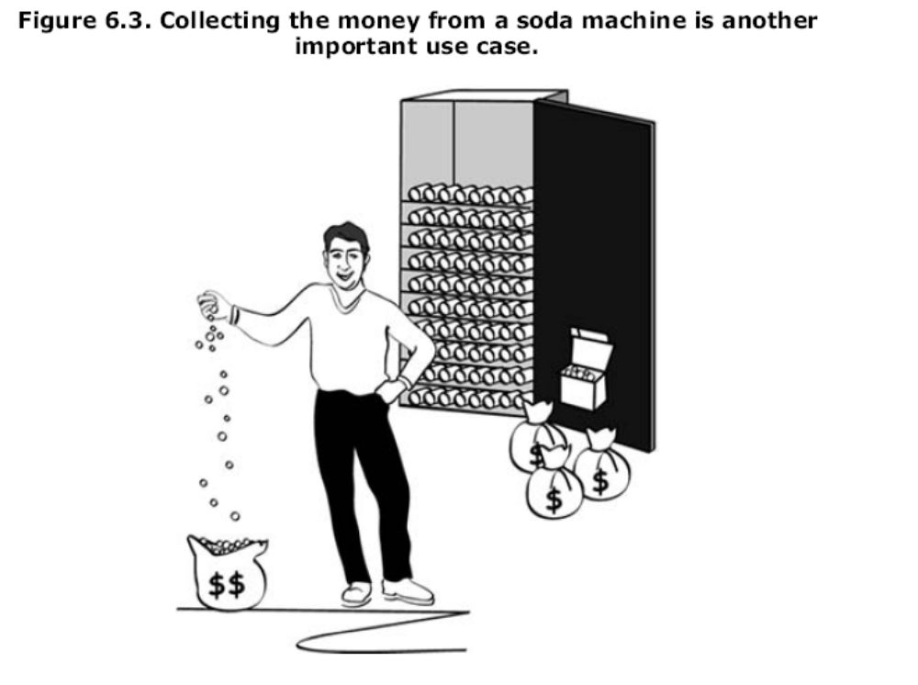

Slide 10
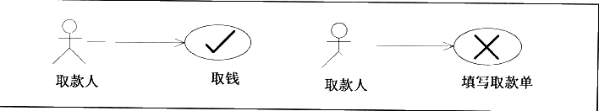
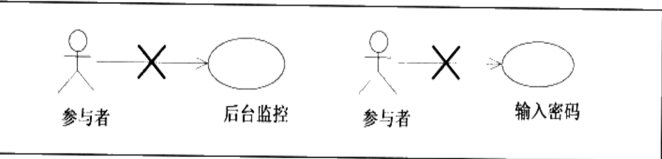
违背了独立性，不完整
违背了可观察，有意义

Slide 11
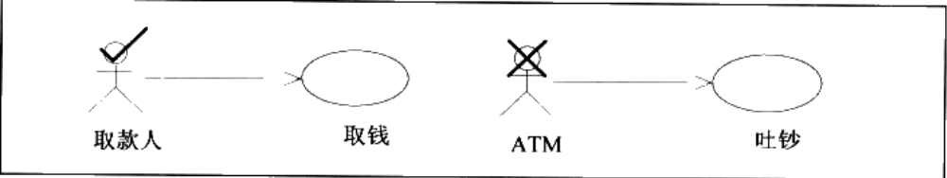
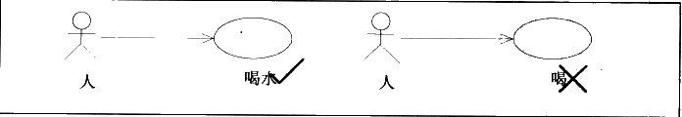
违背了参与者的愿望，ATM不会主动吐钞的
违背了命名规则

Slide 12
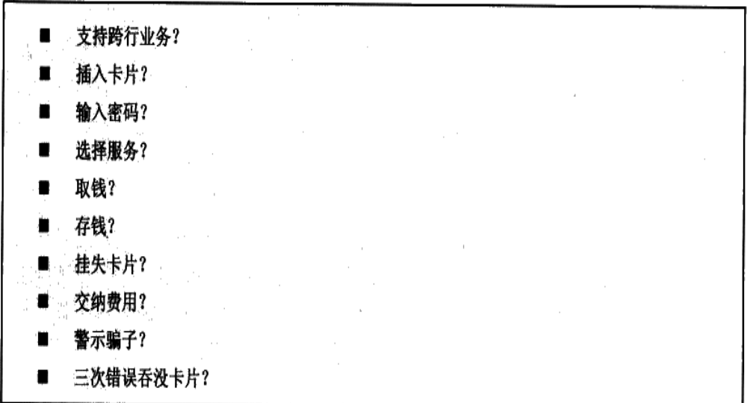
哪些是用例？哪些不是？

Slide 13
