Slide 1
Understanding Packages and
Foundations
Package diagrams
The structure of the UML
Extending the UML

Slide 2
Packages 包
为什么要用包？
  当程序的复杂性增加时，很容易就包含成百上千的类
  面对如此庞大的类库怎么办？
  将类组织成逻辑分组易于管理和理解
  大多数面向对象语言具有某种结构组织类和避免名字冲突
    C++ namespace，java package
在UML中，类的分组用包建模
  可以用 UML packages 对程序语言中的这些结构建模
  包可以组织几乎任何UML元素，不仅是类
    例如用例

Slide 3
Package Diagrams
a package is designed to group the elements (like classes or use cases) of a diagram.
If you name the package, you have named the group.
In UMLspeak, the package provides a namespace for the grouped elements, which the package owns.

Slide 4
Package Diagrams
To reference an element in a package, the notation is PackageName::PackageElement (for example, Tools::Hammer).
This notation is called a fully qualified name.

Slide 5
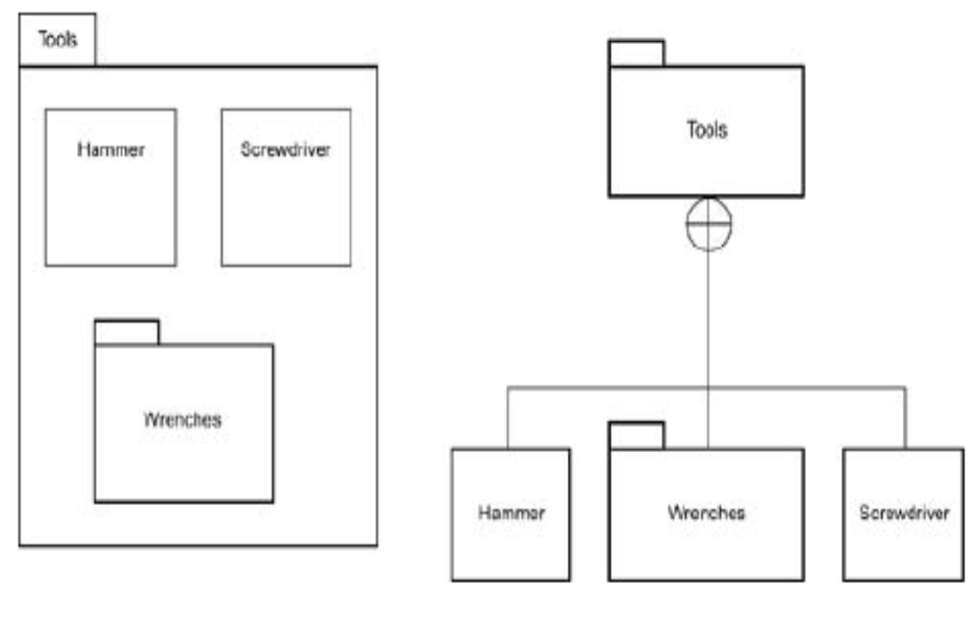
Package Diagrams
Two ways of showing a package's contents.

Slide 6

Namespaces 名空间
一个UML包建立了一个名空间
  如果在一个包中使用来自另一个包的元素，需要指出其位置
  同一个包中的元素名字要唯一
  不同包中如果有同名元素，用它们的全名区分，如图
  嵌套包隐含的语义是“继承”名空间
    内层包中可以直接使用外围包中的名字，无需限定

Slide 7
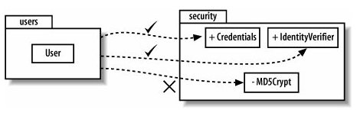
元素可见性
包中的元素可以具有public 或 private可见性
  public：可以从包外访问
  private： 只对同一包内的其他元素可用
  表示法：在元素前加可见性记号（＋，－）

Slide 8
Interpackage Relationships
Packages can relate to one another in either of three ways:
One package can generalize another, depend on another, or refine another.

Slide 9
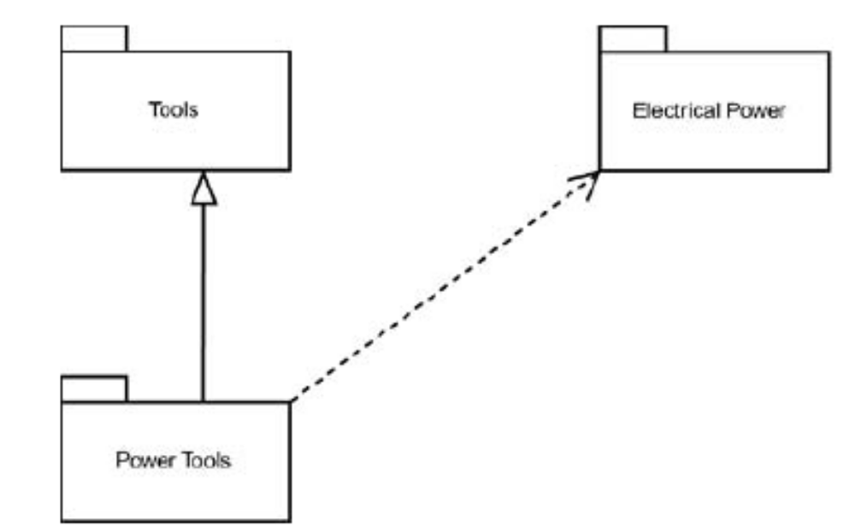
Interpackage Relationships
Generalization and dependency between packages.

Slide 10
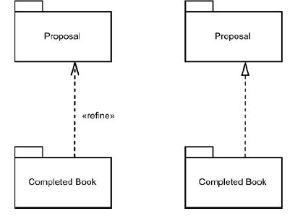
Interpackage Relationships
Refinement is all about levels of detail.
One package refines another if it contains the same elements but with more detail.

Slide 11
Merging Packages
A package can merge with another.
The merge relationship is a kind of dependency between the package that does the merging (the source) and the package that gets merged (the target).
The result of a merge is that the source package is transformed.

Slide 12
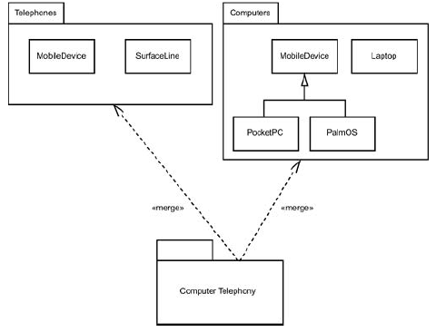
Merging Packages
Modeling the merge of a package with two other packages.

Slide 13
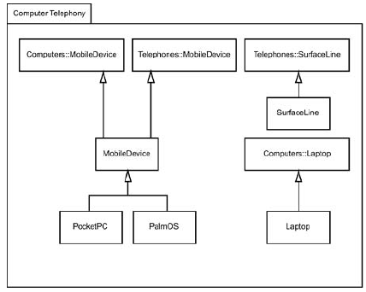
Merging Packages
The transformations that result from the merges in Figure 14.4.

Slide 14
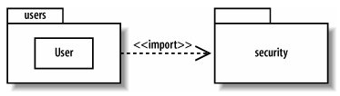
Importing Packages
import关系
  如果包A引入（ imports ）另一个包B，那么被B中的元素可以在A中不用全名使用
    public元素可用，private元素仍不可见
  其中B又称为target package
表示法
  用标注有<< import>>构造型的依赖箭头表示

Slide 15
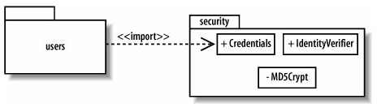
Importing Packages
一个包也可以只引入另一个包中的某个特定元素
  如图， users 只包引入了security包中的 Credentials 元素，而不是整个包

Slide 16
Accessing Packages
public import 和 private import
  public import（默认的），被引入的元素在引入它的包名空间中具有public可见性
  private import：被引入的元素在引入它的名空间中具有private可见性
  私有引入可以使用<<access>>构造型表示
import 和 access 的区别
  被引入的元素具有public可见性，可以被进一步引入到其他包（传递）
  access则不能

Slide 17
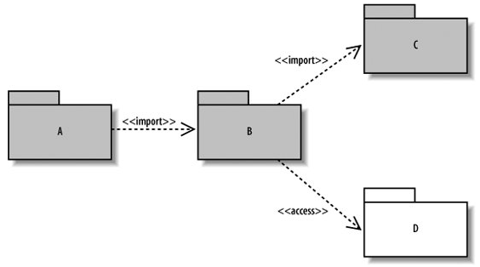
Accessing Packages
A 可以看到C中的public元素，但不能看到D中的
  B可以看到C和D中的public元素
  A可以看到B中的public元素
  D中的元素在B中是私有的

Slide 18
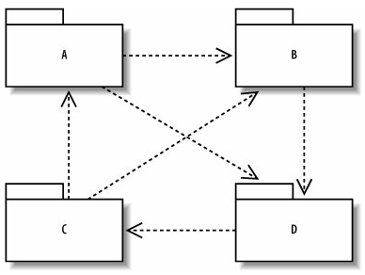
管理包的依赖关系
复杂的依赖关系可能使软件系统不够稳定
  一个包的改变会影响所有依赖于它的包
  例如，下图中任一个包的修改都会影响到其他包

Slide 19
管理包的依赖关系
一些原则
  avoiding cyclical package dependencies 避免循环依赖
  depending in the “direction of stability”
    如软件体系结构中的依赖关系：上层依赖下层
    易变的包依赖稳定的包
去除循环依赖的方法
  析出一个新的包，让两个包都依赖这个新包
    如下页图
  考虑能否将它们放在同一个包中

Slide 20
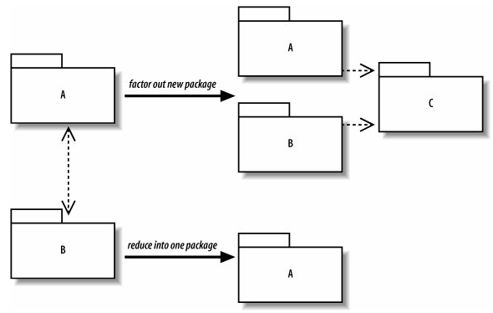
管理包的依赖关系
例：去除循环依赖

Slide 21
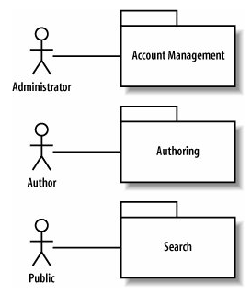
组织用例
可以用包来组织用例
  包可以用来将功能相似的类组织在一起
  包还可以用来组织其他的UML元素，如用例
  将用例组织成更高的层次有助于组织模型，可以看到参与者与系统的哪部分交互
    如图，CMS的用例包

Slide 22
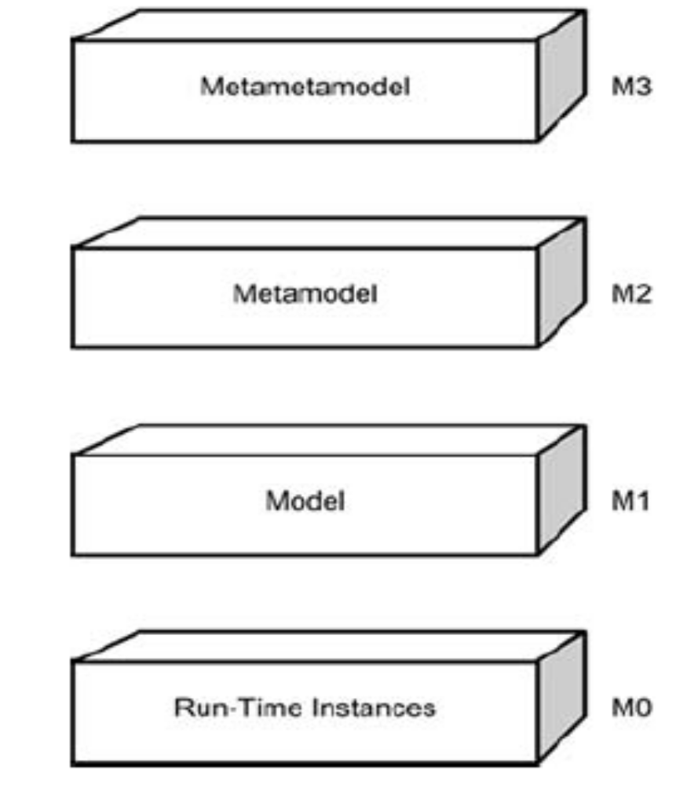
A Hierarchy

Slide 23
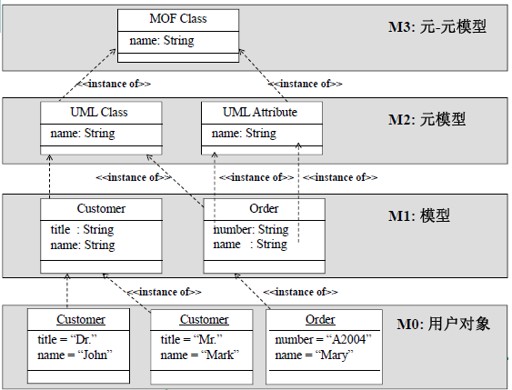

Slide 24
Packaging the Infrastructure of UML
we can use packages to model the foundations of the UML—what the OMG refers to as the UML's infrastructure.
the Infrastructure Library owns two packages, Core and Profiles.

Slide 25
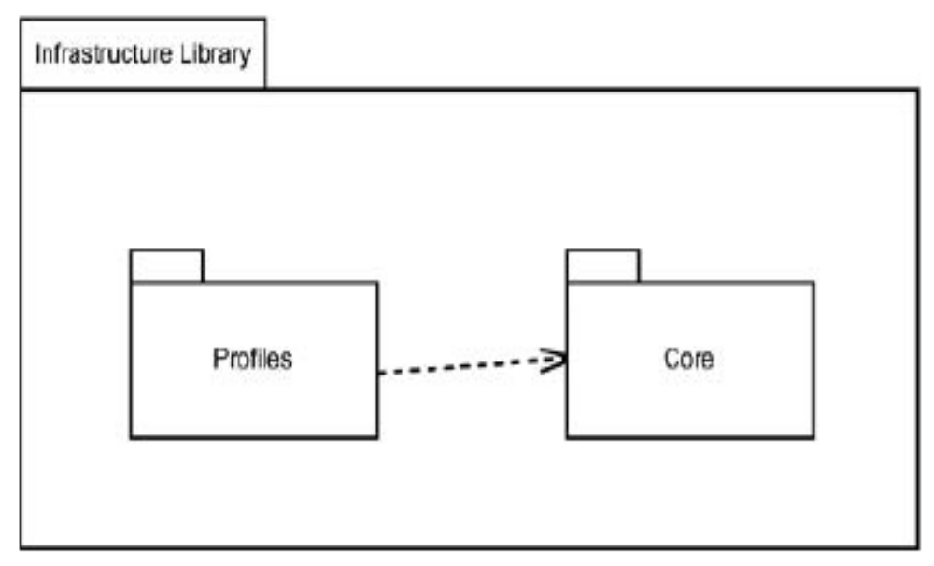
Packaging the Infrastructure of UML

Slide 26
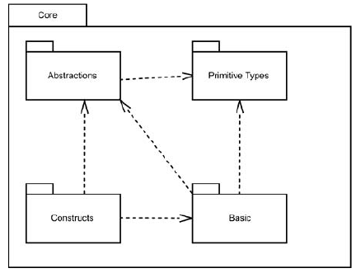
The Core
The Core owns four packages: Primitive Types, Abstractions, Basic, and Constructs

Slide 27
The Core
Primitive Types
  Primitive Types are data types that you would use if you were creating a modeling language.
  The types in this package are Integer, Boolean, String, and UnlimitedNatural.
  That last one means any number in the infinite set of natural numbers, and it specifies that an asterisk ("*") represents infinity.

Slide 28
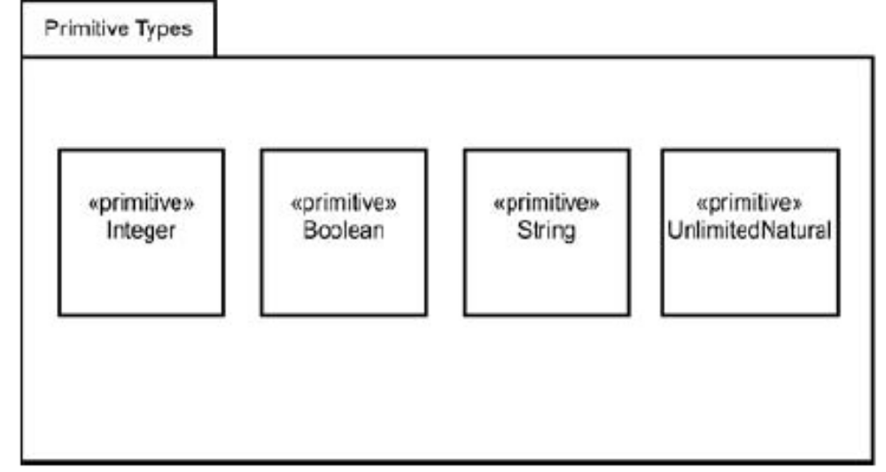
The Core
The Primitive Types package of the Core in the Infrastructure Library.

Slide 29
The Core
Abstractions
  The Abstractions package owns 20 packages.
  Each package specifies how to set up representations of the concepts you learned
  The Elements package is the most fundamental of these packages and owns just one abstract class called, unsurprisingly, Element.
  Element is the superclass for all the other classes

Slide 30
The Core
Basic
  The Basic package is a kind of baby-step into modeling.
  Based on classes, it's a foundation for developing complex modeling languages.

Slide 31
The Core
Constructs
  The Constructs package depends on many of the Abstractions packages and on the Basic package.
  It combines items from those packages to add detail to elements like classes, relationships, and data types.

Slide 32
Profiles
Profiles package is the one that gives you the mechanisms for adapting a metamodel for a specific area of knowledge.
Each adaptation is a separate profile.
If you were creating a new metamodel—that is, a new modeling language—you'd begin with the Core package and work from there.

Slide 33
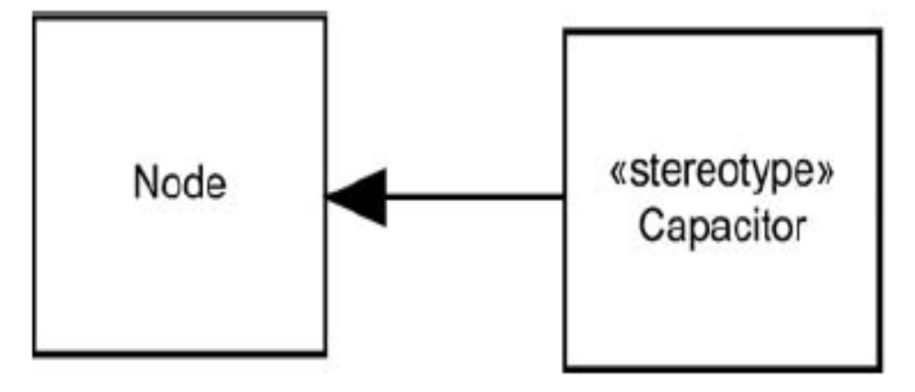
Profiles
Creating a Capacitor stereotype.

Slide 34
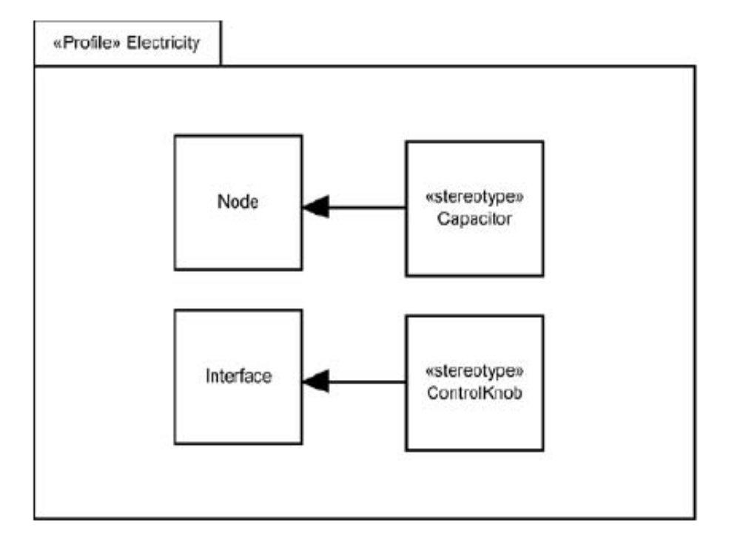
Profiles
The beginning of a profile that adapts the UML for modeling the world of electricity.

Slide 35
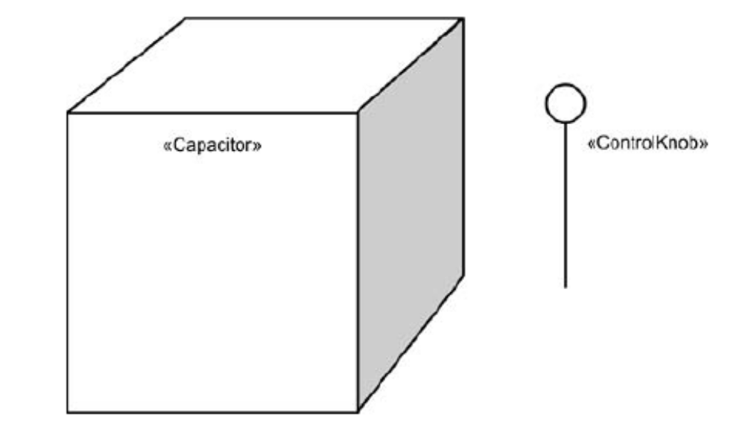
Profiles
once these stereotypes are created you now have symbols available in your UML Electricity profile (that is, in your extended metamodel),

Slide 36
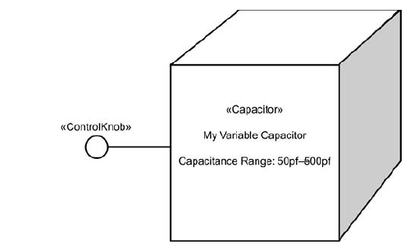
Profiles
Using the symbols from the Electricity profile.

Slide 37
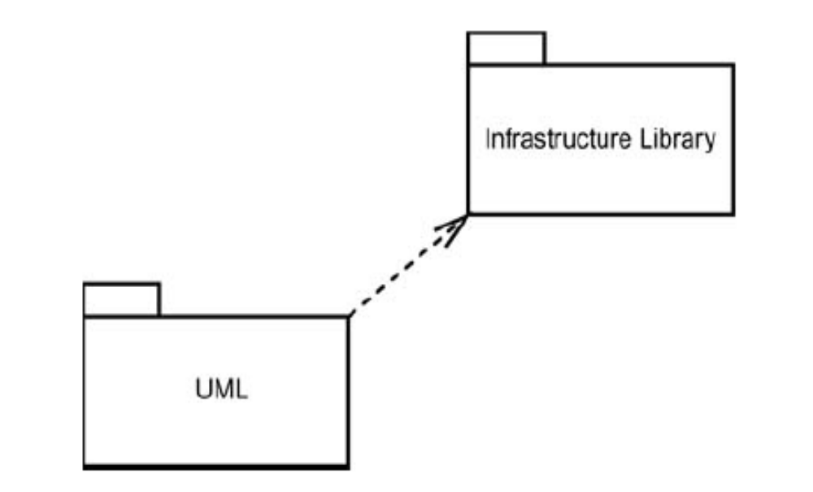
And Now At Last . . . the UML!
Let's leave M3 and explore M2.
The UML is based on the Infrastructure Library.

Slide 38
And Now At Last . . . the UML!
UML is the foundation for the models you create.
A UML class, in turn, is an instance of a metametaclass in the metametamodel.

Slide 39
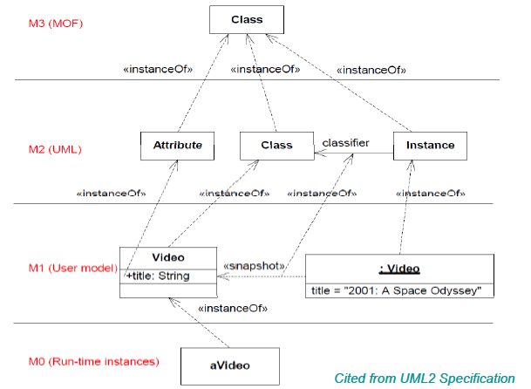

Slide 40
And Now At Last . . . the UML!
Just as package diagrams model the foundation of the UML, package diagrams also model the elements within the UML—what OMG refers to as the UML's superstructure.

Slide 41
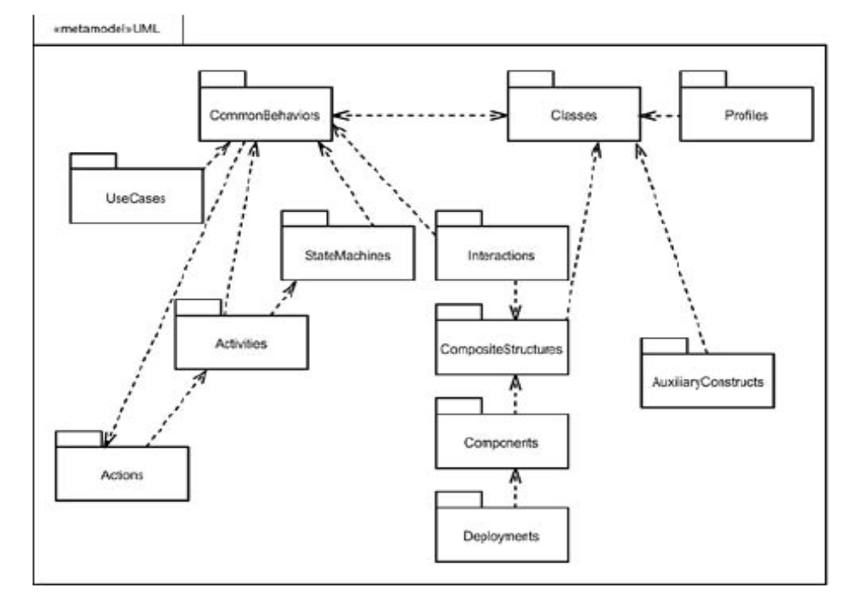
And Now At Last . . . the UML!

Slide 42
Extending the UML
three mechanisms enable you to extend the UML: stereotypes, constraints, and tagged values.

Slide 43
Extending the UML
stereotypes
  Dependency
  Class
  Package

Slide 44
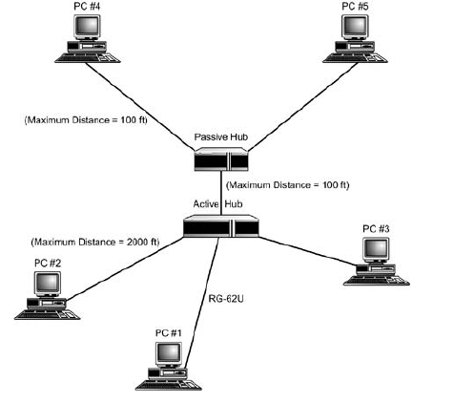
Extending the UML
Graphic Stereotypes

Slide 45
Extending the UML
Constraints
  constraints supply conditions and restrictions for UML model elements.
  You can specify a constraint in any format as long as you write it inside braces.

Slide 46
Extending the UML
Tagged Values
  A tagged value is designed to explicitly define a property.
  It's also written inside braces.
  It consists of a tag, which represents the property to be defined, and a value.

Slide 47
