Slide 1
用例图

Slide 2
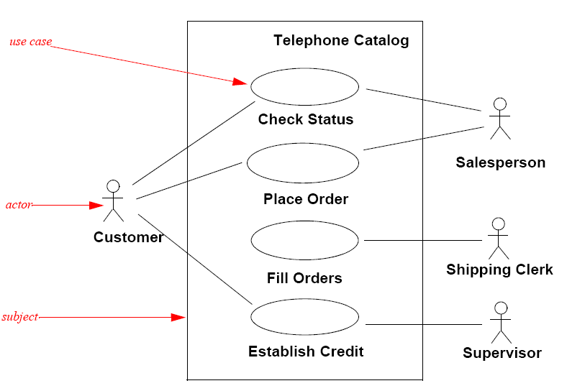

Slide 3
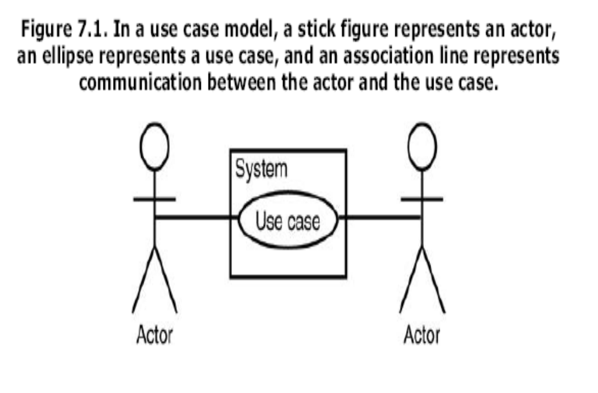

Slide 4
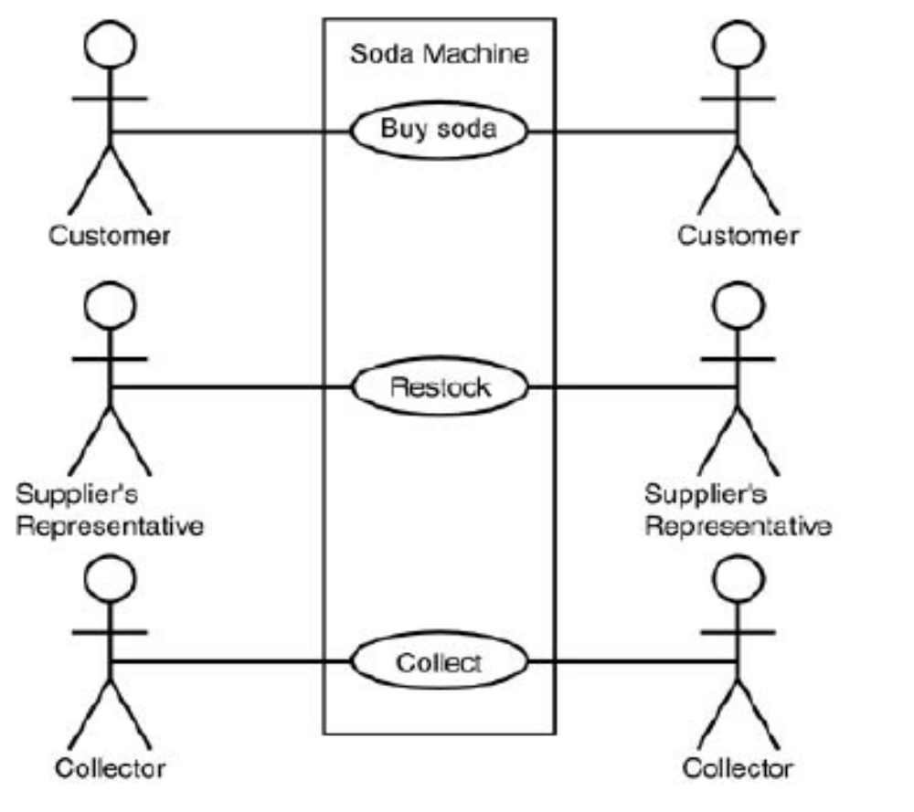
The Soda Machine Revisited

Slide 5
捕捉系统需求
A simple example
  假设我们正在定义一个web content management system (CMS)的需求
  Requirement A.1
    The content management system shall allow an administrator to create a new blog account, provided the personal details of the new blogger are verified using the author credentials database.

Slide 6
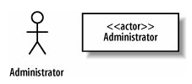
系统外部: Actors
第一步：查看与系统交互的人或物
  参与者（actor）
  在Requirement A.1中， Administrator角色是一个参与者：与系统交互而且不是系统的一部分
参与者的UML notation
  a "stick man" or a stereotyped box
  标示一个适当的名字

Slide 7
Actors
命名参与者
  使用客户和系统设计人员都能够理解的名字
  最好使用顾客需求中的原始术语
什么是参与者？什么不是？
  经验
  参与者可以是人、其他系统
  可以将参与者看作是一个黑盒
    不能改变参与者，不关心它如何工作
    它必须与这个系统交互

Slide 8
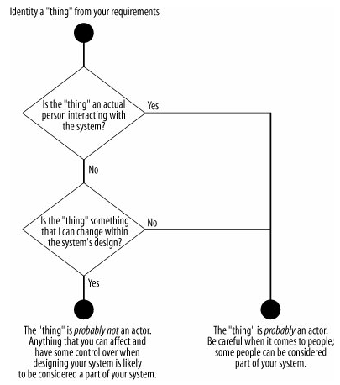
Actors
识别参与者时可以试着回答这几个问题

Slide 9
Actors
Tricky（棘手的） actors
  有些参与者可能不是明显的外部系统或人员
系统时钟（system clock）
  系统时钟是系统的一部分吗？
  系统时钟在引起系统中的某些行为时会起作用
    经验证明，系统时钟通常最好作为参与者，因为你不能影响它
    将时钟描述为参与者有助于说明系统需要根据当前的时间执行一项任务
容易被忽略的参与者
  关注的焦点往往是系统的使用者（user）
  其他人员有安装者、维护者、升级者
    如果忽略了这些人员，可能会遗漏某些重要功能

Slide 10
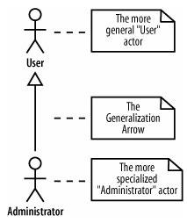
参与者泛化
参与者相互之间可能有关系
  Administrator实际上是系统用户的一种
  泛化可以用来描述这种关系

Slide 11
系统如何使用：用例
第二步：系统如何被用于完成参与者的一项特定工作
用例（use cases）
  用例可以从用户的需求中发现和确定
  可以将用户需求文档提炼为系统的一组清晰的工作
  用例有清晰的通过/失败准则（ pass/fail criteria）
    开发人员、测试员、技术文档人员、用户必须明确知道系统是否完成了一个用例
  从用户的角度看，用例是对系统的一次完整的使用
    可以很简单，也可以很复杂
  有和系统的交互以及交互的输出

Slide 12
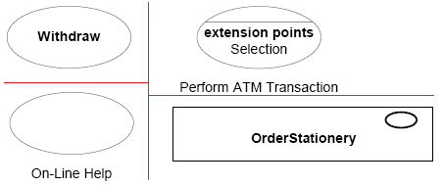
用例
用例的UML表示法
  用一个椭圆表示（4种）
  标示有用例名，描述该用例所表示的交互

Slide 13

Communication Lines
通信线表示参与者参与一个用例
  连接一个参与者和一个用例
    例如： Administrator actor 参与了 Create a new Blog Account 用例

Slide 14
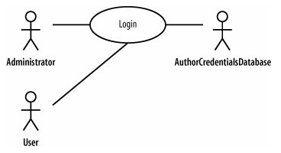
Communication Lines
  多个参与者参与同一个用例
    例如： login 用例在执行时和三个不同的参与者交互

Slide 15
Communication Lines
通信线的导航性
  有时UML用例图中会出现带箭头的通信线
    某些UML建模工具
  通信线的目的是表明actor参与了一个用例的执行
    没有暗含任何信息交换及信息传递的意思
    也没有参与者开始一个用例的意思
  这些信息在用例的详细描述中给出，因此没有必要在通信线上表明方向

Slide 16
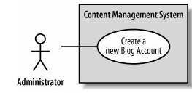
系统边界
在用例图中用一个方框表示系统边界
  用例在方框中，参与者在方框外
  方框上部标示有系统的名字

Slide 17
用例描述
用例图没有为系统设计人员提供足够详细的信息
  只有用例图，系统设计人员无法理解哪个参与者是最重要的，用例中包含哪些步骤，等等
要表达用例有关的详细信息，使用基于文本的描述

Slide 18
用例描述
每个用例应该有一个详细的文字描述，一般来说，用例描述中应该包含的信息
  The actor who initiates the use case
  Assumptions for the use case
  Preconditions for the use case
  Steps in the scenario
  Postconditions when the scenario is complete
  The actor who benefits from the use case
下面的表格是一个样例

Slide 19
Use Case Descriptions
Use case description detail | What the detail means and why it is useful
Related Requirements | Some indication as to which requirements this use case partially or completely fulfills.
Goal In Context | The use case's place within the system and why this use case is important.
Preconditions | What needs to happen before the use case can be executed.
Successful End Condition | What the system's condition should be if the use case executes successfully.
Failed End Condition | What the system's condition should be if the use case fails to execute successfully.
Primary Actors | The main actors that participate in the use case. Often includes the actors that trigger or directly receive information from a use case's execution.
Secondary Actors | Actors that participate but are not the main players in a use case's execution.
Trigger | The event triggered by an actor that causes the use case to execute.
Main Flow | The place to describe each of the important steps in a use case's normal execution.
Extensions | A description of any alternative steps from the ones described in the Main Flow.

Slide 20
用例描述
Create a new Blog Account 用例的描述
Use case name | Create a new Blog Account
Related Requirements | Requirement A.1.
Goal In Context | A new or existing author requests a new blog account from the Administrator.
Preconditions | The system is limited to recognized authors and so the author needs to have appropriate proof of identity.
Successful End Condition | A new blog account is created for the author.
Failed End Condition | The application for a new blog account is rejected.
Primary Actors | Administrator.
Secondary Actors | Author Credentials Database.
Trigger | The Administrator asks the CMS to create a new blog account.

Slide 21
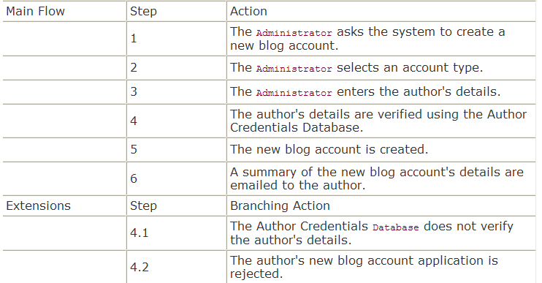
用例描述
Create a new Blog Account 用例的描述（续）

Slide 22
用例描述
用例描述的作用
  用例描述及其包含的信息不只是对用例图的额外说明
  用例描述使用例更完整，没有描述的用例不是很有用
  在描述用例的同时也可以进一步改进和完善用例图
    例如上面的描述和用例图相比有不一致的地方
      在用例描述中涉及了两个参与者，而图中只有一个
    因此可以标识一个新的参与者： Author Credentials Database
    修改后的用例图如下页所示

Slide 23
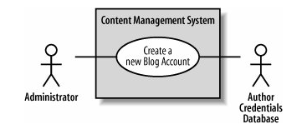
用例描述

Slide 24
用例关系
用例之间经常存在着某些关联
  不同用例的描述中会有一些相同或相似的步骤
  有些用例有若干种不同的工作模式或特例
  有些用例在执行时会有多种可能的流程，并希望在用例图中表示出重要的可选流程
用例之间的复用、扩展和特化关系
  include
  generalize
  extend

Slide 25
Inclusion
  An include relationship defines that a use case contains the behavior defined in another use case. （UML Spec.）
To represent inclusion, you use the symbol you used for dependency between classes—a dashed line connecting the classes with an arrowhead pointing to the depended-on class.

Slide 26
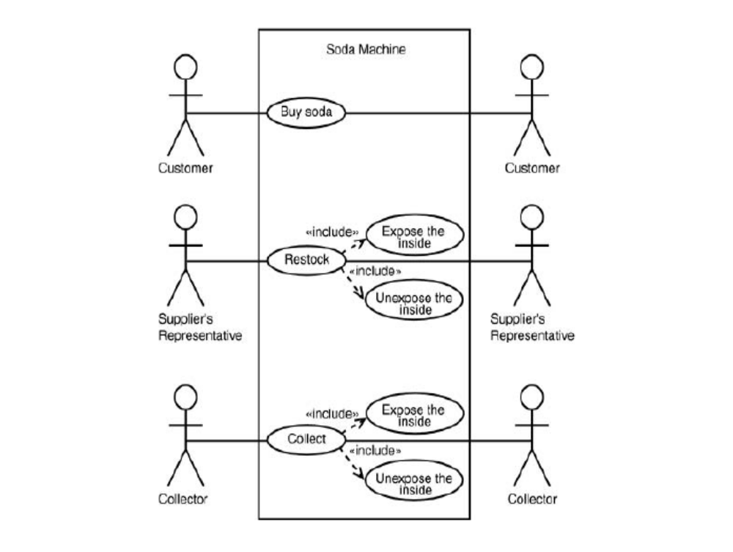

Slide 27
包含关系
例如，对CMS系统增加了另一个需求
  Requirement A.2 :The content management system shall allow an administrator to create a new personal Wiki, provided the personal details of the applying author are verified using the Author Credentials Database.
  为了捕获需求A.2，需要新增加一个用例

Slide 28
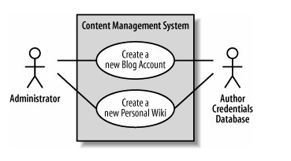
<<include>>

Slide 29
<<include>>
“Create a new Personal Wiki” 用例的详细描述
  回想Create a new Blog Account用例的描述
Use case name | Create a new Personal Wiki
Related Requirements | Requirement A.2.
Goal In Context | A new or existing author requests a new personal Wiki from the Administrator.
Preconditions | The author has appropriate proof of identity.
Successful End Condition | A new personal Wiki is created for the author.
Failed End Condition | The application for a new personal Wiki is rejected.

Slide 30
Use case name | Create a new Personal Wiki (Cont.)
Primary Actors | Administrator.
Secondary Actors | Author Credentials Database.
Trigger | The Administrator asks the CMS to create a new personal Wiki.
Main Flow | Step | Action
 | 1 | The Administrator asks the system to create a new personal Wiki.
 | 2 | The Administrator enters the author's details.
 | 3 | The author's details are verified using the Author Credentials Database.
 | 4 | The new personal Wiki is created.
 | 5 | A summary of the new personal Wiki's details are emailed to the author.
Extensions | Step | Branching Action
 | 3.1 | The Author Credentials Database does not verify the author's details.
 | 3.2 | The author's new personal Wiki application is rejected.

Slide 31
两个用例描述中存在冗余
  Create a new Blog Account and Create a new Personal Wiki 都要检查申请人的资格
  检查和验证的行为在两个用例描述中是重复的
用例包含
  用例之间共享的重复行为可以用一个新的用例来捕获
    Check Identity
  这个新用例在Create a new Blog Account 和 Create a new Personal Wiki 用例中被重用
  <<include>> 关系支持用例之间共享行为的复用

Slide 32
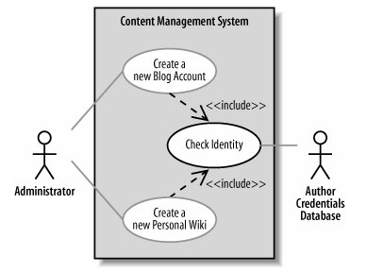
  箭头出发的用例完全复用了被包含用例的所有步骤

Slide 33
在用例描述中对 <<include>>关系的表述
  从 Create a new Blog Account 和 Create new Personal Wiki 用例的描述中删除冗余的步骤
  增加一个Included Cases 栏，指出所包含的用例名
  用include::<use case name> 语法指出在哪一步包含了新用例
  例：上述三个用例的描述

Slide 34
Create a new Blog Account
Use case name | Create a new Blog Account
Related Requirements | Requirement A.1.
Goal In Context | A new or existing author requests a new blog account from the Administrator.
Preconditions | The author has appropriate proof of identity.
Successful End Condition | A new blog account is created for the author.
Failed End Condition | The application for a new blog account is rejected.
Primary Actors | Administrator
Secondary Actors | None
Trigger | The Administrator asks the CMS to create a new blog account.
Included Cases | Check Identity
Main Flow | Step | Action
 | 1 | The Administrator asks the system to create a new blog account.
 | 2 | The Administrator selects an account type.
 | 3 | The Administrator enters the author's details.
 | 4 include::Check Identity | The author's details are checked.
 | 5 | The new account is created.
 | 6 | A summary of the new blog account's details are emailed to the author.

Slide 35
Wiki
Use case name | Create a new Personal Wiki
Related Requirements | Requirement A.2
Goal In Context | A new or existing author requests a new personal Wiki from the Administrator.
Preconditions | The author has appropriate proof of identity.
Successful End Condition | A new personal Wiki is created for the author.
Failed End Condition | The application for a new personal Wiki is rejected.
Primary Actors | Administrator
Secondary Actors | None
Trigger | The Administrator asks the CMS to create a new personal Wiki.
Included Cases | Check Identity
Main Flow | Step | Action
 | 1 | The Administrator asks the system to create a new personal Wiki.
 | 2 | The Administrator enters the author's details.
 | 3 include::Check Identity | The author's details are checked.
 | 5 | The new personal Wiki is created.
 | 6 | A summary of the new personal Wiki's details are emailed to the author.

Slide 36
Check Identity
Use case name | Check Identity
Related Requirements | Requirement A.1, Requirement A.2.
Goal In Context | An author's details need to be checked and verified as accurate.
Preconditions | The author being checked has appropriate proof of identity.
Successful End Condition | The details are verified.
Failed End Condition | The details are not verified.
Primary Actors | Author Credentials Database.
Secondary Actors | None.
Trigger | An author's credentials are provided to the system for verification.
Main Flow | Step | Action
 | 1 | The details are provided to the system.
 | 2 | The Author Credentials Database verifies the details.
 | 3 | The details are returned as verified by the Author Credentials Database.
Extensions | Step | Branching Action
 | 2.1 | The Author Credentials Database does not verify the details.
 | 2.2 | The details are returned as unverified.

Slide 37

Extension（扩展关系）
UML规范中的<<extend>>关系
  A relationship from an extending use case to an extended use case that specifies how and when the behavior defined in the extending use case can be inserted into the behavior defined in the extended use case.
  用来表示一个用例可能完全复用另一个用例的行为，但是，这种复用是可选的，依赖于运行时或系统实现时的判定

Slide 38
<<extend>>
CMS example
  如果Create a new Blog Account 用例希望在作者创建新账户的申请被拒绝时将这个信息记录在作者的申请历史中
  可以在 Create a new Blog Account用例的描述中增加步骤来描述这个可选行为
    如下表中的Step 4.3
  Step 4.3的行为还可以用于 Create a new Personal Wiki 用例的执行中

Slide 39
Use case name | Create a new Blog Account
Related Requirements | Requirement A.1.
…… | ……
Included Cases | Check Identity
Main Flow | Step | Action
 | 1 | The Administrator asks the system to create a new blog account.
 | 2 | The Administrator selects an account type.
 | 3 | The Administrator enters the author's details.
 | 4 include::Check Identity | The author's details are checked.
 | 5 | The new account is created.
 | 6 | A summary of the new blog account's details are emailed to the author.
Extensions | Step | Branching Action
 | 4.1 | The author is not allowed to create a new blog.
 | 4.2 | The blog account application is rejected.
 | 4.3 | The application rejection is recorded as part of the author's history.

Slide 40
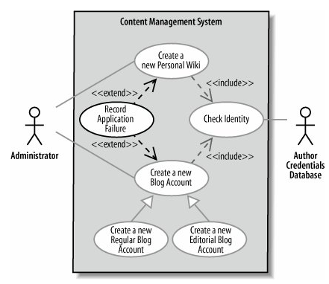
<<extend>>
<<extend>> 关系适合描述这种复用
  根据需求，这种可复用的行为在两个用例中都是可选的，在请求被接受时不需要记录

Slide 41
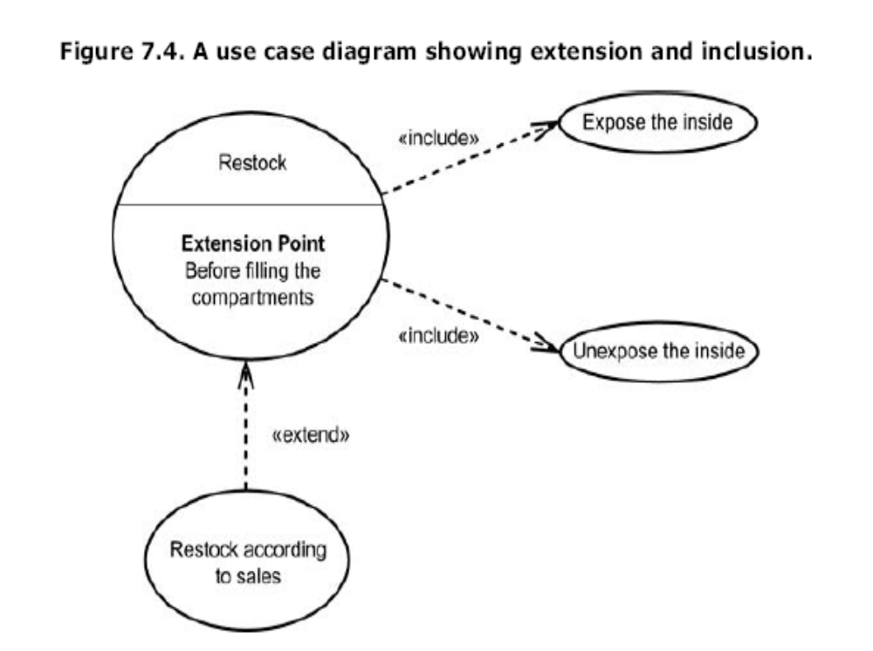

Slide 42
用例泛化和特化
一个用例的行为可能适用于几种不同的情况，但是有很小的变化
  不是 <<include>> 关系
  以面向对象的术语来说，是一个一般化（泛化）的用例有几种特殊化（特化）的情况
例如
  如果给CMS增加了支持创建几种不同类型blog账户的功能，那么创建每个账户的行为和原始的用例有些什么差别呢？
  在Create a new Blog Account 用例中描述创建blog账户的一般行为，然后定义各种特化的用例，修改原始用例，来分别描述创建特定类型账户的行为

Slide 43
用例泛化和特化
泛化关系也可以用术语“继承”来描述
  Use case继承可以用来表示一个用例是另一个用例的一种特殊类型
  表示法：泛化箭头
  例如：下面的图中给出了扩展后的CMS的用例，可以创建不同的blog账户
    regular account
    editorial account

Slide 44
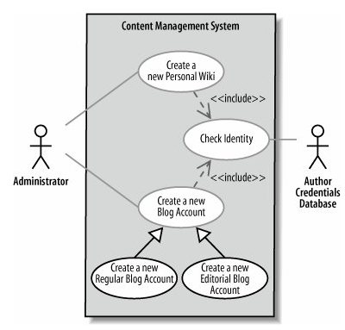
用例泛化和特化

Slide 45
用例泛化和特化
Create a new Editorial Blog Account 特化用例的描述
  Create a new Blog Account 用例的大多数行为被复用
  只需要添加特定于创建一个editorial账户的行为
Use case name | Create a new Editorial Blog Account
Related Requirements | Requirement A.1.
Goal In Context | A new or existing author requests a new editorial blog account from the Administrator .
Preconditions | The author has appropriate proof of identity.
Successful End Condition | A new editorial blog account is created for the author.
Failed End Condition | The application for a new editorial blog account is rejected.
Primary Actors | Administrator.
Secondary Actors | None.
Trigger | The Administrator asks the CMS to create a new editorial account that will allow an author to edit entries in a set of blogs.
Base Use Cases | Create a new Blog Account

Slide 46
Main Flow | Step | Action
 | 1 | The Administrator asks the system to create a new blog account.
 | 2 | The Administrator selects the editorial account type.
 | 3 | The Administrator enters the author's details.
 | 4 | The Administrator selects the blogs that the account is to have editorial rights over.
 | 5 include::Check Identity | The author's details are checked.
 | 6 | The new editorial account is created.
 | 7 | A summary of the new editorial account's details are emailed to the author.
Extensions | Step | Branching Action
 | 5.1 | The author is not allowed to edit the indicated blogs.
 | 5.2 | The editorial blog account application is rejected.
 | 5.3 | The application rejection is recorded as part of the author's history.

Slide 47
用例泛化和特化
通过用例继承可以复用用例
  只需要说明特化用例中需要的额外步骤
  一般用例中的每个步骤必须在特化用例中出现
  一般用例与外部参与者或其他用例之间的关系对特化的用例也适用
如果不希望特化用例做一般用例描述的每一件事情，不要适用泛化
  可以考虑适用<<include>> 关系或者 <<extend>> 关系
  抽象用例

Slide 48
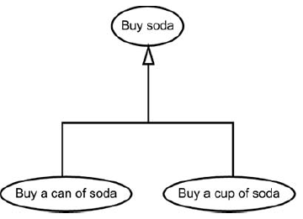
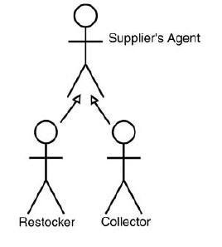

Slide 49
Use Case Overview Diagrams
用例概图的用途
  了解系统所处的环境会有助于理解系统
  用例概图对系统所处的环境或领域进行描述
  Example
    CMS‘s 的环境

Slide 50
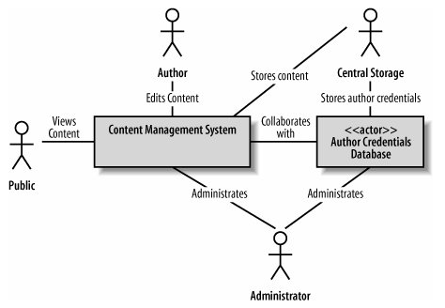
Use Case Overview Diagrams

Slide 51
用例图练习
绘制一个电视机遥控器的用例模型草图

