Slide 1
类的表示

Slide 2

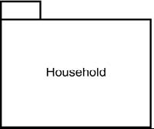
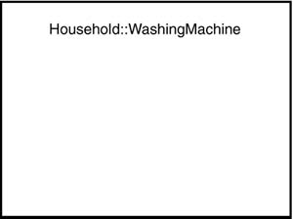
类的表示

Slide 3
属性
类的特性
属性会有取值范围.
一个类有零个或多个属性.
对象的每个属性一定会有一个值
在类中，你可以指定属性的类型，属性名与类型用冒号隔开
你也可以给属性一个缺省值

Slide 4
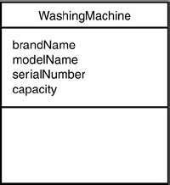
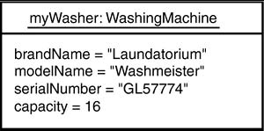
属性

Slide 5
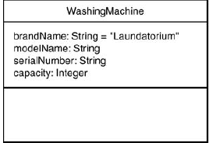
Attributes

Slide 6
操作
操作是类的行为，或者其他类需要它做的事情
操作名后必须有括号，括号里可以给出参数及参数类型
有返回值的操作称为函数
Signature（签名）.

Slide 7
Operations

Slide 8
属性，操作的表示
可以不给出属性和操作

Slide 9
属性，操作的表示
也可以给出某些属性和操作

Slide 10
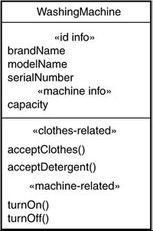
属性，操作的表示
如果有很多个属性和操作，
可以用关键字进行分组

Slide 11
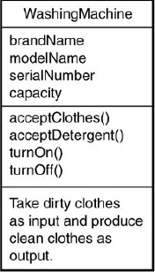
职责和约束
The responsibility is a description of what the class has to do—that is, what its attributes and operations are trying to accomplish.

Slide 12
职责和约束
A slightly more formal way is to add a constraint, a free-form text enclosed in curly brackets. The bracketed text specifies one or more rules the class follows.

Slide 13
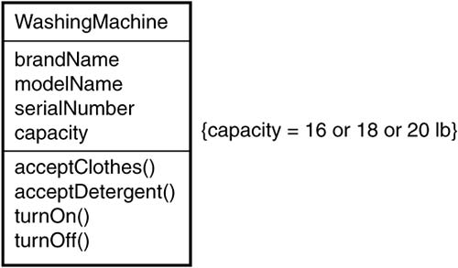
约束

Slide 14
添加注释

Slide 15
类的识别（名词识别法）
一支冰球队由一名中锋、一名守门员、两名边锋以及两名后卫组成。每个队员都手持一个曲棍，用来在冰上运球，目标是用曲棍将球射入对方的球门。冰球比赛通常在一个室内的冰球场进行。场地长200英尺、宽最大为100英尺。中锋的任务是将冰球传递给边锋，边锋的射门技术通常比前锋更好。后卫力图阻止对方到达本方的射门位置和射门。守门员是最后 一道防线，阻挡对方的射门。每当他成功地阻挡出对方的射门，他就进行了一次“救球”。每射进球门一次得一分。一场冰球比赛要进行60分钟，这60分钟被分3次20分钟的比赛。

Slide 16
类之间的关联关系

Slide 17
Associations（关联）
When classes are connected together conceptually, that connection is called an association.

Slide 18
Associations （关联）
each one usually plays a role within that association.

Slide 19
Associations
You can show both associations in the same diagram,

Slide 20
Associations （关联）
Several classes can connect to one class.

Slide 21

Constraints on Associations
Sometimes an association between two classes has to follow a rule.
You indicate that rule by putting a constraint near the association line.

Slide 22
Constraints on Associations
Another type of constraint is the Or relationship, signified by {or} on a dashed line that connects two association lines.

Slide 23
Association Classes
An association can have attributes and operations, just like a class. you have an association class.
visualize an association class the same way you
show a regular class, and you use a dashed line to connect it to the association line.
An association class can have associations to other classes

Slide 24
Association Classes

Slide 25
Multiplicity
the number of objects from one class that relate with a single object in an associated class.

Slide 27
Qualified Associations
When an association's multiplicity is one-to-many, a particular challenge often arises: lookup.
When an object from one class has to choose a particular object from another in order to fulfill a role in an association, the first class has to rely on a specific attribute to select the correct object.
That attribute is typically an identifier, such as an ID number.
ID information is called a qualifier.

Slide 28
Qualified Associations

Slide 29
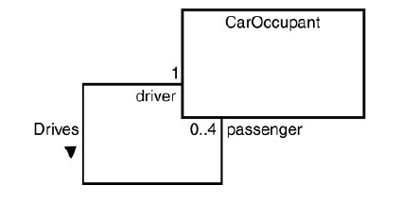
Reflexive Associations
Sometimes, a class is in an association with itself. Referred to as a reflexive association,

Slide 30
关联的实现
public class Reservation {
private Customer customer ;
public Reservation( Customer c ) {
customer = c ;
}
}

Slide 31
关联的实现
every reservation should be linked to exactly one customer
but the reservation could hold a null reference
public Reservation( Customer c ) {
if ( c == null ) { /* throw NullCustomerException */ }
customer = c ;
}

Slide 32

关联的实现
public class BookingSystem {
private Vector current = new Vector( ) ;
public void addBooking( Booking b ) {
current.addElement(b);
}
}

Slide 33
类之间的 继承关系

Slide 35
Inheritance and Generalization
A class might have no parents, in which case it's a base class or root class.
A class might have no children, in which case it's a leaf class.
If a class has exactly one parent, it has
single inheritance.
If a class has more than one parent, it has multiple inheritance.

Slide 36
Discovering Inheritance
The analyst has to realize that the attributes and operations of one class are general and
perhaps apply to several other classes, which may add attributes and operations of their own.

Slide 37
Discovering Inheritance
Another possibility is that the analyst notes that two or more classes have a number of attributes and operations in common.

Slide 38
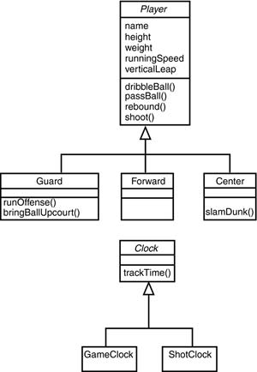
Abstract Classes
provide no objects

Slide 39
类之间 的依赖关系

Slide 40
Dependencies
In a different kind of relationship, one class uses another. This is called a dependency.

Slide 41

关联关系练习
有一句格言:“为自己辩护的律师对诉讼人来说是徒劳的”。试着建立这句格言的类模型。
给出下图的类模型

