Slide 1
顺序图

Slide 2
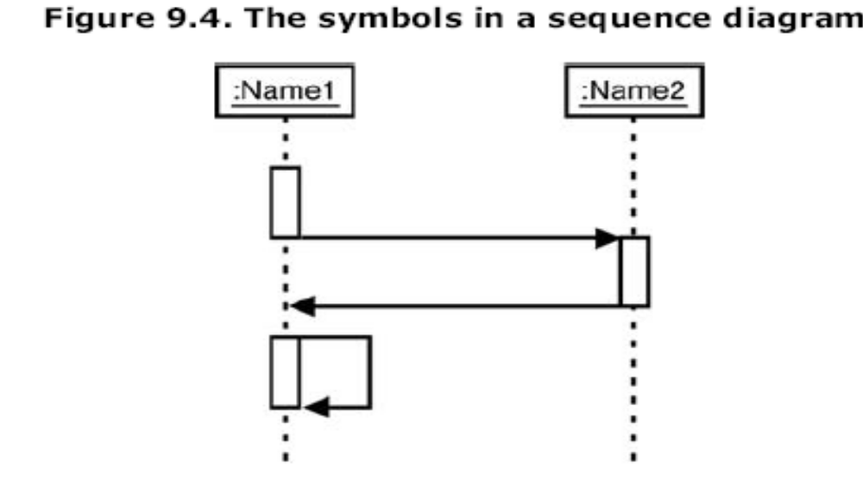
What Is a Sequence Diagram

Slide 3
What Is a Sequence Diagram?
The sequence diagram consists of objects represented in the usual way (as named
rectangles with the name underlined),
messages represented as solid-line arrows, and time represented as a vertical progression.

Slide 4
Objects
The objects are laid out near the top of the diagram from left to right. They're arranged in any order that simplifies the diagram.
Extending downward from each object is a dashed line called the object's lifeline.
Along the lifeline is a narrow rectangle called an activation.

Slide 5
Objects
The activation represents an execution of an operation the object carries out
The length of the rectangle signifies the activation's duration.
Duration, and time in general, are represented in a rough, ordinal way.

Slide 6
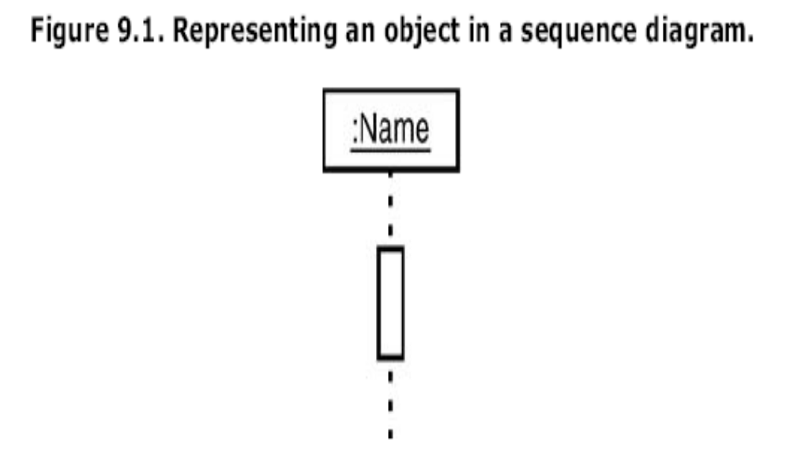

Slide 7
参与者
参与者的名字
  顺序图上的参与者可以以多种方式命名，标准格式如下:
    name [selector] : class_name ref decomposition
    可以根据特定参与者的信息选择其中的某些元素，例如
参与者名 | 描述
admin | 名字是 admin, 但此时还没有指定所属的类
: ContentManagementSystem | 参与者所属的类是ContentManagementSystem 但是没有名字
admin : Administrator | 参与者名为 admin ，是 Administrator类的
eventHandlers [2] : EventHandler | 参与者是一个数组元素，下标为2 所属类为EventHandler.
: ContentManagementSystem ref cmsInteraction | 参与者所属类是 ContentManagementSystem 其内部如何工作在另一个名为cmsInteraction的交互图中显示

Slide 8
Messages
A message that goes from one object to another goes from one object's lifeline to the other object's lifeline.
An object can also send a message to itself—that is, from its lifeline back to its own lifeline.
UML represents a message as an arrow that starts at one lifeline and ends at another.
The shape of the arrowhead shows what type of message it is

Slide 9
Messages
One type of message is a call.
This is a request from the object sending the message to the object receiving the message.
Because the sender waits for the receiver (that is, "synchs up" with the receiver), this message is also referred to as synchronous.
UML signifies this message type with a filled arrowhead at the end of a solid line

Slide 10
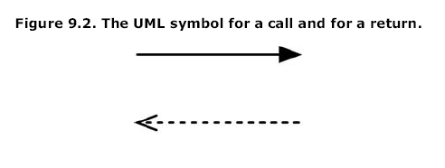
Messages

Slide 11

Messages
Another kind of message is asynchronous.
With this one, the sender transfers control to the receiver and doesn't wait for the operation to complete.

Slide 12
消息
Message Signatures
  消息箭头上标注有其描述，即signature
  message signature 的格式
    attribute = signal_or_message_name (arguments) : return_type
    参数（argument）的格式
    <name>:<class>

Slide 13
事件、信号和消息
Example message signature | Description
doSomething( ) | The message's name is doSomething, but no further information is known about it.
doSomething(number1 : Number, number2 : Number) | The message's name is doSomething, and it takes two arguments, number1 and number2, which are both of class Number.
doSomething( ) : ReturnClass | The message's name is doSomething; it takes no arguments and returns an object of class ReturnClass.
myVar = doSomething( ) : ReturnClass | The message's name is doSomething; it takes no arguments, and it returns an object of class ReturnClass that is assigned to the myVar attribute of the message caller.

Slide 14
Time
the sequence diagram is two-dimensional. The left-to-right dimension is the layout of the objects
the top-to-bottom dimension shows the passage of time.

Slide 15
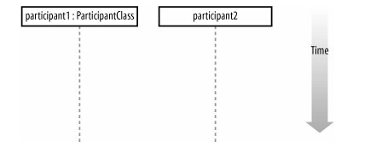
Time

Slide 16
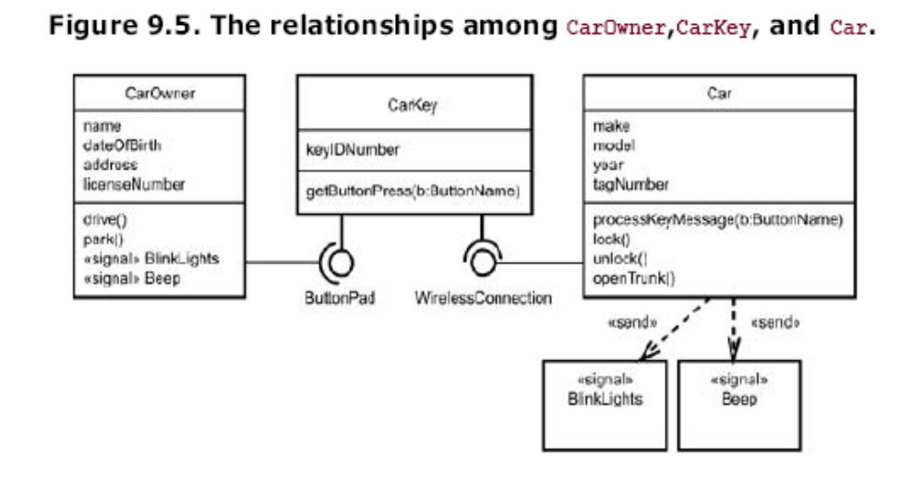
Cars and Car Keys

Slide 17
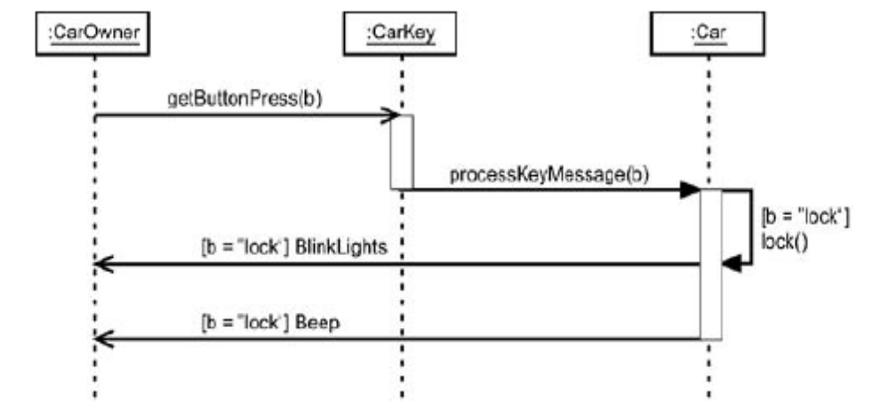
Cars and Car Keys
Figure 9.7. Messages complete the sequence diagram.

Slide 18
The Soda Machine
In your model of the soda machine, the front
  Accepts selections and cash
  Displays prompts like "Out of selection" and "Use correct change"
  Receives change from the register and makes it available to the customer
  Returns cash
  Receives a can of soda from the dispenser and makes it available to the customer

Slide 19
The Soda Machine
The register
  Gets the customer's input (that is, the selection and the cash) from the front
  Updates its cash reserve
  Checks for change

Slide 20
The Soda Machine
The dispenser
  Checks the availability of a selection
  Releases a can of soda

Slide 21
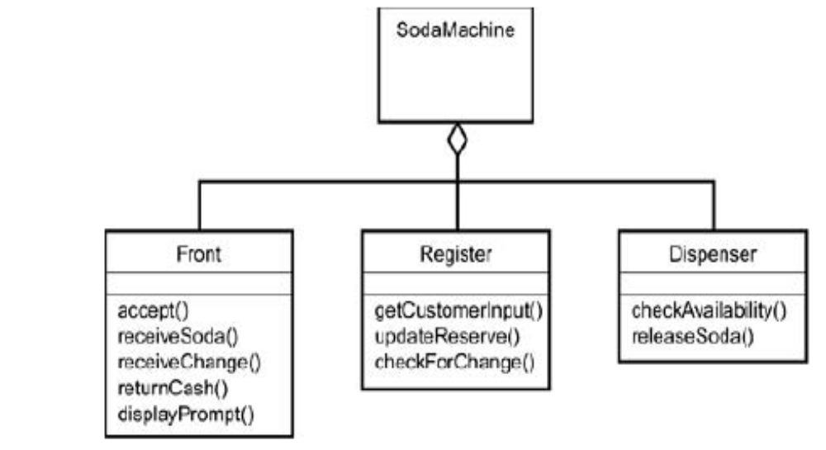
The Soda Machine

Slide 22
The Soda Machine
The sequence goes like this:
  The customer inserts the money into the money
  slot in the front of the machine and makes a selection
  The money travels to the register, which updates itself.
  Bacause this is the best scensrio, an availability check reveals the soda is in stock, and the register has the dispense release the soda to the front of the machine.

Slide 23
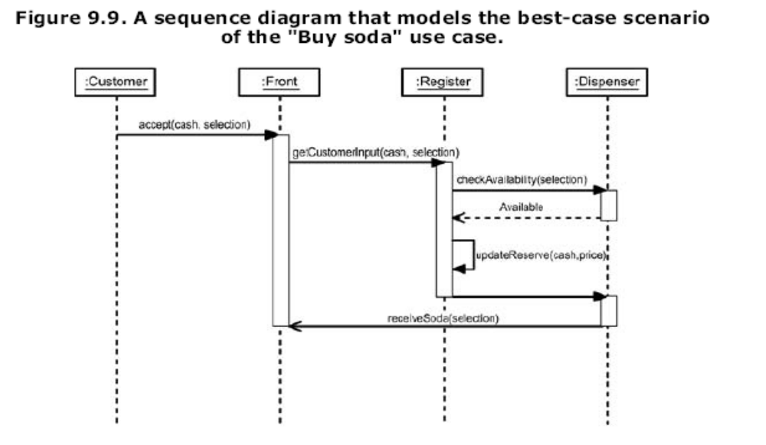
The Soda Machine

Slide 24
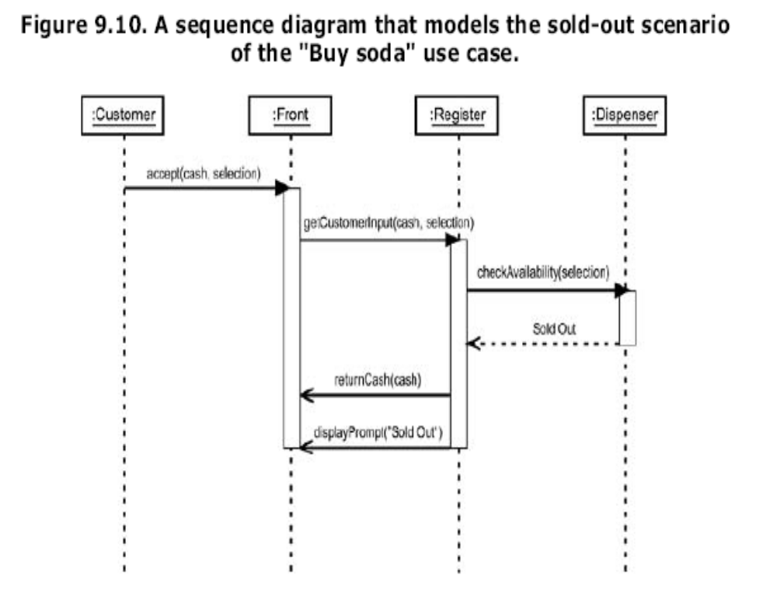

Slide 25
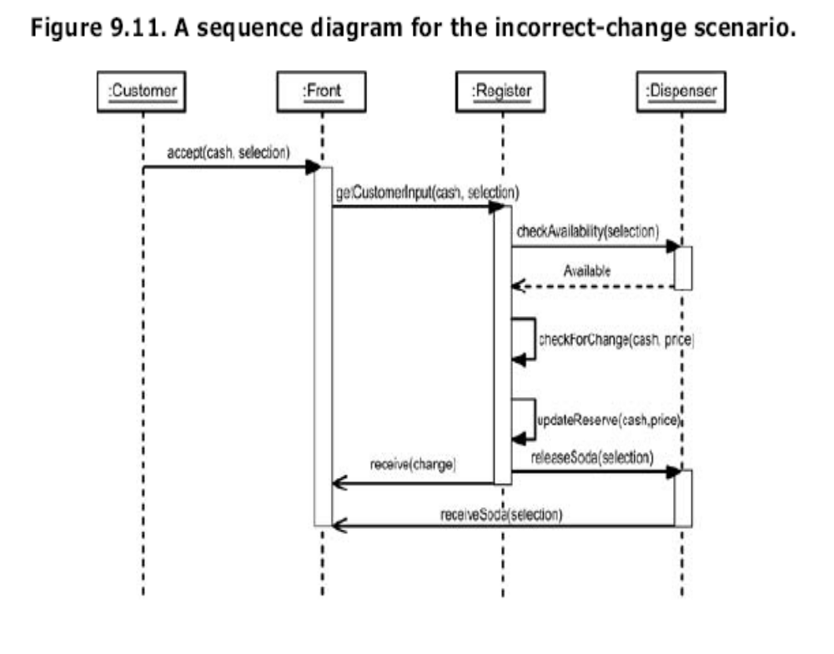

Slide 26
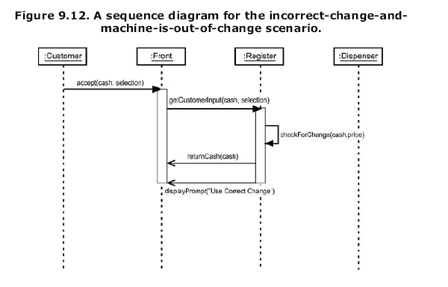

Slide 27
Sequence Diagrams: The Generic Sequence Diagram
you've put just one scenario into a sequence diagram. When you do this, you create an instance sequence diagram.
If you include all of a use case's scenarios when you draw a sequence diagram, you create a generic sequence diagram.
We need some way of indicating conditions;
one condition necessitates the messages in one
scenario, another condition necessitates others.

Slide 28
Sequence Diagrams: The Generic Sequence Diagram
The guard conditions provide essentially the same information as the return messages.
You want to be able to show that if you fully follow one scenario's sequence of messages to its conclusion, the transaction is over, and that the remaining messages are related to other scenarios.
To do this, you preface the final message in each scenario with «transaction over».

Slide 29
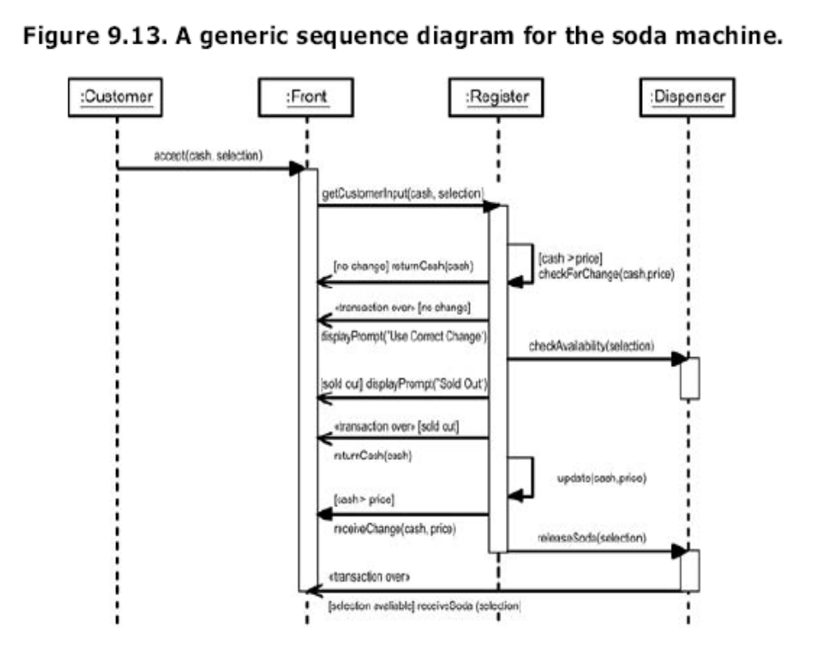

Slide 30
创建和销毁
参与者创建和销毁消息
  有些参与者不是在顺序图所描述的交互过程中一直都存在
  可以根据传递的消息来创建和销毁参与者
创建的两种表示
  向参与者的生命线传递一个create(..) 消息
  比其他参与者在图中的位置低一些，将<<create>>消息发送给参与者
销毁的两种表示
  发送《destroy》消息，在要被销毁的参与者的生命线上画一个“X”
  只在生命线上画“X”（如java语言中没有析构函数）

Slide 31
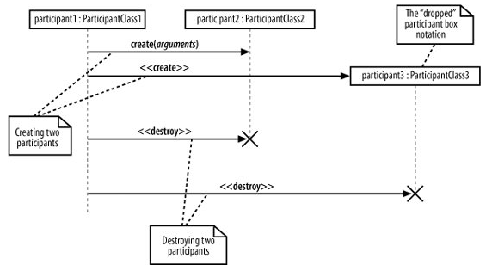
创建和销毁

Slide 32
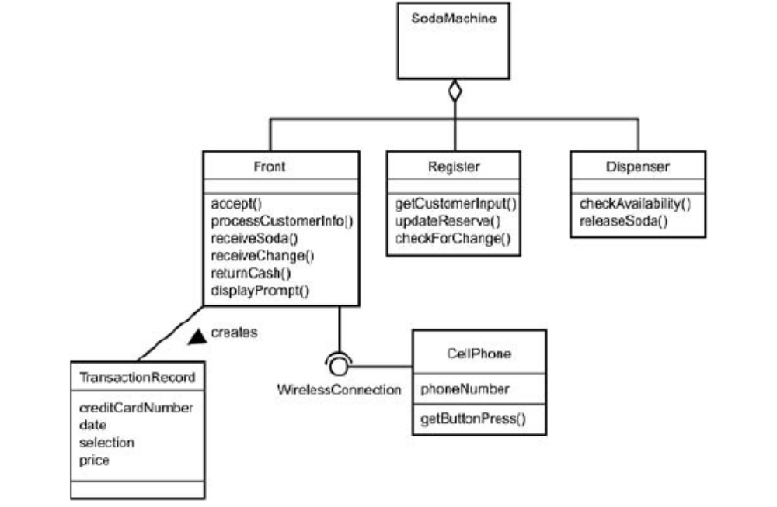
Sequence Diagrams: The Generic Sequence Diagram

Slide 33
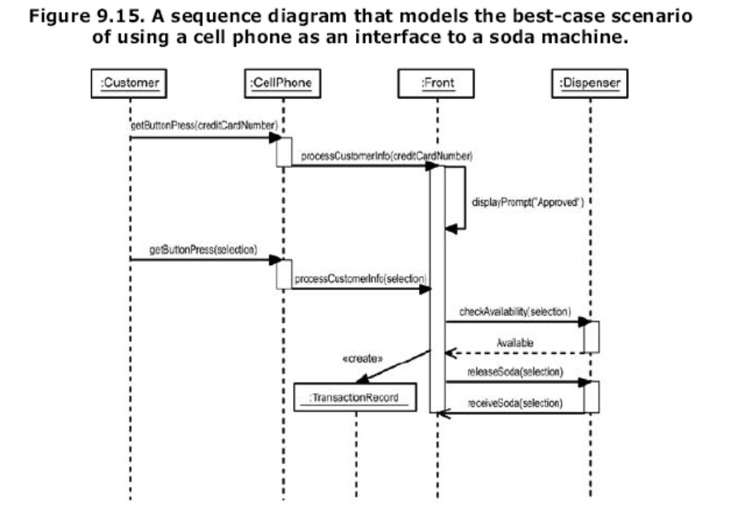

Slide 34
Sequence Diagrams: The Generic Sequence Diagram
While we're on the subject of object creation, we should also talk about object destruction. To show an object being destroyed, you place a large, bold X at the bottom of its lifeline

Slide 35
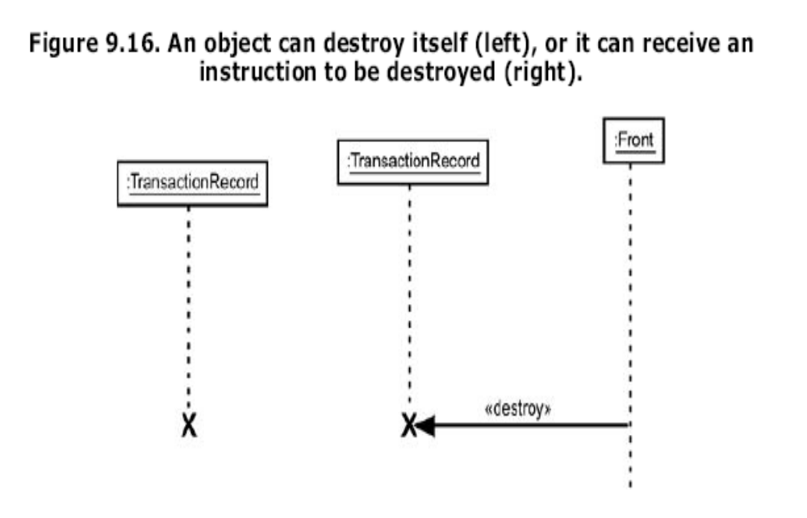

Slide 36
Framing a Sequence: Sequence Diagramming in UML2.0
UML 2.0 adds a useful touch to sequence diagrams.
You can now frame a sequence diagram by surrounding it with a border and adding a compartment in the upper left corner.
The compartment contains information that identifies the diagram.

Slide 37
Framing a Sequence: Sequence Diagramming in UML2.0
One of the pieces of information is an operator, an expression that describes the type of diagram inside the frame.
For a sequence diagram, the operator is sd.

Slide 38
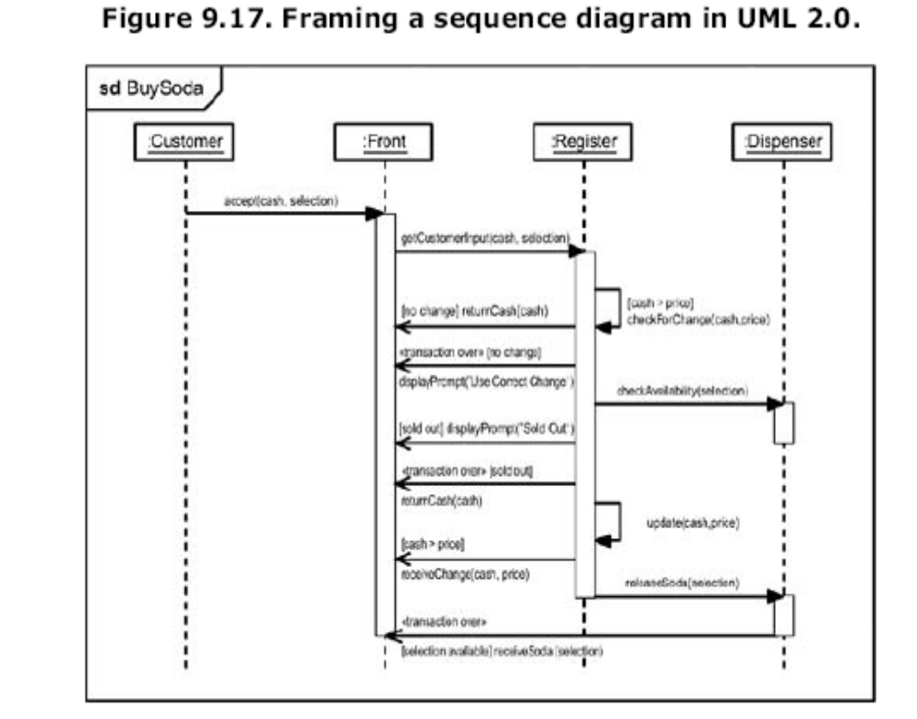

Slide 39
Framing a Sequence: Sequence Diagramming in UML2.0
Interaction Occurrences
  If you're creating instance sequence diagrams for the scenarios in a use case, you'll notice a fair amount of duplication from diagram to diagram.
  Framing gives you a quick and easy way to reuse part of one sequence diagram in another.
  You draw a frame around part of the diagram, label the frame's compartment, and just insert the frame with a label (but without the messages and lifelines) into the new diagram.
  This particular framed part is called an interaction occurrence. Its operator is ref.

Slide 40
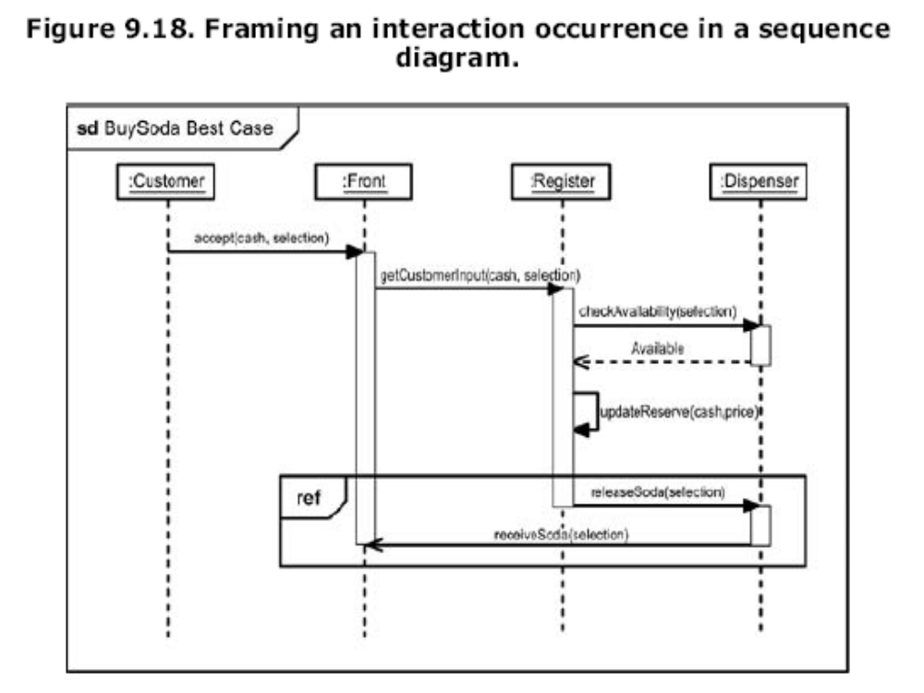

Slide 41
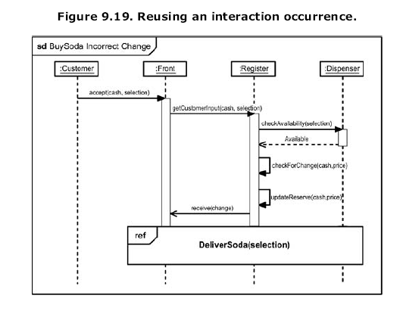

Slide 42
Framing a Sequence: Sequence Diagramming in UML2.0
Combined Interaction Fragments
  An interaction occurrence is a special case of an interaction fragment—UML 2.0's generic name for a piece of a sequence diagram.
  You can combine these interaction fragments in various ways.
  The operator indicates the type of combination.
  To show a combination, frame the entire set of fragments, and use a dotted line as a border between adjoining interaction fragments.

Slide 43
Framing a Sequence: Sequence Diagramming in UML2.0
The two types of combinations I think will be the most widely used are denoted by the alt
operator and by the par operator.
In the alt combination, each fragment is an alternative and can proceed only under certain
conditions.
Guard conditions indicate which fragment can take place.

Slide 44
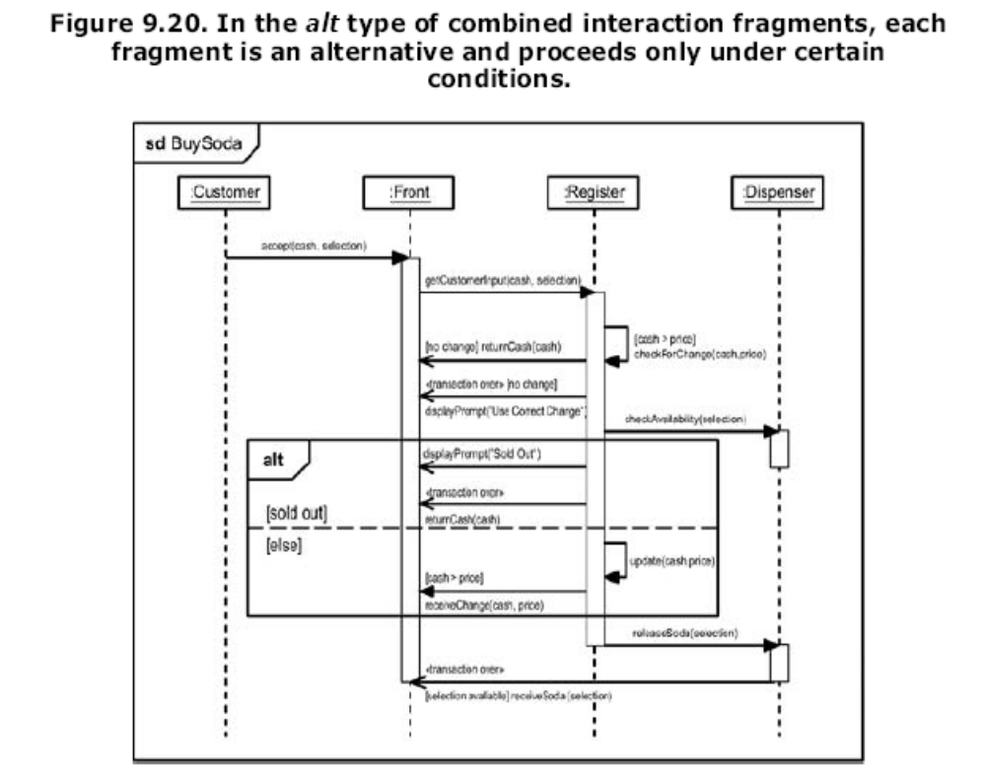

Slide 45
Framing a Sequence: Sequence Diagramming in UML2.0
In the par combination, the combined fragments work in parallel and don't interfere with one another

Slide 46
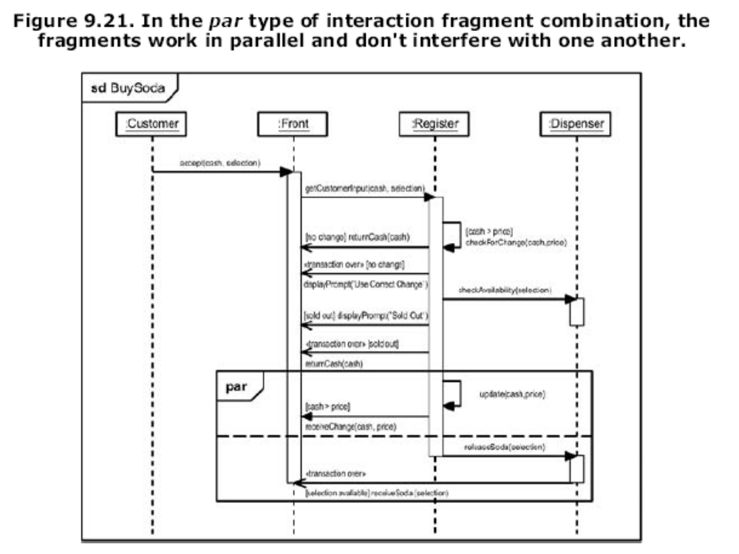

Slide 47
用例实现
从用例描述的Main Flow中抽出构造顺序图所需的信息
Main Flow | Step | Action
 | 1 | The Administrator asks the system to create a new blog account.
 | 2 | The Administrator selects the regular blog account type.
 | 3 | The Administrator enters the author's details.
 | 4 | The author's details are checked using the Author Credentials Database.
 | 5 | The new regular blog account is created.
 | 6 | A summary of the new blog account's details are emailed to the author.

Slide 48
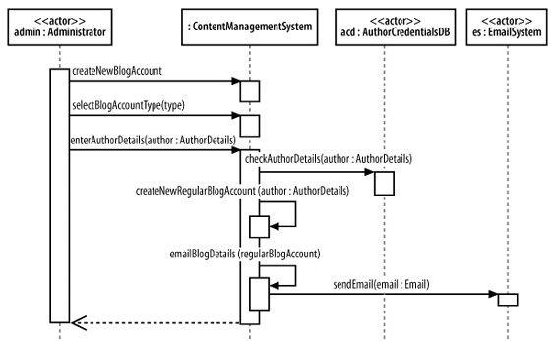
A Top-Level Sequence Diagram

Slide 49
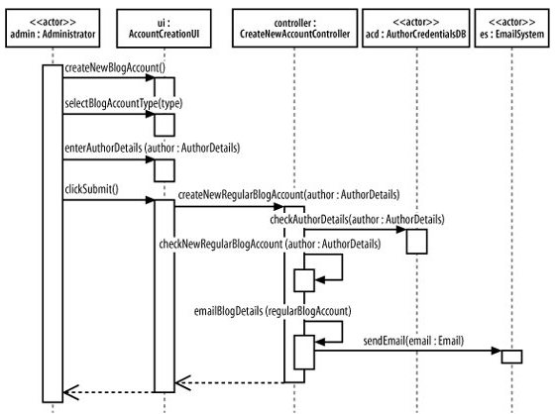
细化顺序图

