Slide 1
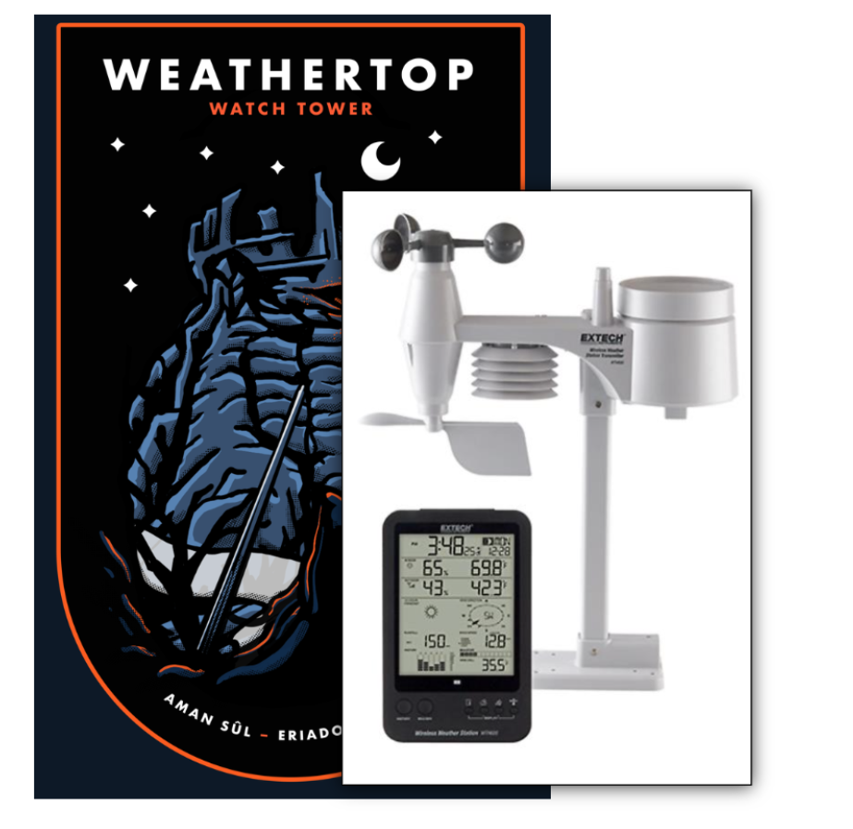
Name: | Matthew Hornby
Student Number: | 20058053
GitHub: | https://github.com/Maxi937/WeatherTop
URL: | https://pacific-escarpment-80032.herokuapp.com/

Slide 2
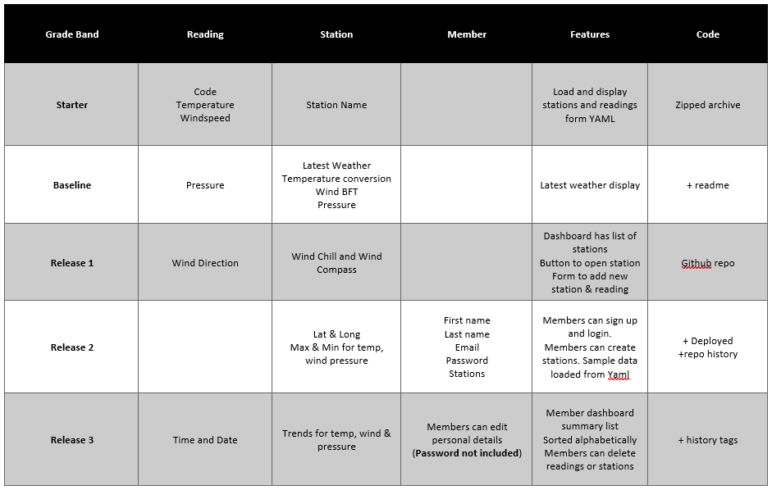
Estimated Payment: 85% - 90%

Slide 3
Demo
3 mins

Slide 4
Code Walkthrough:
Structure
Overview
Classes
WeatherInstrument
Controllers
MemberCtrl
Views
Tags

Slide 5
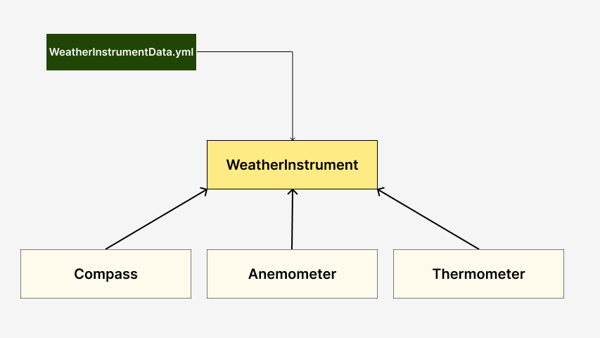
Weather Instrument Package

Slide 6
Weather Instrument Package
Each Instrument is a sub class of “WeatherInstrument”.
WeatherInstrument Data is loaded from a YAML file.
The Data is accessed through a protected variable in WeatherInstrument.
The Instruments are not Static classes *probably should have been static.

Slide 7
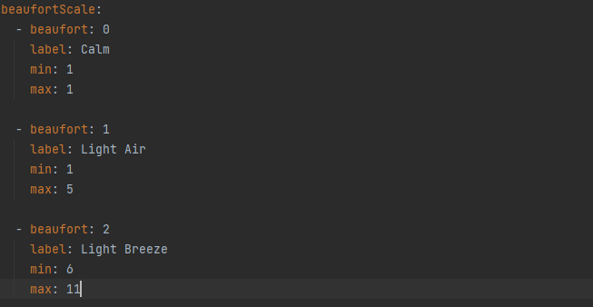
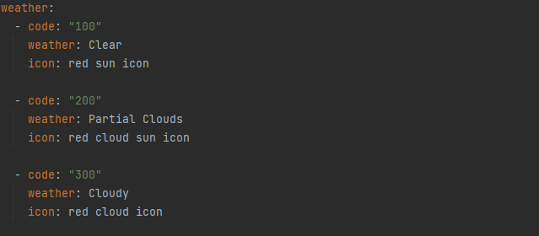
Sample shot of Yaml
Key
Array of HashMaps

Slide 8
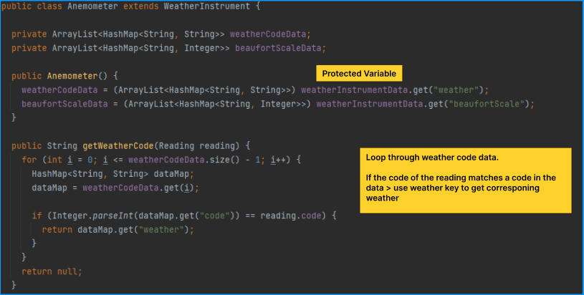
Anemometer:
Get IntrumentData > Get WeatherCodeData with key “weather” > Get Element of Weather Code data > Check the weather code of that element against the weather code of the reading > return value of weather key of that element

Slide 9
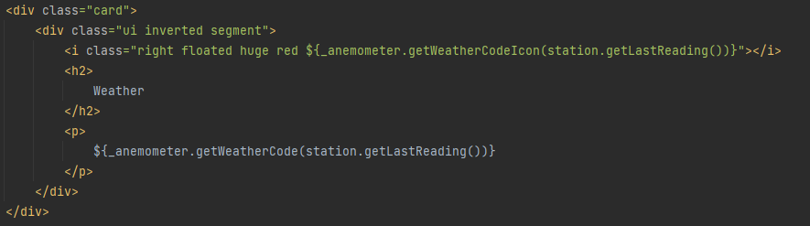
View:
An Anemometer object is created and dropped into the “laststationreadings.html” tag as _anemometer.
Call the function _anemometer.getWeatherCode(Reading reading) which takes a Reading object as an argument.
Station has a function to return the last reading of the station, so we call station.getLastReading() for the argument.

Slide 10
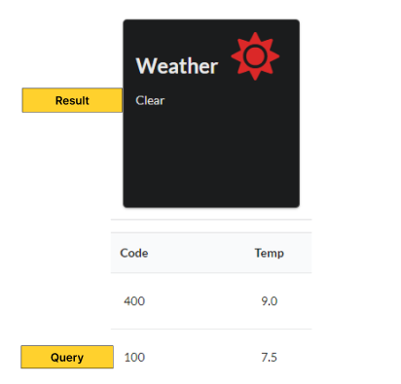
Result:

