Slide 1
Mobile App Development 2
Matthew Hornby: 20058053
My Fitness Trainer

Slide 2
Introduction
Summary:
Mobile App for tracking workouts
Developed using wireless debugging feature in Android Studio
Stuck with same app but rebuilt with Jetpack Compose

Slide 3
Demo
3 minute Demo

Slide 4
Code Highlights
Architecture
Android Account Manager:
Composables:
Screen
Workout
Exercise

Slide 5
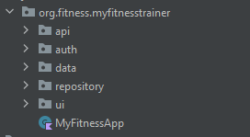
Architecture
Tried to follow MVVM

Slide 6
Architecture
Tried to follow MVVM
Backend
AUTH
API
Models
Repository
ViewModel
UI

Slide 7
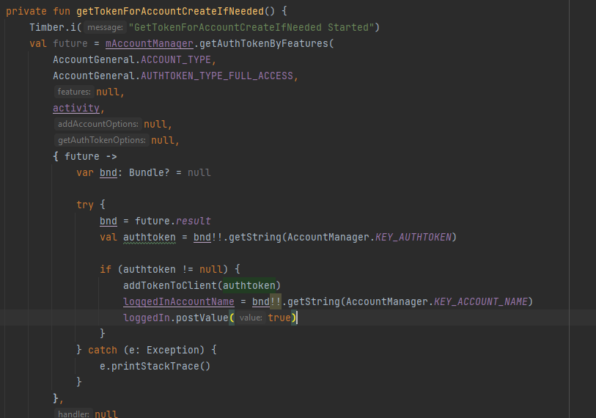
Auth
Implemented Android Account Manager.
Persistent login and token refresh.
Extended from AbstractAccountManager.
Account Manager calls login or signup activity and stores credentials.
App will attempt to automatically login on start > if fail > goes to the login flow.

Slide 8
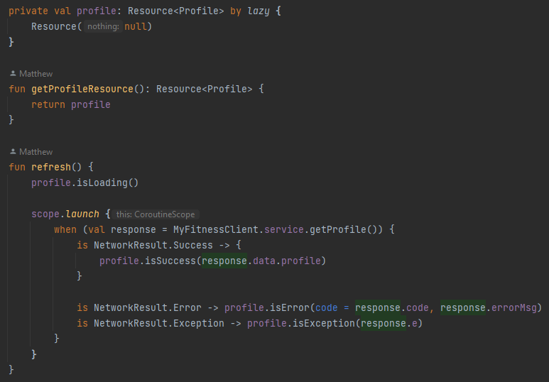
Repository
Profile object is returned from API.
New class to represent “resources” that could be loading at time of composition.
The Repository is an Object and is observed by view models for changes in state.

Slide 9
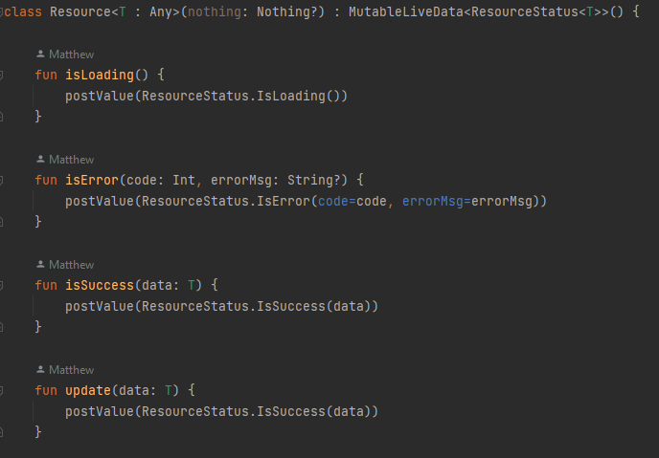
Repository

Slide 10
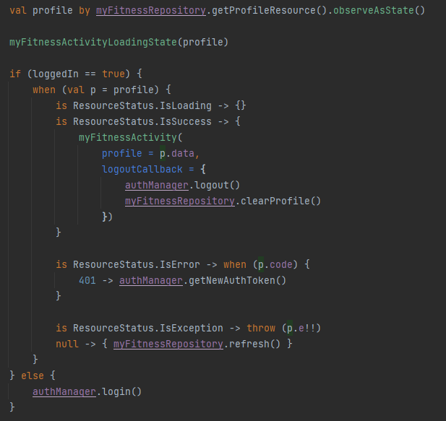
Repository

Slide 11
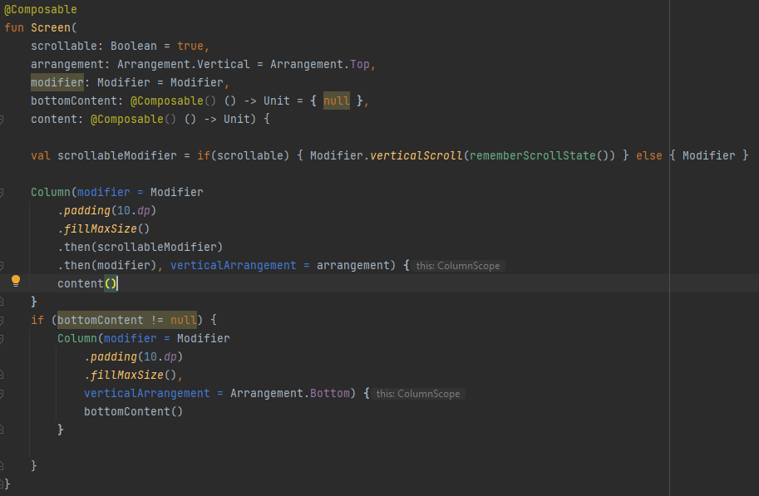
Composable - Screen

Slide 12
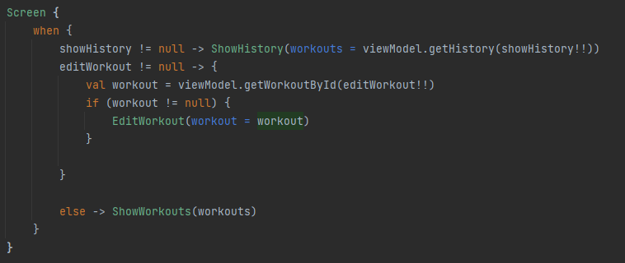
Composable - Screen

Slide 13
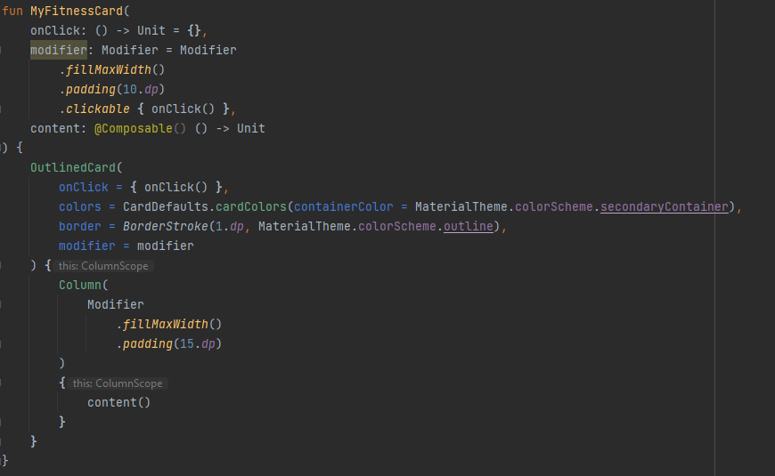
Composable – Card

Slide 14
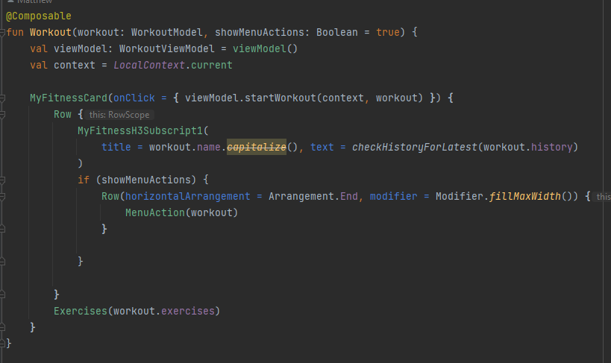
Composable – Card

Slide 15
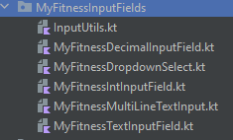
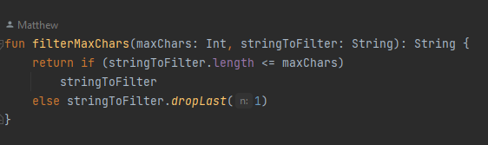
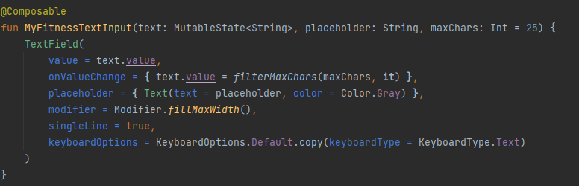
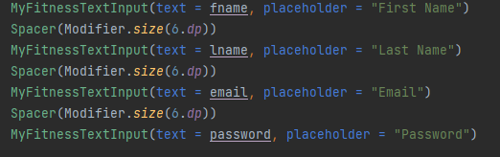
Composable - Inputs

Slide 16
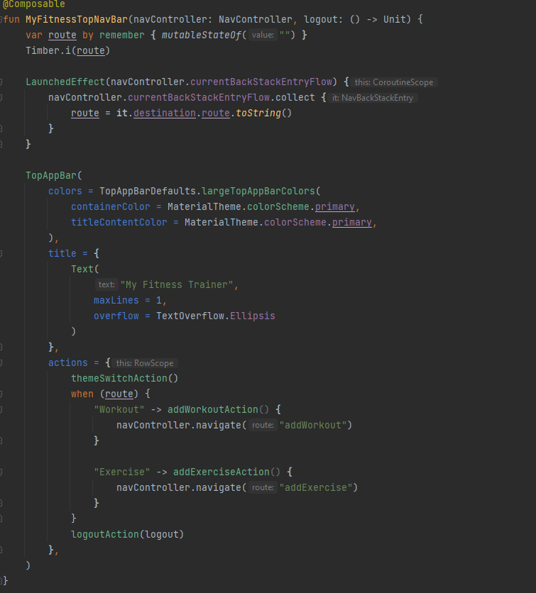
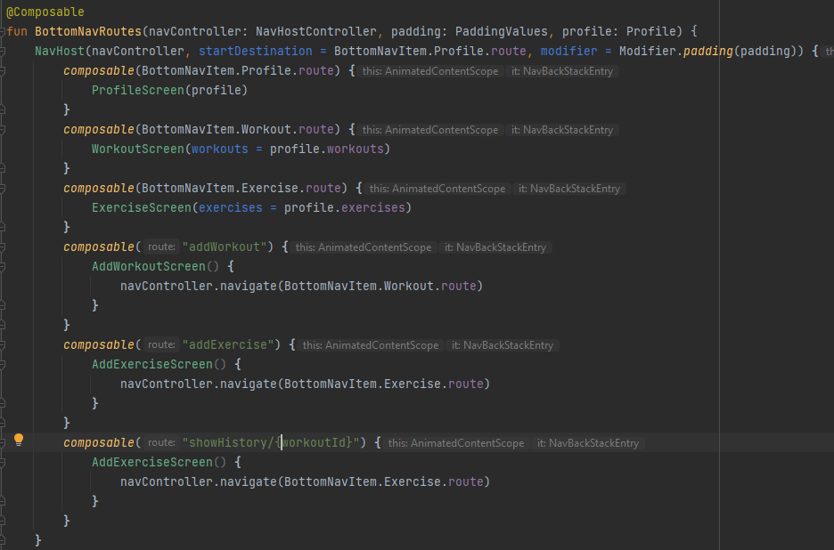
Navigation

Slide 17
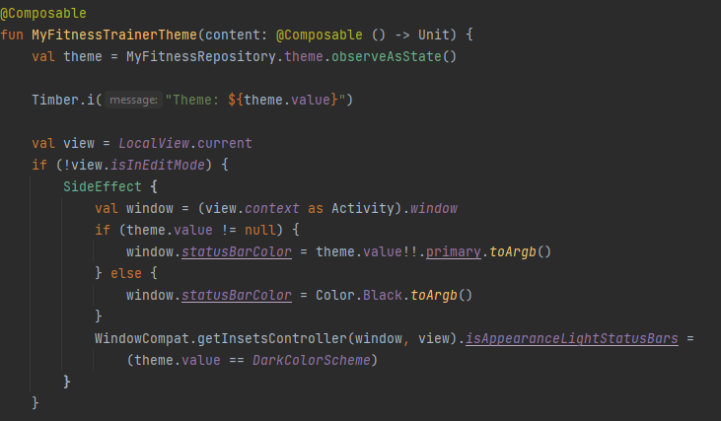
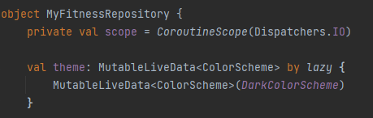
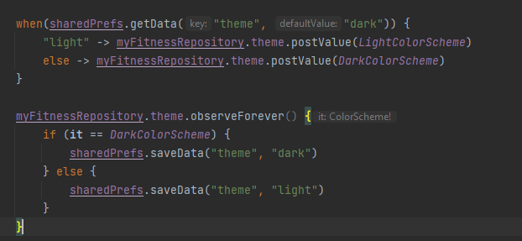
Theme

