Slide 1
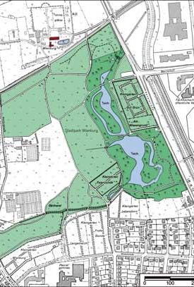
Green Space accessibility
Elevator pitch by
Hendrik Lüning and Maximilian Elfers

Slide 2
Objective
Create a tool to evaluate the accessibility of green spaces in urban areas

Slide 3
Features
Calculate walking distance to nearest green space
Analyze population data to identify underserved areas
Generate accessibility maps and reports
Suggest locations for new green spaces based on population density and current accessibility

Slide 4
Possible Add-Ons
ChatGPT
Enable the user to use the tool for every urban area they want
Get green area addresses from ChatGPT for the data

Slide 5
Answer questions
Why is it a good fit for the course?
Combines different functions learned in the course (ArcGIS Widget, Georeferencing, Routing)
Goes a bit beyond what was learned in the course (Heatmap, Suggestion creation based on data)
Expected time frame?
20 hours per person

Slide 6
Final Product
ArcGIS Pro Widget where users can select the desired functionalities from a range of options and a report is generated based on these.
4 (or 5 with add-ons) buttons to select the functionalities
Each functionality will add different information onto the map

