Slide 1
Real-Time Telemetry in Open AI RAN
using Microsoft Janus (jBPF)
Midterm Progress Report
Maxim Bitiu · Bachelor Thesis · April 2026
srsRAN Project · jBPF / Microsoft Janus · ZMQ Virtual Radio · InfluxDB · Grafana

Slide 2
Why Build This?
The problem with standard 5G network monitoring
Standard 5G monitoring gives you ~1-second averages at the MAC layer only:
• "MCS dropped from 27 to 22" — but why? Radio problem? Scheduler overloaded? Traffic flood?
• No way to tell from standard metrics alone
eBPF (extended Berkeley Packet Filter) lets us inject probes into any running program:
• Zero kernel changes — probes load and unload at runtime
• Per-event granularity at every 1 ms radio slot
• Multiple protocol layers simultaneously
Microsoft Janus (jBPF) extends eBPF to userspace gNB software:
• Hook directly into the srsRAN gNB source code at 22 function call sites
• Capture microsecond-level events invisible to any standard interface
Research Question
Can jBPF hook telemetry distinguish infrastructure faults from channel impairments in a live 5G NR system?
Answer: Yes — and the standard metrics channel cannot do this at all.

Slide 3
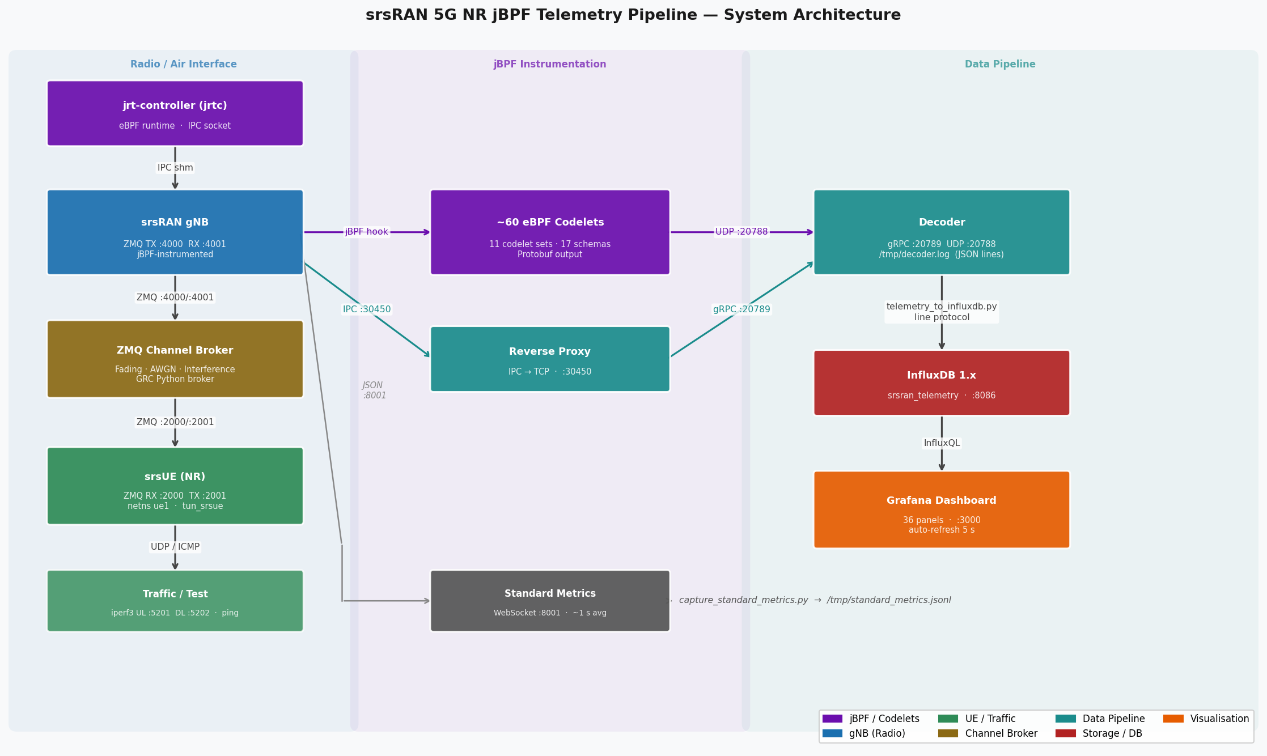
What We Built
A complete 5G NR telemetry pipeline — no physical radio hardware required

Slide 4
First Attempt: k3d Kubernetes Deployment
The official Microsoft deployment path — and why it didn't work for us
The jrtc-apps repo (Microsoft) recommends k3d as the default deployment — lightweight Kubernetes running locally, no physical hardware required.
What k3d Offers
What Went Wrong
• Single Helm chart deploys gNB + jrtc + decoder + UE
• ZMQ mode available — no radio hardware needed
• Designed to run on a single laptop or workstation
• Containers handle all dependencies automatically
• Helm chart values.yaml was built for enterprise O-RAN servers
• Pods stayed in Pending — Kubernetes couldn't schedule them
• Required resources our machine couldn't provide:
· Hugepages (4 Gi+) — not configured on the k3d node
· SR-IOV device plugin — Intel NIC feature not present
· DPDK CPU pinning — assumes 30+ dedicated physical cores
· Physical RU MAC/VLAN bindings in the config
The chart worked as designed — it was designed for a different class of machine. We needed a different approach.

Slide 5
The Fix: Bare Metal Deployment on Ubuntu 22.04
Skipped the Helm chart entirely — built and ran everything natively
① Build from Source
② Fix the gNB Config
③ Fix eBPF Verifier Errors
④ Fix jrtc Decoder Bug
⑤ Automate Startup
Compiled srsRAN (jBPF fork), jBPF runtime, and jrtc manually — required LLVM/Clang toolchain and specific kernel headers
Example YAML had invalid keys that silently crashed the gNB at startup. Debugged logs, identified correct keys, rewrote the config for ZMQ mode
All 10 MAC codelets failed the eBPF verifier and refused to load. Fixed map definitions and removed unsupported hash clear loops
DL and UL HARQ codelets shared the same schema name — the decoder silently dropped one stream. Fixed in the jrtc Go source
Built a single launch script that starts all 8 components in correct order with dependency checks, timeouts, and clean shutdown
Result: full pipeline running — all 17 telemetry streams flowing, 36-panel Grafana dashboard live, ZMQ channel broker active

Slide 6
What We Hooked — 22 Instrumentation Points, 17 Schemas
Coverage across every layer of the 5G gNB software stack
MAC Scheduler
FAPI (PHY↔MAC)
RLC / PDCP
Control Plane RRC / NGAP
Performance Meta
harq_stats (MCS, retx, HARQ state)
fapi_dl_config (DL MCS, PRB, TBS per slot)
rlc_ul/dl_stats (SDU latency, retx bytes)
rach_stats (per-RACH SNR + timing adv.)
jbpf_out_ perf_list p50/p90/ p95/p99 per hook ★ Novel metric no standard equivalent
crc_stats (SINR, CRC success rate)
rrc_procedure (setup, reconfig, reestablishment)
fapi_ul_config (UL scheduler decisions)
pdcp_ul/dl_stats (per-bearer byte counters)
bsr_stats (UE buffer occupancy)
fapi_crc_stats (PHY CRC, SNR hist)
ngap_procedure (core network round-trip)
uci_stats (CQI, SR, Timing advance)
★ jbpf_out_perf_list is the ONLY signal sensitive to infrastructure faults — completely invisible to any standard 5G monitoring interface

Slide 7
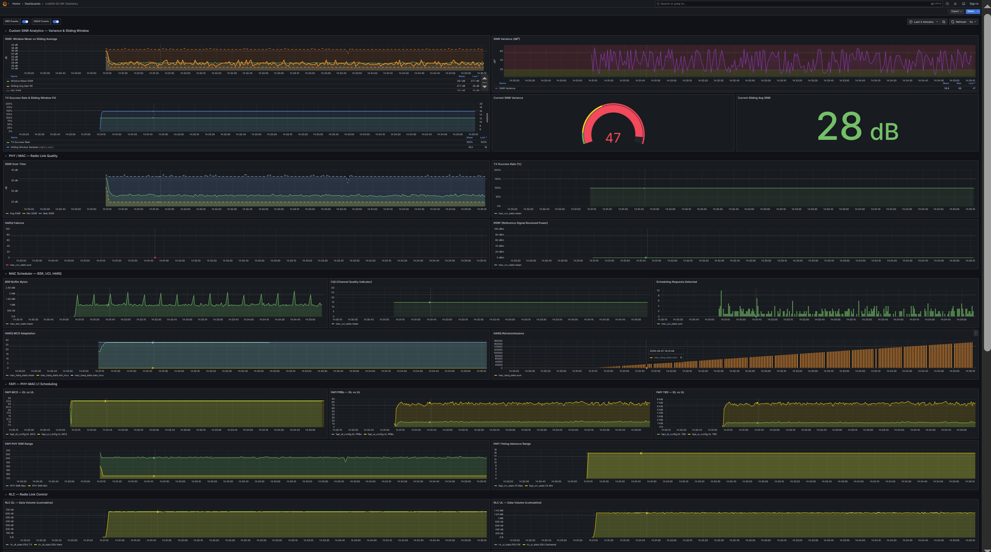
36-Panel Real-Time Dashboard
Live Grafana dashboard — every metric from every layer in one view
Dashboard sections:
• Custom SINR Analytics (5 panels) — variance, sliding avg, fill level
• PHY / MAC — Radio Link Quality (4 panels) — SINR, TX success, HARQ, RSRP
• MAC Scheduler (5 panels) — BSR, CQI, scheduling requests, MCS, retx
• FAPI (5 panels) — per-slot MCS/PRB/TBS DL vs UL, SNR, timing advance
• RLC / PDCP (6 panels) — DL/UL data volume, retx, SDU latency
• RRC / NGAP (2 panels) — control plane event timelines
• jBPF hook latency (3 panels) — p50/p99 per hook, invocation count
• Summary Statistics (6 panels) — SINR, TX%, HARQ, CQI, p50, BSR
Auto-refresh: 5 s · InfluxDB 1.x backend · InfluxQL queries

Slide 8
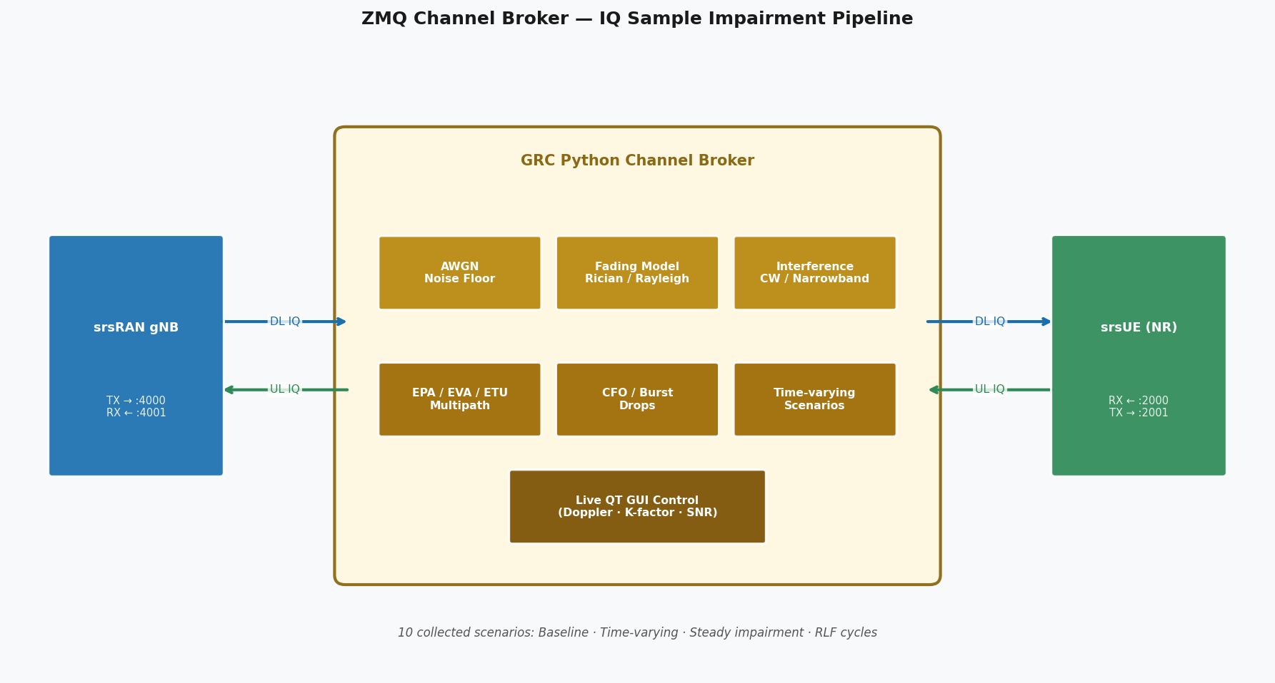
The Channel Problem — Why a Broker Was Needed
ZMQ virtual radio gives a perfect channel — useless for a thesis on anomaly detection
The Problem
• srsRAN ZMQ transport = perfect wire: SINR constant at 42 dB, zero fading, zero loss
• No RF variation → no channel anomalies → nothing to detect
• Every dataset would look identical — the thesis has no content
Attempt 1: srsUE built-in channel emulator
• srsUE has a --channel.model flag (AWGN, EPA, EVA, ETU)
• Problem: it is wired to the LTE PHY path only — silently ignored in NR mode
• Confirmed by reading source: NR PHY never calls the channel emulator
Solution: ZMQ IQ-level Broker
• Intercepts raw IQ samples on the ZMQ socket between gNB and UE
• No changes to srsRAN source — broker is a transparent proxy
• C broker: AWGN + Rician fading (fast, low latency)
• Pure Rayleigh crash: |h|²→0 nulls cause RRC timeout in ~2 min
• Fix → Rician K=3 dB adds LoS component, prevents complete nulls
• Sweet spot: K=3 dB, SNR=28 dB, fd=5 Hz → stable 15+ min, 12 HARQ failures

Slide 9
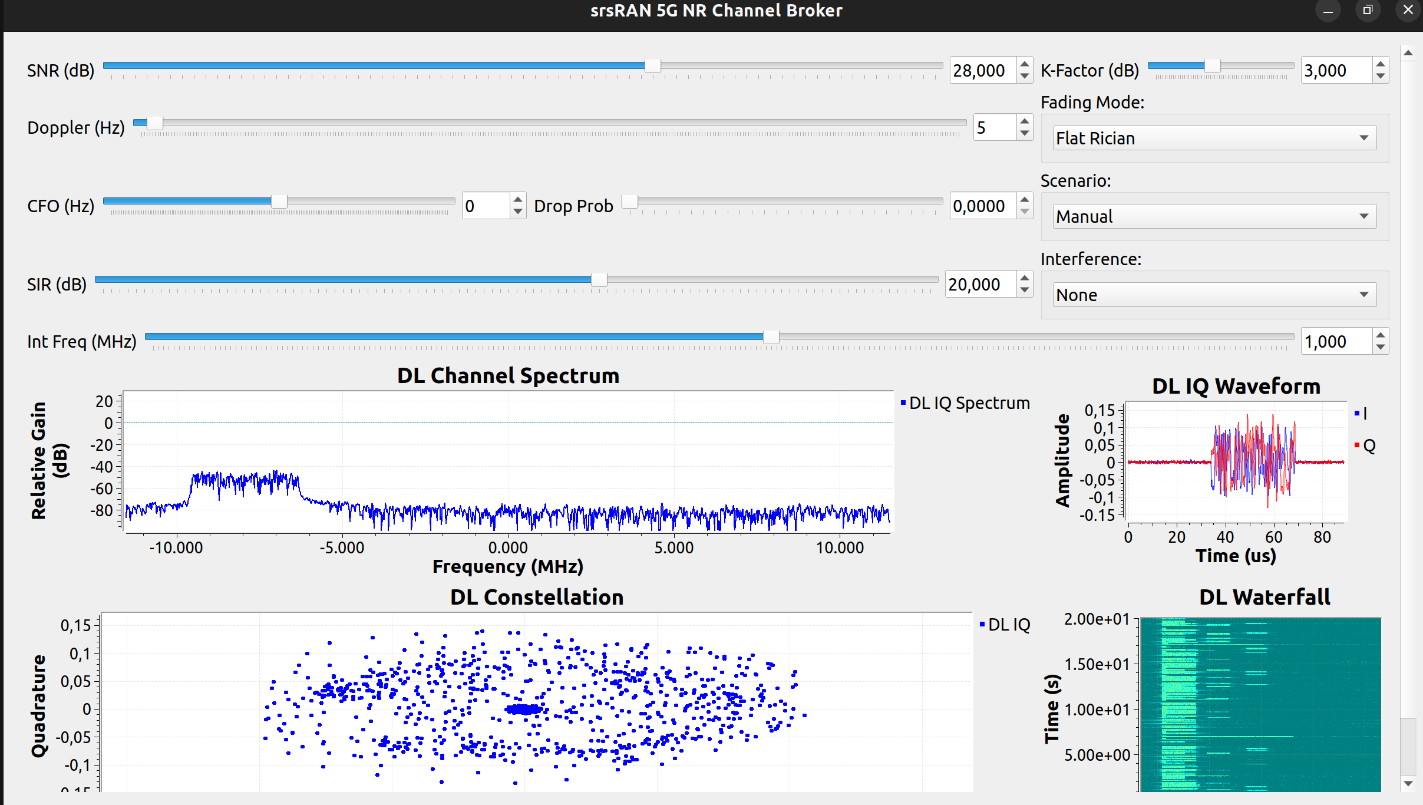
From C Broker to GNU Radio — Adding Realism
Flat fading is unrealistic; frequency-selective 3GPP profiles needed for the thesis
C Broker Limitation: Flat Fading
Live GRC Broker GUI
• All OFDM subcarriers fade together by the same random gain
• Real 5G channels are frequency-selective: different subcarriers
• experience different fading (multi-path reflections at different delays)
• Flat fading produces unrealistic, uniform SINR — all PRBs degraded equally
• 3GPP test profiles (EPA, EVA, ETU) require multi-tap FIR filters, not flat
GRC Python Broker — Built on GNU Radio
• EPA / EVA / ETU frequency-selective fading (scipy FIR + persistent state zi)
• FFT-based per-subcarrier filtering — each tap has independent delay
• Carrier Frequency Offset (CFO) — Doppler-like phase rotation
• Burst packet drops — simulate deep fade or interference events
• Narrowband CW interference injection
• Time-varying scenario scripts (10 realistic channel sequences)
• Live QT GUI — view IQ constellation and spectrum in real time
• Processing budget: DL 413 µs · UL 503 µs < 1 ms slot

Slide 10
jBPF vs Standard Metrics — What Were We Trying to Prove?
Week 7 evaluation — running both telemetry channels simultaneously on the same gNB
The Setup
Three Questions
We ran both telemetry systems on the same gNB at the same time: jBPF codelets → InfluxDB 1.x | Standard metrics → InfluxDB 3 57 minutes of steady-state traffic with Rician fading channel
1. Do both systems agree where they measure the same thing? 2. Why do the numbers differ even for the same metric? 3. What can jBPF see that standard metrics simply cannot?
Finding 1 — They Agree
Finding 2 — Differences Are Expected
Finding 3 — jBPF Sees What Standard Cannot
Where both measure the same signal (SINR, MCS, CQI, BLER), values match within 1.5%. The codelets are extracting correct data.
Throughput shows a 1.95× gap because jBPF measures at the application layer while standard metrics measure at the MAC layer — two valid measurements of different things.
Hook latency, per-slot FAPI data, RLC/PDCP counters, RRC/NGAP procedure timing — none of these exist in the standard interface. Infrastructure faults are invisible without them.
Conclusion: jBPF is not a replacement for standard metrics — it is a complementary layer that adds depth, resolution, and fault visibility that standard monitoring cannot provide.

Slide 11
jBPF vs Standard Metrics — Capability Comparison
What each telemetry channel can and cannot measure
Capability
Standard Metrics
jBPF (Janus)
Update rate
~1 s aggregates
Configurable — down to 1 ms per slot
Per-slot (1 ms) visibility
No
Yes
SINR / MCS / CQI / BLER
Yes
Yes
Hook execution latency
No
Yes — 22 hooks (p50/p99/max)
Infrastructure fault detection
No
Yes — only via hook latency
Per-layer byte counters
No
Yes — RLC and PDCP separately
RLC SDU delivery latency
No
Yes
RRC / NGAP procedure timing
No
Yes — per-event timestamps
Scheduling latency histograms
Yes
No
PHR / Rank Indicator
Yes
No
Metric count
~30 fields, 1 table
60+ fields, 17 measurements
CPU overhead
Negligible
~3.3% of one CPU core

Slide 12
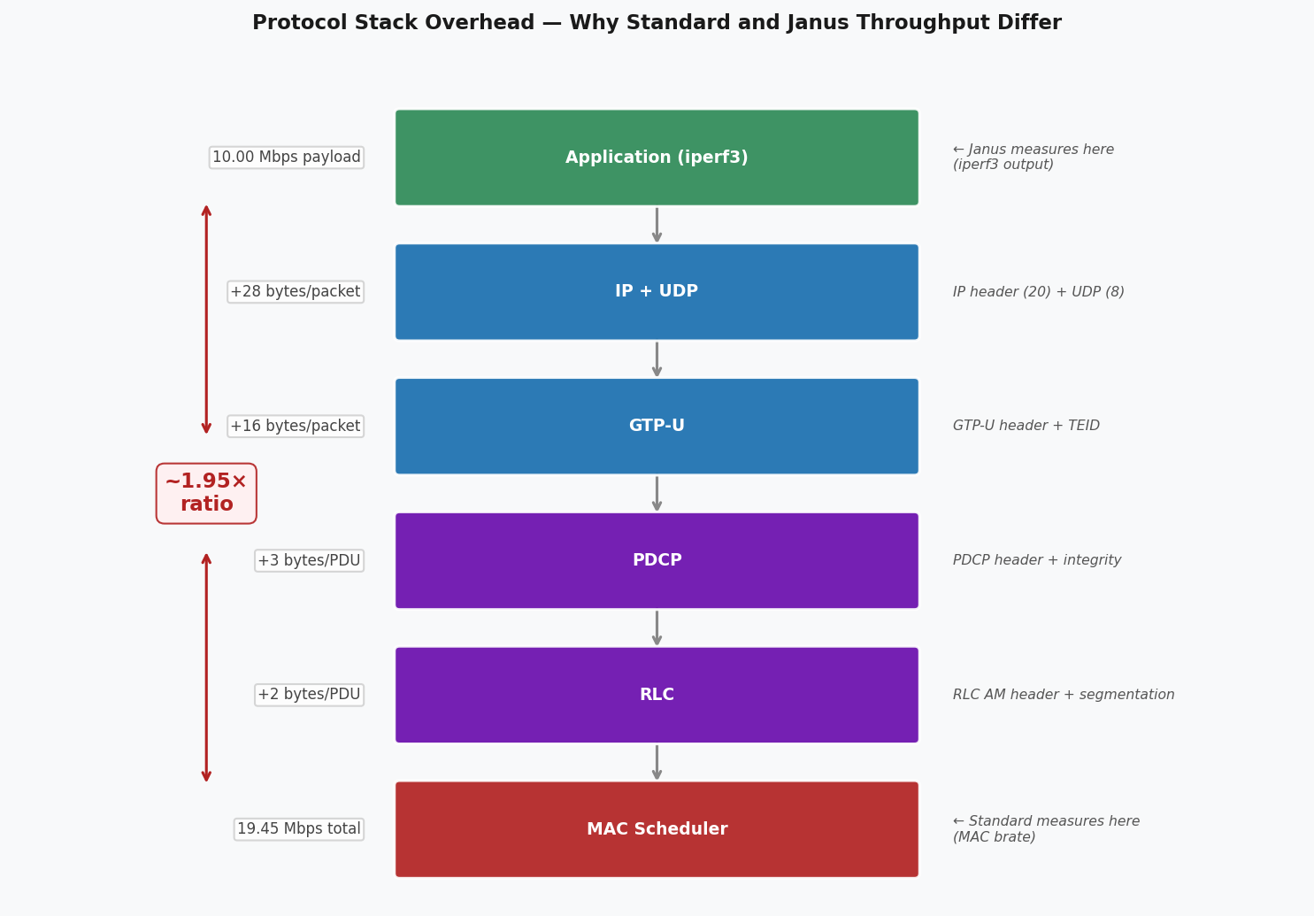
The 1.95× Throughput Difference — Not a Bug
Both systems are correct — they measure at different protocol layers
iperf3 sends 10 Mbps of UDP payload.
The standard srsRAN dashboard reads the MAC-layer bitrate: 19.45 Mbps.
The extra 9.45 Mbps comes from:
• Protocol headers: IP (20B) + UDP (8B) + GTP-U (16B) + PDCP (3B) + RLC (2B)
• MAC control elements: BSR, PHR, timing advance
• HARQ overhead: scheduled bytes count even for retransmissions
• PDCCH/reference signals: resource grant signalling
Radio metrics (SINR, MCS, CQI, BLER) agree with r > 0.88.
The mismatch is in throughput only — expected, not an error.

Slide 13
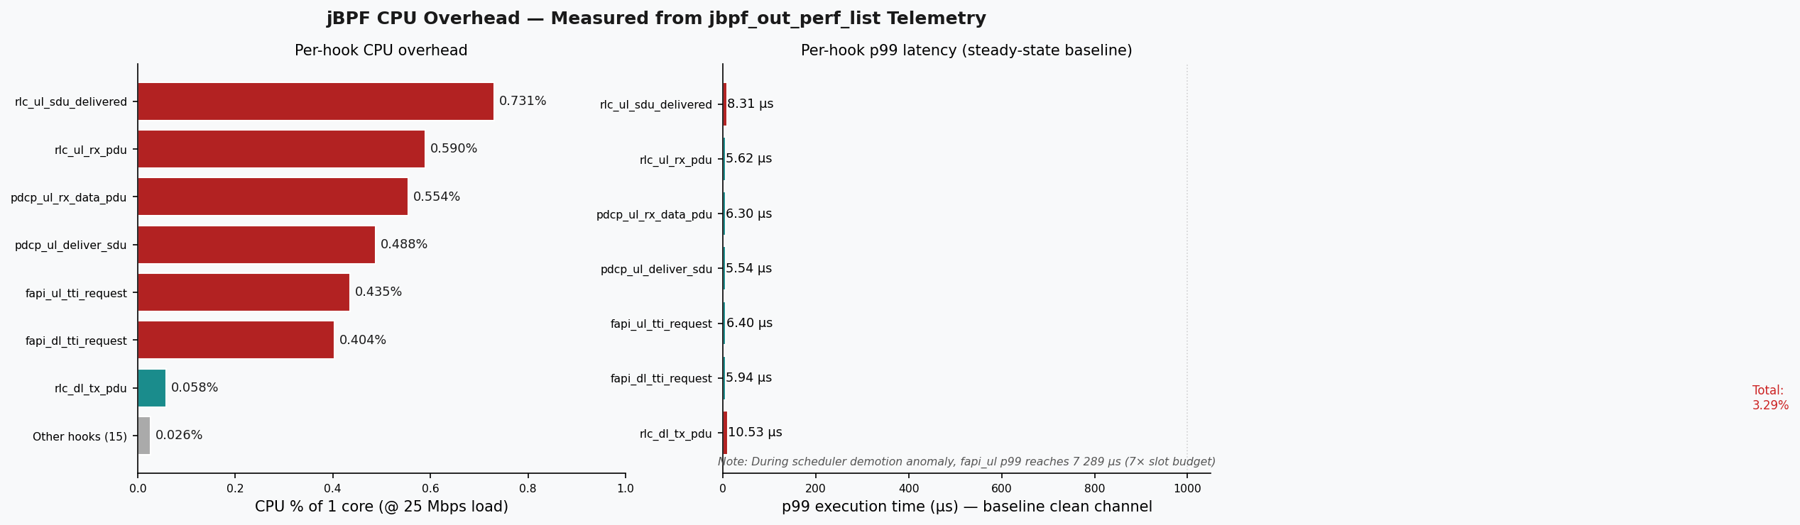
CPU Overhead — Measured from the Telemetry Itself
jbpf_out_perf_list records hook execution time — no external profiler needed

Slide 14
Anomaly Datasets — 5 621 Labelled Samples, 19 Features
35 recorded scenarios covering 4 failure types — ready for AI/ML training
Class 0 — Normal
Class 1 — Scheduler Fault
Class 2 — Traffic Flood
Class 3 — Channel Degradation
The network running as intended. Clean radio, no load stress. 2 063 samples (baseline reference)
We lowered the priority of the gNB real-time thread in the OS. The radio starts missing its 1 ms deadlines. 462 samples (software/OS fault)
We blasted the UE with massive UDP / TCP traffic — like a denial-of- service attack on the radio link. 936 samples (overload stress)
We injected RF impairments via the channel broker: fading, noise, burst drops — simulating poor radio coverage. 2 160 samples (radio environment stress)
19 features per 1-second window · 7 hook latencies (p99 µs) · HARQ (MCS, retx, fail rate) · CRC (SINR, success rate) · BSR (buffer) · RLC (throughput, latency)
Key finding: 14 of 23 stress scenarios produce signatures invisible to standard metrics.
hook_p99_us_fapi_ul spikes to >7 000 µs (7× the 1 ms slot budget) during scheduler demotion while SINR/MCS remain normal — impossible to detect without hook latency.

Slide 15
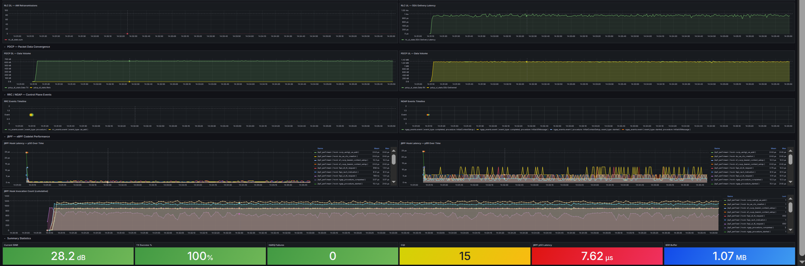
The Core Result — Hook Latency Identifies Infrastructure Faults
A metric that exists nowhere in standard 5G monitoring
What happened:
• gNB threads demoted from SCHED_FIFO:96 to SCHED_BATCH
• OS scheduler deprioritises them — slot processing delayed
• hook_p99_us_fapi_ul: 6 µs → 7 289 µs (1200× spike)
What standard metrics show:
• Slight MCS drop (looks like minor channel fading)
• BSR increase (looks like congestion)
• No indication of a software fault
What hook latency shows:
• Unmistakable spike — 7× the 1 ms slot budget
• Pure infrastructure signature — SINR unchanged
• No channel probe can see this

Slide 16
In-Network Pre-Processing — Week 8 Extension
Computing statistics inside the eBPF program — no userspace required
Custom SINR codelet (C code):
• Hook: mac_sched_crc_indication — fires on every UL CRC PDU
Two algorithms inside the eBPF program:
• Variance: Welford online algorithm
• E[X²] − E[X]² — no stored history needed
• Sliding avg: 16-entry ring buffer
• Constant time update (no inner loop)
Why it matters:
• Anomaly detection logic runs at the gNB itself
• Sub-millisecond latency — no network hop to userspace
• Bandwidth saving: send avg/variance, not every raw sample
• New Grafana panels: SINR variance + sliding average

Slide 17
Progress vs 12-Week Plan
All implementation phases complete — in Phase V (writing)
Phase I Wks 1–2 Foundation
Phase II Wks 3–5 Corelets
Phase III Wks 6–7 Evaluation
Phase IV Wks 8–9 Extension
Phase V Wks 10–12 Conclusion
Setup 5G sim + ZMQ link
22 hooks 17 schemas
Dashboard Comparison
Codelet math AI datasets
Validation Thesis writing
DONE
DONE
DONE
DONE
IN PROG
Deliverables
✓ Source code (codelets, scripts, pipeline)
✓ Janus vs Standard comparison (live data)
✓ AI-ready datasets (CSV + HDF5, 5 621 samples)
✓ Custom codelet documentation
✓ Setup guide and all documentation
○ Bachelor Thesis Report
✓ Anomaly collection report (35 scenarios)
○ Final presentation

Slide 18
Summary of Contributions
1. Full 5G NR Telemetry Pipeline
22 jBPF hook points · 17 schemas · 1 ms granularity · 36-panel Grafana dashboard
2. ZMQ Channel Broker
GRC Python broker: AWGN + Rician/Rayleigh + EPA/EVA/ETU + interference + time-varying scenarios
3. Baremetal Installation
Fixed 10 eBPF verifier failures + 2 jrtc-ctl bugs + YAML config keys to get the full stack running
4. Two Labelled AI-Ready Datasets
5 621 samples · 19 features · 4 classes · 35 scenarios · scenario-based train/test split
5. Key Finding — Hook Latency as Fault Detector
Only metric that distinguishes scheduler faults from channel impairments · 7× spike · invisible to standard
6. Custom In-Network Codelet
SINR variance + sliding window computed inside eBPF at 1 ms — no userspace post-processing

Slide 19
Remaining Work — Phase V
Thesis Writing (Week 11):
• Chapter: System architecture and implementation
• Chapter: Evaluation — jBPF vs standard comparison with live plots
• Chapter: Anomaly detection — dataset description, key findings
• Chapter: Conclusion and future work
Optional extensions (if time permits):
• Train a lightweight anomaly classifier on the collected dataset
• Evaluate CPU overhead at multiple traffic rates (10/25/50 Mbps)
• Extend custom codelet to output an anomaly score directly
Hardware (USRP) Bonus
Project plan explicitly designs for ZMQ simulation.
Hardware (USRP B210/X310) is optional bonus only.
If time permits after thesis draft:
• Replace ZMQ with real USRP radio
• Run codelets on live air interface
• Compare simulated vs real-world hook latency
Risk mitigation: do NOT attempt if it jeopardises the report deadline.

Slide 20
Thank You
Questions?
github.com/MaximBitiu1/srsran-telemetry-pipeline
22
17
45
5 621
3.3%
7 000+
jBPF hook points
Telemetry schemas
Grafana panels
Labelled samples
CPU overhead
µs fault spike

