Slide 1
Real-Time Telemetry in Open AI RAN
using Microsoft Janus (jBPF)
Midterm Progress Report
Maxim Bitiu

Slide 2
Why Build This?
Standard 5G monitoring gives you ~1-second averages at the MAC layer only:
• "MCS dropped from 27 to 22" — but why? Radio problem? Scheduler overloaded? Traffic flood?
• No way to tell from standard metrics alone
eBPF (extended Berkeley Packet Filter) lets us inject probes into any running program:
• Zero kernel changes — probes load and unload at runtime
• Per-event granularity at every 1 ms radio slot
• Multiple protocol layers simultaneously
Microsoft Janus (jBPF) extends eBPF to userspace gNB software:
• Hook directly into the srsRAN gNB source code at 22 function call sites
• Capture microsecond-level events invisible to any standard interface
Research Question
This project aims to implement a real-time monitoring system within an Open AI RAN
environment using Microsoft Janus (JBPF). The goal is to move beyond standard "black box"monitoring by inserting codelets directly into the srsRAN software stack to capture microsecond-
level events.

Slide 3
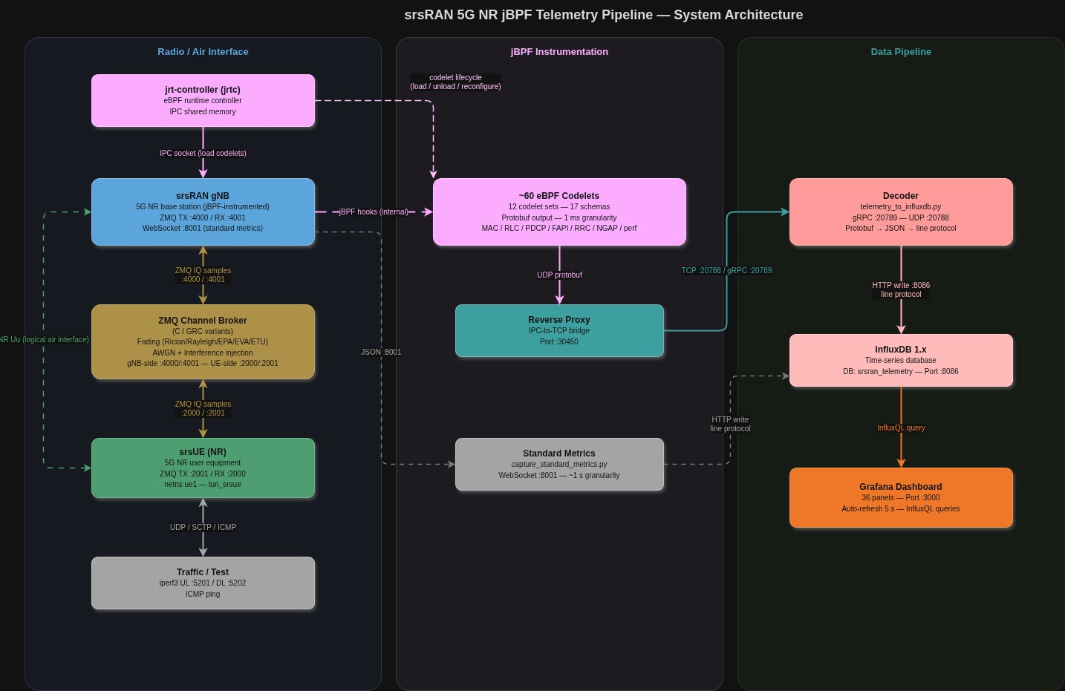
What I Built

Slide 4
First Attempt: k3d Kubernetes Deployment
What k3d Offers
What Went Wrong
• Single Helm chart deploys gNB + jrtc + decoder + UE
• ZMQ mode available, no radio hardware needed
• Designed to run on a single workstation
• Containers handle all dependencies automatically
• Helm chart values.yaml was built for enterprise O-RAN servers
• Pods stayed in Pending , Kubernetes couldn't schedule them
• Required resources our machine couldn't provide:
· Hugepages (4 Gi+), not configured on the k3d node
· SR-IOV device plugin, Intel NIC feature not present
· DPDK CPU pinning, assumes 30+ dedicated physical cores
· Physical RU MAC/VLAN bindings in the config

Slide 5
The Fix: Bare Metal Deployment on Ubuntu 22.04
① Build from Source
② Fix the gNB Config
③ Fix eBPF Verifier Errors
④ Fix jrtc Decoder Bug
⑤ Automate Startup
Compiled srsRAN (jBPF fork), jBPF runtime, and jrtc manually — required LLVM/Clang toolchain and specific kernel headers
Example YAML had invalid keys that silently crashed the gNB at startup. Debugged logs, identified correct keys, rewrote the config for ZMQ mode
All 10 MAC codelets failed the eBPF verifier and refused to load. Fixed map definitions and removed unsupported hash clear loops
DL and UL HARQ codelets shared the same schema name — the decoder silently dropped one stream. Fixed in the jrtc Go source
Built a single launch script that starts all 8 components in correct order with dependency checks, timeouts, and clean shutdown

Slide 6
What I Hooked — 22 Instrumentation Points, 17 Schemas
MAC Scheduler
FAPI (PHY↔MAC)
RLC / PDCP
Control Plane RRC / NGAP
Performance Meta
harq_stats (MCS, retx, HARQ state)
fapi_dl_config (DL MCS, PRB, TBS per slot)
rlc_ul/dl_stats (SDU latency, retx bytes)
rach_stats (per-RACH SNR + timing adv.)
jbpf_out_ perf_list p50/p90/ p95/p99 per hook
crc_stats (SINR, CRC success rate)
rrc_procedure (setup, reconfig, reestablishment)
fapi_ul_config (UL scheduler decisions)
pdcp_ul/dl_stats (per-bearer byte counters)
bsr_stats (UE buffer occupancy)
fapi_crc_stats (PHY CRC, SNR hist)
ngap_procedure (core network round-trip)
uci_stats (CQI, SR, Timing advance)

Slide 7
36-Panel Real-Time Dashboard
Live Grafana dashboard — every metric from every layer in one view
Dashboard sections:
- Custom SINR Analytics (5 panels) — variance, sliding avg, fill level
- PHY / MAC — Radio Link Quality (4 panels) — SINR, TX success, HARQ, RSRP
- MAC Scheduler (5 panels) — BSR, CQI, scheduling requests, MCS, retx
- FAPI (5 panels) — per-slot MCS/PRB/TBS DL vs UL, SNR, timing advance
- RLC / PDCP (6 panels) — DL/UL data volume, retx, SDU latency
- RRC / NGAP (2 panels) — control plane event timelines
- jBPF hook latency (3 panels) — p50/p99 per hook, invocation count
- Summary Statistics (6 panels) — SINR, TX%, HARQ, CQI, p50, BSR

Slide 8
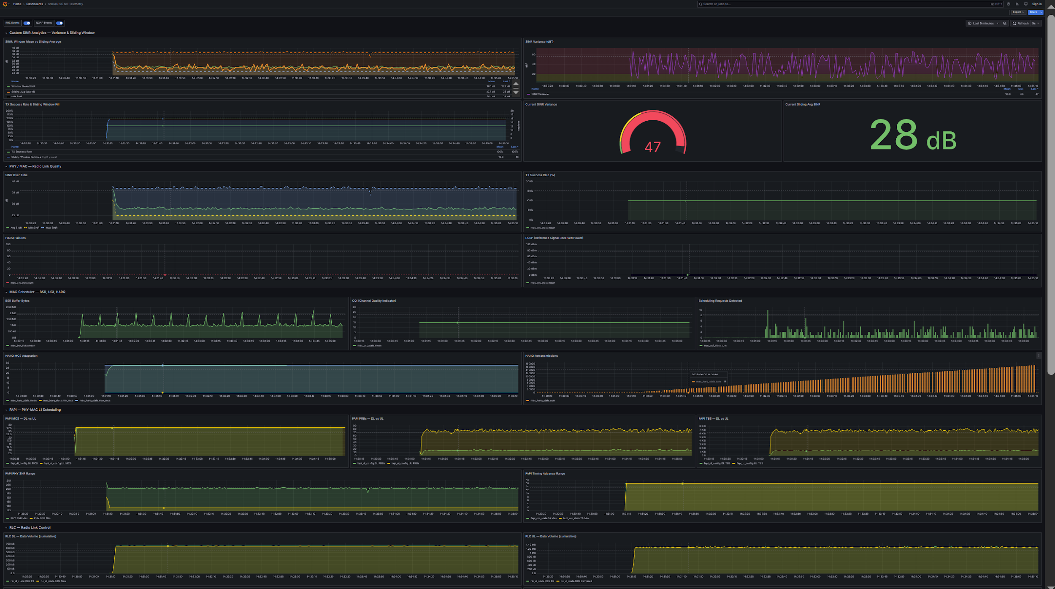

Slide 9
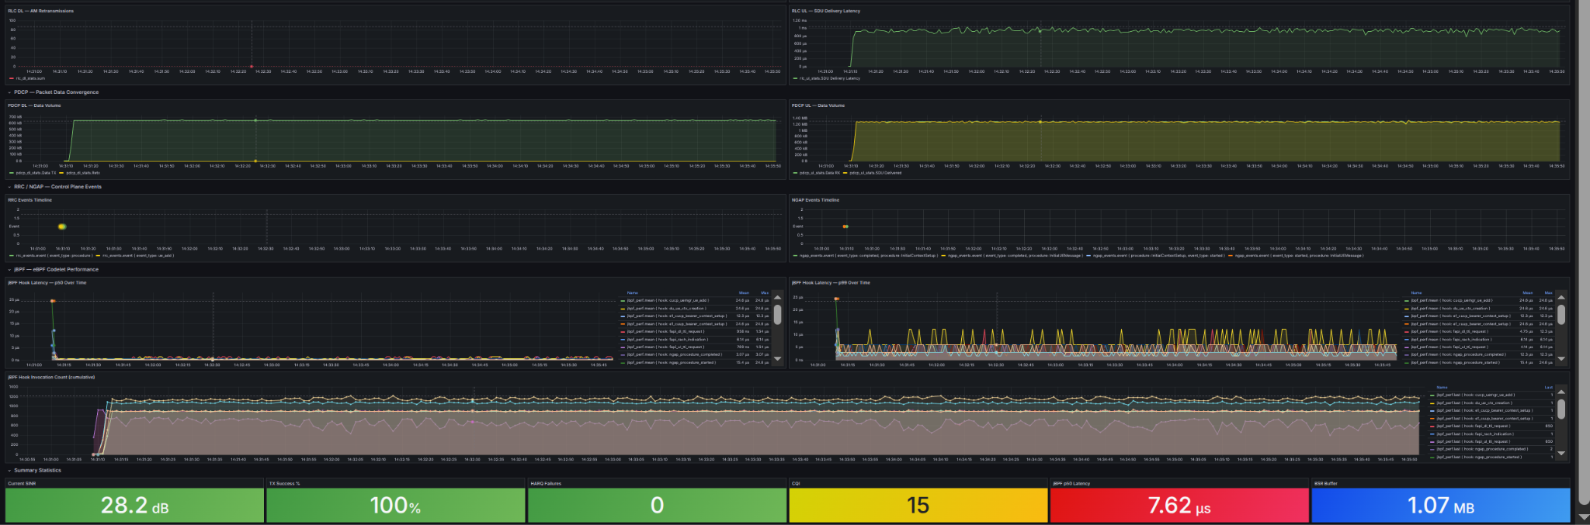

Slide 10
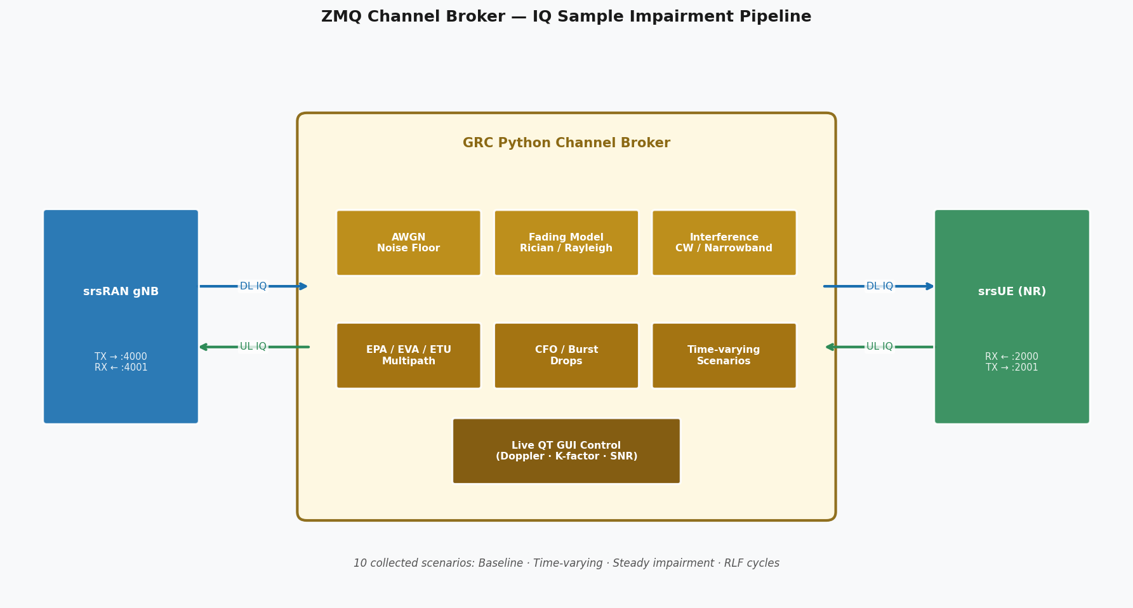
The Channel Problem — Why a Broker Was Needed
The Problem
• srsRAN ZMQ transport = perfect wire: SINR constant at 42 dB, zero fading, zero loss
• No RF variation → no channel anomalies → nothing to detect
• Every dataset would look identical
Attempt 1: srsUE built-in channel emulator
• srsUE has a --channel.model flag (AWGN, EPA, EVA, ETU)
• Problem: it is wired to the LTE PHY path only, silently ignored in NR mode
• Confirmed by reading source: NR PHY never calls the channel emulator
Solution: ZMQ IQ-level Broker
- Sits between the gNB and the UE — intercepts the radio signal without touching srsRAN's code
- Injects noise and fading to simulate a real-world wireless channel
- Launched via the pipeline script with configurable channel settings (SNR, fading type, Doppler)

Slide 11
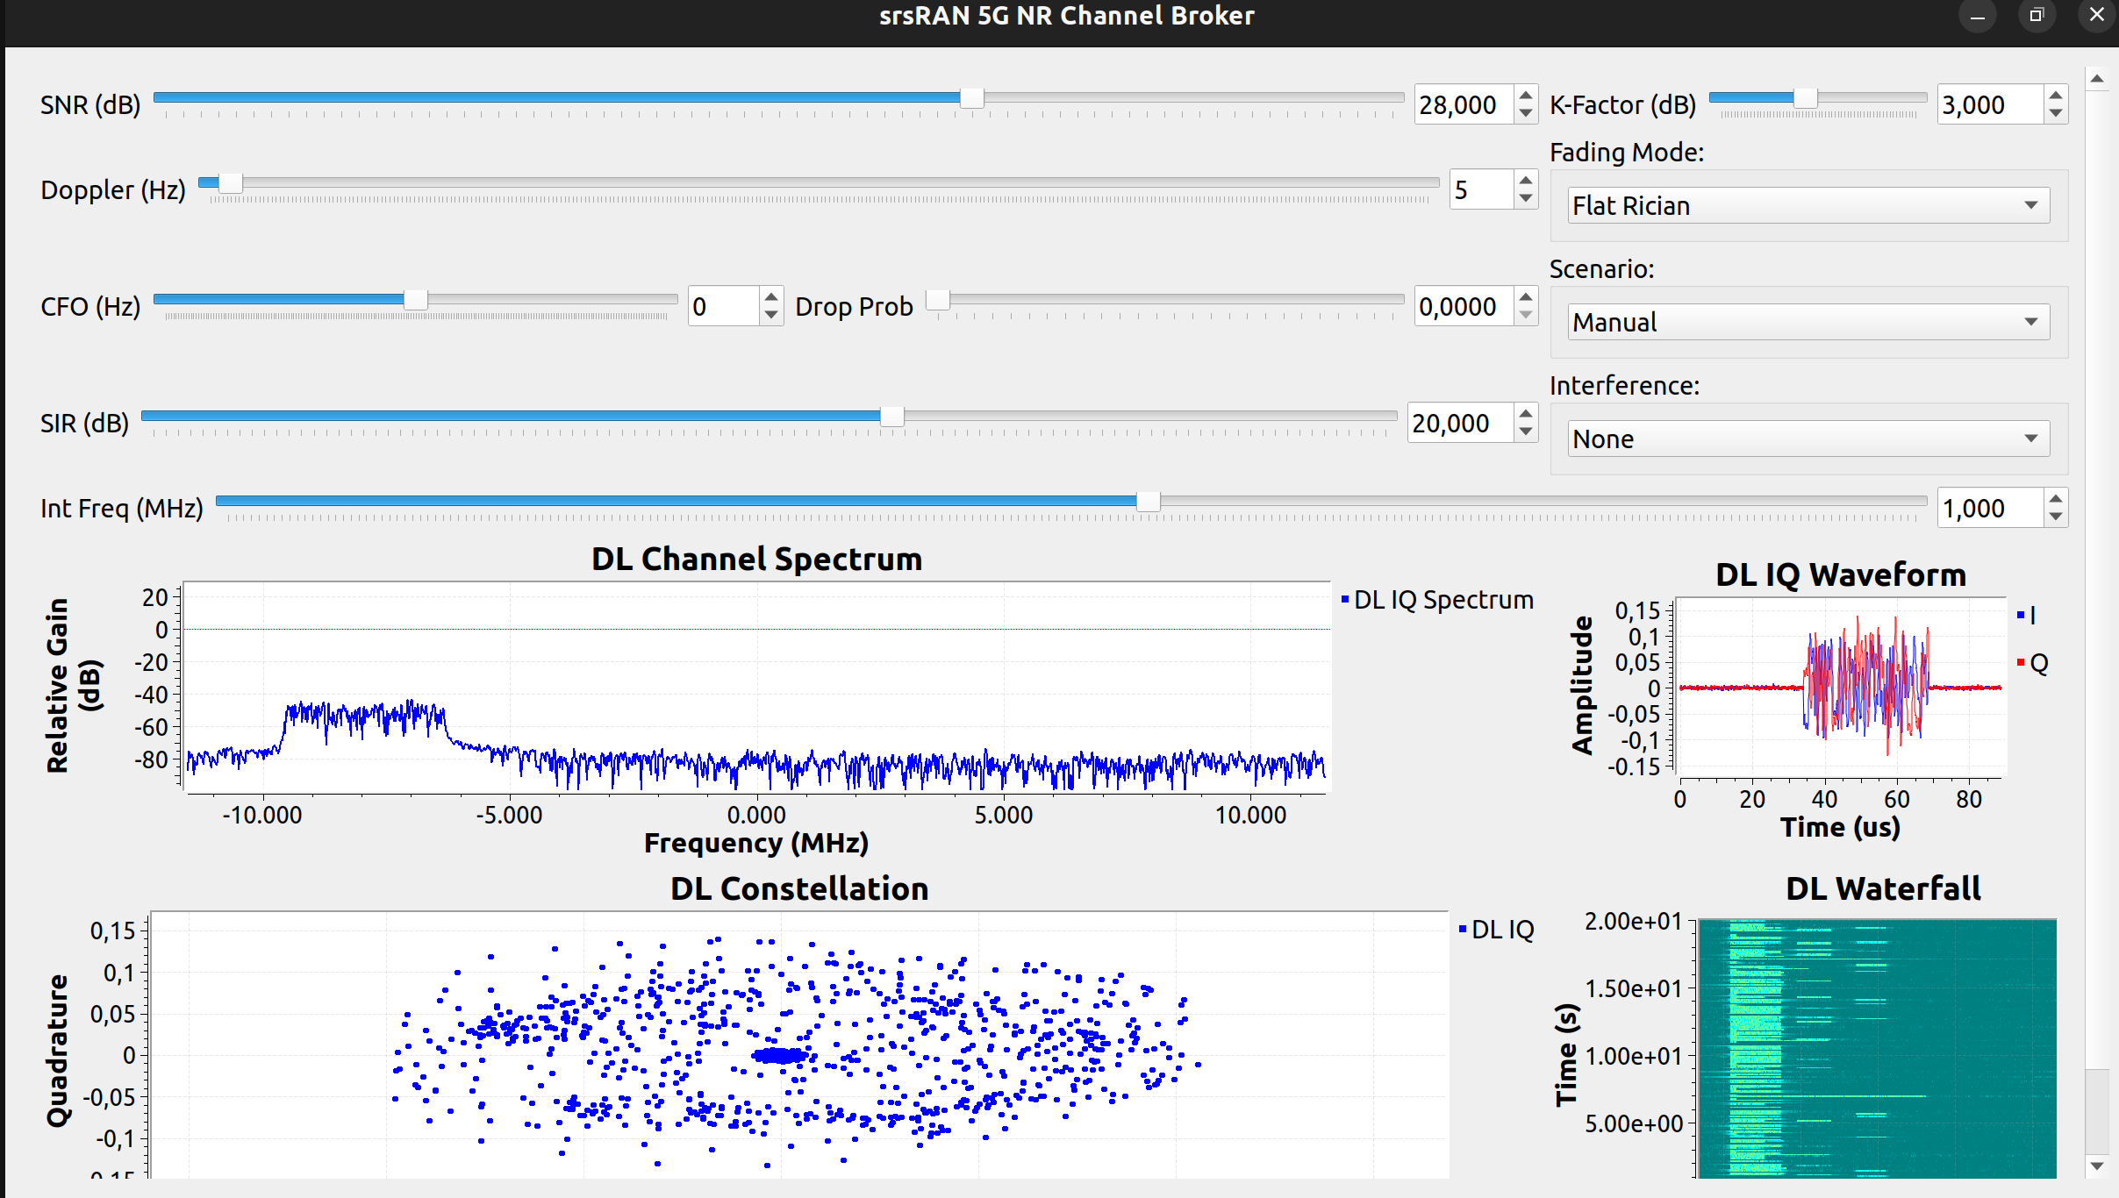
From C Broker to GNU Radio — Adding Realism
C Broker Limitation: Flat Fading
Live GRC Broker GUI
- Flat fading fades all frequencies equally , which unrealistic for real 5G
- Real channels fade differently across frequencies due to multipath reflections
- 3GPP defines standard profiles (EPA, EVA, ETU) to model this properly
- The C broker could not replicate this — a more advanced solution was needed
GRC Python Broker, built on GNU Radio
- Applies EPA / EVA / ETU frequency-selective fading, each frequency band fades independently
- Adds carrier frequency offset, burst packet drops, and narrowband interference
- Includes 10 pre-built time-varying channel scenarios
- Live visual display showing the signal spectrum and IQ constellation in real time
- Fast enough to process each 1 ms radio slot without causing delays
- Prototyped visually in GNU Radio Companion by connecting signal processing blocks
- The generated Python code was then extended with: ZMQ socket interception, persistent FIR filter state across slots, time-varying scenario engine, burst drop logic, narrowband interference injection, and command-line configuration, none of which GNU Radio Companion can generate on its own.

Slide 12
jBPF vs Standard Metrics — What Were We Trying to Prove?
The Setup
Three Questions
The srsRAN gNB exposes metrics through two separate channels. I ran both simultaneously for 57
minutes to compare them:
- jBPF codelets, the custom instrumentation, injected directly into the gNB internals, capturing
per-event telemetry across all stack layers. Data flows into InfluxDB 1.x
- Standard metrics , the gNB's built-in monitoring, a simple WebSocket feed that reports
pre-aggregated radio statistics roughly once per second. Data flows into InfluxDB 3
Both databases were recording the same gNB, the same traffic, and the same Rician fading channel
for the entire 57 minutes.
1. Do both systems agree where they measure the same thing? 2. Why do the numbers differ even for the same metric? 3. What can jBPF see that standard metrics simply cannot?
Finding 1 — They Agree
Finding 2 — Differences Are Expected
Finding 3 — jBPF Sees What Standard Cannot
Where both measure the same signal (SINR, MCS, CQI, BLER), values match within 1.5%. The codelets are extracting correct data.
Throughput shows a 1.95× gap because jBPF measures at the application layer while standard metrics measure at the MAC layer , two valid measurements of different things.
Hook latency, per-slot FAPI data, RLC/PDCP counters, RRC/NGAP procedure timing, none of these exist in the standard interface. Infrastructure faults are invisible without them.
Conclusion: jBPF is not a replacement for standard metrics, but rather it is a complementary layer that adds depth, resolution, and fault visibility that standard monitoring cannot provide.

Slide 13
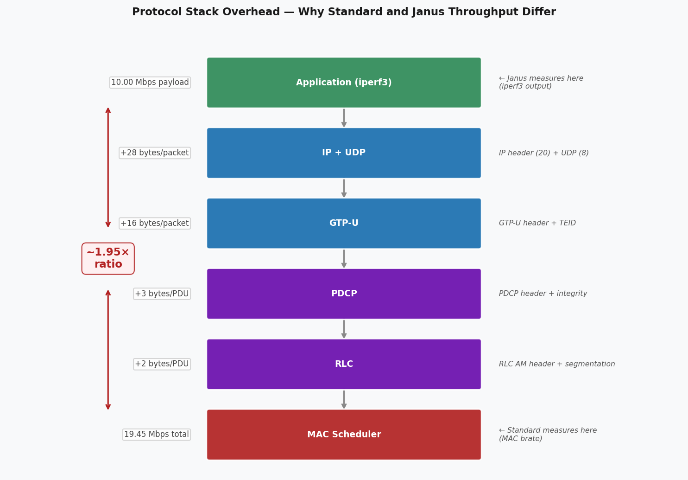
The 1.95× Throughput Difference — Not a Bug
What I observed:
We sent 10 Mbps UL and 5 Mbps DL through the pipeline and recorded both telemetry systems simultaneously. The numbers came back different:
- jBPF (ue_ul/dl_throughput codelet) reported 10 Mbps UL / 5 Mbps DL - Standard metrics reported 19.45 Mbps UL / 9.79 Mbps DL
Why it happens:
They measure at different points in the stack. The jBPF throughput codelet hooks into the application layer and captures exactly what iperf3 delivered, the raw payload. The standard metrics tap into the MAC layer, deep inside the base station, after every protocol layer has
wrapped the data with its own headers and control information:
All that wrapping consistently adds up to roughly 2× the original payload. The 1.95× ratio I observed is exactly what you would expect from a 10 MHz NR cell carrying UDP traffic.
The takeaway:
This is not a measurement error. Both systems are correct, they simply have different vantage points. The radio metrics (SINR, MCS, CQI, BLER) where both systems measure the same thing agree within 1.5%.

Slide 14
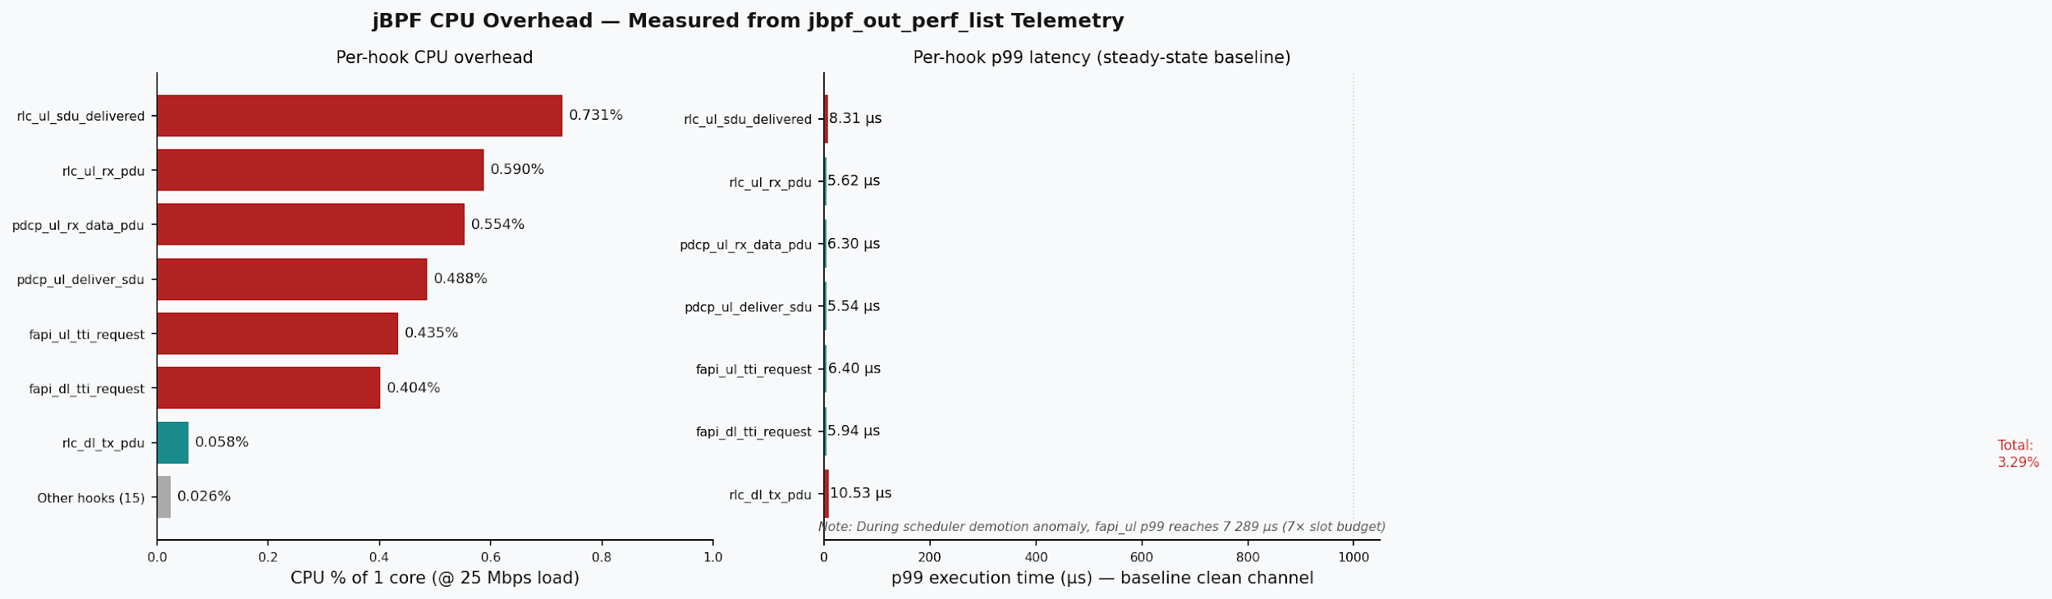
CPU Overhead — Measured from the Telemetry Itself

Slide 15
Anomaly Datasets — 5 621 Labelled Samples, 19 Features
Class 0 — Normal
Class 1 — Scheduler Fault
Class 2 — Traffic Flood
Class 3 — Channel Degradation
The network running as intended. Clean radio, no load stress. 2 063 samples (baseline reference)
I lowered the priority of the gNB real-time thread in the OS. The radio starts missing its 1 ms deadlines. 462 samples (software/OS fault)
I blasted the UE with massive UDP / TCP traffic , like a denial-of- service attack on the radio link. 936 samples (overload stress)
I injected RF impairments via the channel broker: fading, noise, burst Drops, simulating poor radio coverage. 2 160 samples (radio environment stress)
The project needed labelled data showing how the 5G network behaves under different failure conditions. The challenge was that a real network never tells you what is wrong or when something failed.
For each class I ran multiple scenarios, recorded the telemetry, and attached a label. The result is 5,621 labelled samples with 19 features per sample, covering 35 recorded scenarios.

Slide 16
Anomaly Dataset — Labels and Features
Labels (4 classes)
Features (19 per sample)
0 — Normal
Hook Latency (p99) — 8 features
Network running cleanly. No stress, no impairment. 2,063 samples
- fapi_ul_tti_request p99 — worst-case execution time of the uplink slot scheduling function. The
key fault detector, spikes to 7,000+ µs during scheduler faults
- fapi_dl_tti_request p99 — worst-case execution time of the downlink slot scheduling function
- pdcp_ul_deliver_sdu p99 — worst-case time to deliver an uplink data unit to the layer above
- pdcp_ul_rx_data_pdu p99 — worst-case time to receive and process an uplink data packet at PDCP
- rlc_ul_rx_pdu p99 — worst-case time to receive an uplink packet at the RLC layer
- rlc_ul_sdu_delivered p99 — worst-case time to confirm uplink delivery from RLC to PDCP
- rlc_dl_tx_pdu p99 — worst-case time to transmit a downlink packet from RLC
- fapi_ul_tti_request max — absolute maximum execution time of the uplink scheduler across the
entire measurement window. Catches single extreme spikes that p99 might average out
1 — Scheduler Fault
gNB real-time thread priority lowered by the OS, misses 1ms slot deadlines. 462 samples
MAC / Radio — 8 features
2 — Traffic Flood
· harq_mcs_avg — average modulation order
UE blasted with UDP traffic exceeding uplink capacity. Simulates a DDoS overload. 936 samples
· harq_mcs_min — worst-slot modulation
· harq_cons_retx — consecutive retransmissions
· harq_fail_rate — HARQ failure rate
· crc_sinr_avg — average signal quality
3 — Channel Degradation
· crc_harq_fail — CRC-level HARQ failures
RF impairments injected via the channel broker: fading, noise, burst drops. 2,160 samples
· crc_success_rate — transmission success rate
· bsr_kb — UE uplink buffer size
RLC Layer — 3 features
· rlc_throughput_kb · rlc_lat_avg_us · rlc_lat_max_us

Slide 17
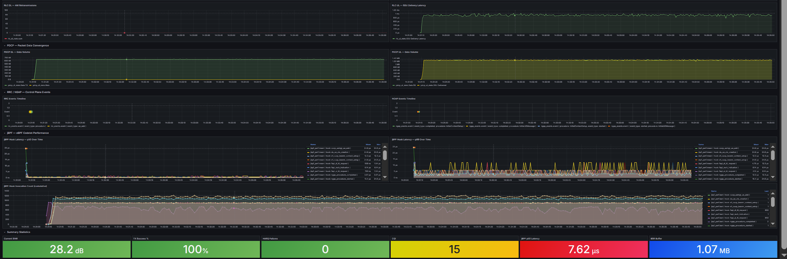
The Core Result — Hook Latency Identifies Infrastructure Faults
What happened:
I lowered the gNB's real-time CPU priority, simulating a misconfiguration in the OS. The base
station started missing its 1ms processing deadlines.
What standard metrics showed:
A small drop in data rate and a slight buffer build-up, easy to mistake for normal channel
variation. No indication anything was wrong with the software.
What hook latency showed:
The uplink scheduling function went from taking 6 µs to 7,289 µs, over 7 times the entire 1ms slot
budget. An unmistakable spike that could only come from a software stall, not a radio problem. The
signal quality was completely unchanged throughout.
Why this matters:
Without hook latency, this fault looks identical to mild fading. With it, the root cause is immediately obvious.

Slide 18
In-Network Pre-Processing
What was the goal:
Phase IV of the project plan required demonstrating that a jBPF codelet can do more than just collect raw data, but it can also perform computation directly inside the gNB. The task was to pick a codelet and implement two statistical algorithms inside it: a variance calculation and a sliding window average.
What I built:
A custom eBPF codelet written in C that hooks into the gNB at the exact moment each uplink transmission is acknowledged. Every time a packet is received, the codelet runs two algorithms on the SINR value:
Variance tracks how unstable the signal quality is over time, using a method that requires no stored history.
Sliding average keeps a running average of the last 16 measurements using a circular buffer, updated in constant time.
Why it matters:
The computation happens inside the gNB at sub-millisecond speed, before any data leaves the machine. Instead of transmitting every individual SINR reading, only the average and variance are sent out, saving bandwidth. The results appear as two new panels in the Grafana dashboard, giving alive view of signal stability that did not exist before.

Slide 19
Progress vs 12-Week Plan
Phase I Wks 1–2 Foundation
Phase II Wks 3–5 Corelets
Phase III Wks 6–7 Evaluation
Phase IV Wks 8–9 Extension
Phase V Wks 10–12 Conclusion
Setup 5G sim + ZMQ link
22 hooks 17 schemas
Dashboard Comparison
Codelet math AI datasets
Validation Thesis writing
DONE
DONE
DONE
DONE
IN PROG
Deliverables
✓ Source code (codelets, scripts, pipeline)
✓ Janus vs Standard comparison (live data)
✓ AI-ready datasets (CSV + HDF5, 5 621 samples)
✓ Custom codelet documentation
✓ Setup guide and all documentation
○ Bachelor Thesis Report
✓ Anomaly collection report (35 scenarios)
○ Final presentation

Slide 20
Remaining Work — Phase V
Hardware (USRP) Bonus
Project plan explicitly designs for ZMQ simulation.
Hardware (USRP B210/X310) is optional bonus only.
If time permits after thesis draft:
• Replace ZMQ with real USRP radio
• Run codelets on live air interface
• Compare simulated vs real-world hook latency
Risk mitigation: do NOT attempt if it jeopardises the report deadline.

Slide 21
Summary of Contributions
1. Full 5G Telemetry Pipeline
2. ZMQ Channel Broker
3. Baremetal Installation
5. Analysis and Comparison of standard metrics offered by srsRAN and the collected jrtc telemetry data
4. Two Labelled AI-Ready Datasets
6. Custom In-Network Codelet

Slide 22
Thank You
Questions?
github.com/MaximBitiu1/srsran-telemetry-pipeline

