Slide 1
PyFGH: Methods and Benchmarking
FGH Code
Molecular simulation
Maxim Secor
31 June, 2023
Yale

Slide 2
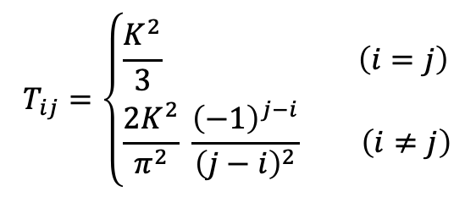
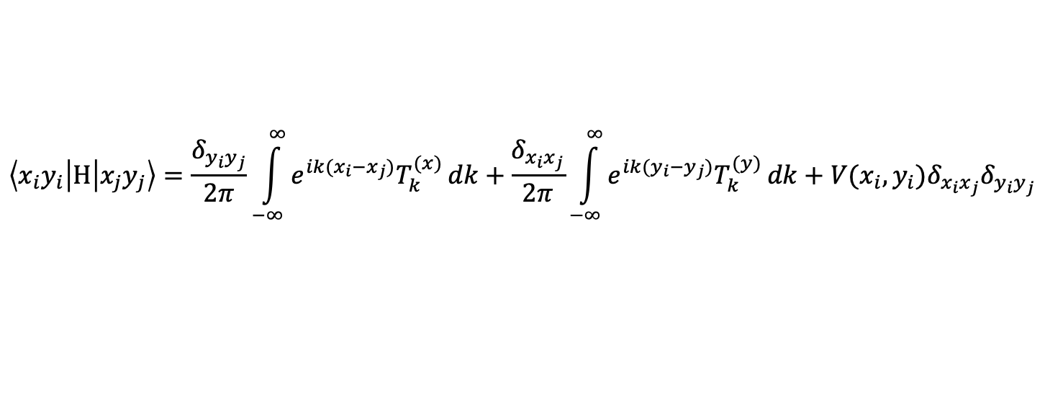
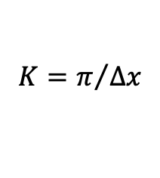
FGH Code
$$\left\langle x_{i}y_{i} | H | x_{j}y_{j}\right\rangle =\frac{δ_{y_{i}y_{j}}}{2π}\int_{−∞}^{∞}{e^{ik(x_{i}−x_{j})}T_{k}^{(x)}}dk+\frac{δ_{x_{i}x_{j}}}{2π}\int_{−∞}^{∞}{e^{ik(y_{i}−y_{j})}T_{k}^{(y)}}dk+V(x_{i},y_{i})δ_{x_{i}x_{j}}δ_{y_{i}y_{j}}$$
Potential energy operator commutes with position operator
Kinetic energy operator undergoes Fourier transformations
Potential energy terms requires all indices must match
$$T_{ij}=\left\{\begin{aligned}&\frac{K^{2}}{3} \left(i=j\right) \\ &\frac{{2K}^{2}}{π^{2}} \frac{{\left(−1\right)}^{j−i}}{{\left(j−i\right)}^{2}} \left(i≠j\right)\end{aligned}\right.$$
$$K=π/{Δx}$$
Discretization and in the limit of infinite points, kinetic energy operator
Yale

Slide 3
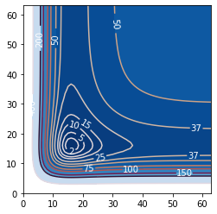
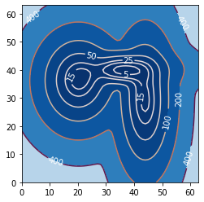
FGH Code
States | Morse | 3-minima
2 | 0 | 25.983
5 | 0 | 1.696
10 | 0 | 0.011
15 | 0 | 0.0005
20 | 0 | 0.000078
25 | 0 | 0.000029
Position (a₀)
Position (a₀)
FCI/MCSCF comparison
MCSCF low # of states good for some systems
MCSCF necessary for higher dimensionality
Position (a₀)
Position (a₀)
FCI
MCSCF*
Dimensions
 | 2 | 3 | 2 | 3 | 4
16 | 0.01 | 5.43 | 0.25 | 69.16 | 0.99
32 | 0.16 | 16166 | 0.32 | 103.45 | 13.72
64 | 7.48 | 4.813E+7 | 0.51 | 381.21 | 471.06
128 | 594.46 | 1.433E+11 | 1.1 | 1404.74687 | 16173.2889
Plots: kcal/mol
Tables: cm⁻¹
# grid
points
Extrapolated
*2d and 3d used 10 states and 4d used 3 states
Yale

Slide 4
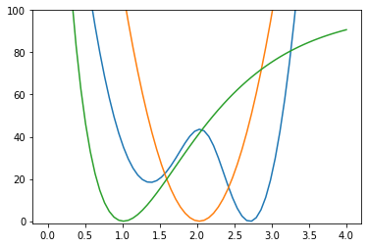
FGH Code
Different potentials require different number of grid points to accurately get ZPE
Double well potential requires 2048 for sub-wavenumber accuracy
ZPE, 1D FCI, cm⁻¹
# of pts | HO | MP | DW
8 | 738.22 | 732.80 | 739.98
16 | 1482.56 | 1466.58 | 1661.20
32 | 1500.00 | 1483.92 | 2089.49
64 | 1500.00 | 1483.92 | 2193.08
128 | 1500.00 | 1483.92 | 2229.59
﻿2048 | 1500.00 | 1483.92 | 2231.99
Yale

Slide 5
Molecular Simulations
Method | CH Bend | CH Stretch | CPU Time(s)
grid | 642 | 3122 | -
HF grid | 910 | 3637 | 95
MP2 grid | 666 | 3216 | 256
epc17-2 | 670 | 3110 | -
﻿no-epc | 662 | 3098 | -
Yale

