Slide 1
Pulse oxymeter
Cloud Server
Maxim Speczyk

Slide 2
Problem
Today´s pulse oxymeters are wired
-> making patients immobile
Nurses have to many patients to control

Slide 3
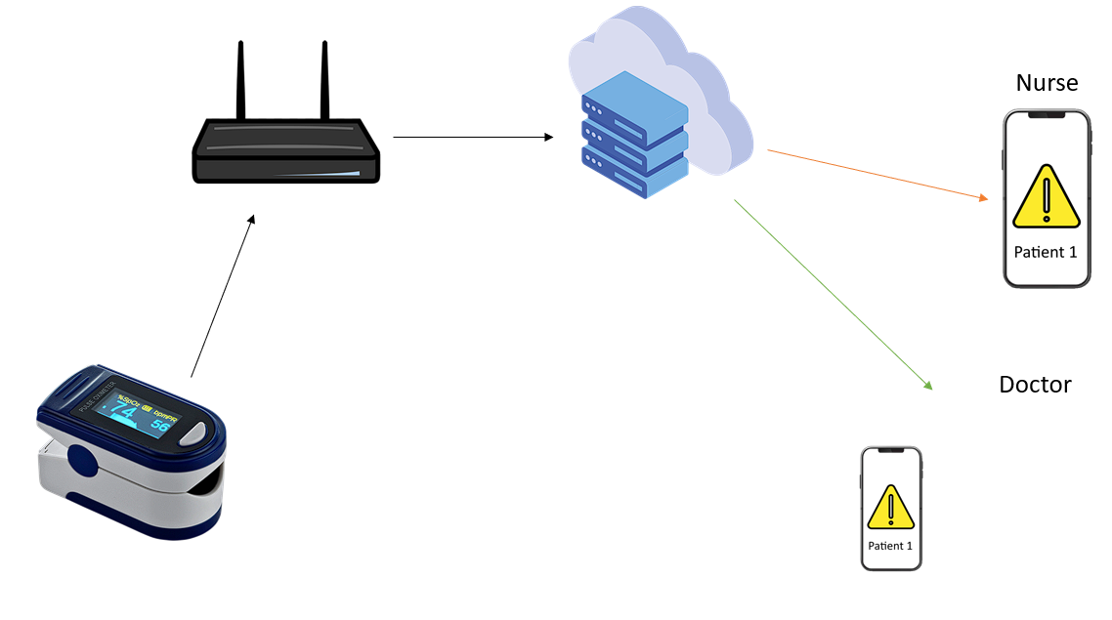

Idea
Portable pulse oximeter
Connection to cloud server
Alarm if threshold is exceeded or patient is in a bad condition
Real time monitoring over any device

Slide 4
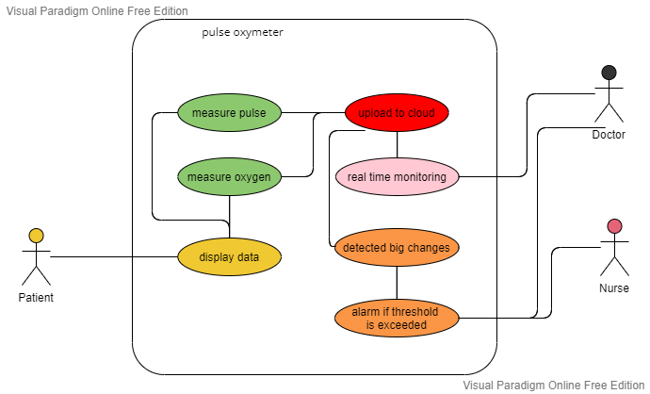
Use case

Slide 5
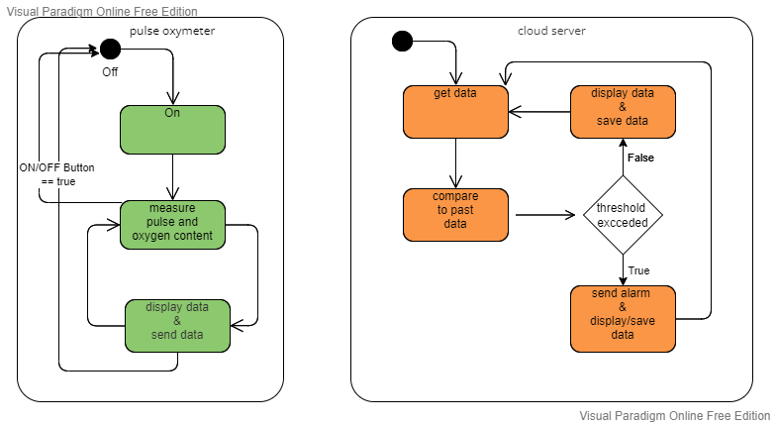
State Machine

Slide 6
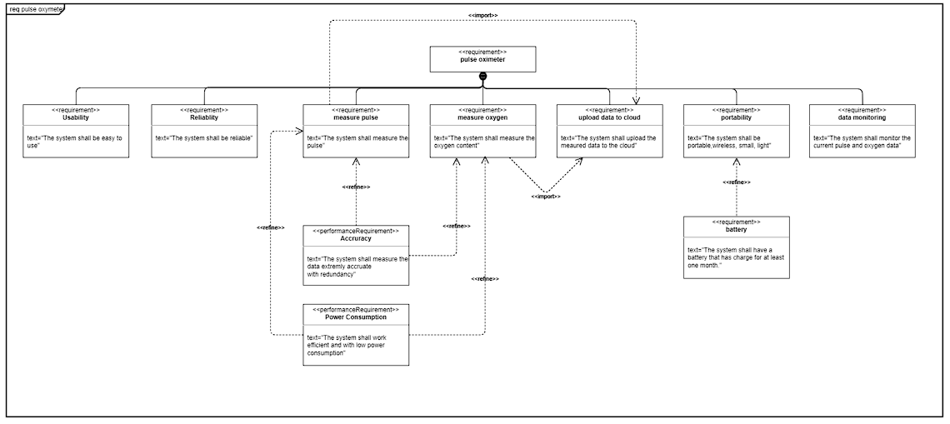
Requirements Pulse Oxymeter
Usability
Reliability
Portability
Measure pulse
Measure oxygen
Accuracy
Power Consumption

Slide 7
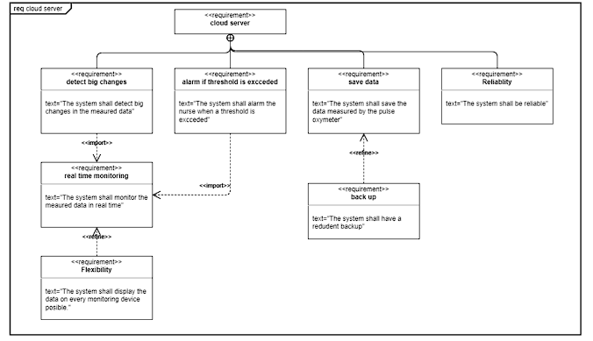
Requirements Cloud server

Slide 8
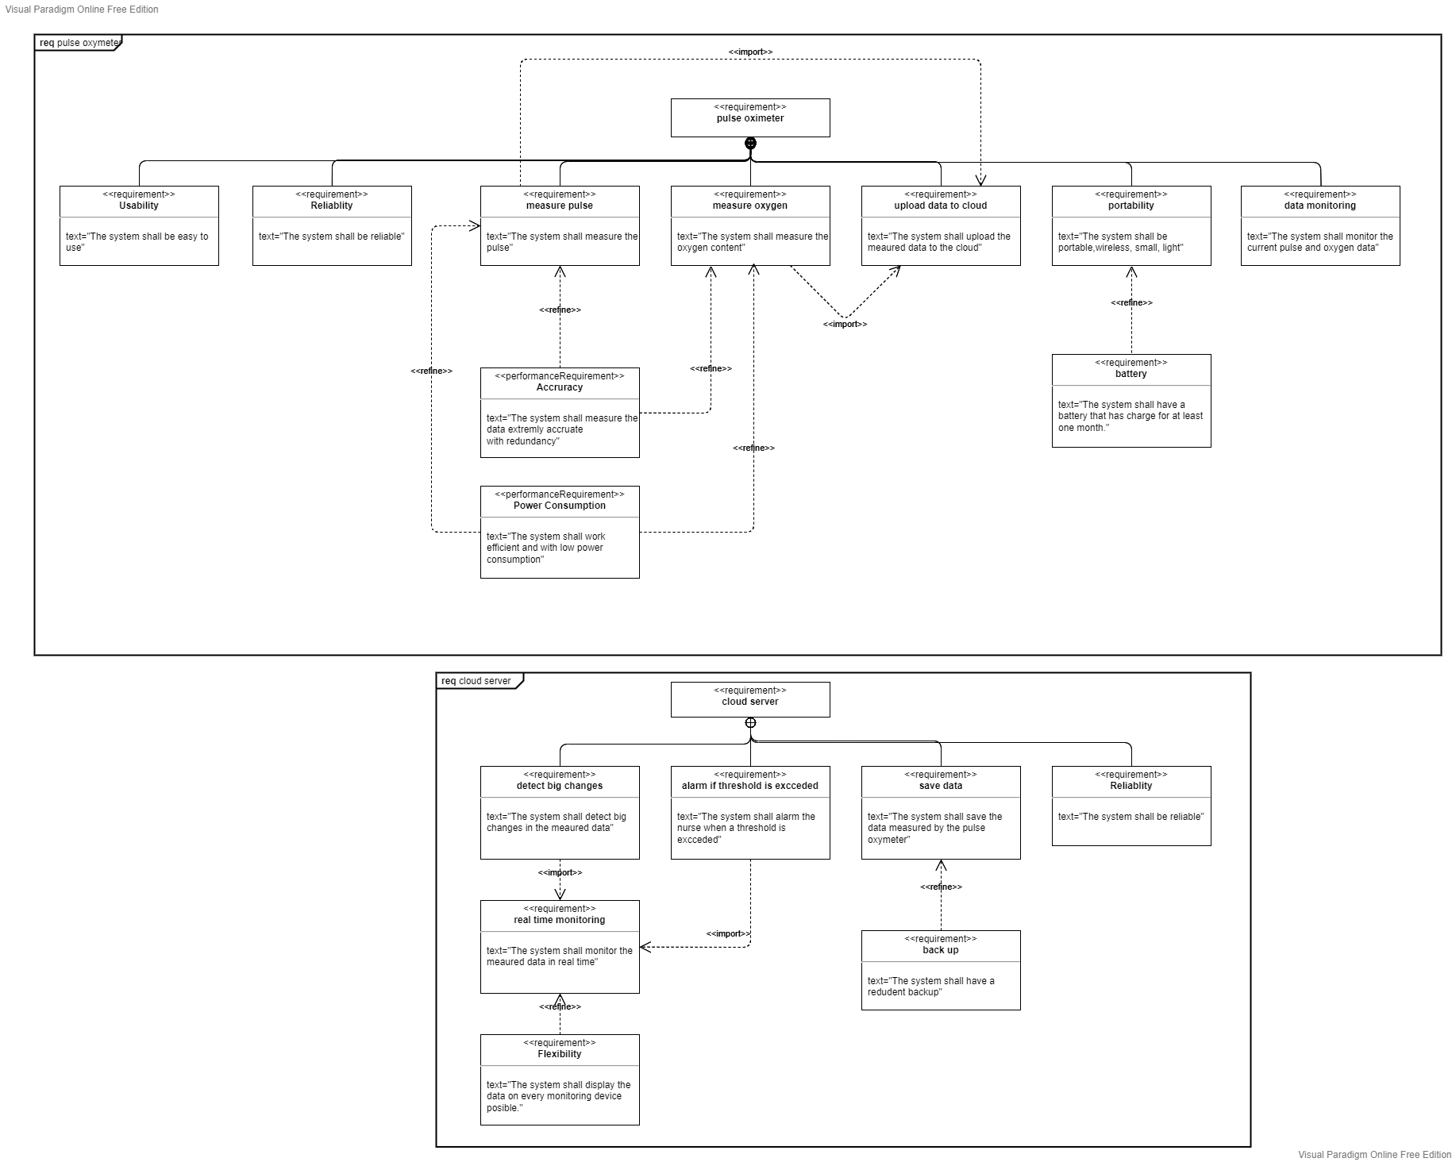
Requirements

Slide 9
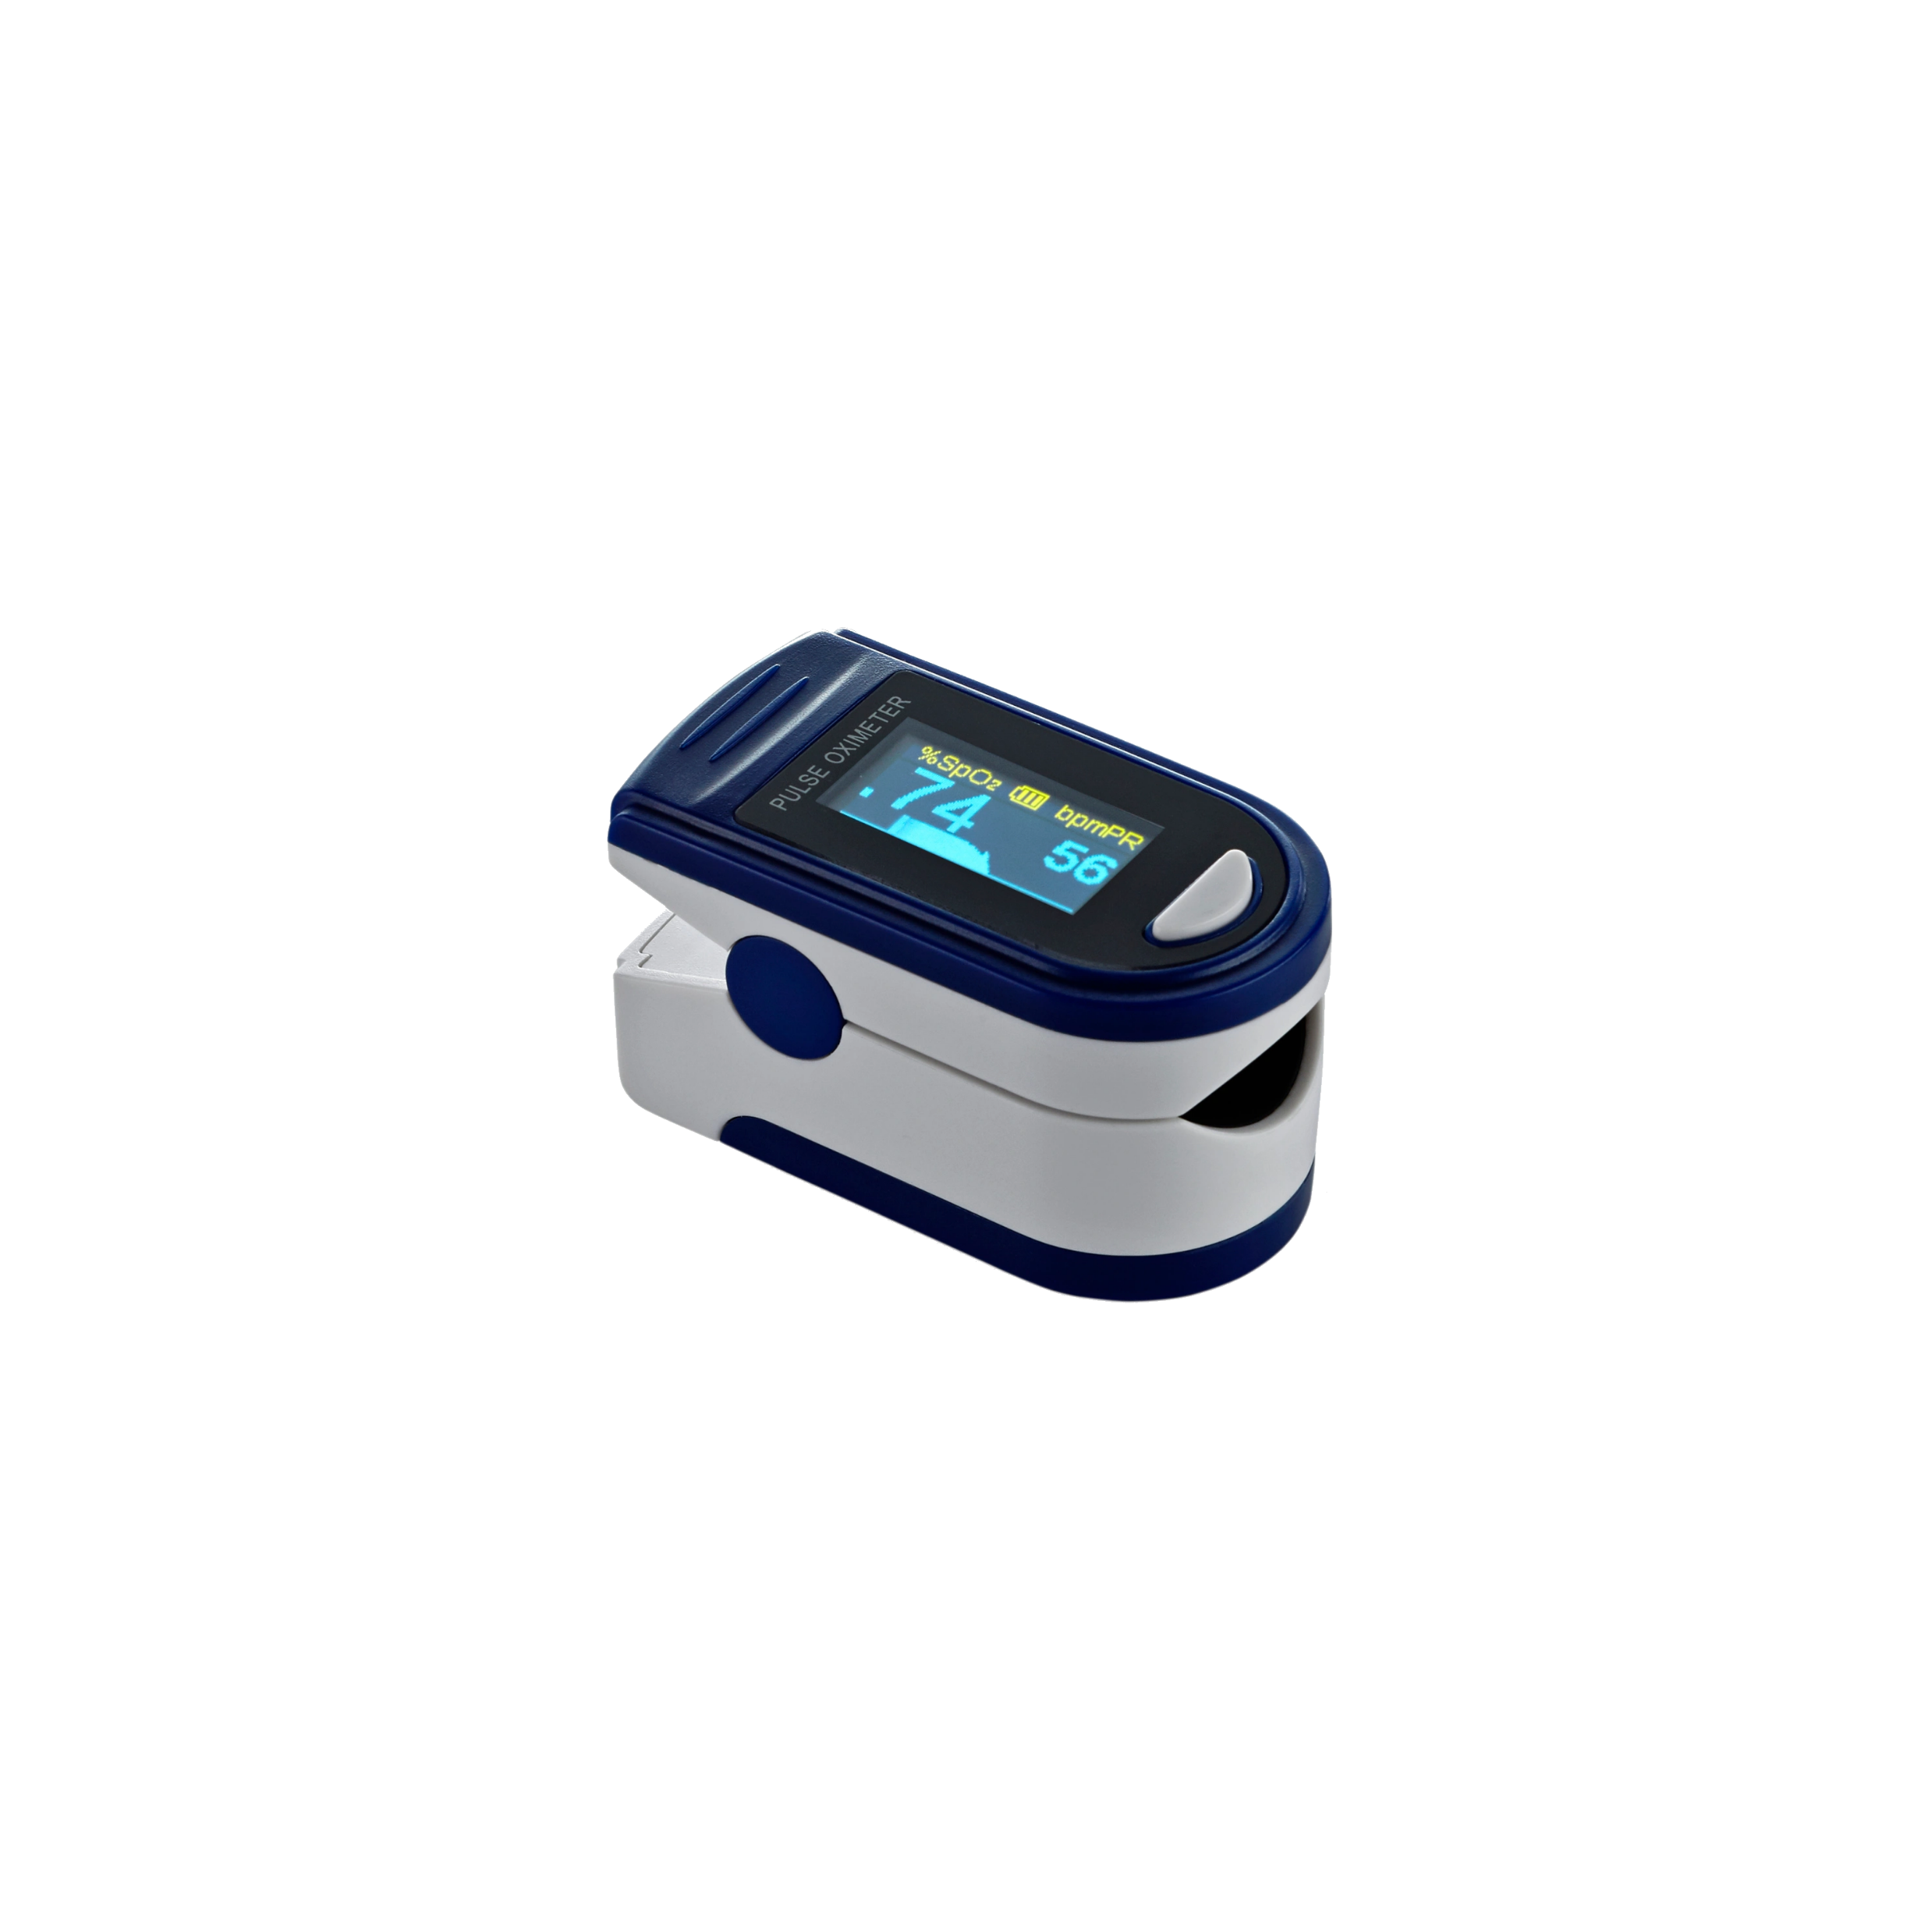
Hardware Pulse Oxymeter
sensors
microprocessor
battery
2 pulse
2 oxygen
Wi-fi
Low power consumption
Single core

Slide 10
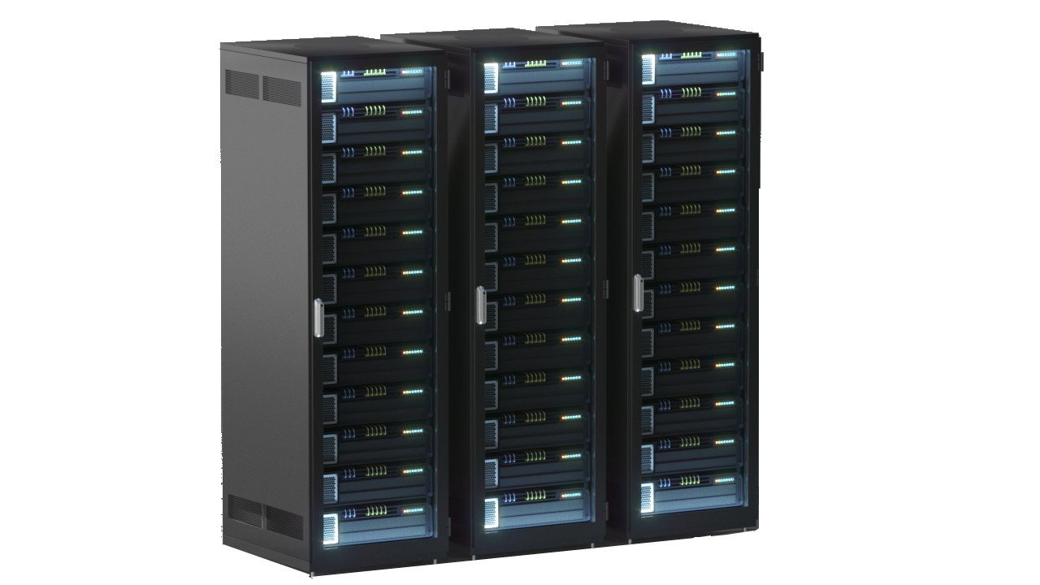
Hardware Cloud Server
Storage
Wired connection
High capacity
(min. 5 petabyte)
Wi-fi access points
Moderate speed

Slide 11
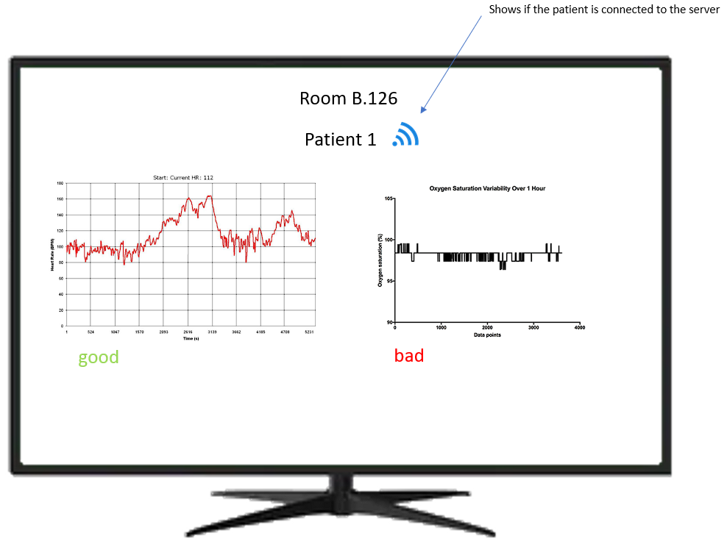
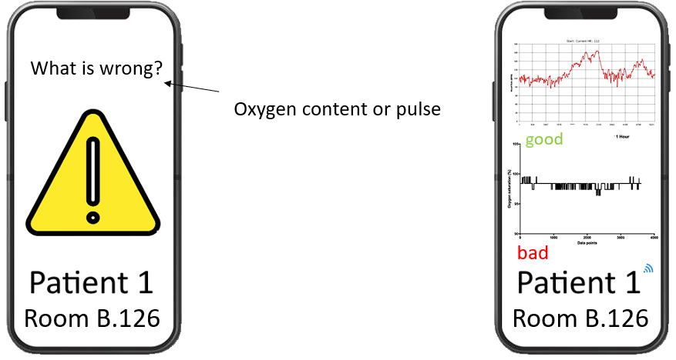
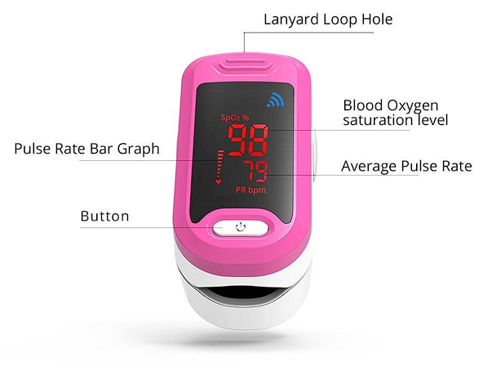
User Interface

Slide 12
Thank you

