Slide 1
SMART GREENHOUSE
Advanced Embedded Systems
Team H
Stephanie Chinenye Okosa, Muhammad Umer Bin Yaqoob, Maxim Emile Speczyk

Slide 2
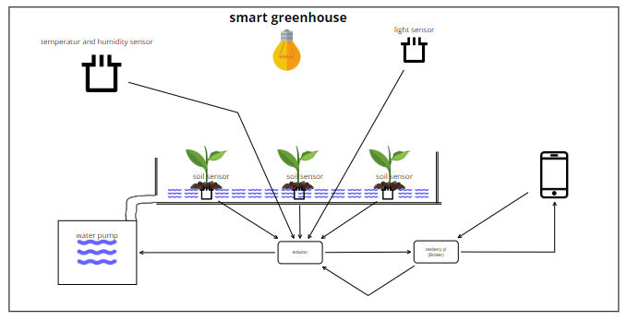
Concept

Slide 3
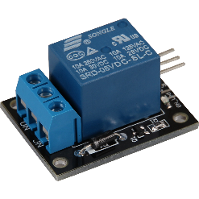
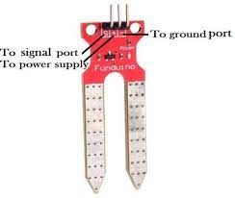
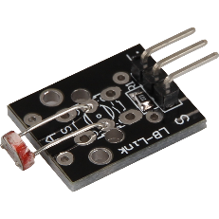

Sensors & Actuators
Relay
Connected to the subscriber
Controls the water pump
Soil moisture sensor
Connected to the publisher
Measures soil water content
DHT11
Connected to the publisher
Measures the temperature and moisture of the air
Photoresistor
Connected to the publisher
Measures the light intensity (the lower the brighter)
2
1
3
4

Slide 4
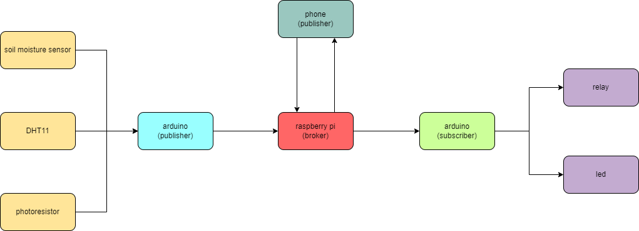
Components
(subscriber)

Slide 5
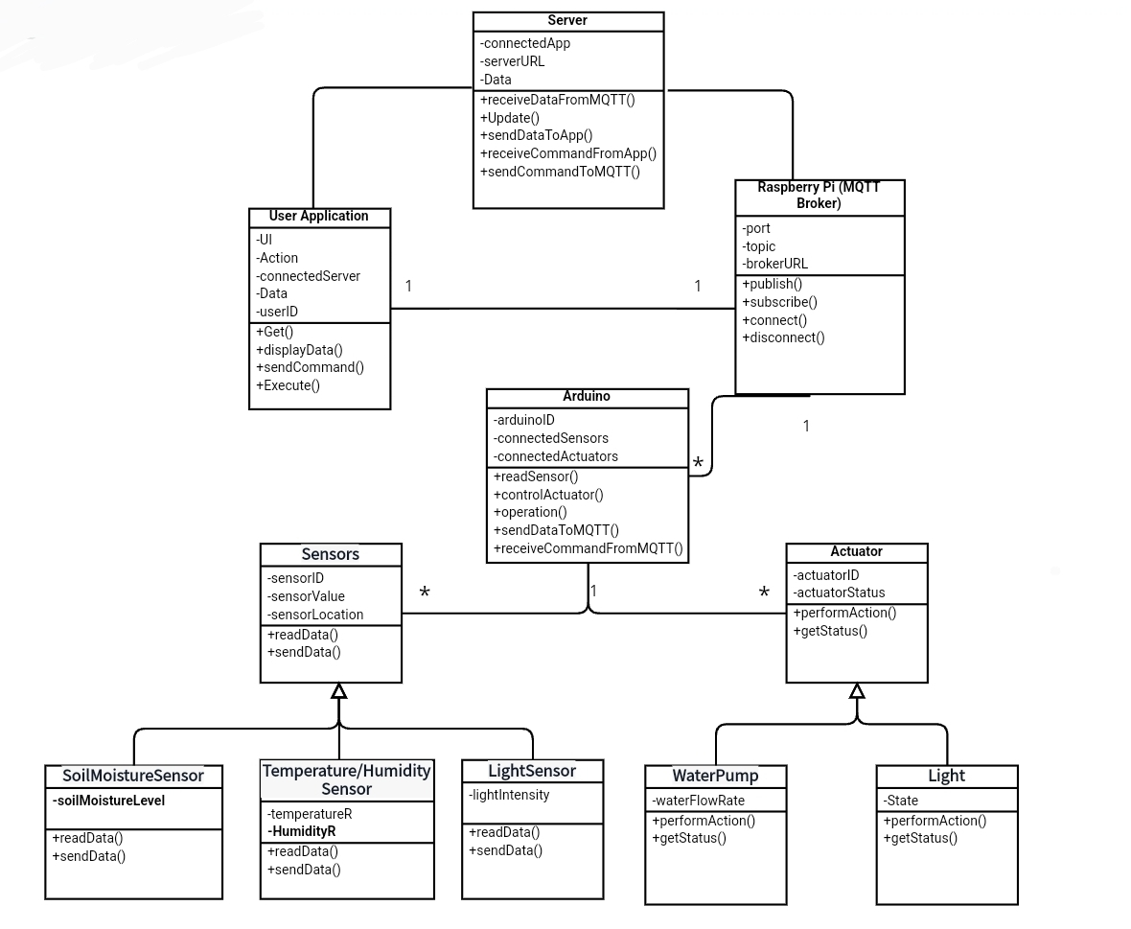
Class Diagram

Slide 6
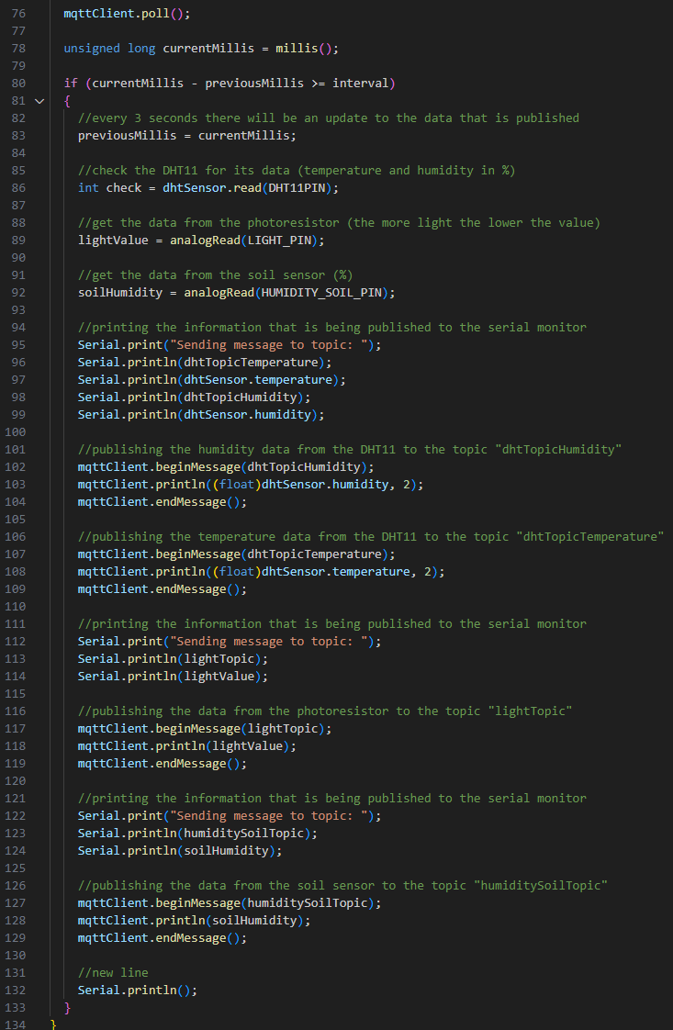
Code Publisher

Slide 7
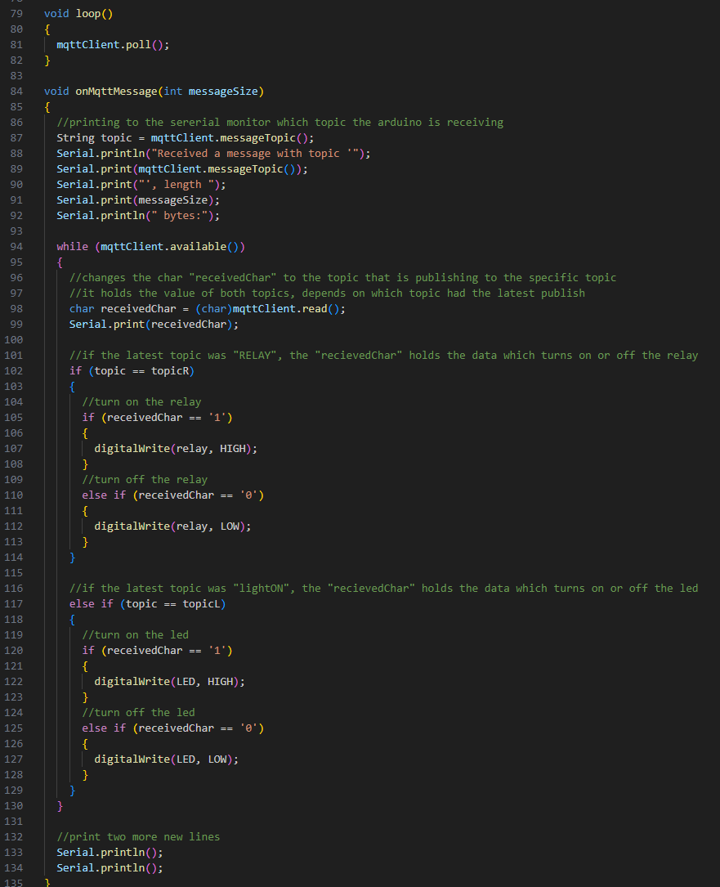
Code Subscriber

Slide 8

Let’s see it working !

