Slide 1
Los Angeles Food Market Research
Sprint 9. How To Tell a Story Using Data

Slide 2
General Conclusion
Based on the analyses of seating capacity between different categories and chains we can assume the following locations on the streets with high restaurant visitors traffic and below average (or even 0) number of the same type entities for the new innovative robot-run Café:
1st street, 6th street, 8th streets and Broadway as locations for chain-member establishment;
Central street, Westwood Boulevard, 8th street, Whistler streets or Wilshire Boulevard as locations for the independent establishments.
If and when the novelty of robot waiters wears off this locations would have been likely generating good level of traffic and revenue.

Slide 3
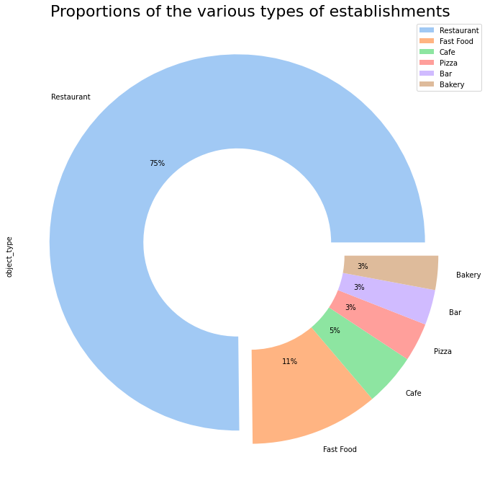
Restaurants dominate the market
We can see that 3/4 of the market in Los Angeles is occupied by Restaurants, and a bit more than 1/10 - by Fast Food establishments. Cafes got the 3d place with 5%, while Pizzerias, Bars and Backeries holds around 3% of the market each.

Slide 4
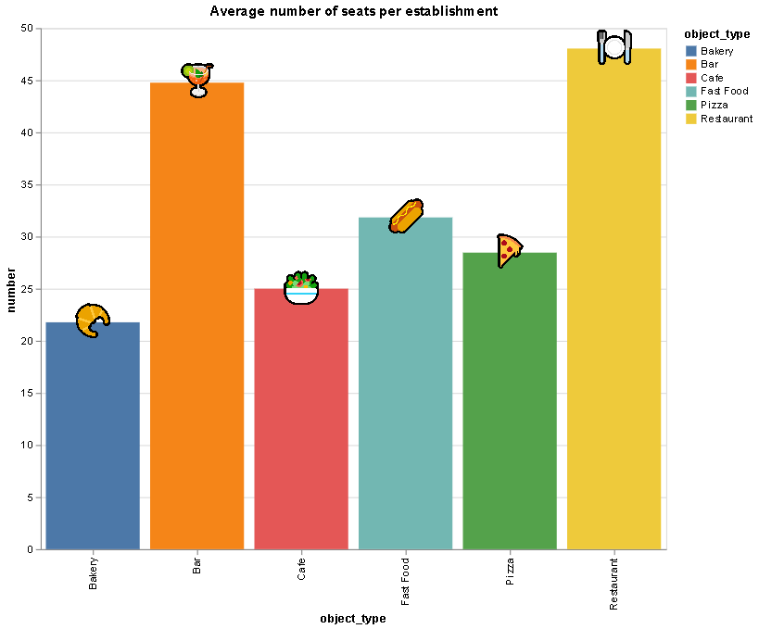
What is the average size of the establishment
The leader in total number of establishments is also a leader in the average venue size:
Restaurants - 48 seats
Bars - 45 seats
Fast Food - 32 seats
Pizza - 28 seats
Cafe - 25 seats
Bakery – 22 seats.

Slide 5
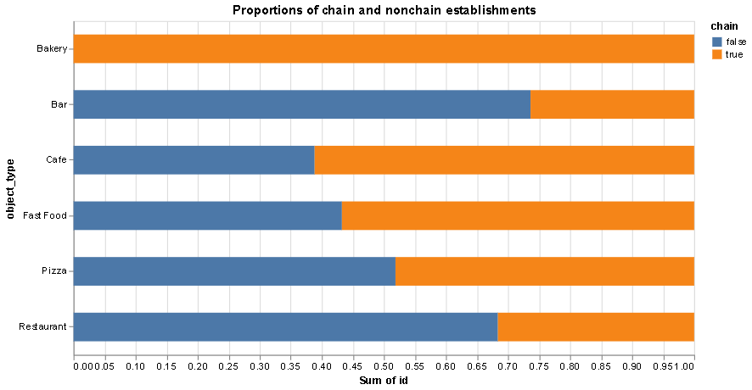
What is typically a chain?
Overall 72% of all entities in LA do not belong to any chain.
The Bakery is always a chain member.
Bars (73%) and Restaurants(68%) are independent entities a bit less, than 3/4 and over 2/3 cases respectively.
Pizzerias are approximately 50/50 chain vs non-chain.
Fast Food and Cafes are the chain members in most cases - 57% and 62% respectively.

Slide 6
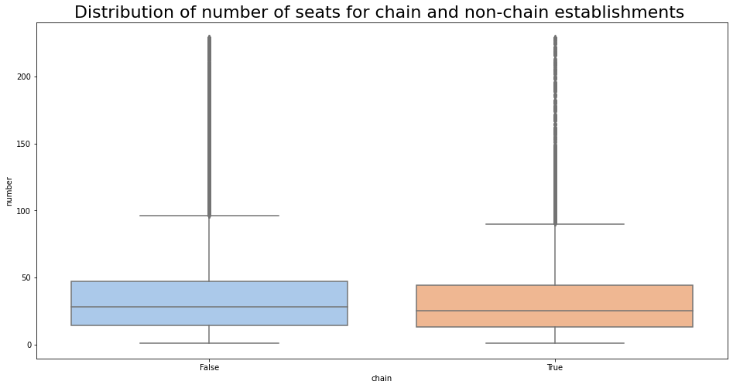
No clear leader . Let’s check by category
Based on the overall statistics and the graph we can't say that there is any significant difference between chain and non chain entities. There are 3 major benchmarks for number of seats: 30, 50 and 230 seats. More than 75% of both chain and non-chain establishments have less than 50 seats. There is also a big gap in number of establishments under and over 30 seats. This limits may be affected by local tax, sanitary and/or ecological limitations, imposed by local authorities.

Slide 7
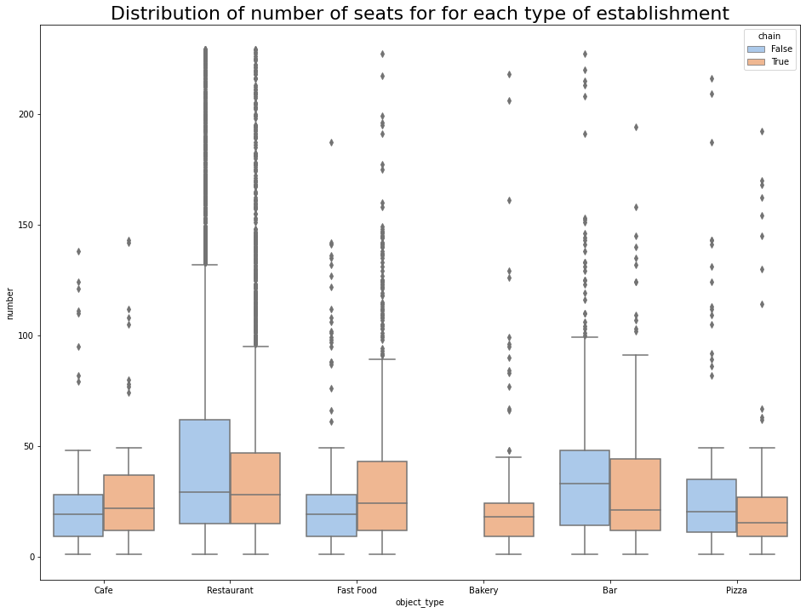
Restaurants and Bars on top
Chain-members Cafe and Fast Food have more establishments with larger amount of seats than non-chain entities. The difference is much more seen for Fast Food chains.
For Bars and Pizzerias the situation is vice versa: chains have relatively smaller amount of establishments with lower number of seats.
Non-chain Restaurants have more entities with more seats, while the medians for both chain and non-chain establishments are approximately the same.

Slide 8
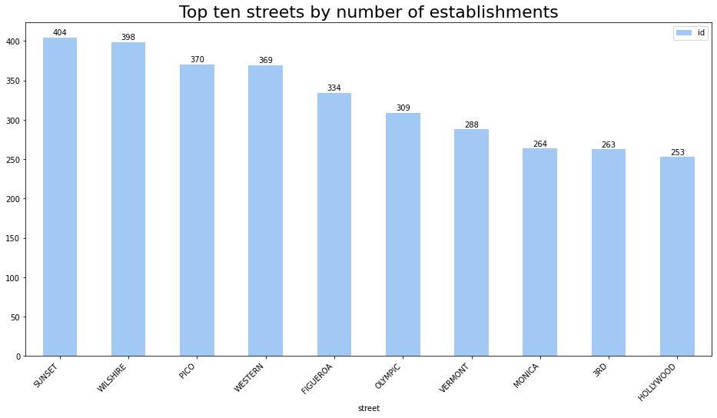
Most known LA boulevards on top

Slide 9
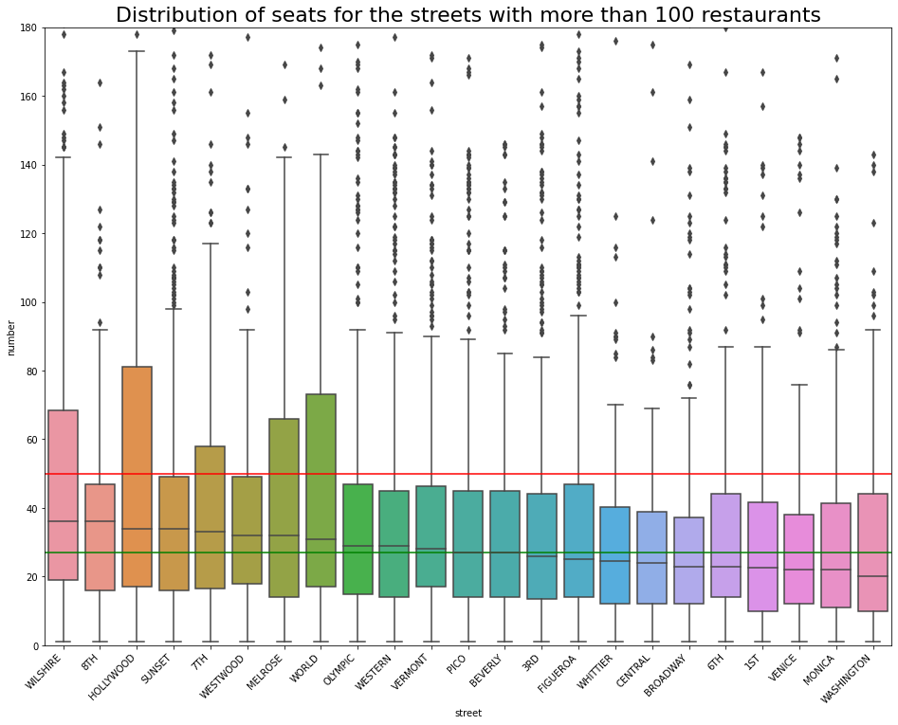
Most Popular Streets
Five streets among the most popular ones have the distribution of seating capacity which is not typical for LA: 3d quartile of the distribution for those streets much exceeds the limit of 50 (red horizontal line on the graph).
This means that Hollywood Blvd, World Way, Wilshire Blvd, Melrose Ave and 7th street have more entities with larger size than other streets in the city.

Slide 10
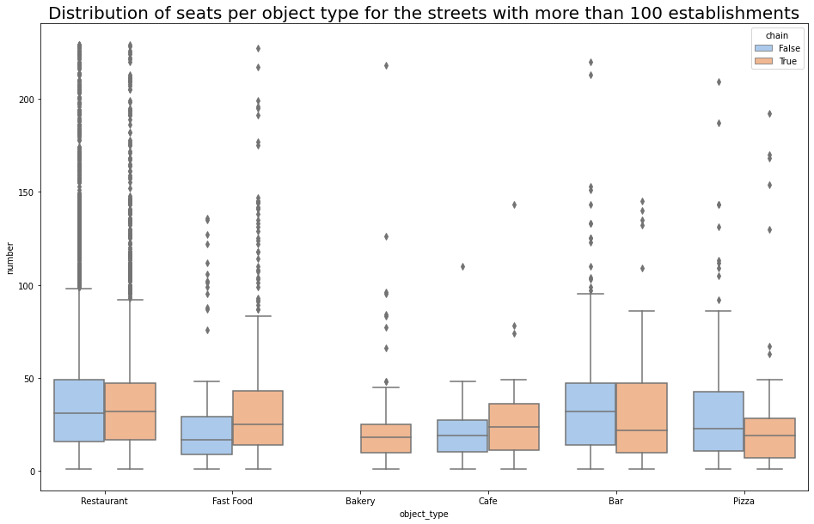
Distribution of seats per category on top streets
For the most popular streets there is almost no difference for the seating distribution between chain and non-chain entities for Restaurants.
Non-chain Fast Food and Cafe entities are visually smaller and less presented than chain members.
The situation is completely different for Pizzerias: independent entities are bigger and are much more present on top streets. This is generally true also and for the Bars, although they are also limited by 49 seats for 75% of distribution for both chain and non-chain establishments.

Slide 11
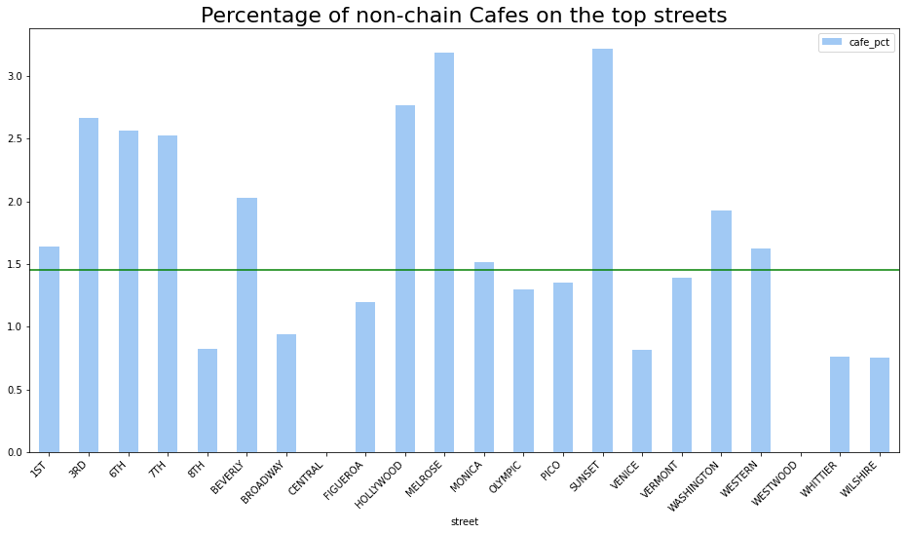
Looking for the best location for independent Cafe
Independent Cafes are relatively smaller on the top streets (green line on the graph indicates median) than chain-members.
There are two streets with no independent Cafes at all: Central street and Westwood Blvd.
Streets with the lowest level of independent Café presence seems to be the most preferrable locations.

Slide 12
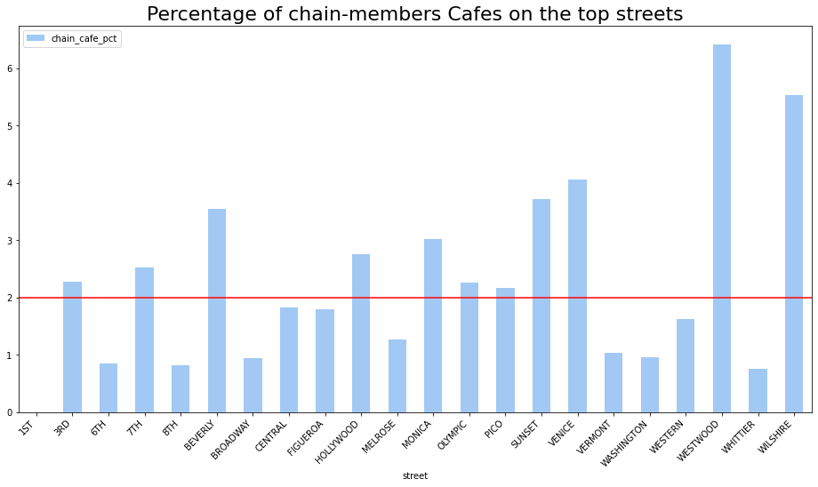
Looking for the best location for chain Cafe
Chain Cafes are relatively bigger on the top streets (red line on the graph indicates median) than non-chain ones.
There is one street with no chain Cafe at all which is 1st street.
Streets with the lowest level of chain Café presence seems to be the most preferrable locations.

