Slide 1
Basisregistratie kinderoncologie

Slide 2
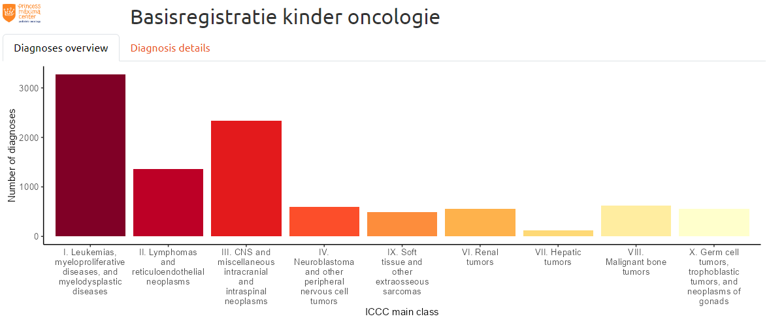
Logo
Title
Tabs
Clickable graph

Slide 3
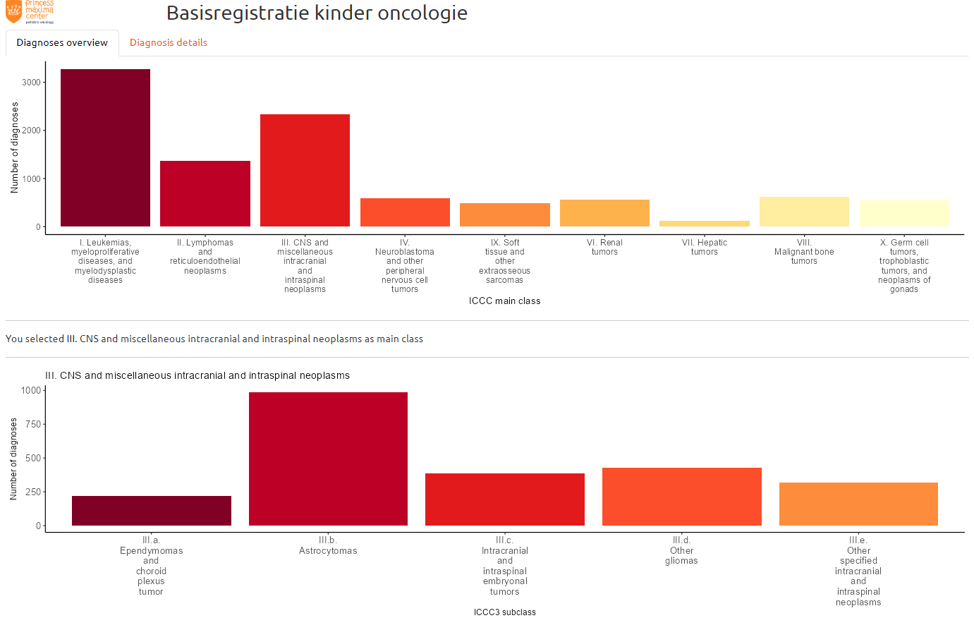
Dynamic text
Detailed view of the main clas diagnoses

Slide 4
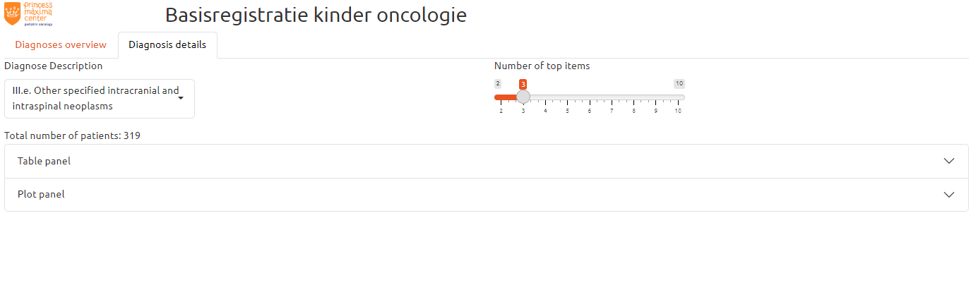
Other tab containing details
Drop-down menu
Dynamic text
Foldable panel (accordion)

Slide 5
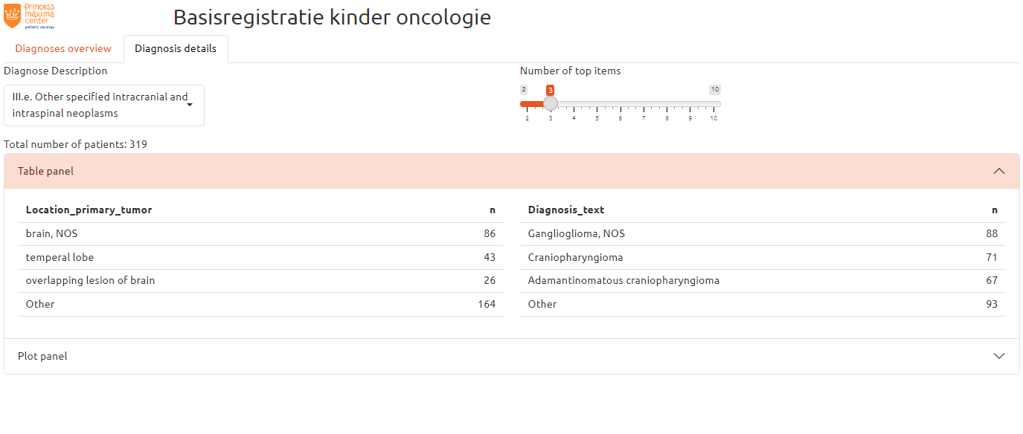
Adjustable slider
Tabular view

Slide 6
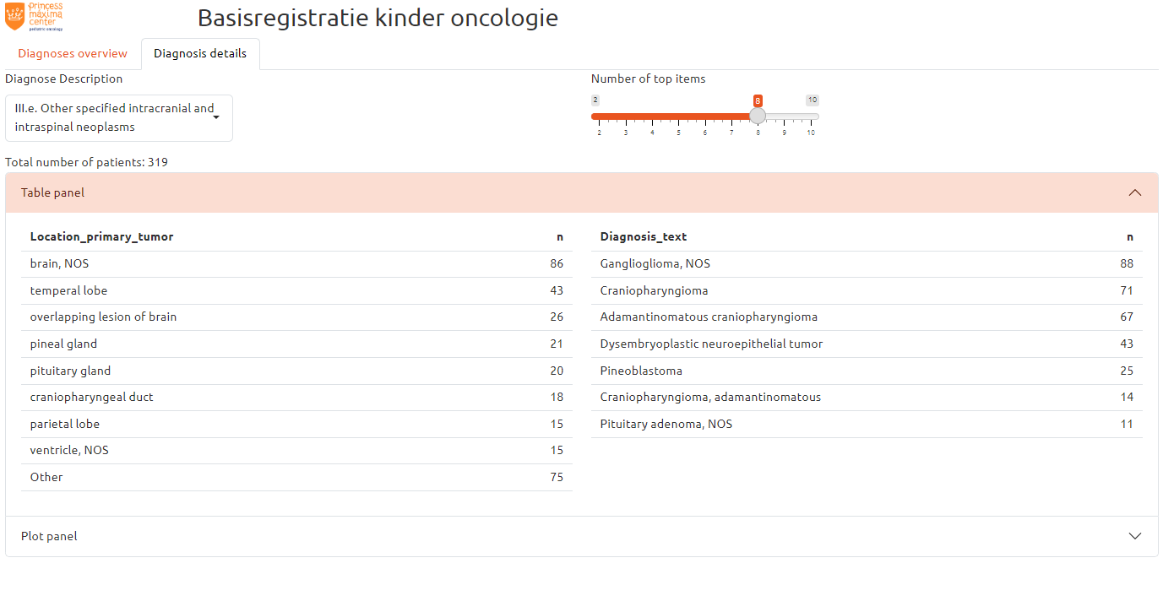
Adjusted table

Slide 7
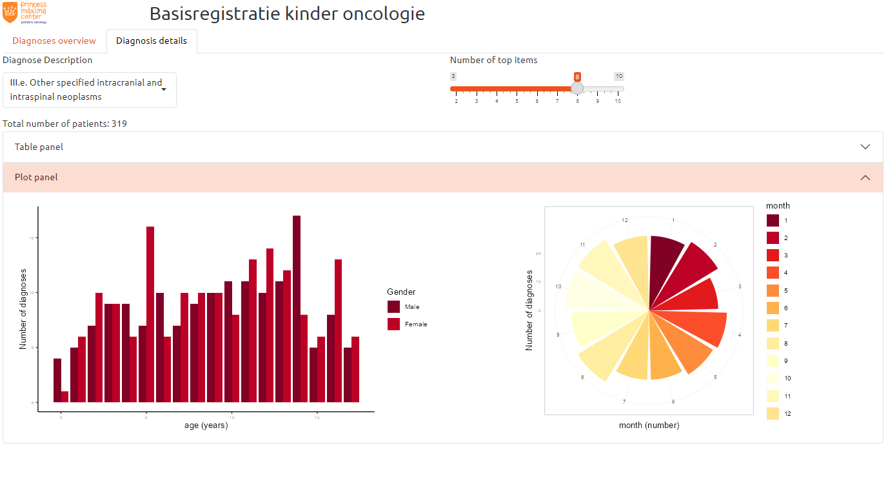
Plots

