Slide 1
Single cell shiny tutorial

Slide 2
Data set
Small subset from this paper: Poort, Vera M et al. “Transient Differentiation-State Plasticity Occurs during Acute Lymphoblastic Leukemia Initiation.” Cancer research vol. 84,16 (2024): 2720-2733. doi:10.1158/0008-5472.CAN-24-1090
1405 cells
21610 genes
RDS object containing data analyzed with Seurat

Slide 3
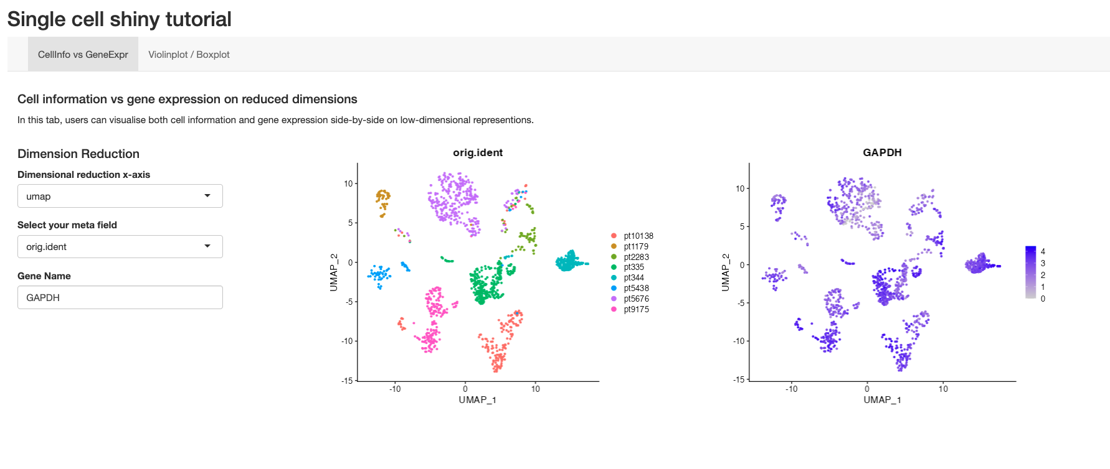
User interface

Slide 4
Orange box: Control the dimensions. UMAP/PCA/etc.
Blue box: Control what you want to see. PatientsIDs/publicationID/subtype/etc
Green box: Type which gene you want to see
Purple box: Select tab you are interested in

Slide 5
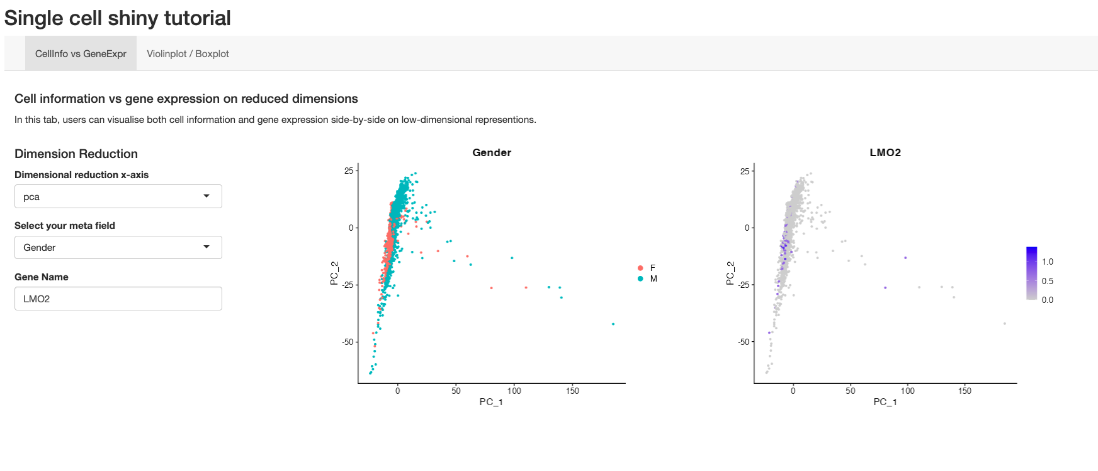
Example of change in the UI

Slide 6
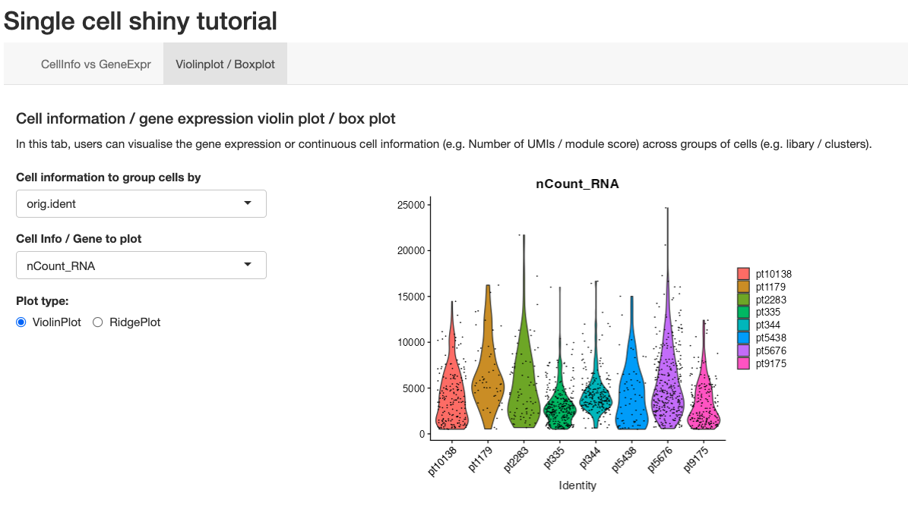
2nd tab
Orange box: Change plot type
Blue box: Change what you want to see

Slide 7
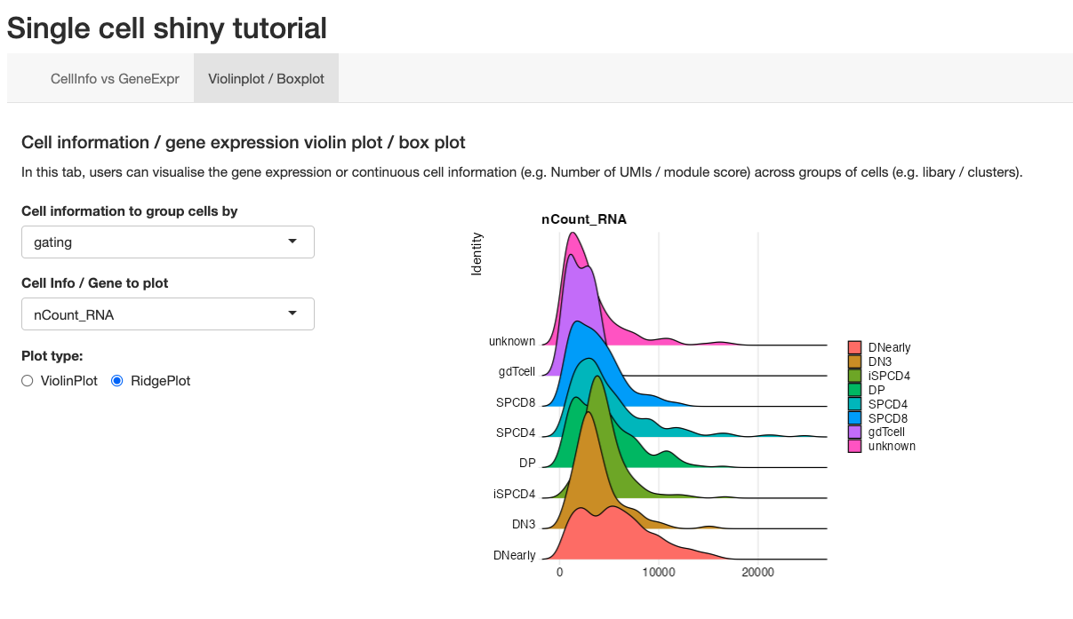
Example of change in the UI

