Slide 1
Single cell shiny tutorial advanced

Slide 2
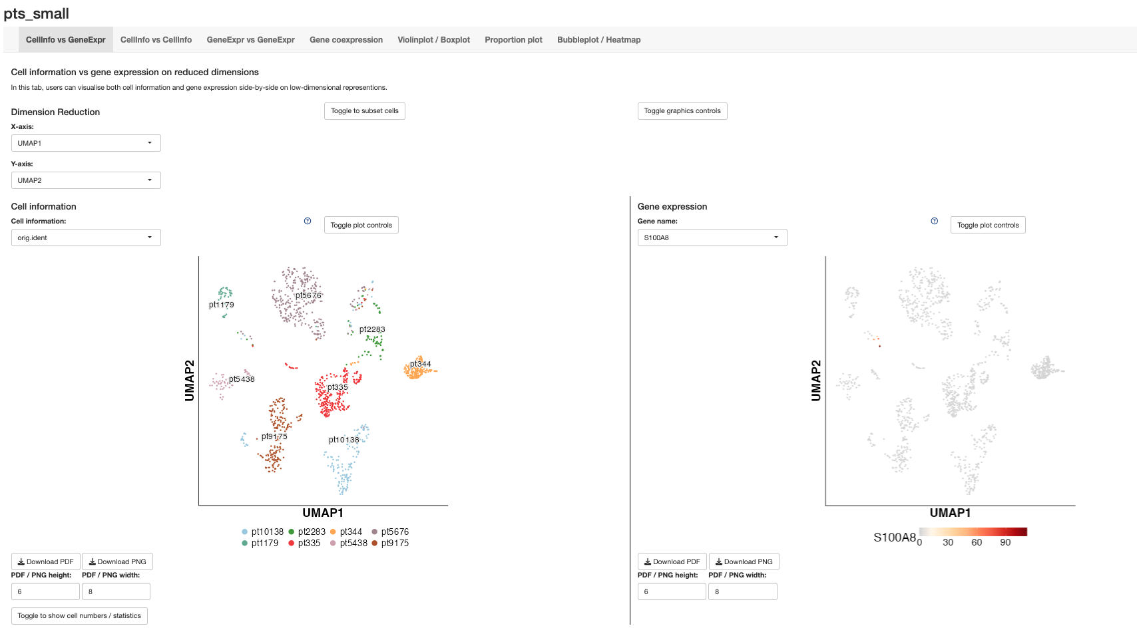
Save options

Slide 3
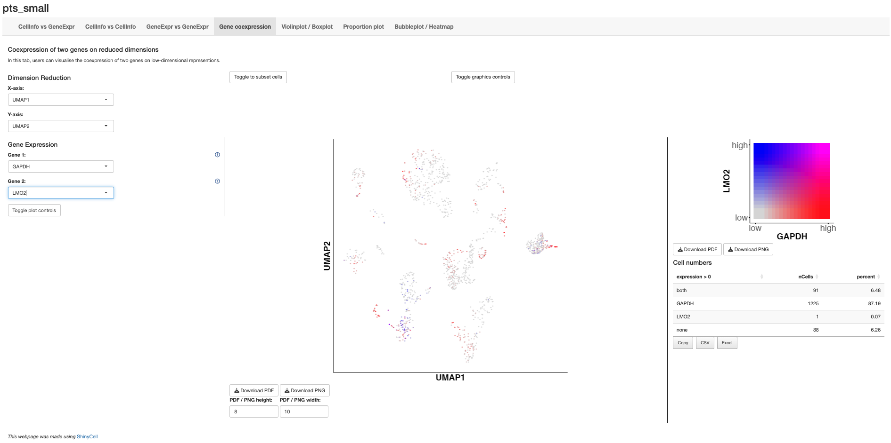
Subset your data
Help function with more info

Slide 4
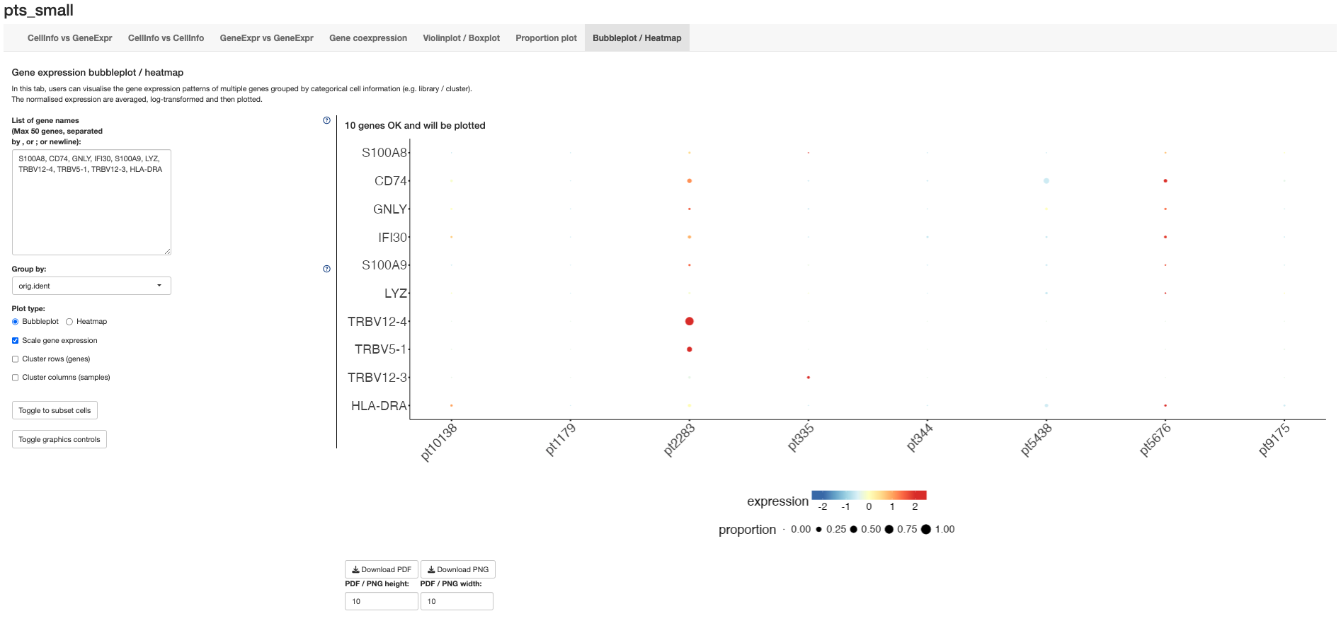
Some additional plot options

