Slide 2
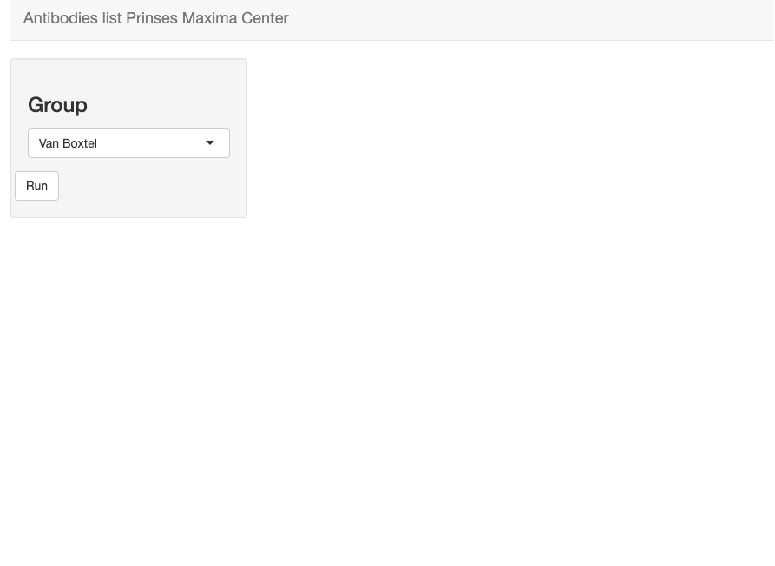
To list the groups you can:
Make a choice list object using the group names in the table input data.
Read the column before hand and give it to the dropdown object
DROP DOWN MENU

Slide 3
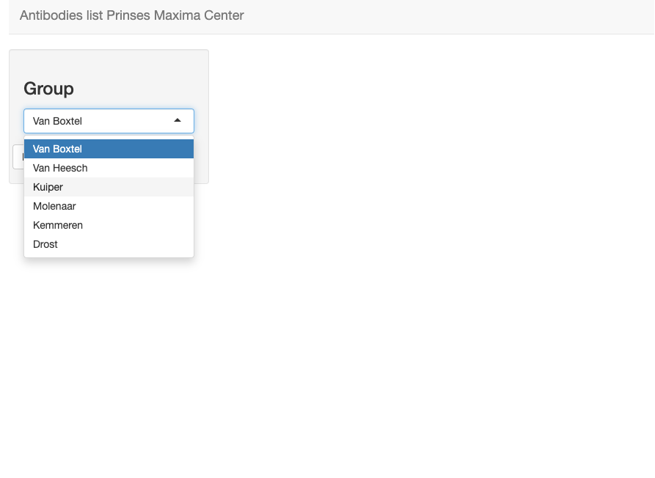
Display groups found in the input table

Slide 4
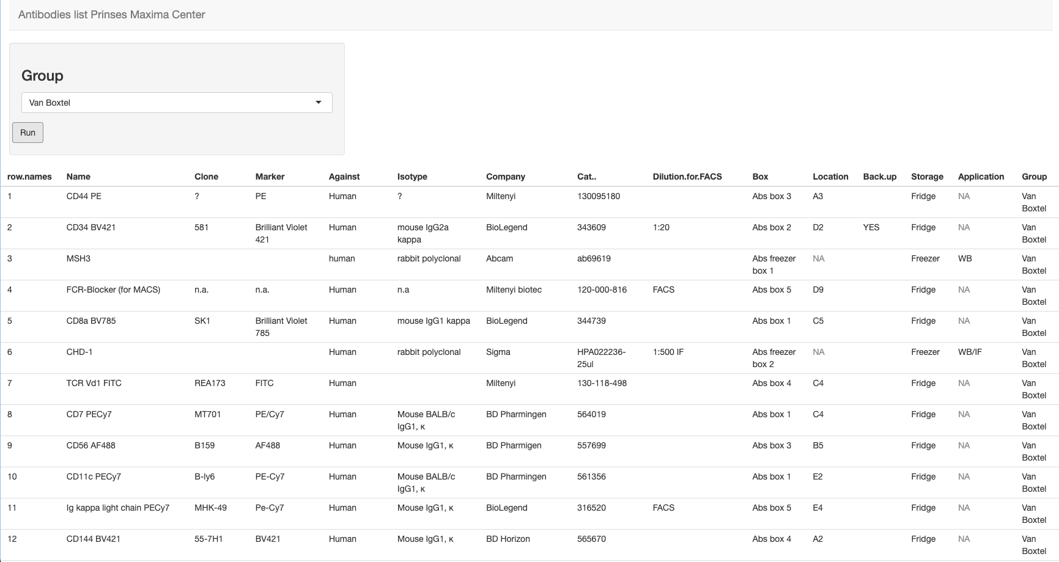
Table output per group

Slide 5
