Slide 2
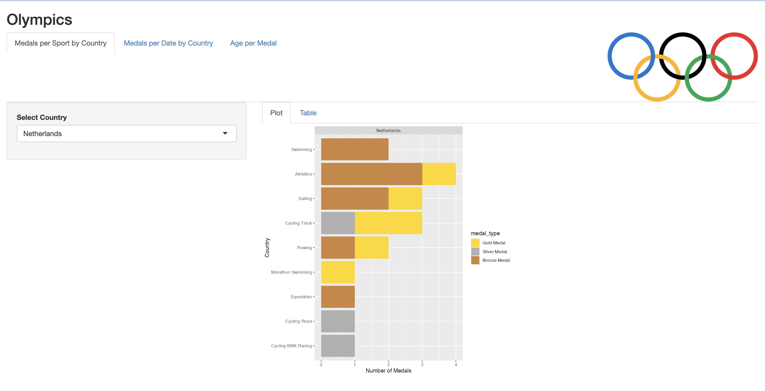
TITLE
TABS
IMAGE
SIDE BAR LAYOUT
SIDE BAR PANEL
TABS (inside main panel)
MAIN PANEL

Slide 3
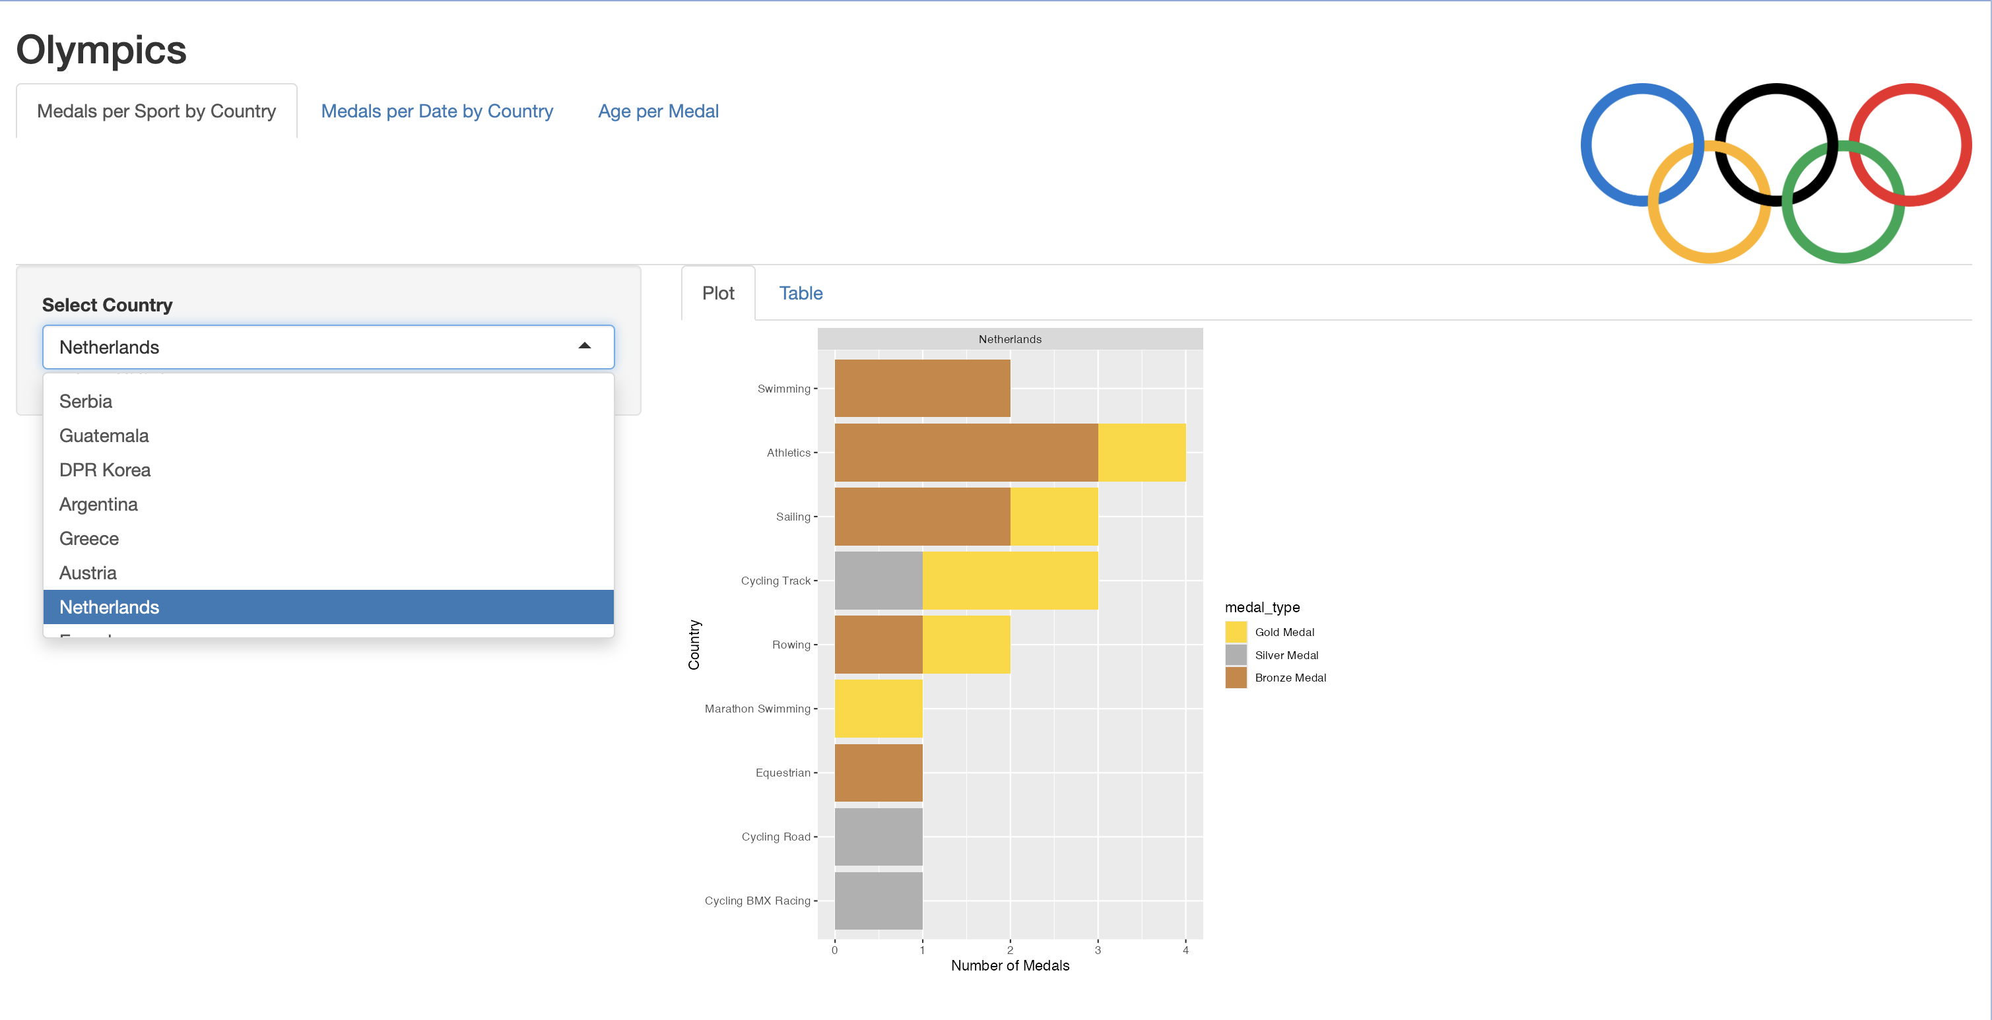
DROP DOWN MENU
PLOT OUTPUT

Slide 4
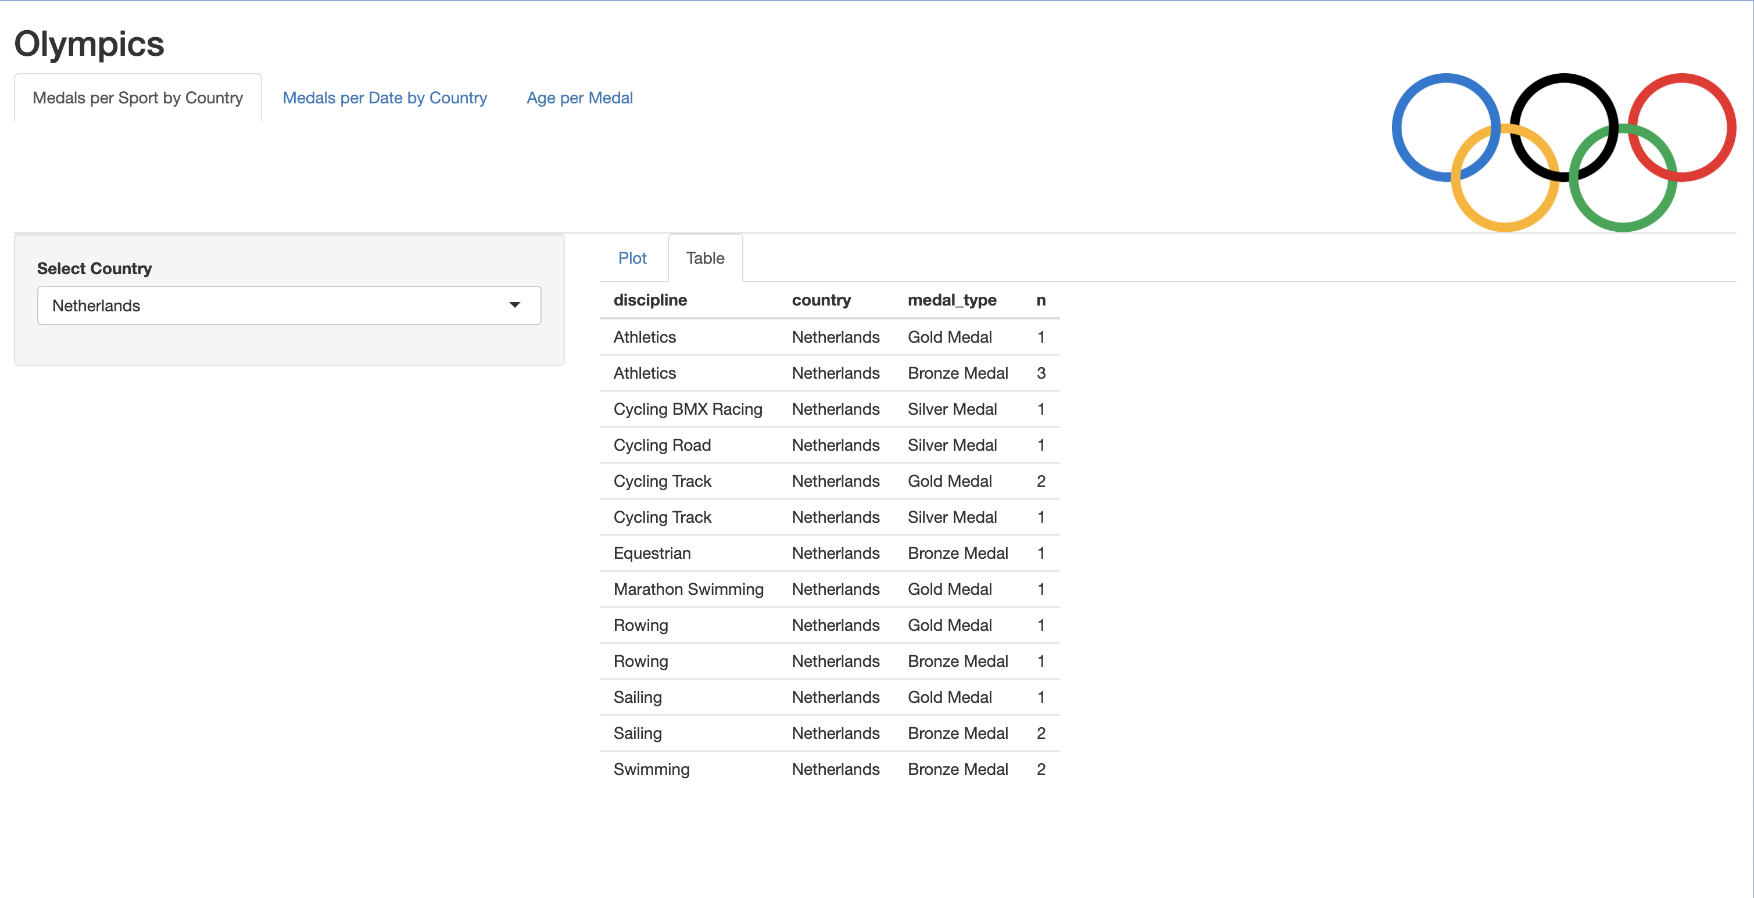
TABLE OUTPUT

Slide 5
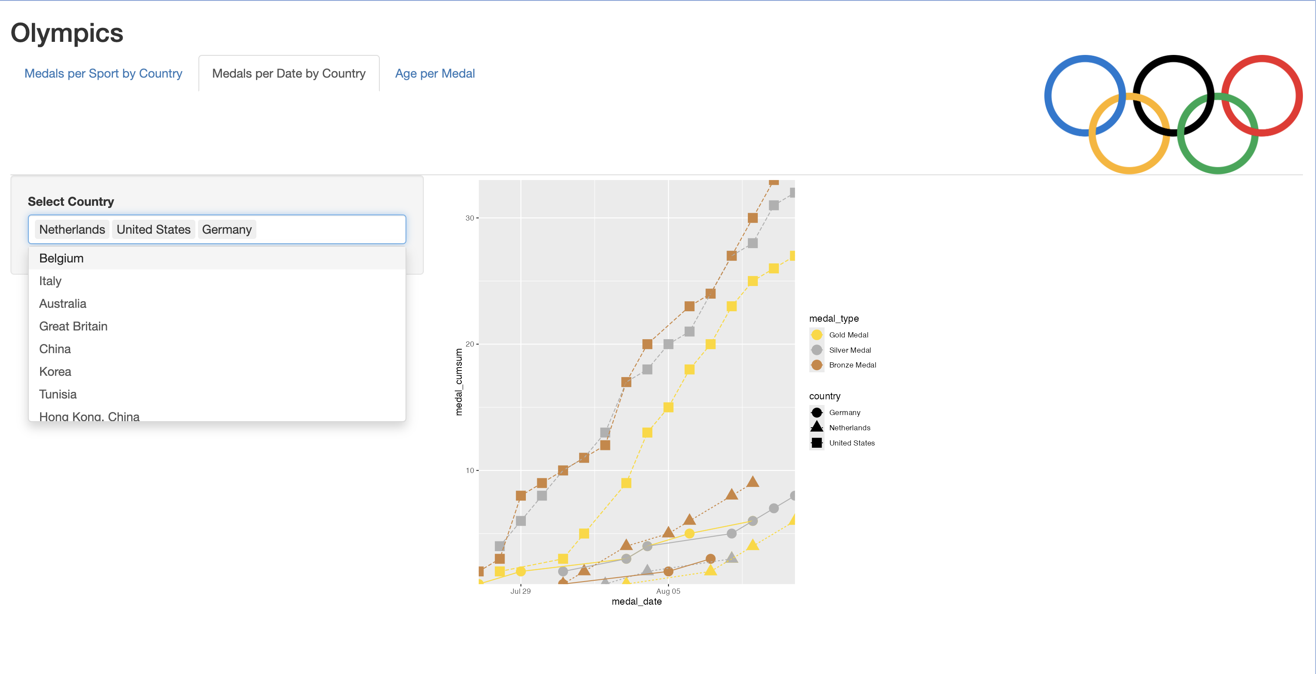
DROP DOWN MENU (multiple selection)

Slide 6
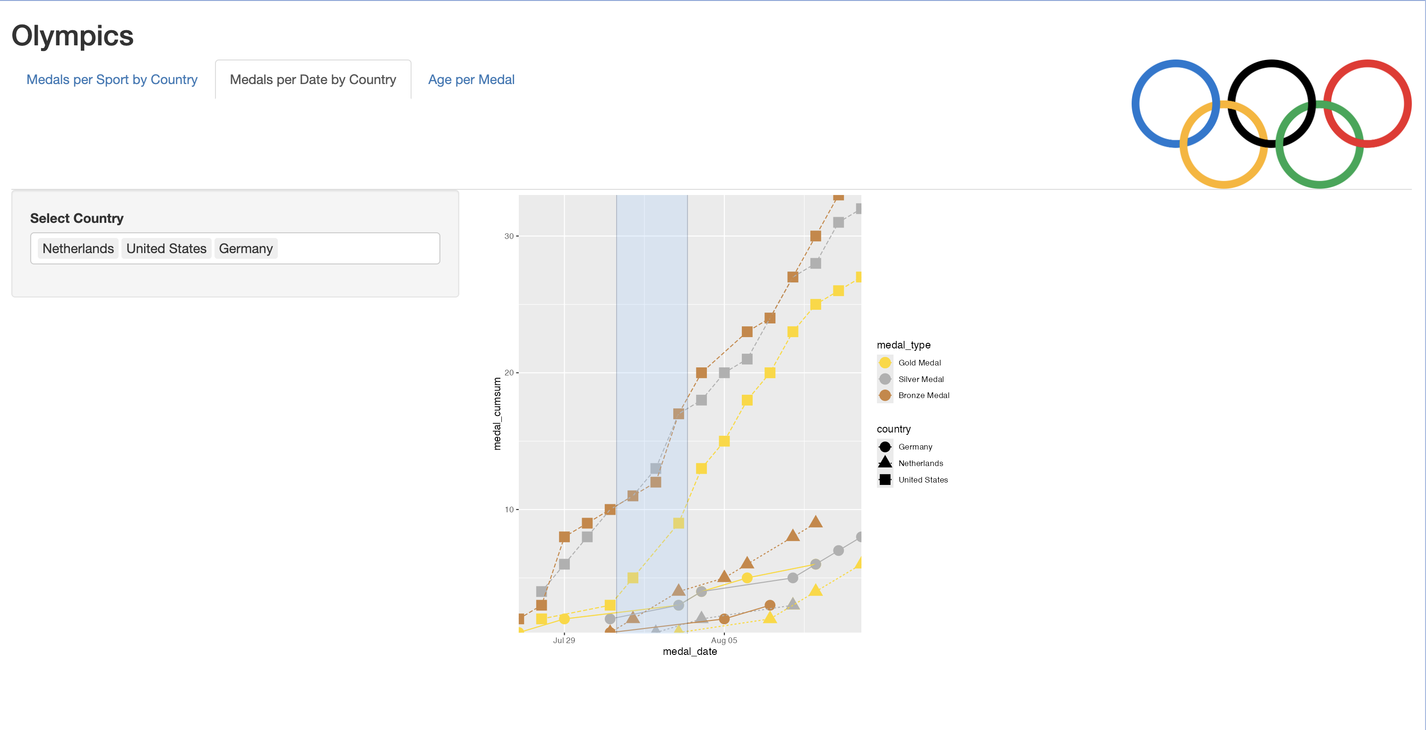
ZOOM FUNCTION (drag and double click to zoom )

Slide 7
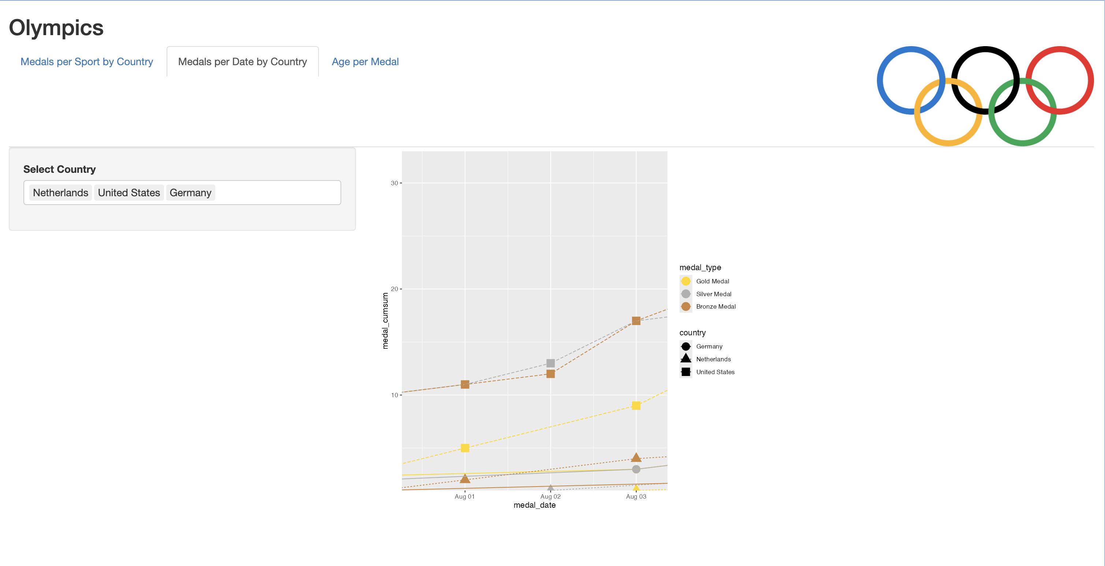
ZOOMED PLOT OUTPUT

Slide 8
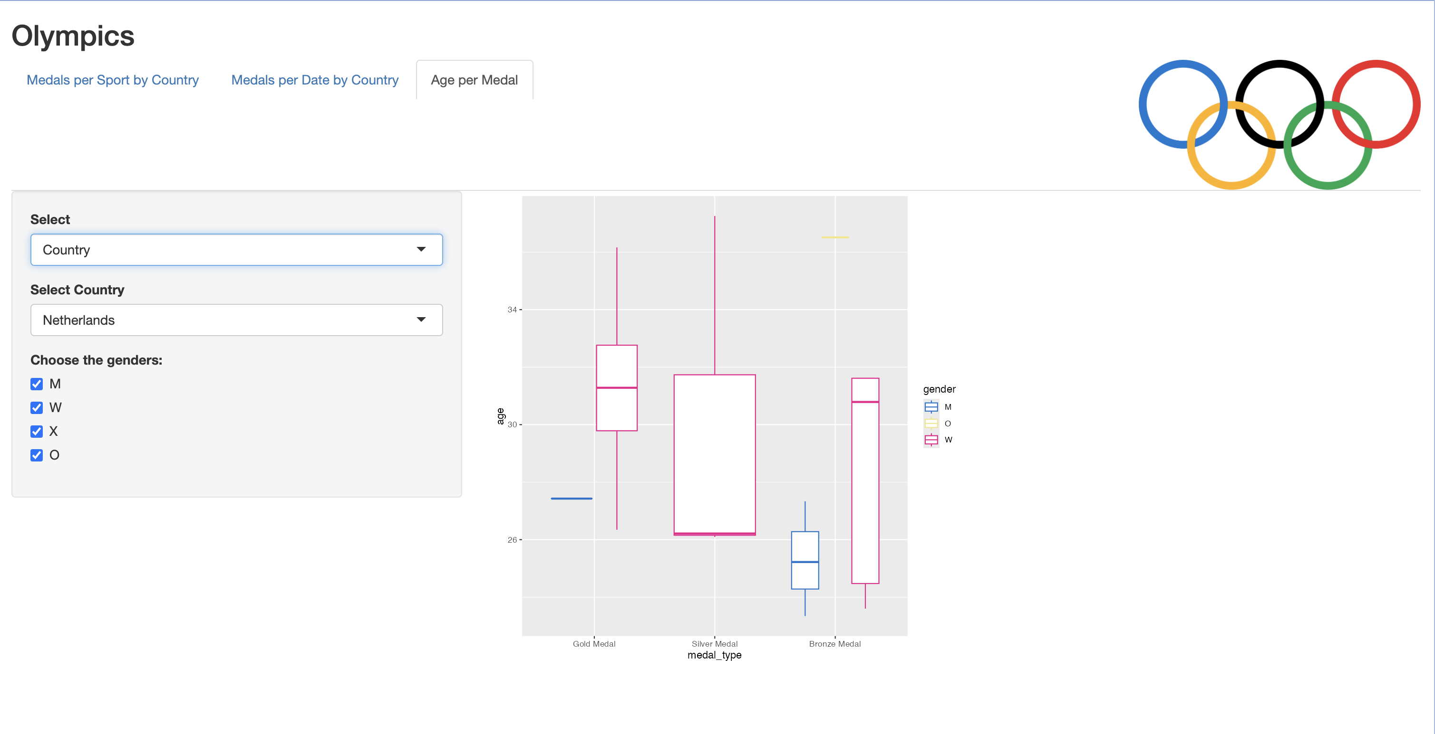
SIDE BAR WITH
DROP DOWN AND CHECK BOX

Slide 9
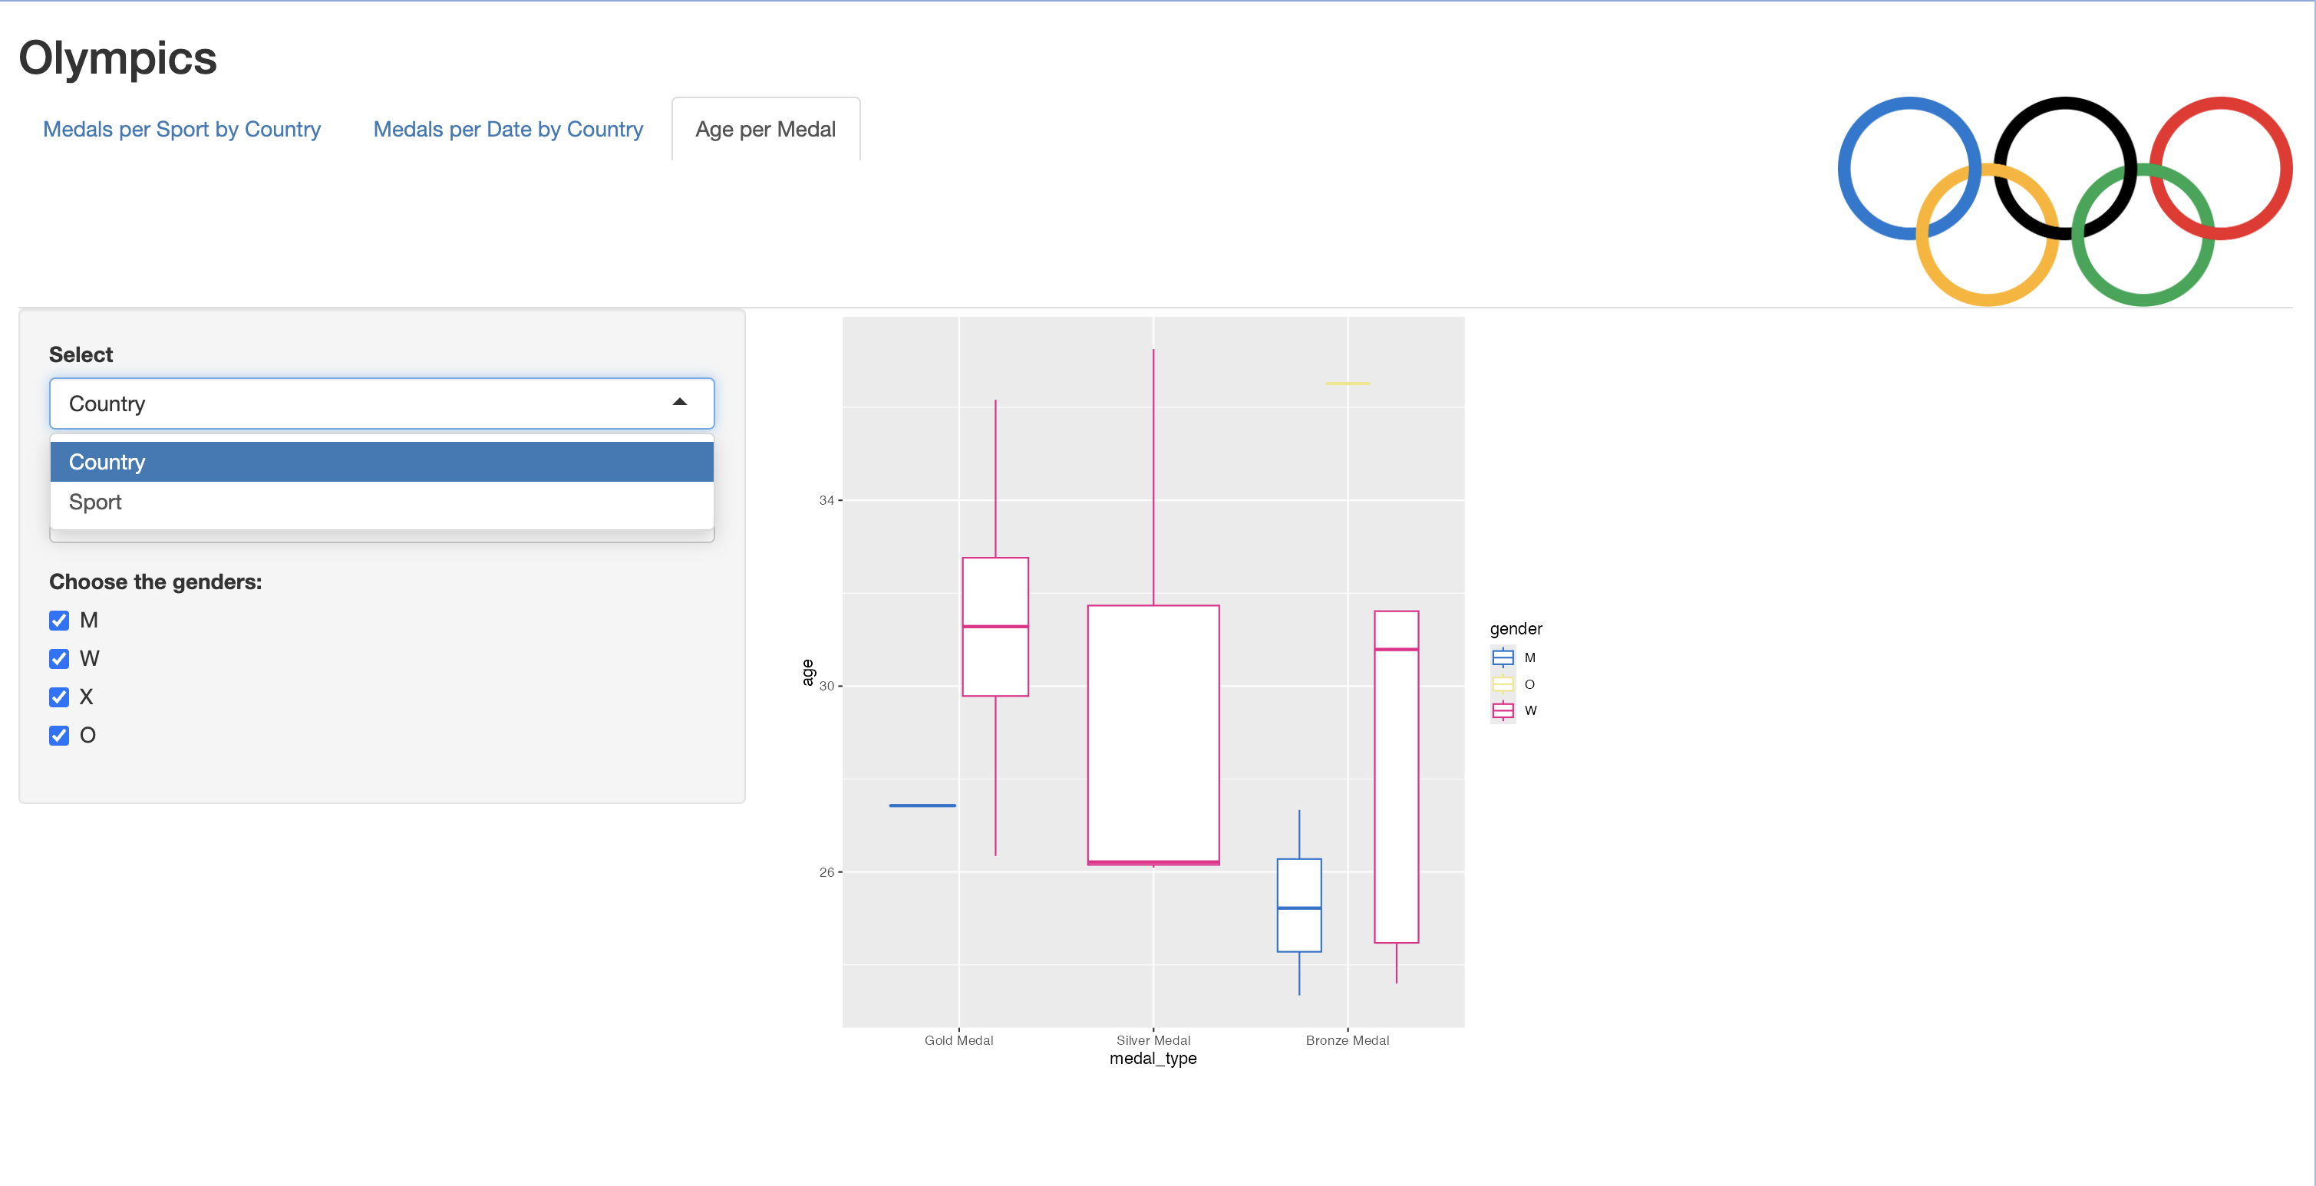
SELECT COUNTRY OR SPORT

Slide 10
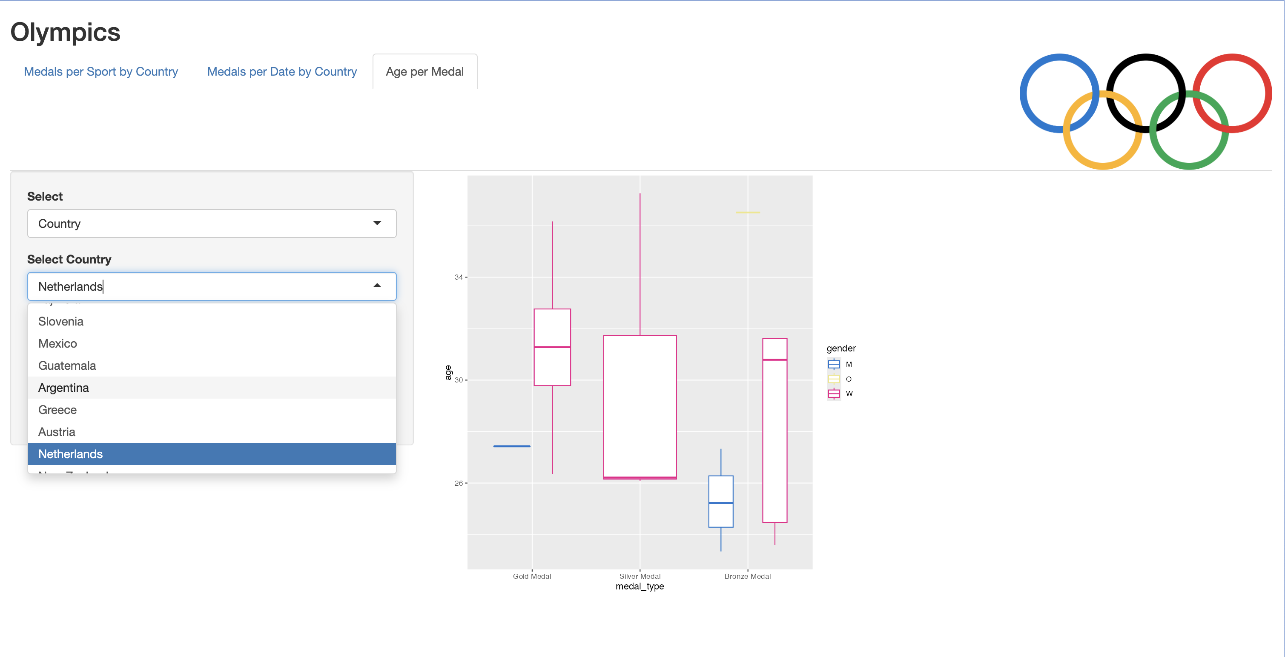
IF COUNTRY SELECTED SHOW LIST OF COUNTRIES

Slide 11
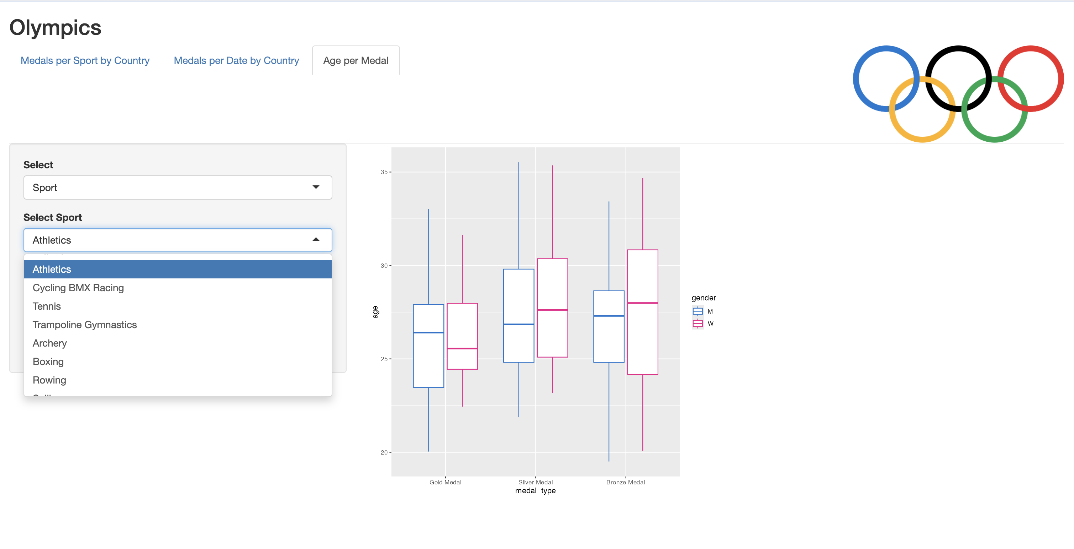
IF SPORT SELECTED SHOW LIST OF SPORTS

Slide 12
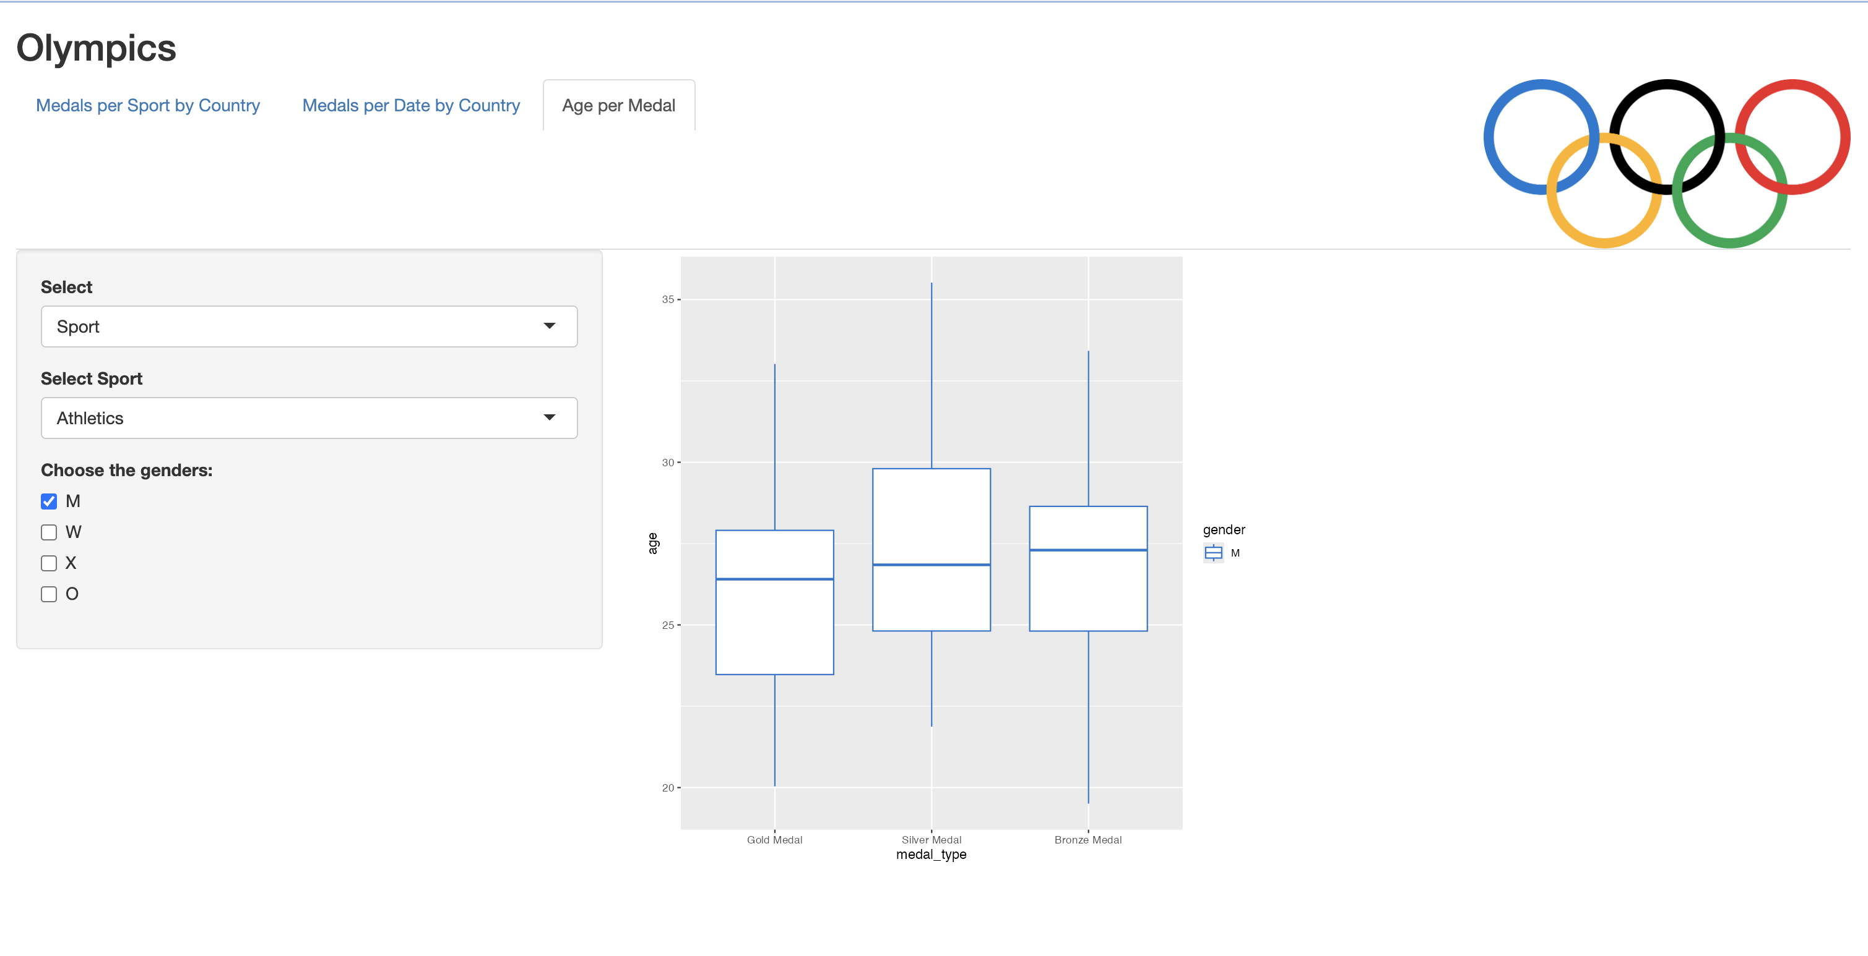
CHECK BOXES TO SELECT GENDER(S)

